Slide 1
Kilkenny County Council
Abbey Creative Quarter

Slide 2
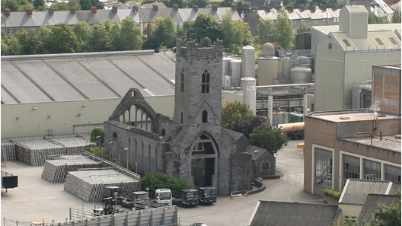
introduction
Key Strategic City Centre site along by the river Nore.
8th May 2012 - Both the former Borough and County Councils agreed to purchase the 10.6 acres former Brewery site from Diageo at a cost of € 2.1 million, following the decision by Diageo to cease production operations in Kilkenny.
July 2014 - Contract documents for the site purchase signed with Diageo

Slide 3
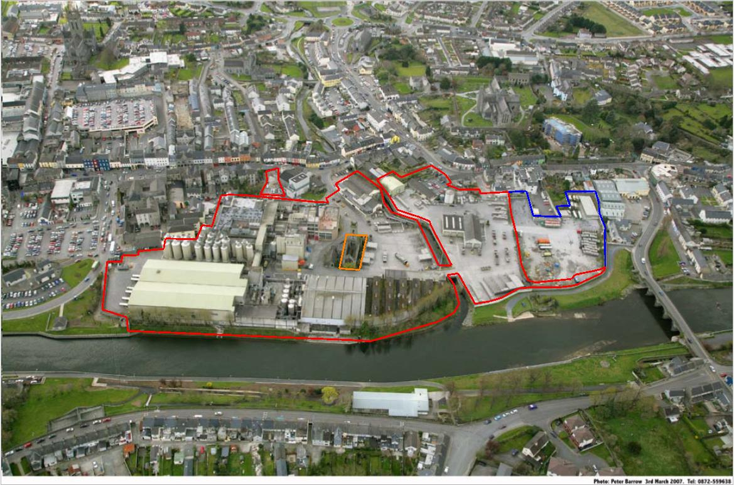
introduction site purchase

Slide 4
introduction site purchase
Key Strategic City Centre site along by the river Nore.
Purchase Contract provided for :
  Diageo to demolish all buildings to slab level except:
    Historical, Protected Structures.
    Mayfair and Brewhouse Buildings which will be refurbished.
    Maturation Building.
  Diageo to surrender IPPC Licence – Completed May 2015.
Demolition is now almost complete.
Expected site handover date – Summer 2016.

Slide 5
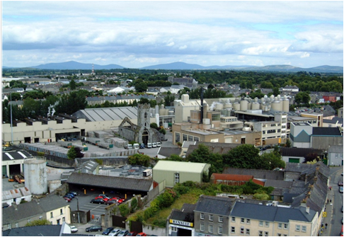
introduction before

Slide 6
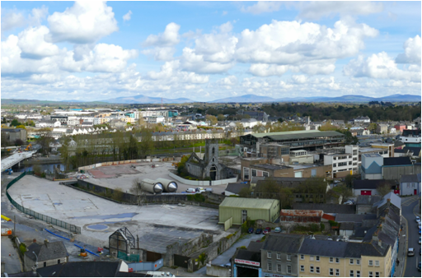
introduction current

Slide 7
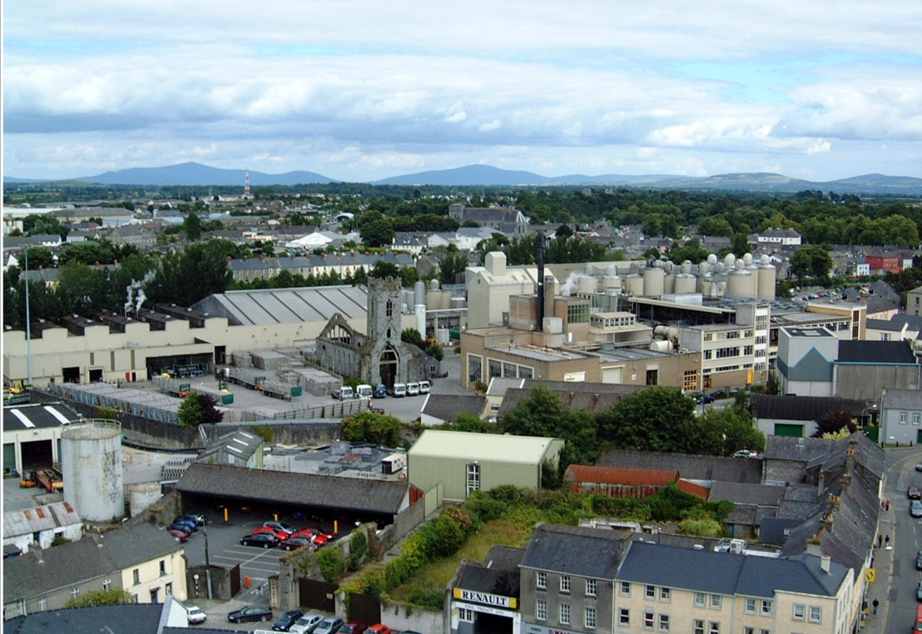

before / current

Slide 8
public consultation
Abbey
Creative Quarter
Jun 2012
Dec2012
May2013
Colloquium
Urban Design review
Public meeting
Colloquium, in relation to the future uses of the site, held in conjunction with the Dept. of Arts, Heritage & the Gaeltacht and the Royal Institute of Architects.
Urban Design Review presented to special joint meeting of Kilkenny Borough and County Councils.
Public meeting held by Mayor in Town Hall

Slide 9
public consultation
Abbey
Creative Quarter
July2013
Nov2013
Nov2014
Joint meeting
Chief Executives Report
Draft Masterplan
Joint meeting of Kilkenny Borough and County Councils at which it was decided to retain the Mayfair and Brewhouse.
Draft Masterplan Document published, with submissions invited.
Public meeting on 5th Nov. 2013
-
38 submissions received.
Chief Executives Report recommended further public consultation to re-vision the Masterplan.

Slide 10
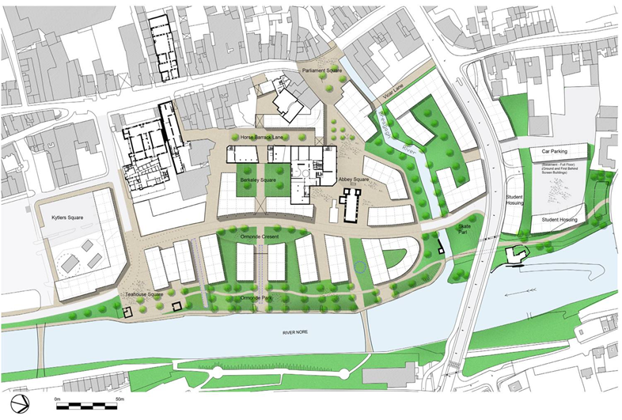
Public Consultation- Masterplan Layout Nov 2013

Slide 11
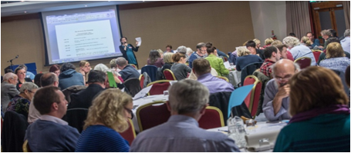
public consultation
Jan2015
Mar2015
The Brewery Re-visioning
Chief Executives Report published
“ The Brewery Re-visioning”
- 2 no. two day public workshops held in Ormonde Hotel
- Attended by 222 people
- Half day workshop with Comhairle na nOg
- Public submissions invited – 71 written submissions received
Chief Executives Report published outlining the issues raised in
“Re-visioning”
- Vision Statement and guidelines put forward as a direct result of the consultation workshops

Slide 12
vision statement
“To plan the area as a seamless complement to the medieval city as an inclusive place for an inter-generational community to work, live, visit and play with St. Francis Abbey at its core. The regeneration of the area will focus on embracing the sites’ natural, cultural and built heritage, whilst maximising the benefits of the rivers Nore and Breagagh, providing for a broad range of uses, sustaining growth in employment, 3rd and 4th level education and advancing economic activity in a sustainable and energy efficient fashion where innovation can flourish. The area will be a permeable expansion of the city for pedestrians and cyclists where smarter travel principles will apply throughout.”
vision
* Vision Statement was subsequently incorporated into the Masterplan

Slide 13
public consultation
Abbey
Creative Quarter
May2015
Jun/Jul2015
31st Jul2015
Public information event
Masterplan approved
Public consultation
Follow up public information event attended by 54 people
Updates provided on the emerging draft Masterplan Layout,having regard to archaeological and environmental reports.
Public consultation in relation to the Draft Masterplan and proposed Variation to the Kilkenny City & Environs Development Plan, incorporating high level objectives from the Masterplan into the Development Plan
Masterplan was approved by the Elected Members Variation no. 1 to the Kilkenny City & Environs Development plan 2014 – 2020 adopted

Slide 14

From Here.....
Masterplan Layout on Public Display, November, 2013

Slide 15
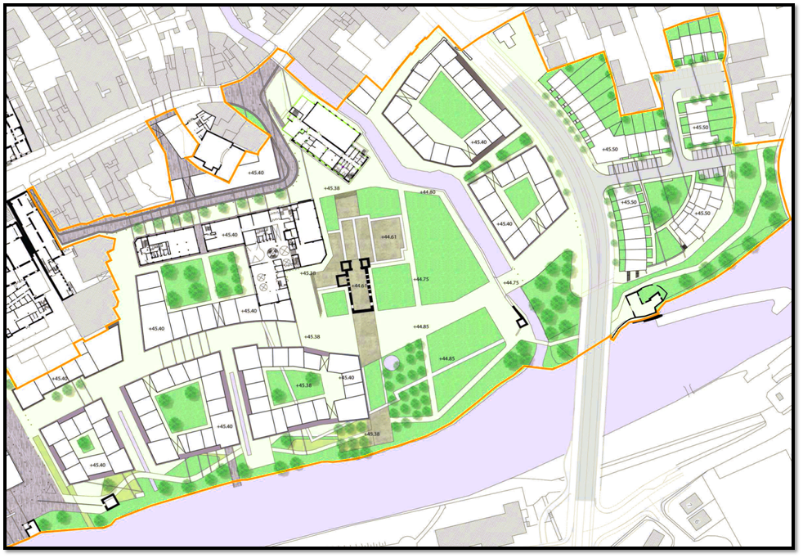
To Here.....
Masterplan May 2015

Slide 16
To Here.....
Summary of Key changes to the Masterplan as advised to council May 2015
Removal of buildings from immediate environs of the Abbey
Finger building changed to urban blocks to reflect more closely the existing urban grain,
Housing proposal to north of Breagagh River
Urban street to be of Pedestrian and cyclist priority, with traffic management measures to inhibit the flow of through traffic and heavy goods vehicles
Urban Park at the Abbey (approx. 2.5 acres in area)
Conservation Planning commitment
Identify and provide Park and Walk Sites close by.

Slide 17
public consultation
Variation no. 1 Kilkenny City & Environs Development Plan 2014 - 2020
To develop a low carbon energy strategy for the masterplan area and advance the provision of near zero energy buildings on site.
To provide for park and walk facilities for car and bus/coach parking at a site or sites in close proximity to the Abbey Creative Quarter Masterplan area
To provide for housing within the masterplan in the area north of the Central Access Scheme
To provide for an urban street of pedestrian and cyclist priority between the Central Access Scheme and Bateman Quay.
To provide for traffic management measures on the street such as to inhibit the flow of through traffic and heavy goods vehicles.

Slide 18
public consultation
Variation no. 1 Kilkenny City & Environs Development Plan 2014 - 2020
To provide for a linear park along the western bank of the River Nore
To provide for an urban park in the vicinity of St. Francis Abbey
To prepare a Heritage Conservation Plan for St. Francis Abbey, Evans’ Turret and St. Francis’ Well
To prepare urban design criteria and archaeological recommendations for the implementation of the Abbey Creative Quarter Masterplan.
To finalise and adopt the Abbey Creative Quarter Masterplan and to incorporate it into the Kilkenny City & Environs Development Plan 2014-2020.

Slide 19
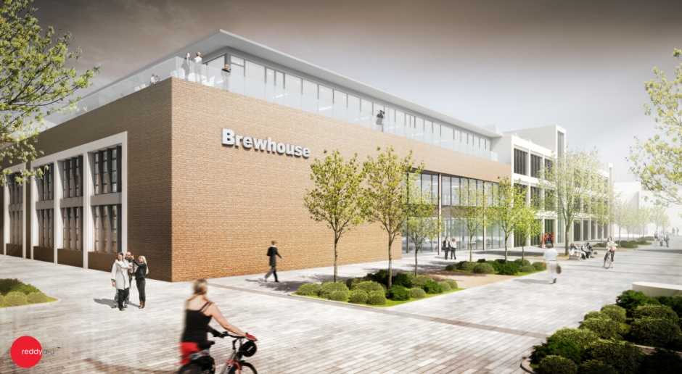
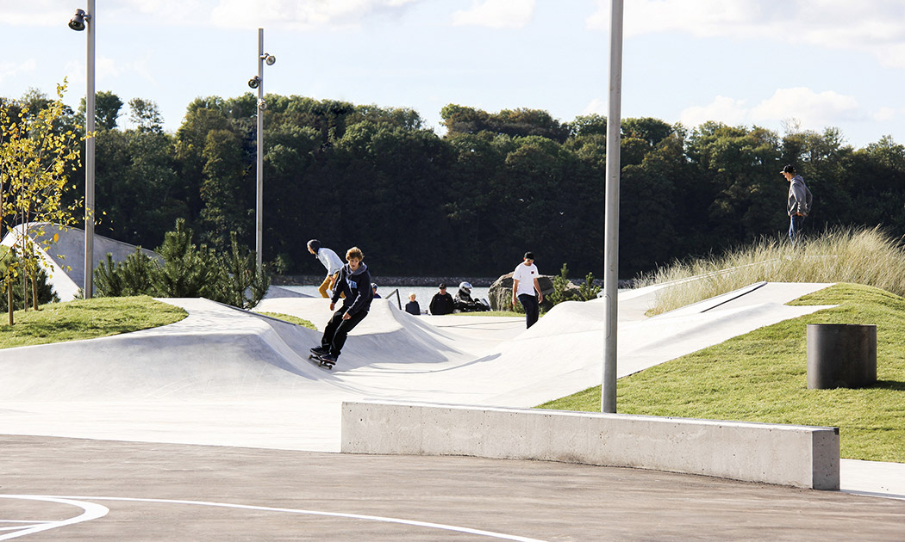
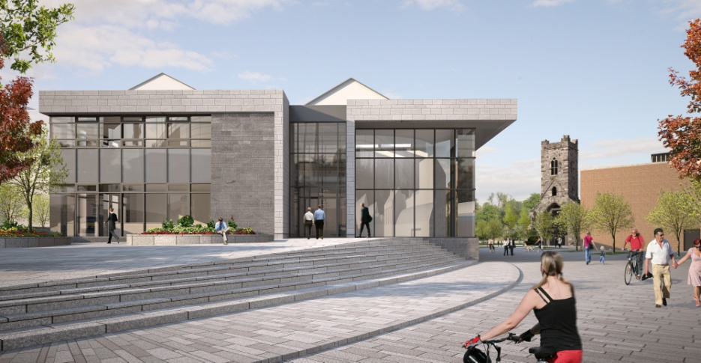
current status
Part VIII for the Brewhouse and associated works approved
(subject to determination by An Bord Pleanala in relation to the need for an EIS)
Part VIII for the Riverside Garden/Linear Park approved.
Consultations to commence with Skate Board community in relation to outdoor activity area , including skate park. (Subject to planning)
Public Consultation undertaken for the redevelopment of the Mayfair Building. (Report on Part VIII to come back to Council)

Slide 20
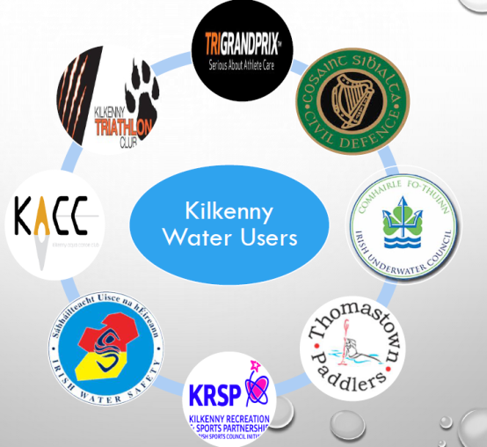
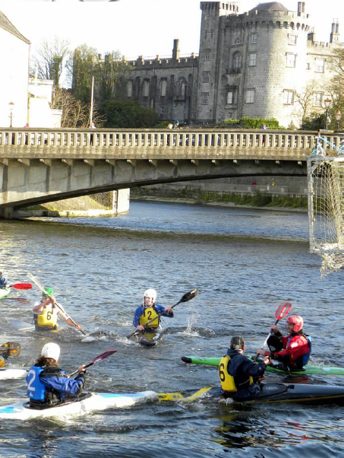
current status
  Development of a low carbon energy strategy for the development of the Masterplan area.
  Design of the Housing scheme
  Design of this site to consider options for the incorporation of a Water based activities facility, with direct access to the river via the existing boatslip – consultation with groups regarding Water based activities . (Subject to planning)
  Development of an Archaeological Assessment (Testing) Strategy for the Masterplan area

Slide 21
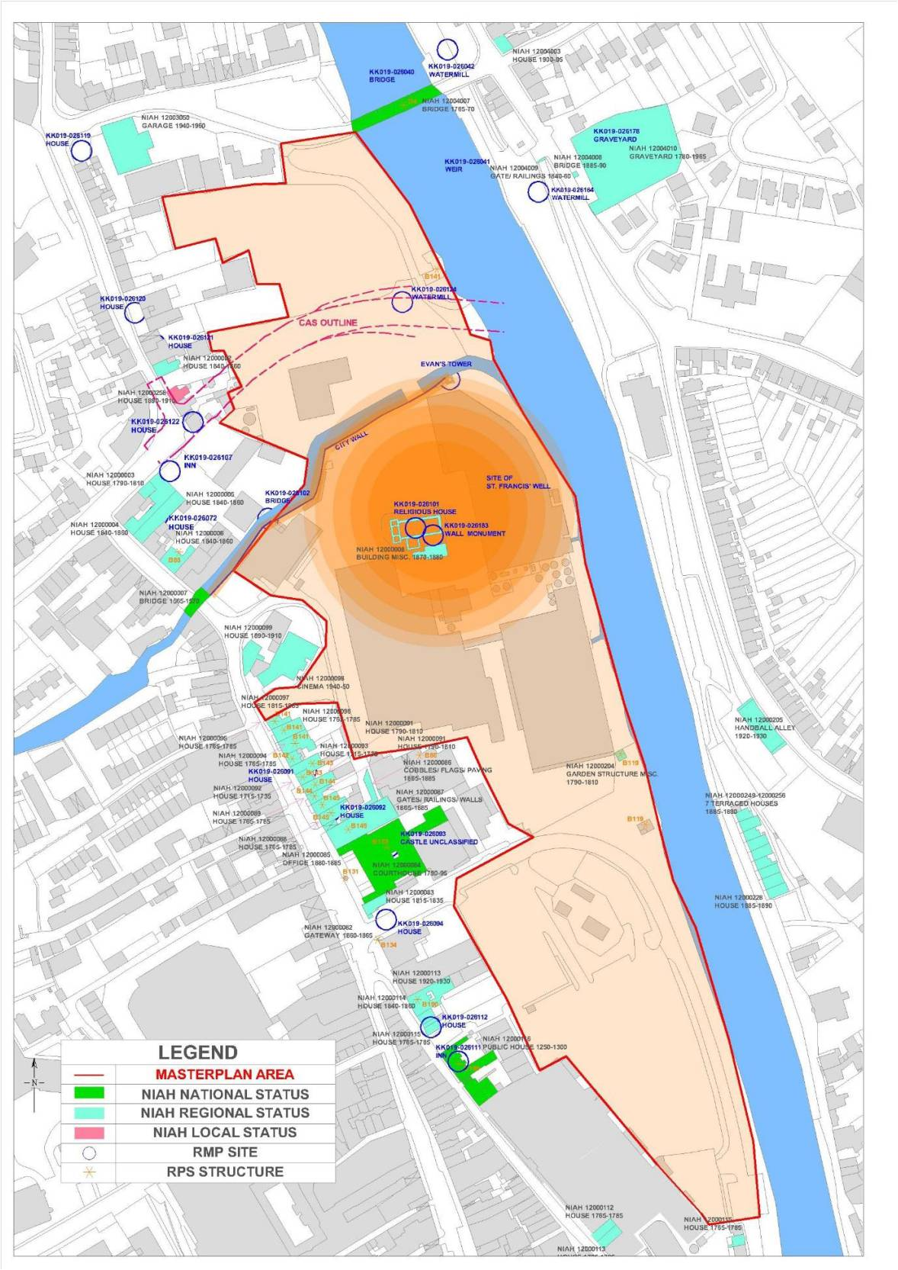
archaeology

Slide 22
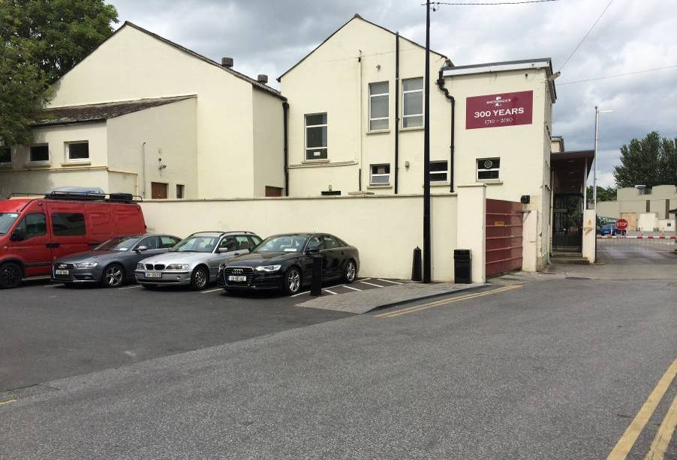

mayfair building

Slide 23
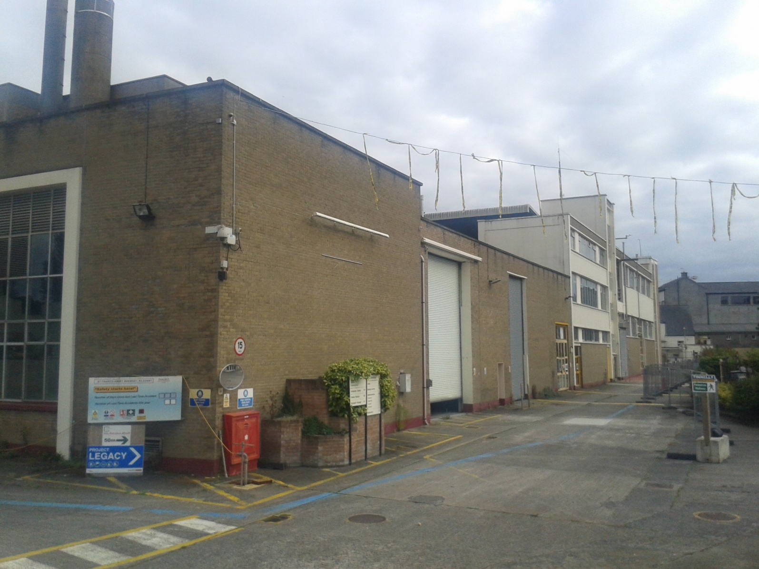

brewhouse

Slide 24
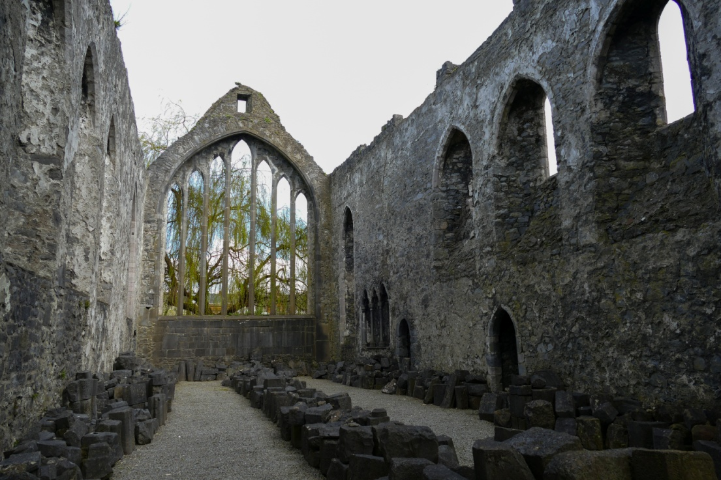
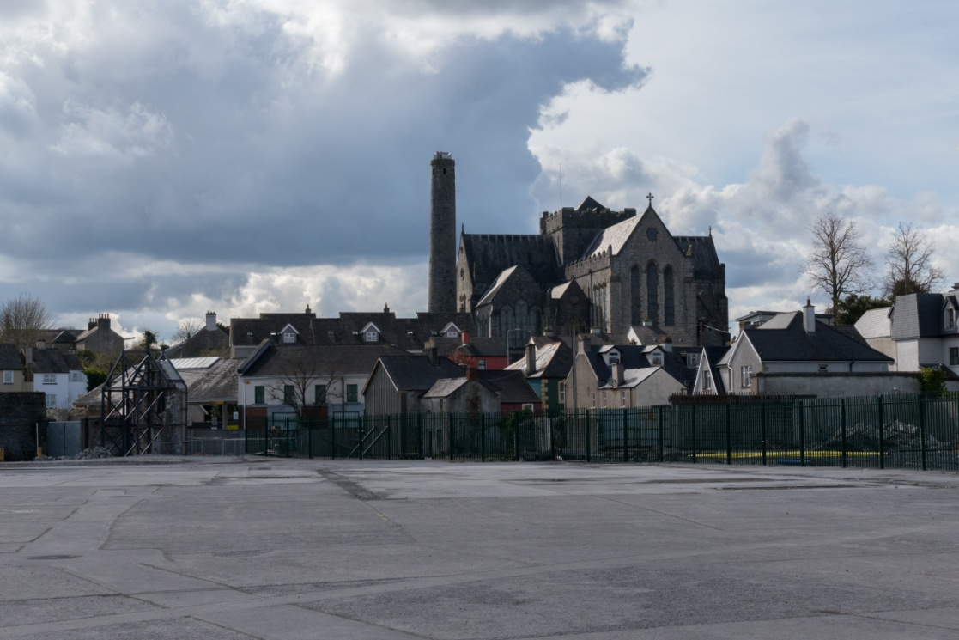
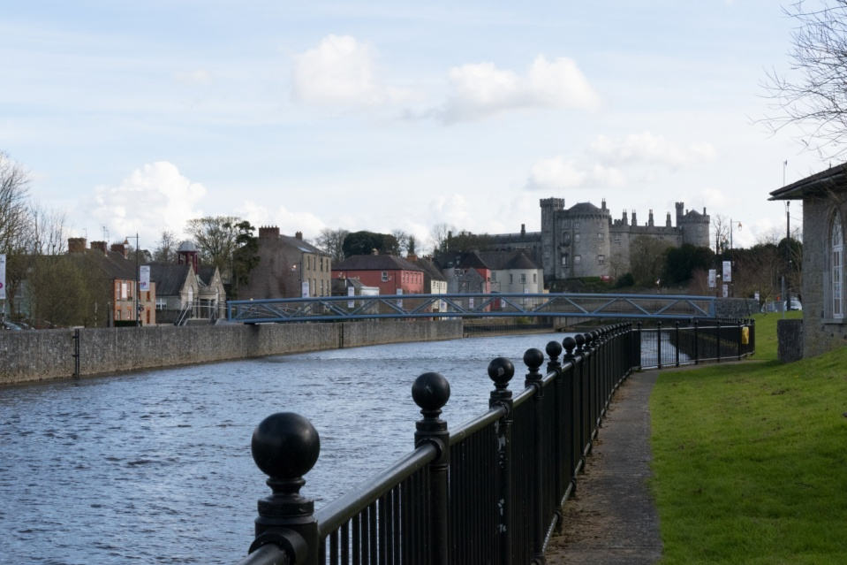
changing views of the cities heritage

Slide 25
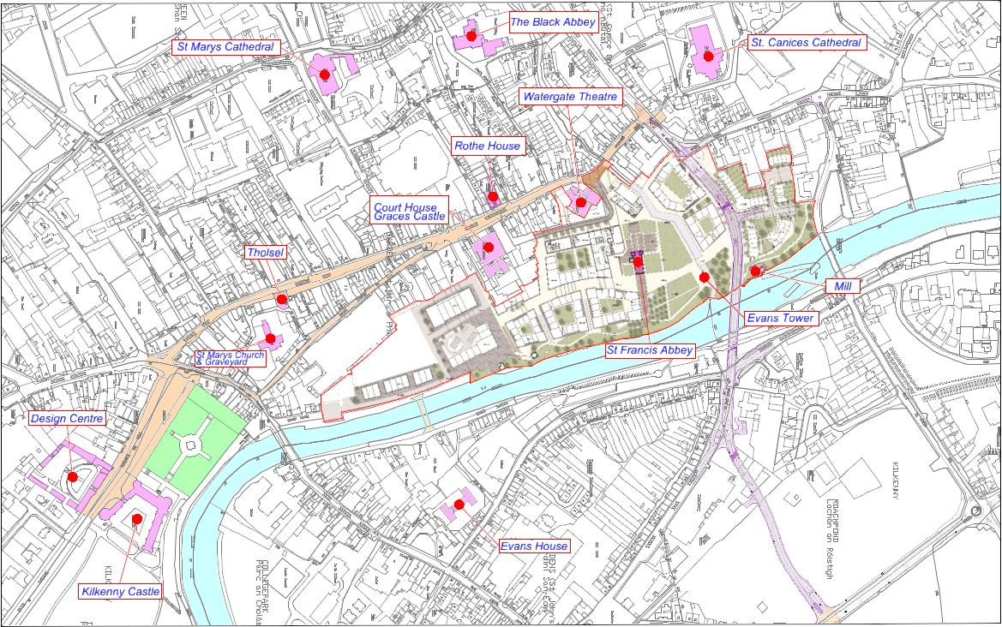
site context

Slide 26
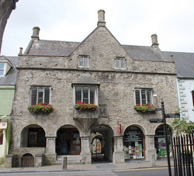
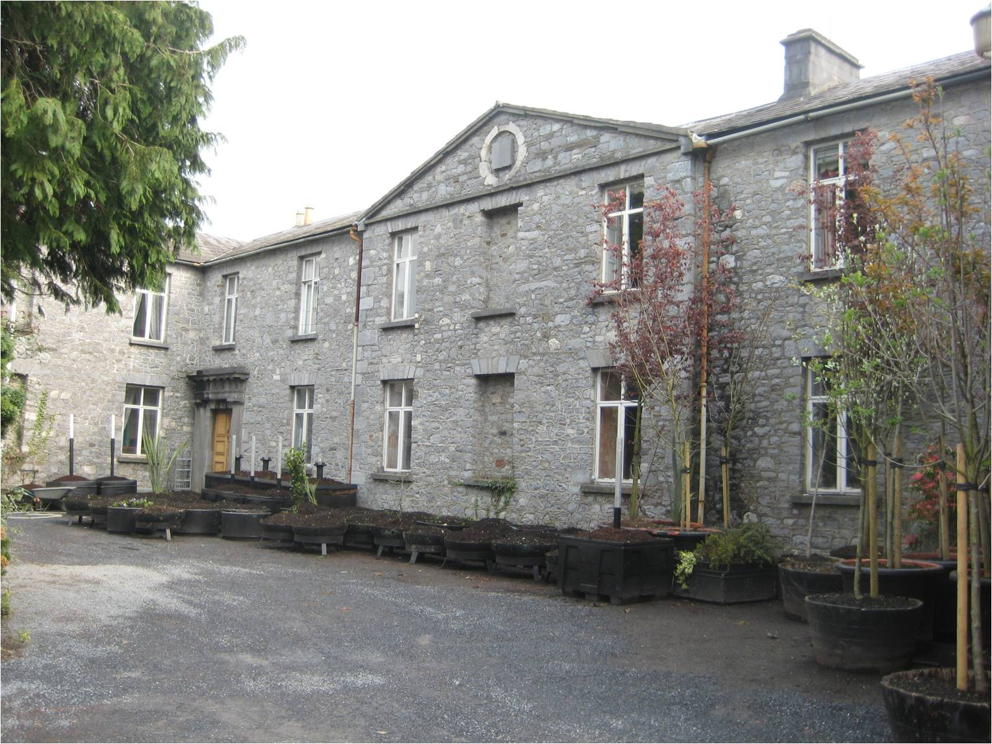
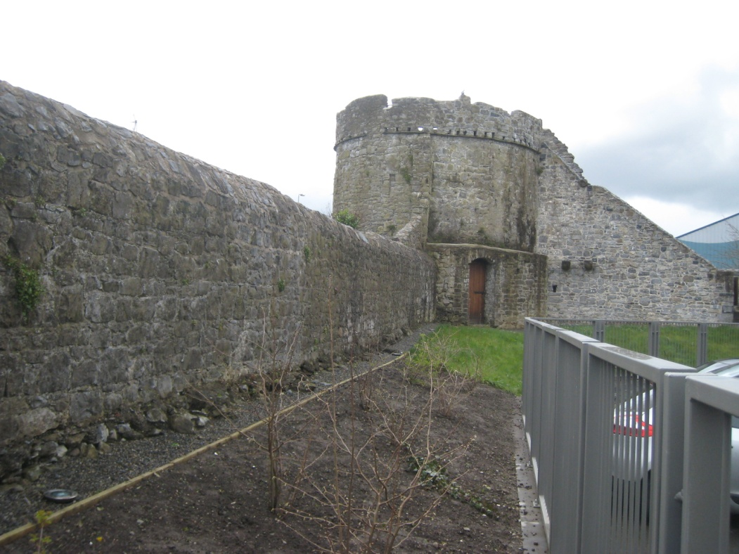
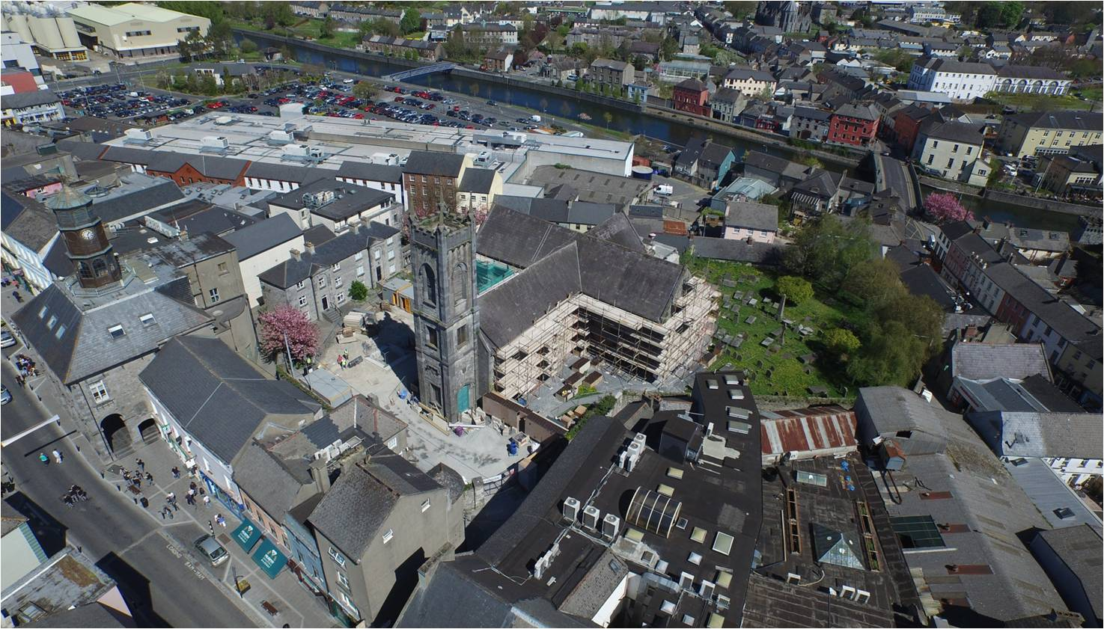
local authority role in heritage
Rothe House
Evan’s Home
Talbot’s Tower
St.Mary’s Church Aerial

Slide 27
Issues raised
06
Economic vs community uses
01
Existing Vacant office space
07
Cultural uses - Watergate Theatre
02
Funding Alternatives
08
03
EIS
Through Traffic & HGV’s
04
09
Access to the River
Urban design guidelines
05
10
Housing
In Committee Meeting

Slide 28
KCC/NTMA partnership
March 2015
– Members informed that March 2015 meeting that an expression of interest had been received from the NTMA on 19th Feb. 2015
- NTMA confirmed that they were interested in principle in working with KCC to invest on a phased basis
- Members approved further engagement with the NTMA in order to secure a long term source of funding.
“That approval is given by the elected members to continue further engagement with ISIF in order to secure a long term source of funding to facilitate the commencement of development of economic activity and employment on the Brewery site”

Slide 29
KCC/NTMA partnership
May 2015
May 2015 - Members received an update on the key principles forming part of any proposed Partnership Agreement.
Asset Ownership.
Commitment from KCC.
Project Governance.
KCC exposure.

Slide 30
KCC/NTMA
ISIF FUND
The National Treasury Management Agency(NTMA) is an organisation providing a range of specialist financial and risk management services to the State.
Ireland Strategic Investment Fund (ISIF) is a State entity under the control of the NTMA.
The NTMA (Amendment) Act 2014:
  Converted the National Pensions Reserve Fund into the Strategic Investment Fund.
  Legislation passed on 22nd December 2014.
The NTMA Board and Investment Committee have overall responsibility for ISIF.
ISIF have a fund of €7.6bn available nationally.
ISIF mandate:
  Invest on a commercial basis to support Economic Activity and Employment in Ireland.

Slide 31
investment
Investment
Funding Sources
A. Site Acquisition, Infrastructure, Public Realm,Linear Park, Urban Street, Etc*
B. Development of plots.*
C. Housing*
(* All subject to planning)
KCC own resources.
Borrowings.
ERDF fund.
Other Grant Funding.
Partnership with the NTMA (ISIF).
1. State/private funding

Slide 32
Site development
KCC responsible for development of public realm, urban street, linear park.
The estimated cost of the first phase is €4.57m and this will be funded from a combination of development contributions, transfers from the Income & Expenditure Account, proceeds from sale of assets and grant funding from ERDF and Failte Ireland.
  ERDF funding of €1m has been approved for this phase of the project.
  KCC already has grant approval from Failte Ireland for €279k for the linear park.
  An application for additional funding will be made to Failte Ireland in the coming months.

Slide 33
Site development
Other Site Works:
Archaeology Surveys & associated works.
Utility Services Design.
Energy Strategy.
Public Realm in the environs of St Francis Abbey, Evans Turret.
Conservation Strategy for the Heritage Structures on the Site.

Slide 34
Site development
Plot to the Northern end of site being retained by Council for housing.
Site will accommodate approx. 60 units.
Funding of € 4.5M allocated by the Dept. of Environment Community & Local Government.
This does not preclude the provision of additional housing on the balance of the site.

Slide 35
KCC/NTMA partnership
A separate Joint Venture to be established with the NTMA –
Limited Liability Partnership.
Proposed name – Kilkenny Abbey Quarter Development Partnership.
Owned by KCC(50%) and NTMA (50%).
KCC Equity = Development Plots 1 to 6 (€1.6m).
ISIF Equity = Cash - (€1.6m).

Slide 36
KCC/NTMA partnership
Business of the Partnership – As defined in the draft Agreement:
  “The business of developing, owning and leasing the properties and the additional property to facilitate business, enterprise, education and research campus at the properties and with ancillary and subsidiary uses including residential, retail and other uses”.
Partnership will have to revert to Partners for approval if it wants to deviate from Business as defined in the agreement.

Slide 37
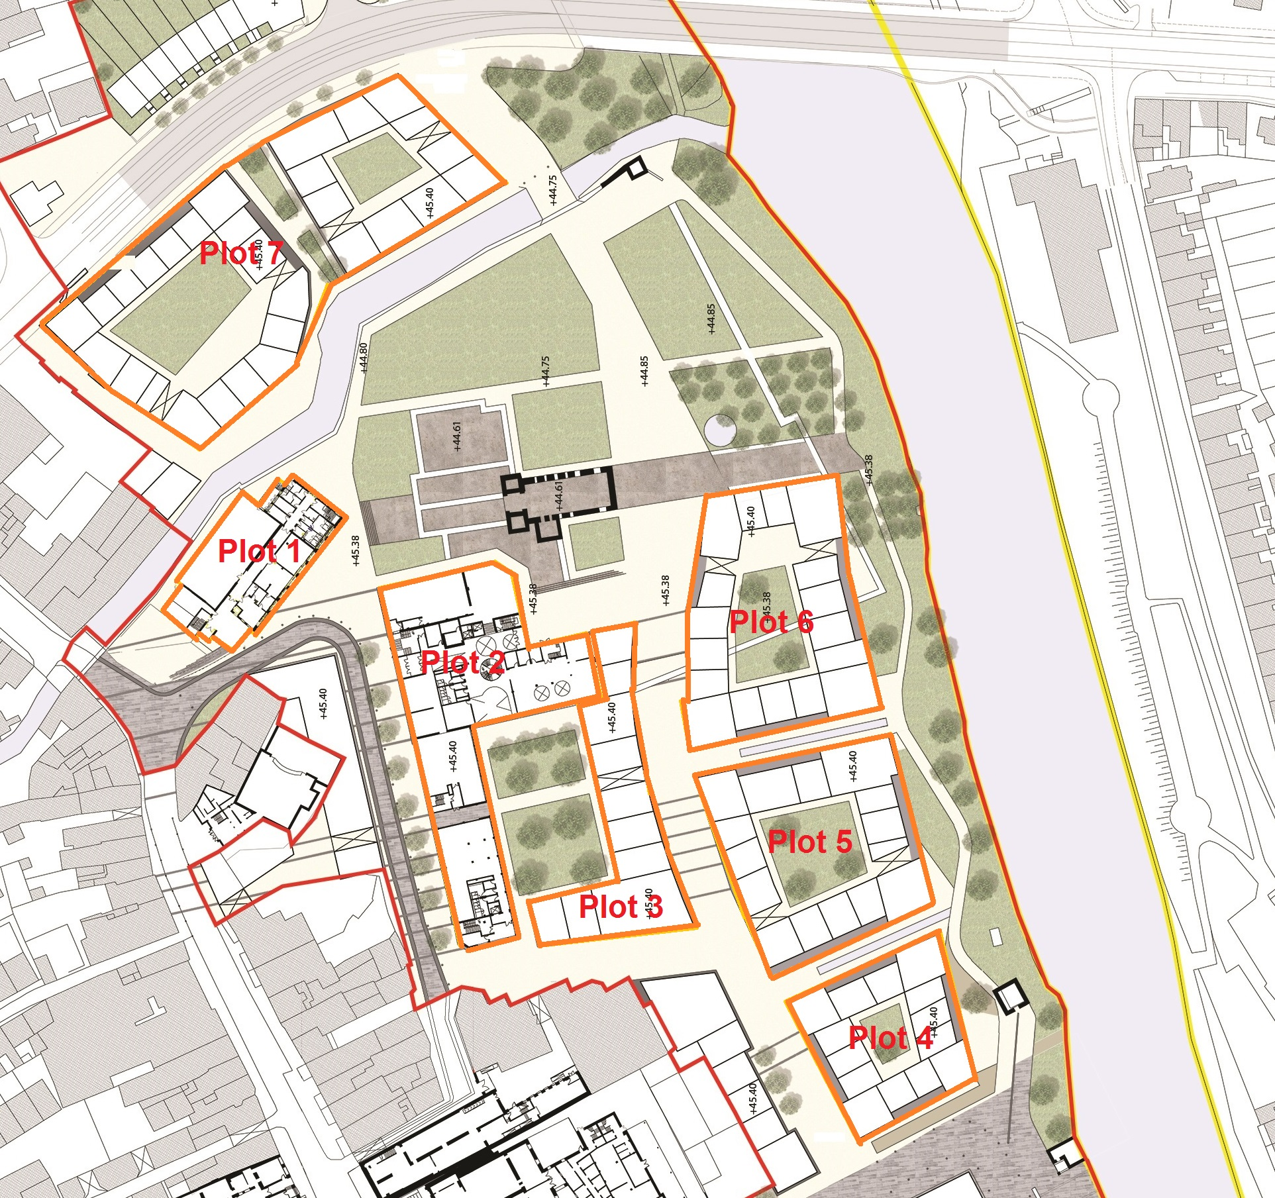
plot locations

Slide 38
plot locations
Plots 1 to 6 will be transferred
to the Partnership on set up.
Plots 1 to 6 represent 27% of the
10.6 acres being acquired.
Partnership to have option on
plot 7 only if substantial
development takes place.
Plot 7 represents 13% of the
10.6 acres being acquired.
NTMA will match with cash to
maintain 50:50 ownership.

Slide 39
KCC/NTMA partnership
Partnership will be responsible for all aspects of the marketing, construction and operation of the developments.
Development will depend on market demand – no speculative build.
Due diligence will be carried out on each proposal prior to decision to proceed to development.
Loan finance for the development of individual proposals will be sourced by the Partnership, most likely from the NTMA on commercial terms.
Each Development proposal will be subject to the planning process as per the requirements of the Planning & Development Act 2000, as amended and the Planning & Development Regulations 2001, as amended.

Slide 40
KCC/NTMA partnership
KCC Exposure on the developments capped at the Equity contribution of the lands (subject to provisions re early termination).
The Partnership will employ a Manager to manage the business on behalf of both Partners.
A separate Board will be appointed to oversee the business of the Partnership:
Independent Chairman.
Two representatives from KCC.
Two representatives from the NTMA.
Agreement provides for regular reporting back to the Partners.
As a minimum, Elected Members will be kept appraised on a quarterly basis.

Slide 41
KCC/NTMA partnership
KCC to provide staff support to the Partnership on Procurement, Project Management, Finance/IT at cost.
All contracts for the supply of goods / services to the Partnership to comply with public procurement rules.
KCC to be responsible for any remediation works on any environmental matters that arise and are not related to the activities of the Partnership.
Environmental risk assessment work has been undertaken.

Slide 42
KCC/NTMA partnership structure
Structure governed by the Partnership Act 1907.
Structure not as widely used as Limited Company Structure.
Listing of registered LLP’s available on the Companies Registration Office website.
This structure is the preferred structure as it ensures both KCC and NTMA avail of Tax Exempt status.
  Both KCC and NTMA are exempt from tax on Income and Gains.
Partnership will have KCC and NTMA as equal limited partners.
A third partner – General Partner (Limited Liability Company) will be set up to manage the business of the partnership on behalf of the partners.
  The GP will also be owned 50:50 by each partner.
Liability of KCC and NTMA will be limited to the amount of the capital contribution.

Slide 43
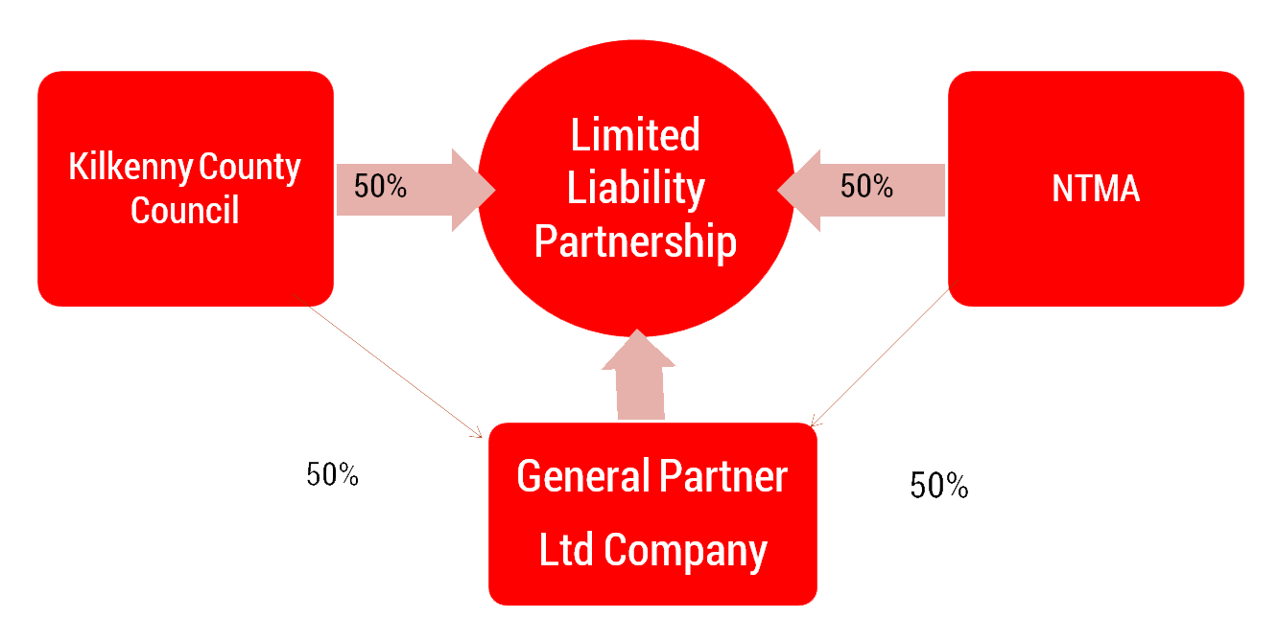
KCC/NTMA joint venture for commercial development.

Slide 44
KCC/NTMA partnership structure
A key difference between LLP and Ltd Company Structure is the manner in which assets are owned.
Ltd Company – The company owns the assets as a separate legal entity and the Shareholders own the shares in the company.
LLP – The Partners own the assets directly in proportion to their respective ownership percentages.
Income stream from any developments will accrue to the partnership and will be used to service the loan.
Note the assets will be registered in the name of the GP but the Partners have beneficial ownership of the assets.

Slide 45
KCC/NTMA partnership
Partnership Agreement to be reviewed at the end of 2 years.
If no substantial development has commenced by the review date :
  KCC have right of first refusal to take back the lands.
  Costs incurred will be shared 50:50.
  Substantial Development – Building of 50,000 sq ft.
Extend agreement for a third year if development is likely to happen.
Third party Offers for individual development plots can be entertained by the Partnership in year 3.
If no substantial development by the end of year 3 – Terminate the Partnership and same provisions apply as per termination at the end of year 2.

Slide 46
KCC/NTMA partnership
Agreement contains provisions for dispute resolution:
  Both Partners have equal voting rights and neither will have an overall controlling interest.
  In the event of a dispute arising:
    Refer to mediation.
    Deadlock Provisions.
    Agreement provides KCC with first option in the event of terminating the Partnership.

Slide 47
summary

Slide 48
summary
Partnership will provide access to a source of longer term funding.
Low / Limited Risk for KCC.
Allows KCC to retain an interest in the developments
Does not tie up KCC resources which are needed for mainstream activities.
Overall Planning Framework remains a matter for the Elected Members. No change to the framework/masterplan as approved on 31st July 2015.

Slide 49
resolution of the
Elected Members
That approval is given by the Elected Members to the establishment of a Limited Liability Partnership with the National Treasury Management Agency ( as controller and manager of the Ireland Strategic Investment Fund), as per the Limited Liability Partnership Agreement outlined to the Elected Members.
Resolution:

Slide 50
The vision of the masterplan in July 2015
“To plan the area as a seamless complement to the medieval city as an inclusive place for an inter-generational community to work, live, visit and play with St. Francis Abbey at its core. The regeneration of the area will focus on embracing the sites’ natural, cultural and built heritage, whilst maximising the benefits of the rivers Nore and Breagagh, providing for a broad range of uses, sustaining growth in employment, 3rd and 4th level education and advancing economic activity in a sustainable and energy efficient fashion where innovation can flourish. The area will be a permeable expansion of the city for pedestrians and cyclists where smarter travel principles will apply throughout.”

Slide 51
thank you.

