Slide 1

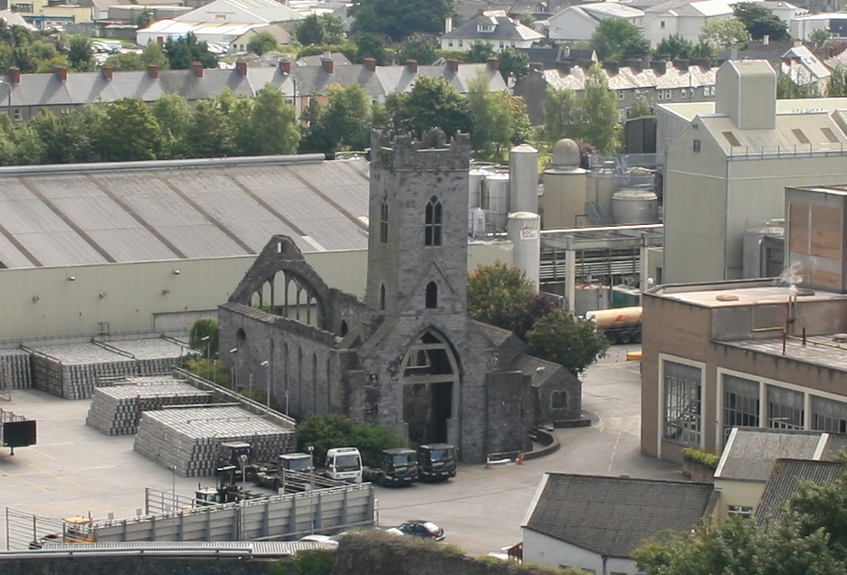
Abbey Creative Quarter Update
September 2016

Slide 2
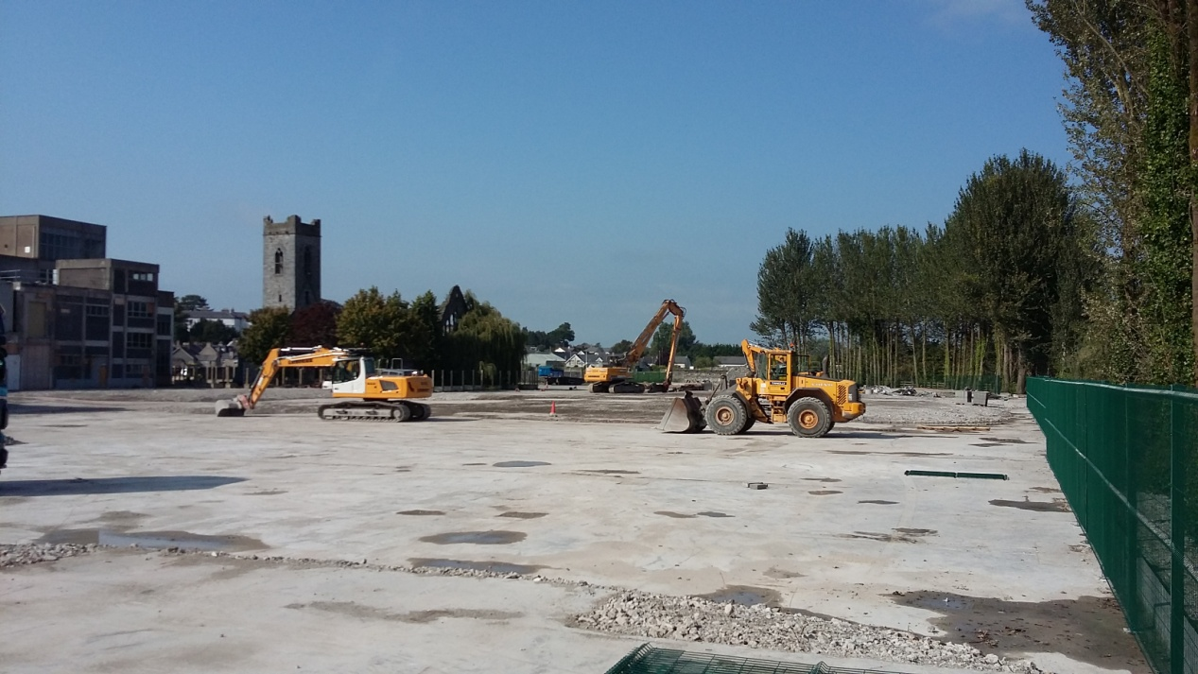
Abbey Creative Quarter – Update Sept. 2016
Demolition works are now significantly complete, with an expected completion date of end Sept. 2016.
It is now expected
that the site purchase
will be completed and
the site handed over
to Kilkenny Co. Co.
towards the end of
October 2016.

Slide 3
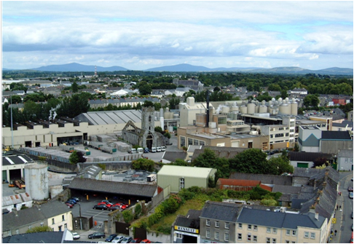
Before

Slide 4
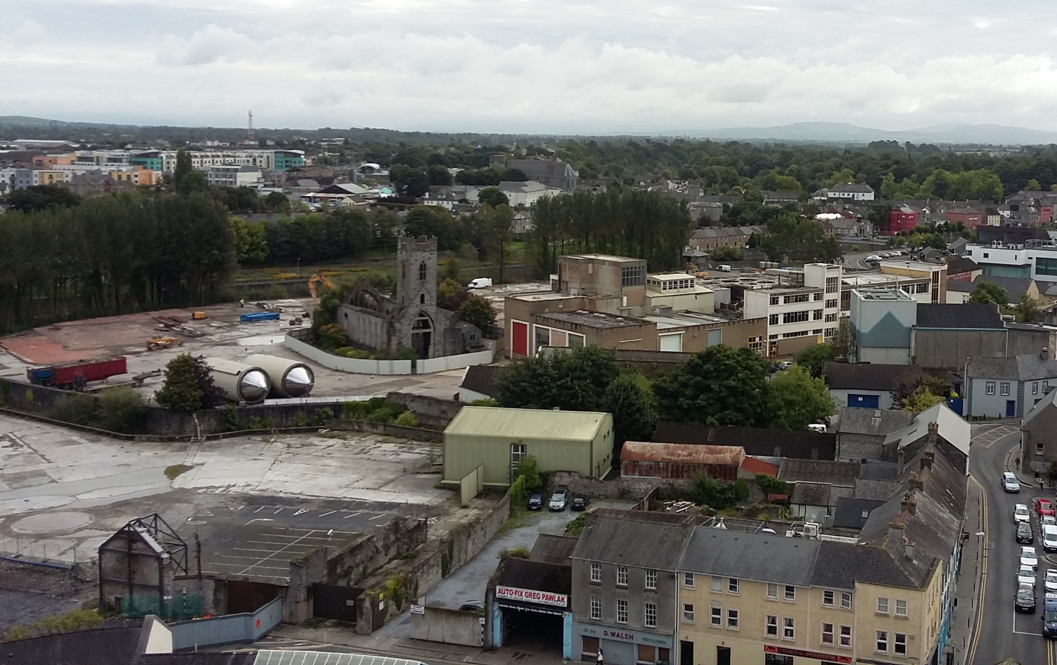
After

Slide 5
Before
After

Slide 6
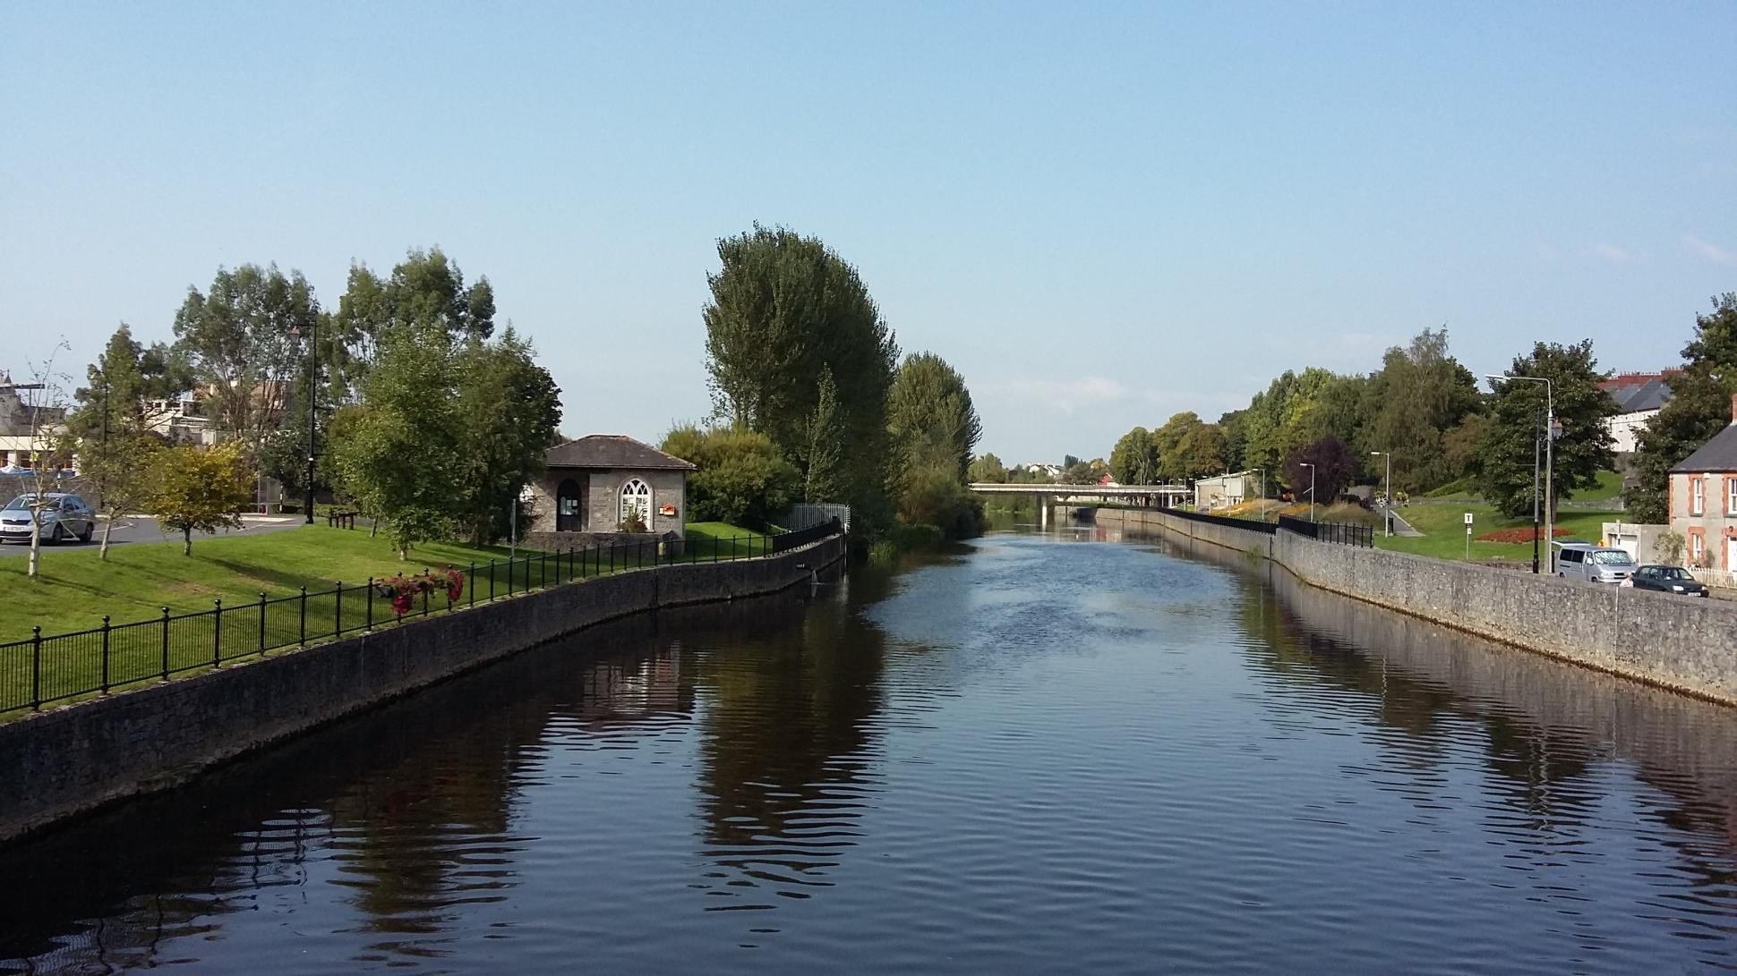
Changing views of the city

Slide 7
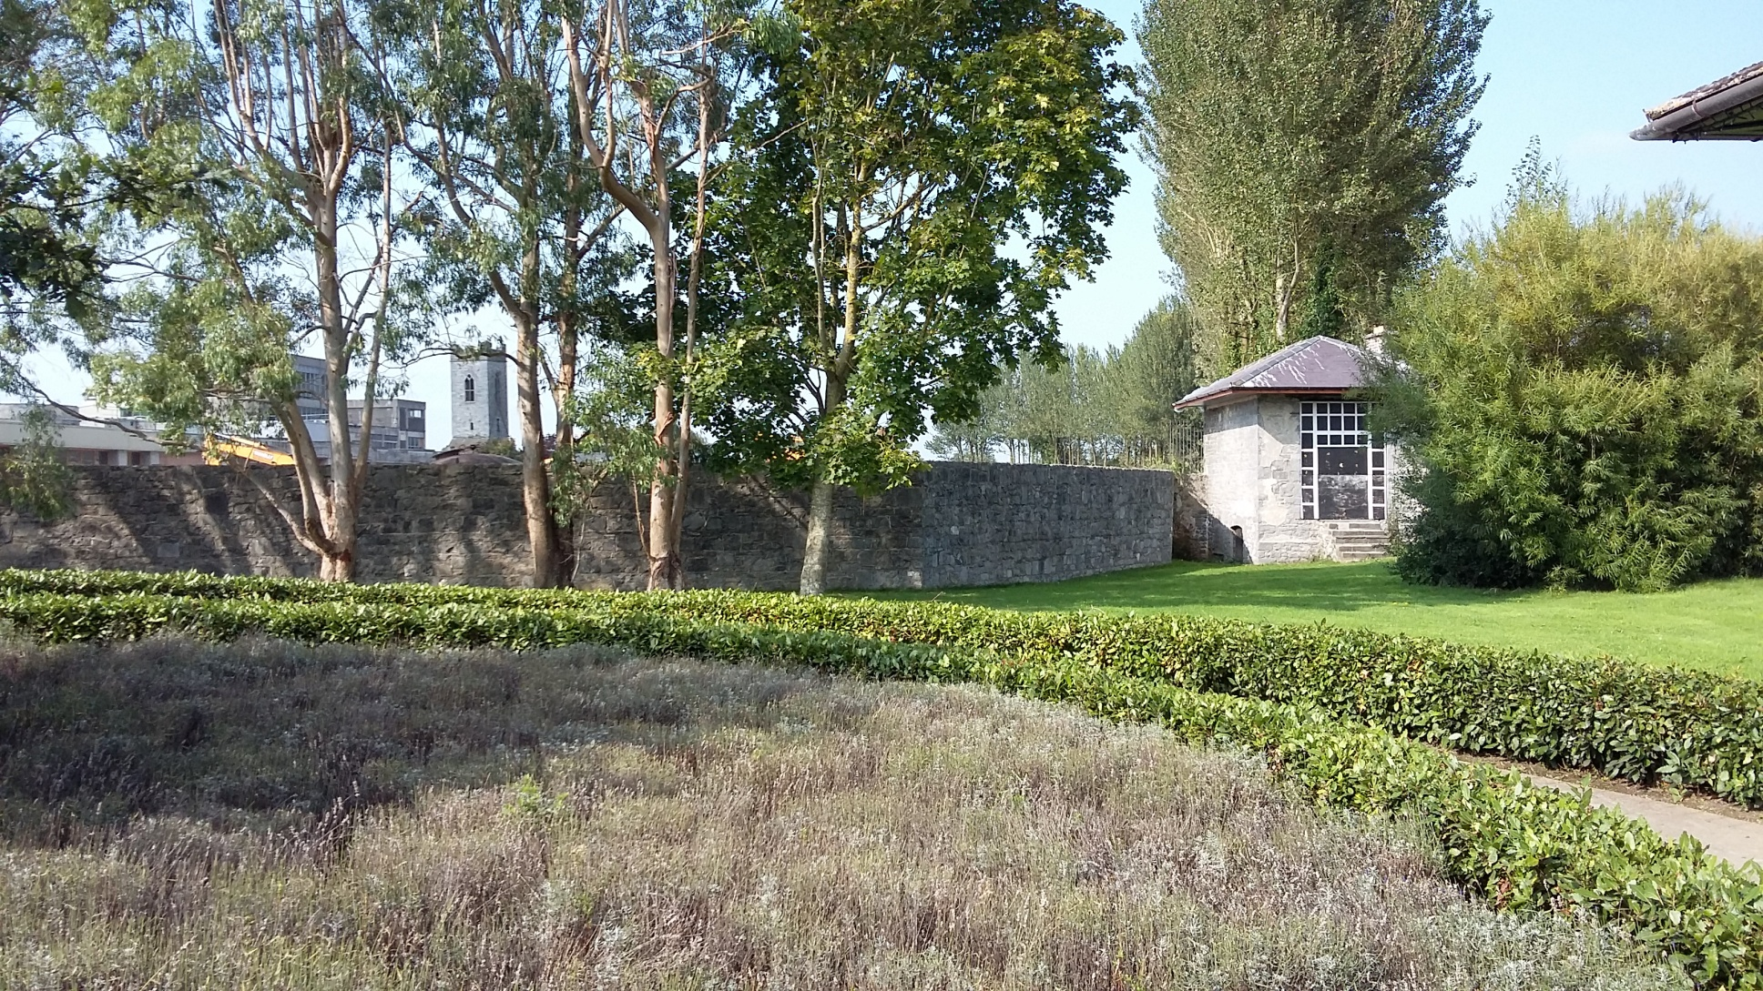
View from Tea House, looking North into the former Brewery Site

Slide 8
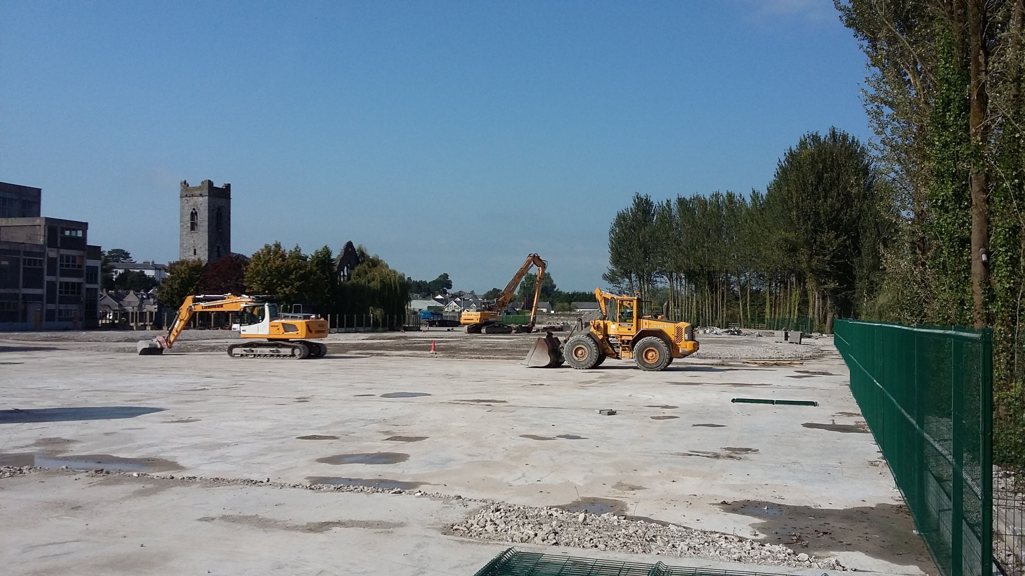
View of Site from Tea House, looking north through the former Brewery Site

Slide 9
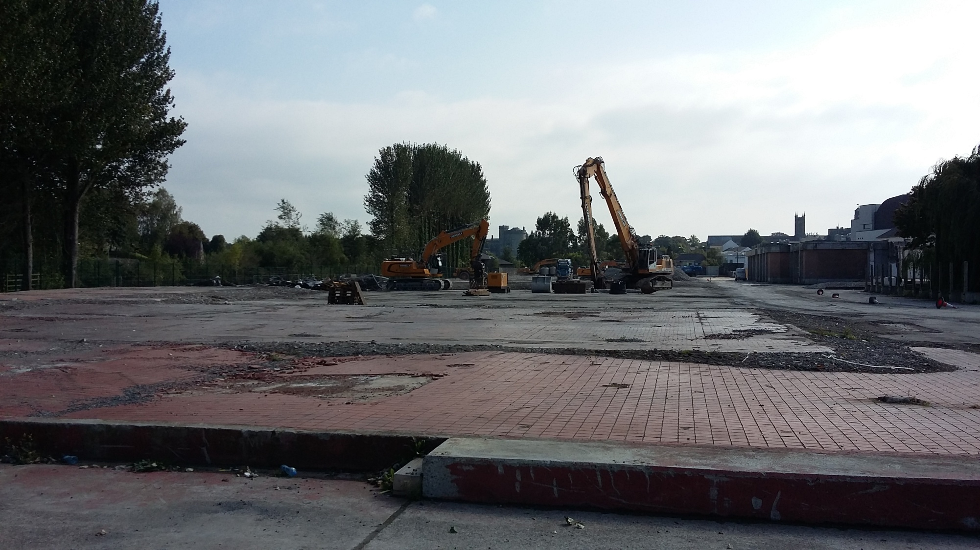
View from Evans Turrett looking south towards Kilkenny Castle

Slide 10
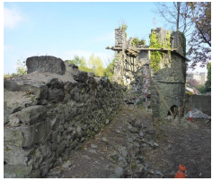
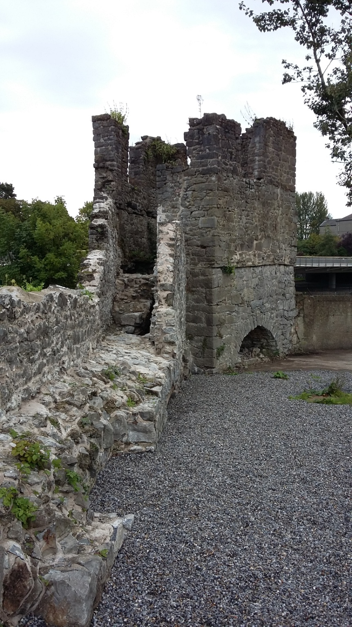
Evans Turrett
Before
After

Slide 11
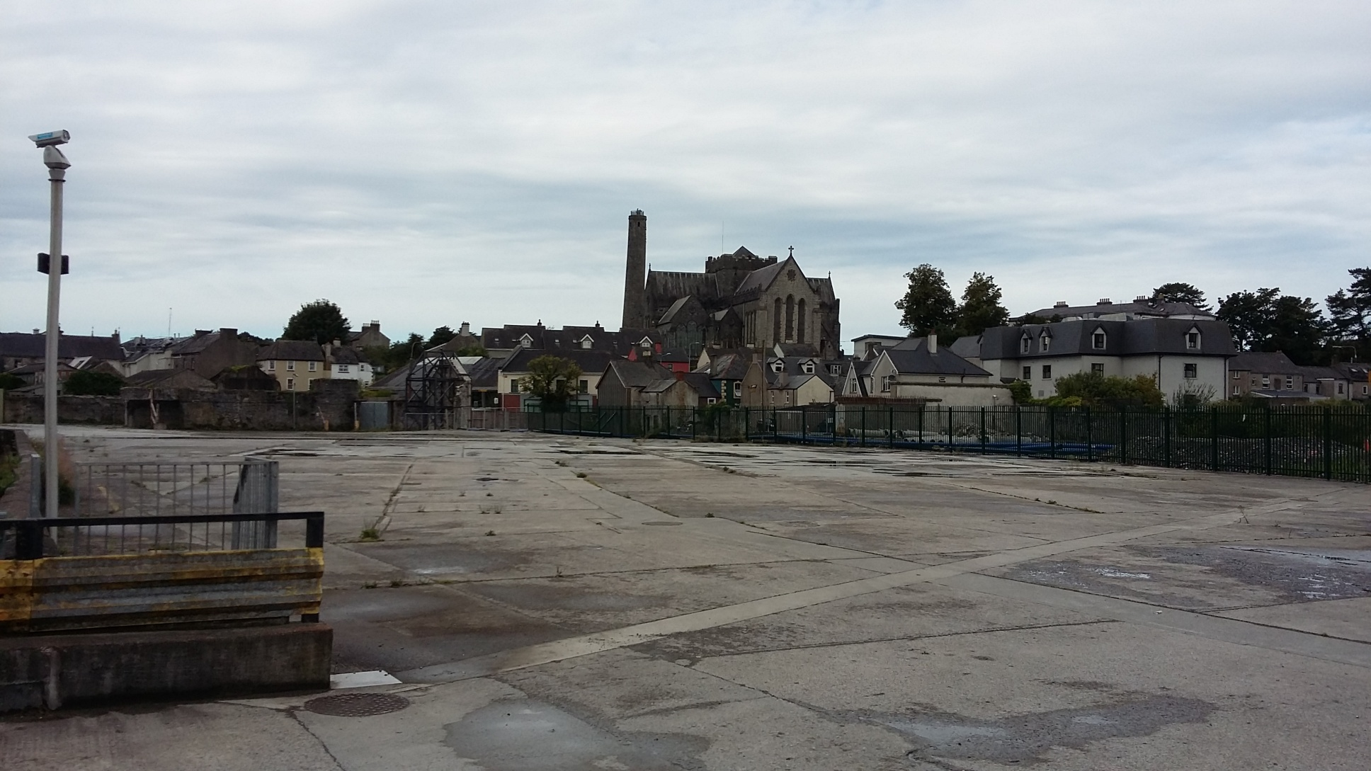
View from River Breagagh Bridge to St Canices Cathedral

Slide 12
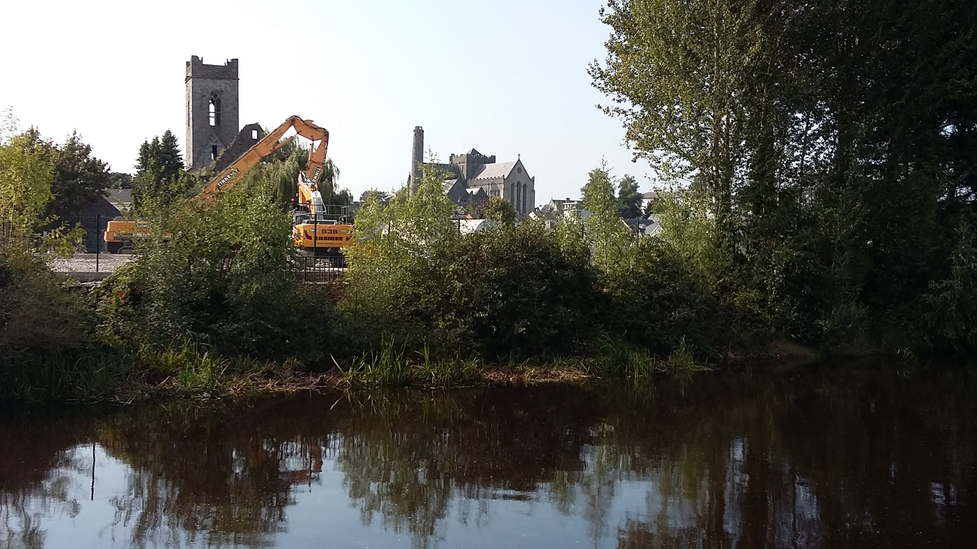
View of St Francis Abbey and St Canices Cathedral from the Peace Park

Slide 13
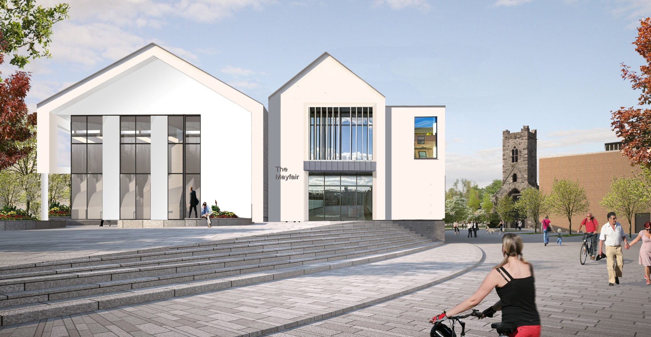
Mayfair Building
Planning was approved at the July 2016 meeting of Kilkenny Co. Co.
Work is now commencing on the preparation of enabling studies and
investigation works
  Preparation of proposal for the
  conservation and protection of
  the City Walls in the vicinity of
  the building.
  Design and implementation
  of an archaeological test
  excavation strategy.
  Site Investigation works
All works will be undertaken in consultation with the National Monuments service, with excavation works requiring ministerial consent.

Slide 14
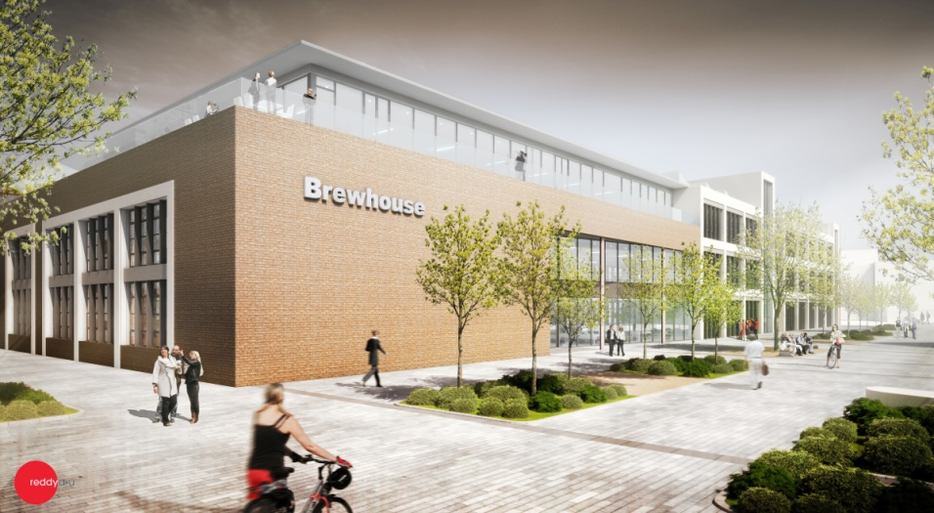
Brewhouse Building
A decision is awaited from An Bord Pleanala in relation to the third party referrals seeking a determination in relation to the need for an Environmental Impact Statement for the proposed development – current indications from the Board are that a decision will be made before the end of Sept. 2016.
Work is continuing on the detailed design of the building.
Site investigation works will
commence once Kilkenny
Co. Co. take possession of
the site. These works require
Ministerial Consent and this
consent is now in place.

Slide 15
Progress on Objectives outlined in Variation no. 1 to the
Kilkenny City & Environs Development Plan 2014 – 2020, adopted by Kilkenny County Council on 31st July 2015

Slide 16
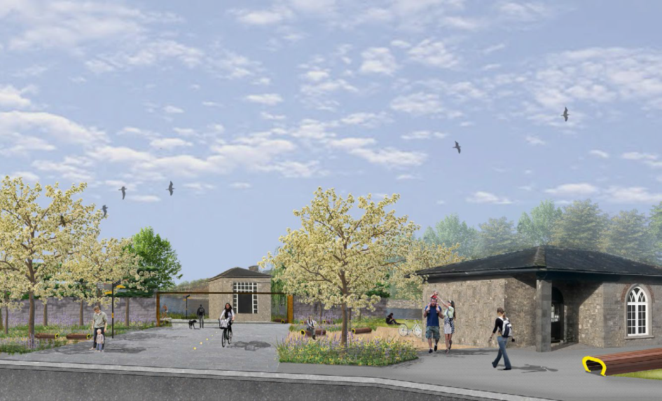
Objective 3H
To provide for a linear park along the western bank of the River Nore connecting to the existing River Nore linear park north of Green’s Bridge and the existing River Nore linear park south of the Masterplan area (Canal Walk)
Current Status
Detailed Design and
Tender Documents are
currently being prepared.
Archaeological test
excavations have been
designed and tender
documents are currently
being prepared for the
excavation works.

Slide 17
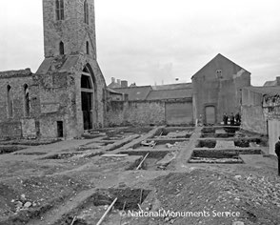
Objective 3I
To provide for an urban park in the vicinity of St. Francis Abbey (National Monument) incorporating the City Walls, Evan’s Turret and St. Francis’ Well Quarter Masterplan.
An Archaeological Assessment Strategy, including test excavations,
is currently being prepared in consultation with the National Monuments Service.
Trial Archaeo-Geophysical (GPR) Survey is proposed in this area.
If successful, the survey will be extended to the full site.
Ministerial License has been
received for the proposed GPR survey

Slide 18
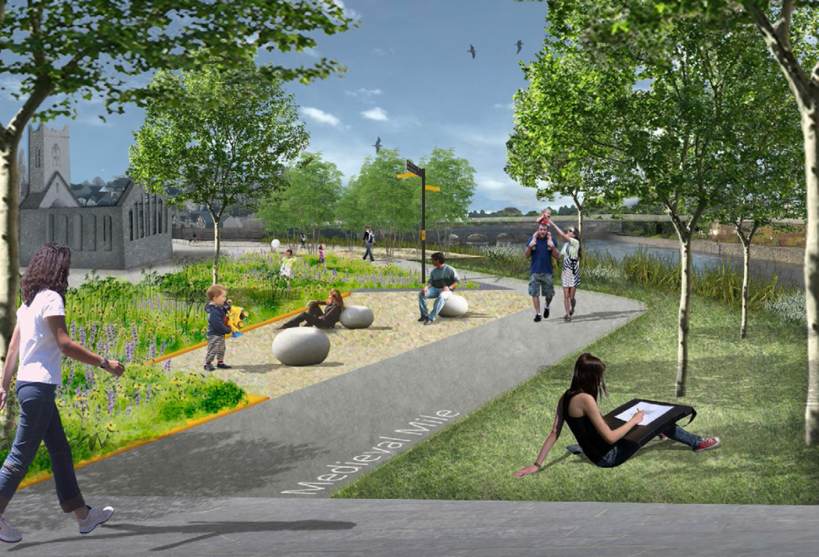
Objective 3J
To prepare a Heritage Conservation Plan for St. Francis Abbey, Evans’ Turret and St. Francis’ Well in the context of the existing City Wall conservation plan
Conservation plan is dependent on the findings of the proposed GPR Survey and the archaeological test excavations in this area.
Work on these surveys and the test excavations can only be undertaken after Kilkenny County Council take possession of the site.

Slide 19
Objective 3K
To prepare urban design criteria and recommendations and archaeological recommendations for the implementation of the Abbey Creative Quarter Masterplan.
Urban Design Criteria
Tenders have been received for the preparation of Urban Design Criteria – work on this element of the Masterplan will commence in October 2016.
Archaeology
An Archaeological Assessment Strategy is currently being prepared for each of the Public Realm Areas and the Urban Blocks proposed in the Masterplan. These draft strategies have been prepared in consultation with the National Monuments Service.
Tenders have recently been sought for a trial Archaeo-Geophysical (GPR) survey of the site. If successful, the survey will be extended to include the full Brewery Site.

Slide 20
Objective 3M
To develop a low carbon energy strategy for the masterplan area and advance the provision of near zero energy buildings on site.
Noel Lawler Green Energy Solutions (Kilkenny) were appointed in March 2016 to prepare an Energy Strategy for the implementation of the Abbey Creative Quarter Masterplan.
The Draft Energy Strategy is nearing completion.
This strategy will consider options for the provision of heating and energy to the Masterplan area, relying primarily on renewable sources.
The strategy will identify solutions that will be implemented across the full site (eg a District Heating System) and measures to be incorporated into individual buildings (eg Photovoltaic Cells to generate electricity for individual buildings)
Funding options for the implementation of the Energy Strategy will need to be considered.

Slide 21
Objective 3N
To provide for park and walk facilities for car and bus/coach parking at a site or sites in close proximity to the Abbey Creative Quarter Masterplan area to service both the masterplan area and the city centre generally taking into account the mobility management plan for the city.
Roadplan Consulting Engineers (Kilkenny) were appointed in August 2016 to undertake a review of existing car parking facilities in the City Centre area and to identify potential sites for car and bus/coach parking to service the Masterplan area and the city centre generally.
The identified options will be considered in the context of the Mobility Management Plan for the City Centre, which is to be reviewed following the opening of the Central Access Scheme.
A site specific Mobility Management Plan will also be prepared.

Slide 22
Objective 3O
To provide for housing within the masterplan in the area north of the Central Access Scheme
Van Dijk Architects were appointed in Spring 2016 to design the proposed Housing Scheme.
Housing design has been progressed to draft planning stage.
Current proposal is for 74 housing units (mix of houses and apartments), a community space and watersports facilities
Housing units will be mixed tenure (social, affordable & private)
Site Investigation works are due to take place in October / November, subject to archaeological licence.

Slide 23
“ To plan the area as a seamless complement to the medieval city as an inclusive place for an inter-generational community to work, live, visit and play with St. Francis Abbey at its core. The regeneration of the area will focus on embracing the sites’ natural, cultural and built heritage, whilst maximising the benefits of the rivers Nore and Breagagh, providing for a broad range of uses, sustaining growth in employment, 3rd and 4th level education and advancing economic activity in a sustainable and energy efficient fashion where innovation can flourish. The area will be a permeable expansion of the city for pedestrians and cyclists where smarter travel principles will apply throughout. ”
Abbey Creative Quarter Masterplan
Vision Statement

