Slide 1


Kilkenny County Council
Housing Programme
Presentation to Members
November 2017

Slide 2

Rebuilding Ireland – An Action Plan for Housing and Homelessness 2016 – 2021
Pillar 2 - Accelerate Social Housing
Replaces Housing Strategy 2015-2017
50,000 homes nationally by 2021
Based on 2016 Housing Needs Assessment
Kilkenny est. to provide 822 homes by 2021

Slide 3
Housing Programme
Delivery Methodology
Kilkenny County Council
  Building Programme
  Voids
  Acquisitions including Buy & Renew
  Repair and Leasing Scheme
  State Lands, Derelict and Vacant Lands
  Living Over the Shop Initiative
Approved Housing Bodies
  Build & Buy
  Capital Assistance Scheme (CAS)
  Leasing Initiative
RAS/HAP not included in Dept Target

Slide 4
Housing Supply – Responding to the Challenge
AHBs
Unfinished Estates
Repair and Leasing
Derelict & Vacant Sites
State Agency Co-operation
Capital Programme
Living Over the Shop
Site Identification
Acquisitions
Buy & Renew
RAS/HAP
Voids

Slide 5
Housing Demand November 17
Area |  | Approved Applicants | 1 Bedroom | 2 Bedroom | 3 Bedroom | 4 Bedroom
Kilkenny City & Environs | 61% | 1,338 | 526 | 503 | 266 | 43
Rest of County | 39% | 838 | 323 | 274 | 201 | 40
Total |  | 2,176 | 849 | 777 | 467 | 83
 |  |  | 39% | 36% | 21% | 4%

Slide 6
Housing Stock
October 2017
Kilkenny County Council | Total
LA Housing Stock | 2,305
RAS Units | 546
HAP Units | 803
Leasing Units | 147
Total stock available to the Council | 3,801
Rebuilding Ireland Target | 822
City | 506
County | 316
CAS Units = 700+

Slide 7
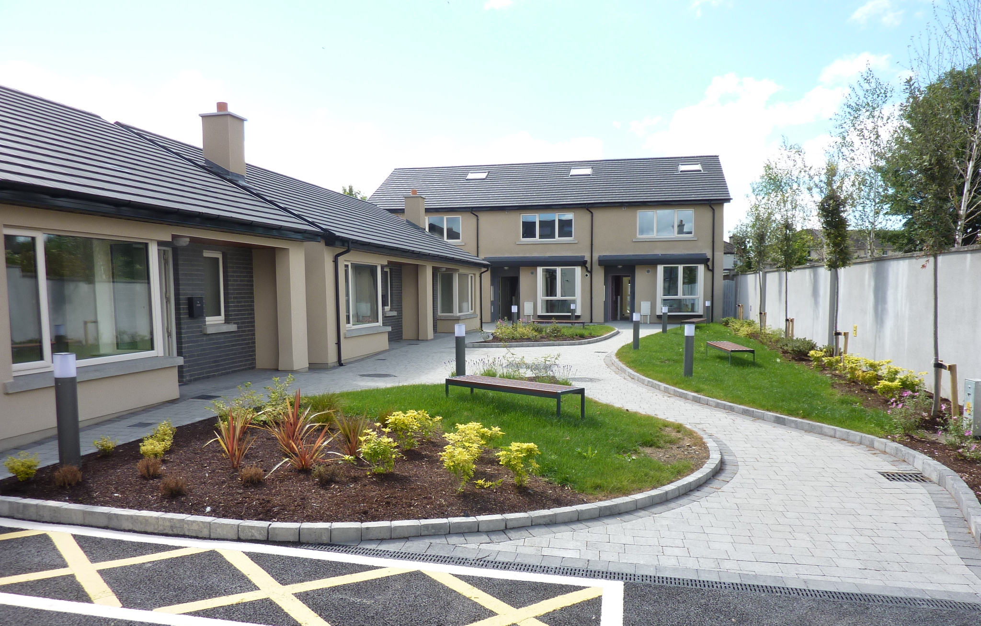
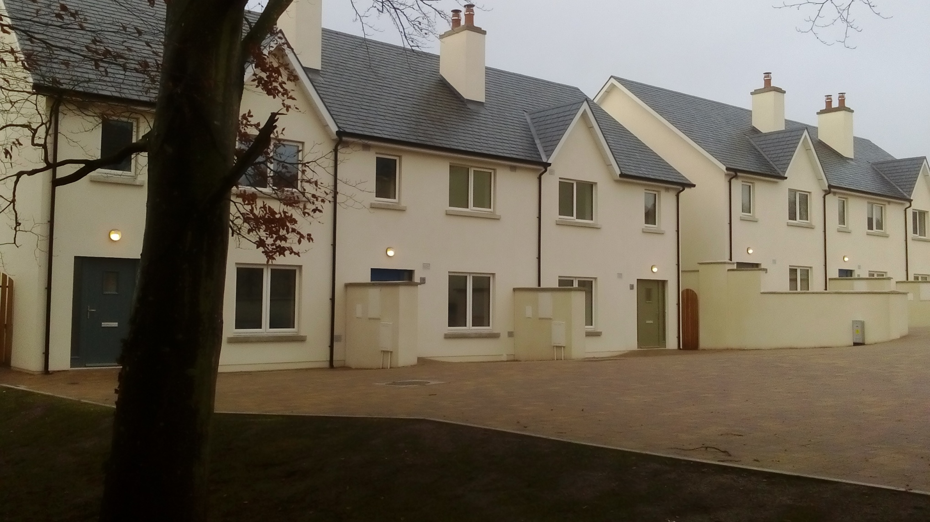
Kilkenny County Council – Recent Completions
Rosehill (6 units)
Gaol Road (10 units)

Slide 8
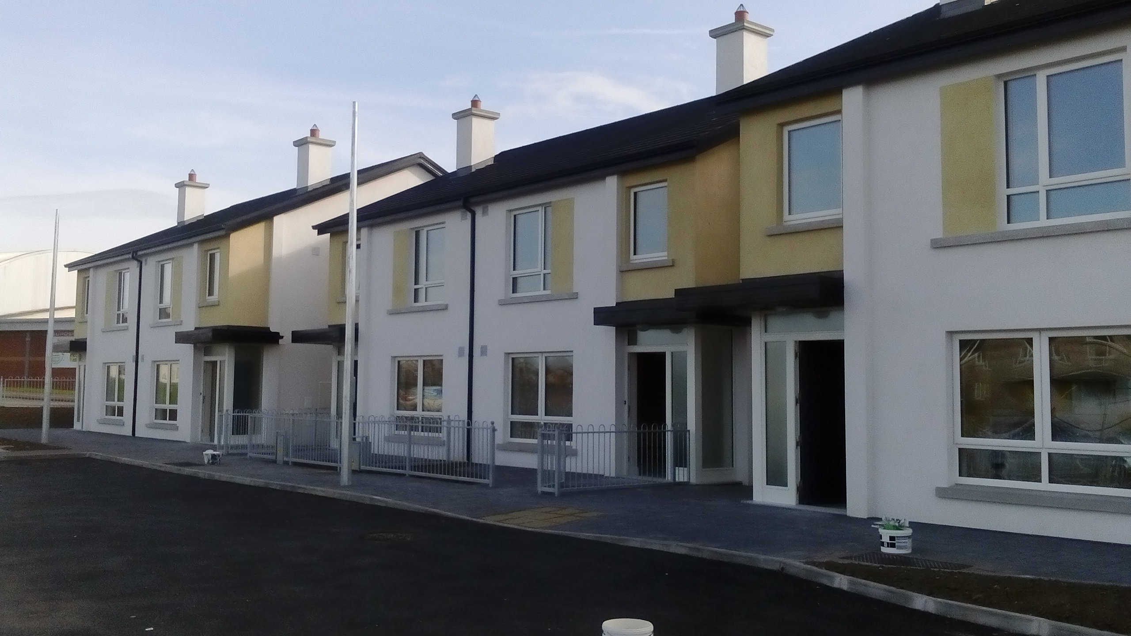
Kilkenny County Council – Recent Completions
7 Houses at Newpark, Kilkenny City (Turnkey)
12 Houses at Friary Walk, Callan (Cluid)
2 Houses, Newrath (Dove AHB)
21 Units Logan Sq.Thomastown (Oaklee Housing)

Slide 9
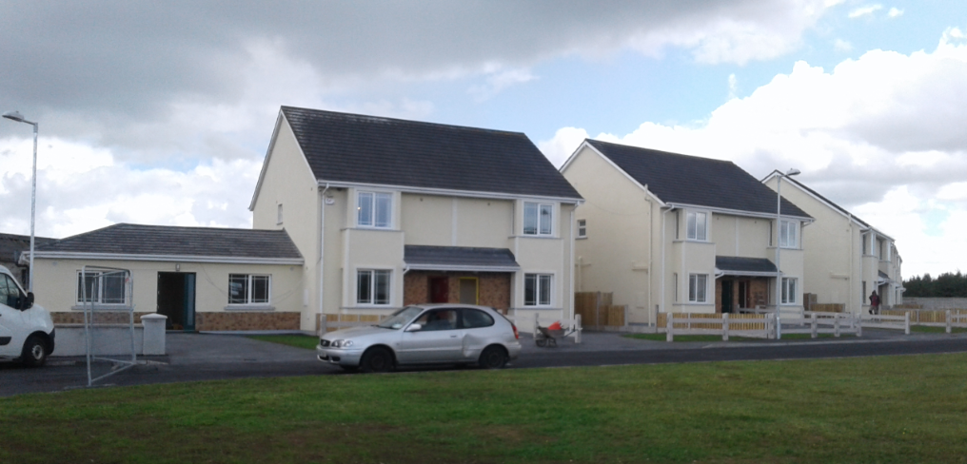
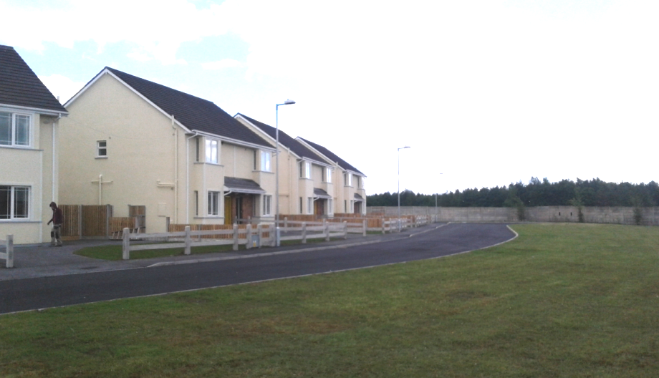
Kilkenny County Council – Recent Completions
Togher Way, Urlingford (11 units)
Brooke House, Thomastown (5 units)
Camphill
74 homes

Slide 10
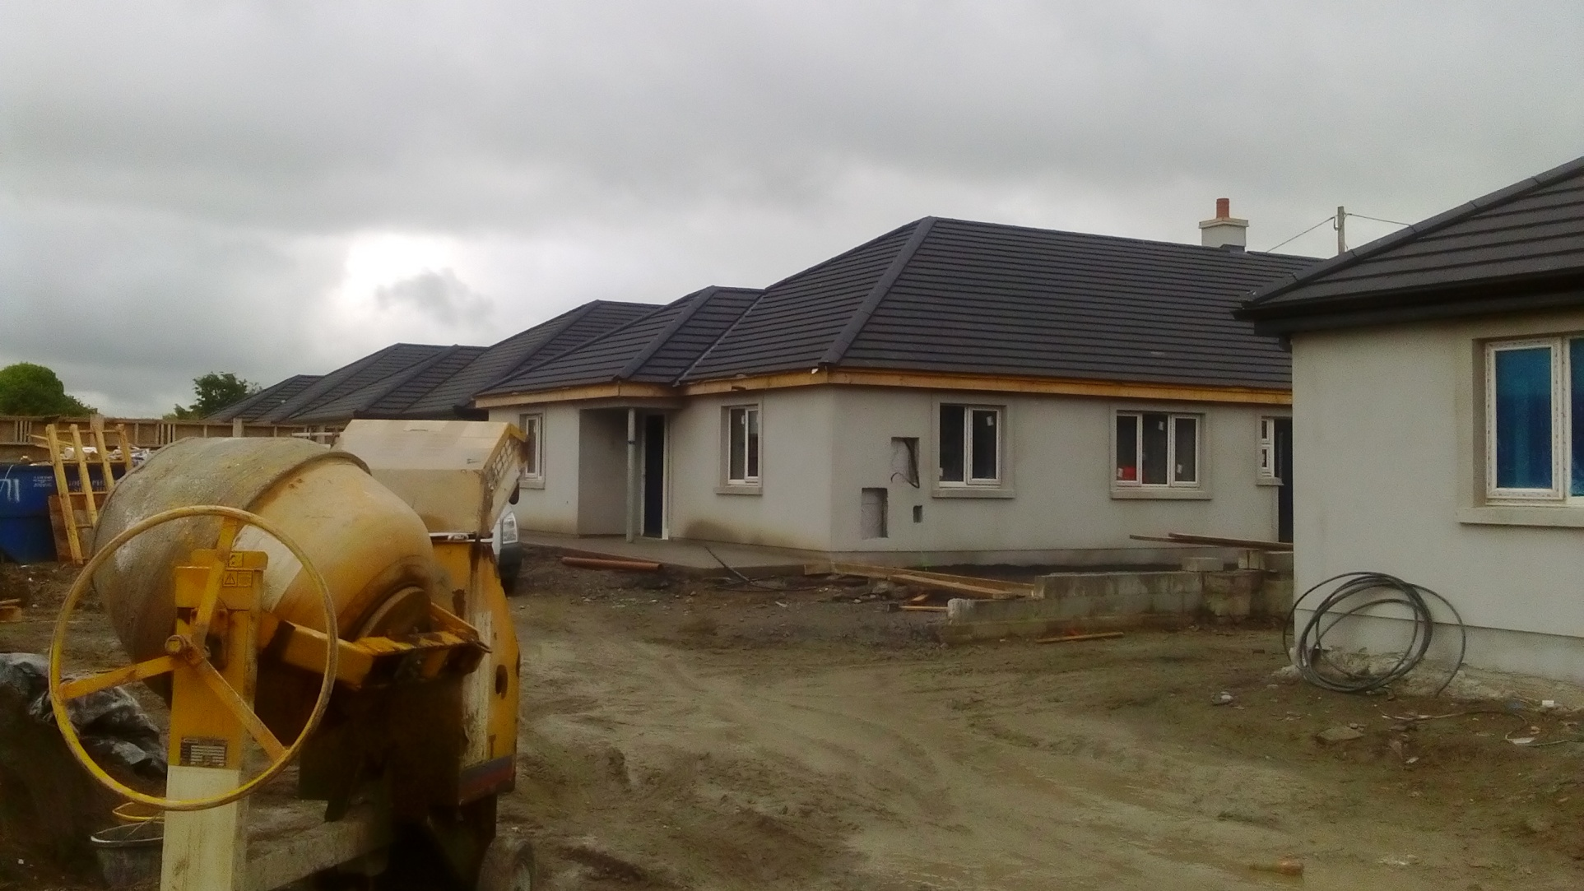
Kilkenny County Council – Under Construction
4 houses in Wetlands under construction, part of a group housing scheme
Work underway at Abbeygate, Ferrybank (11 units) under Turnkey Construction – completion Q4 2017
Side Road, Mooneenroe (9 units) Oaklee Housing Association – completion Q4 2017
Friary Walk, Callan (16 units) Cluid Housing Association
40 homes

Slide 11
Kilkenny County Council – Housing Capital
Planning / Design / Tender Stage
38 units at Bolton, Callan. Tender stage Q4 2017
33 units at Donaguile, Castlecomer, Part 8 completed. Tender stage
5 units at Greensbridge House, Kilkenny City. Part 8 completed.
14 units at Ballyragget. Stage 1 approval received. Part 8 Q1 2018.
18 units at Piltown. Stage 1 approval received. Part 8 Q1 2018.
70 - 80 units Crokers Hill, Kilkenny City. Dept. Stage 1 approval received.
7 units at Golf Links Rd, Kilkenny City. Stage 1 approval received.

Slide 12
Kilkenny County Council – Housing Capital
Planning / Design / Tender Stage
4 units at Robertshill, Kilkenny City. Stage 1 approval received.
4 units at Blackstaff, Callan. Stage 1 approval received. PART 8 Nov meeting
1 rural cottage at Barna, Freshford. Stage 4 approval expected
1 House at St Mary’s Group Housing Scheme
3 House at St Catherine’s Group Housing Scheme (Phases 3)
10 houses at Ladywell & 3 houses at Cloghabrody, Thomastown
15 Units at Broguemaker, Castlecomer Road, Kilkenny
231 homes

Slide 13
Kilkenny County Council – (Leasing) AHB’s
12 units at Ogenty Gowran - est delivery Q1 2018
10 units at Castlehyde, Rosbercon - est delivery Q1 2018
2 units at O’Loughlin Court, Hebron Rd – construction to start
6 units at Mooncoin – site clearance
39 units at Ballybought St, Kilkenny City – estimated delivery Q4 2018
27 units at Walkin St, Kilkenny City – estimated delivery 2019
15 - 50 units (Phase 1,2,3) at Nuncio Rd., Kilkenny City - estimated delivery 2019
15 units at Callan Manor, Callan - est delivery Q1 2018
20 Leasing Acquisitions – Various Locations in City and County
181 homes

Slide 14
Kilkenny County Council – (CAS) AHB’s
Location | AHB | Number
Smiths Road, Ballyraggett | Oaklee/St Patricks | 4
Good Shepherd Centre, Wing 52 | GCSK | 12
Garringreen, Kilkenny | SOS | 6
Jerpoint, Thomastown | Camphill | 3
Golf Links Road, Kilkenny | Respond | 15
Callan (Nimble Spaces Project) | Camphill | 16
Church Lane, Kilkenny | GSCK | 6
Ennisnag, Stoneyford | Kingsriver Community | 2
64 Units

Slide 15
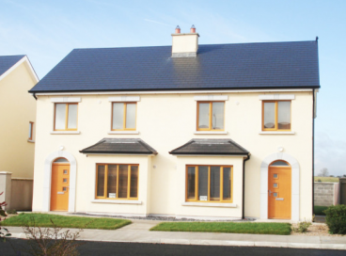
Kilkenny County Council – Single Aquisitions
30 units – sales completed in 2017 to date
15 units – sale agreed – purchase in progress
45 homes

Slide 16
Rebuilding Ireland 2016 - 2021
Summary
Scheme of Delivery | Units
Acquisitions
-Completed | 45
-Proposed | 60
Construction
-Completed | 74
-Under Construction | 40
-Planning, Design, Tender stage KCC | 231
-Site Appraisals (15) | 121+
-Long Term Voids | 16
Voluntary
Leasing Proposals | 181+
Capital Assistance Scheme (CAS) | 64+
Total | 832
Rebuilding Ireland 2016 – 2021
Target = 822

Slide 17
Kilkenny County Council – Challenges
Identification of additional development sites, particularly Kilkenny City, seeking to provide sustainable housing development.
75% of the overall demand is for 1 and 2 bed units but there is limited stock of such units available for purchase.
Changes in the mechanisms for Social Housing development
  less reliance on new units from HAP/RAS
  enabling private sector housing provision and Part V e.g. LIHAF
  Vacant Lands & Sites including Derelict Properties

Slide 18
Homelessness
Currently, Average of 30 homeless presentations each month
In addition to current stock levels, the Council in collaboration with Voluntary Bodies provide;
  24 units at Good Shepherd Centre
  8 transitional units at Brother Thomas Place
  1 family unit at the Lodge, GSC
  10 Rooms in local Hotel
  7 rooms in Amber Women’s Refuge Centre
  11 Community houses/apartments by GSC and Focus Irl
  5 units proposed for Greensbridge
66+ Units

Slide 19
Private Grants 2017
Department Allocation 2017 = €1,812,486 (80%/20%)
Total Grants Approved to Date: 274 i.e. €1,920,702
Estimated Approvals by year end = €2ml+
  HGD Approved 75 i.e. €901,020
  MAG Approved 27 i.e. €128,937
  HOP Approved 172 i.e. €890,745
KCC Budget Provision 2017 = €1,544,000 (80%/20%)
€500,000 additional grant approval
Net Cost to Council (20%) ~ €100,000

Slide 20
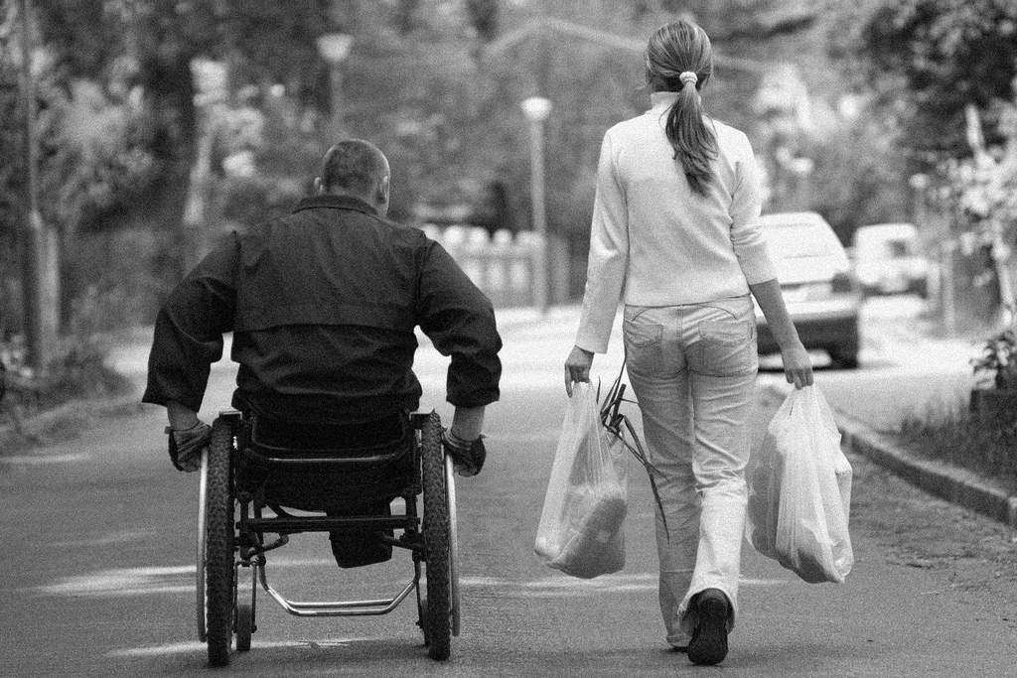
Kilkenny Strategic Plan for People with a Disability 2016 - 2020
Goal: Meet the indentified housing needs of people with disabilities whether they are living in the community or in a congregated setting
National and Local Strategies in place
National Strategy updated to reflect Housing Needs Assessment and data on Emerging Need from the HSE early 2017
Kilkenny Strategic Plan went before Housing SPC4 on 26th January 2017
Kilkenny Housing & Disability Steering Group set up. Membership includes;- Local Authority, HSE, Disability Sector (4 Pillars) & Approved Housing Bodies.

Slide 21
Voids
Council has a housing stock of 2, Units
On average 90 units become vacant each year i.e. 4%
Jan 2017 - 21 vacant units. 92 units became vacant during the year
85 of the 113 vacant units refurbished and returned to productive use
28 Vacant units now but 16 on site and 12 at pre tender stage
On Average 2 houses per week returned to stock

Slide 22
Mortgage to Rent (MTR)
Government Initiative to keep people in Homes
Households that have unsustainable mortgages
Borrower surrenders to the lender, who sells to AHB
AHB rents to the borrower who becomes a social housing tenant
Tenant pays an income based differential rent
Tenant can buy back after 5 years
Certain criteria to be met e.g. Negative Equity, Valuation, Assets

Slide 23
MTR - 3 Models
MTR Schemes
1. Local Authority MTR –LA own Loans
2. Approved Housing Body (AHB) MTR
a. Icare Housing and AIB MTR – NEW
3. Private Company MTR – Pilot Scheme NEW
Model 1. Local Authority MTR
626 Loans with a book value of €34ml
111 Accounts in Arrears (20%) amounting to €498,000
80 – 85 cases in MARP
3 successful Applicants transferred to MTR to date

Slide 24
Voluntary Body (AHB) MTR
Model 2. Voluntary
In Kilkenny there are eight (8) successful cases
Eleven (11) applications at various stages
Cases take average 12 – 18 months
Icare and AIB MTR - NEW
Icare AHB pays OMV less repairs and less discount from Bank
Tenant can buy back from day 1 for cost AHB paid
Model 3. Private MTR with Long Term Lease
Similar to Lease under a RAS type arrangement with LA. 25 year lease
Owner manages and maintains property as provided in the Lease with LA
Borrower becomes tenant. Pays Rent to LA
EOI advertised 26th October. Closing date 21st December 2017.

Slide 25
thank you.

