Slide 1
Youth Area & Skate Park at Abbey Quarter
November 2017

Slide 2
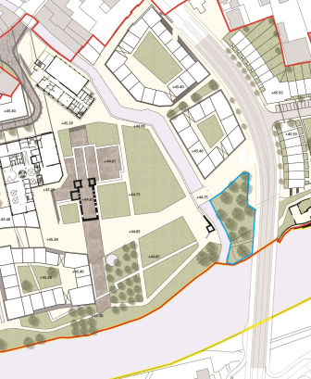

Background
Abbey Creative Quarter Masterplan
Section 4.3.3 Linear Park Strategy
“...the design of the park will also provide for a skate park facility within the masterplan area..”
Part VIII Riverside Garden Project
Identified area between River Breagagh & St Francis Bridge as location for proposed skate park
Consultation
Kilkenny Recreation & Sports Partnership
Sport Ireland – Dormant Accounts Fund
Callan Workhouse Union

Slide 3
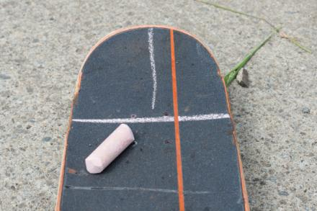
Introduction
Key Objectives for Youth Space
  Inclusive
  Open to all young people
  Meet the needs of local Kilkenny skaters
  Process
  Design led workshops with wider youth community
  Meeting with key skate park advocates and understanding recent community led initiatives for skate park.
  On site Co Design Workshop with Spanish Architects Todo por la Praxis and young skaters
  Steering Group
  Kilkenny Recreation & Sports Partnership
  Kilkenny County Council
  Callan Workhouse Union
  Kilkenny Childcare Committee

Slide 4
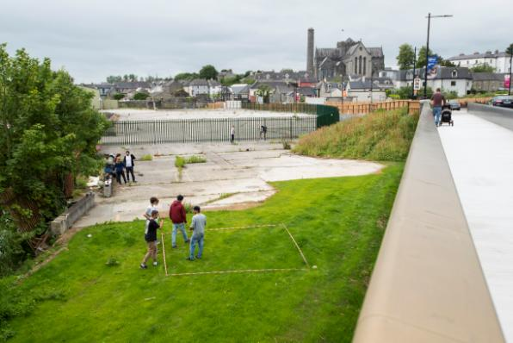
Location
Proposed Site location
Confluence of River Breagagh / River Nore
Adjacent to St Francis Bridge
Feedback from consultation
  Location is a huge asset
  Suits climate – shelter
  Centrally located
  Ease of access when Riverside Garden
  is developed.
  Strong precedent internationally

Slide 5
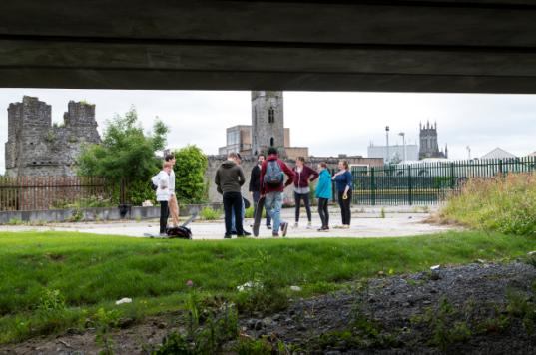
Public Engagement
Public Engagement
Foroige Group
Urban Sports Kilkenny / Paradicals
Colaiste Pobail Osrai x 2
Kilkenny City Vocational School x 2
Presentation Secondary School
Young Irish Film Makers
Comhairle na nOg
Paradicals
Ciclovia
11 workshops
Over 200 young people

Slide 6
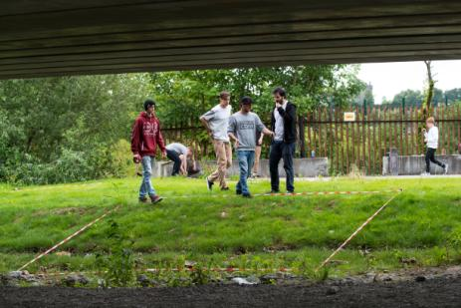
Kilkenny City : Public Space
Kilkenny City : Public Space
A sense of place & belonging
Workshops focused on young peoples relationship with public space in the city centre
Perception of safety & belonging
Five Themes
  My Familiar Space
  My Social Space
  My Open Space
  My City Space
  Shifting our sense of Place

Slide 7
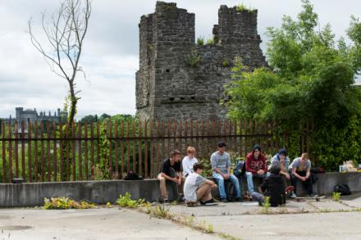
Kilkenny City : Public Space
Familiar Space : Home
  Strong identification with home and environs
  Familiarity
My social space : School, Youth groups, Sports
  Secondary school
  Ossory Youths desart Hall
  Barnstorm
  Young Irish film Makers
  Foroige
  Watershed
  The Drum
  Sports Clubs

Slide 8
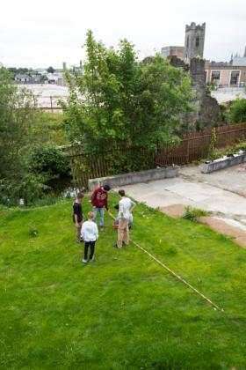
Kilkenny City : Public Space
My Open Space : Parks & Rivers
Castle Park
  Young people over 12 not allowed to use playground
  Lack of any facility in the park for older children
  Feel safe in the grassed areas
  Rivers
    Conflicting experience
      Lifeguard supervision
      Life buoys
      Safety of personal belongings on river bank

Slide 9
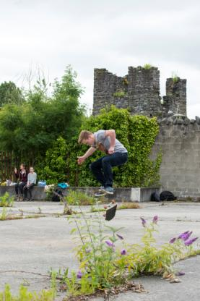
Kilkenny City Public Space
  My City Space : Streets, Lanes & Footpaths
  Do you hang out alone in small or large groups ?
  Is the cityscape a play space for you – skating, blades, running ?
  What are your attitudes to drinking smoking and drugs ?
  Sense of anxiety entering some city spaces – intimidated by older
  teenagers or adults
  Unsafe areas included areas that were not being maintained.
  Lack of public lighting cited as an issue in relation to a sense of safety.
  Young people outlined a perception of Kieran street being unsafe
  due to behaviour of some older teenagers.
  Often asked to leave fast food outlets.
  Skateboarders regularly asked to move on.

Slide 10
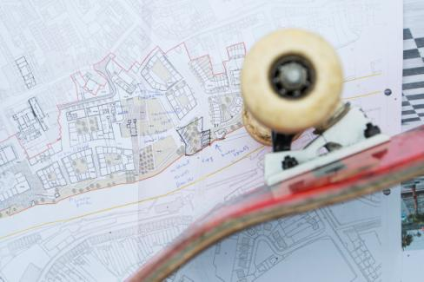
Kilkenny City Public Space
  My City Space : Streets, Lanes & Footpaths
  Positive features for safe and enjoyable public spaces
  Easy accessibility,
  Proximity
  Good Seating
  Good Lighting
  Tables
  WiFi
  Shelter
  Grass
  Lots of space
  Accessible late into the evening

Slide 11
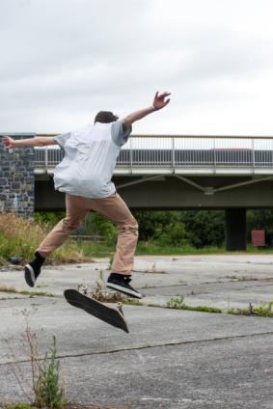
Kilkenny City Public Space
  Shifting our sense of place
  Groups of Young People congregating in public space,
  without proper facilities, is perceived as ‘anti social
  behaviour’
  Young people feel excluded from public, social and
  cultural life of the city
  Engagement with Young People is found to be more
  effective in curtailing perceived anti-social behaviour,
  rather than excluding them from civic space

Slide 12
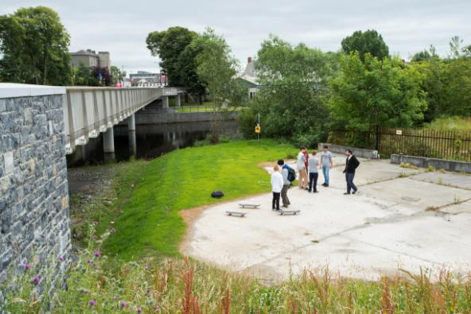
Co-design process
Participatory design Process
Co design workshop – 31st July
Urban Design Architects- Todo Por La Praxis
Familiarise participants with site and context
Plan Sketching & on site 1:1 marking
Issues Discussed
How the skate park integrates into wider urban
regeneration project
Integration of pedestrian path crossing through
the area.
Safe area for people to watch the skaters or
hang around.

Slide 13
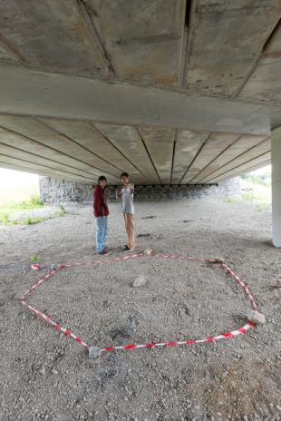
Skate Park Design
Skate Park Design Considerations
  Bowl
  Street Skate
  Weather
  Balancing the complexity of elements
  Lighting
  Access
  Seating
  Capacity
  Security & Safety
  Maintenance
  Drainage
  Storage

Slide 14
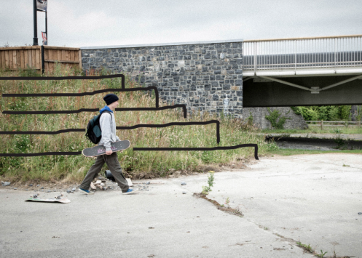
Sketch Design
Project design / Plan Sketches
General strategy
Placement & integration of elements
Precise design of the overall skating circuit
Integrated chill out or rest area
Grandstand area to connect lower and higher levels
Could also facilitate performance, theatre, music etc
Electricity supply – powered by photovoltaic
Wi-fi public connection
Storage space
Use of Brewery Artefacts

Slide 15
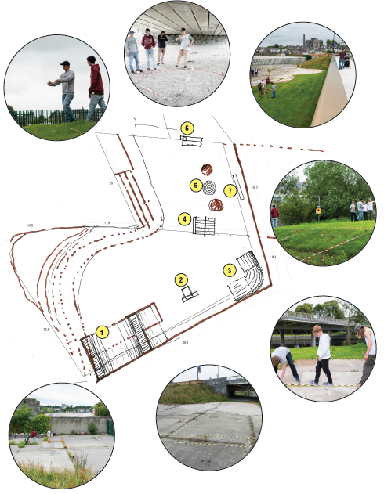
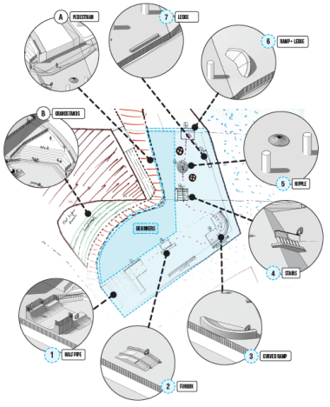
Outline Design

Slide 16
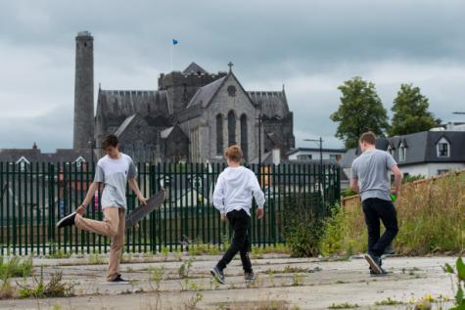
Next Steps
Detailed Design – KRSP grant from Sport Ireland
Ongoing engagement with youth community
in the detailed design of the space
Part VIII Planning
Application for Sports Capital Funding
(National Lottery Funding)

