Slide 1

Yulefest Kilkenny

Slide 2
Mission Statement
To develop and promote “Yulefest Kilkenny” as a destination for people of all ages seeking a quality Christmas experience of shopping, food, crafts and entertainment.

Slide 3
Vision
To develop a nationally and internationally recognised and desirable Christmas Festival of crafts, food, entertainment and family events in Kilkenny for local communities and visitors to enjoy which supports local businesses and producers.

Slide 4
Facts to Remember
Two Thirds of Visitors come from outside of host towns
Regional and National visitors spend on average 40% more than local visitors
Irish people spend more than any other nationality in Europe at Christmas, average €1,045 per person
Up to 50% of retail income annually is generated in the four weeks before Christmas
Shopping has moved online but at Christmas most people travel or day trip for shopping and entertainment

Slide 5
Yulefest Objectives
To improve, co-ordinate, promote Kilkenny Christmas Offering
To retain and attract visitors
To celebrate and showcase local talent
To showcase and provide outlets for local produce
To develop community cohesion in celebration
Increase footfall and spend
To measure and evaluate performance

Slide 6
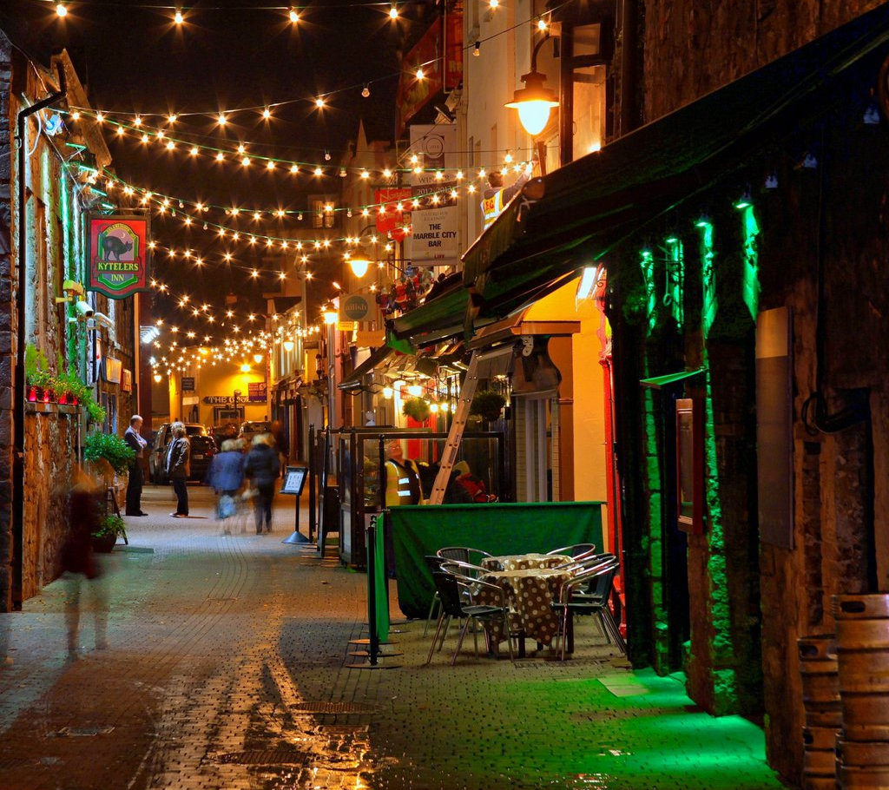
Kilkenny’s Suitability

Slide 7
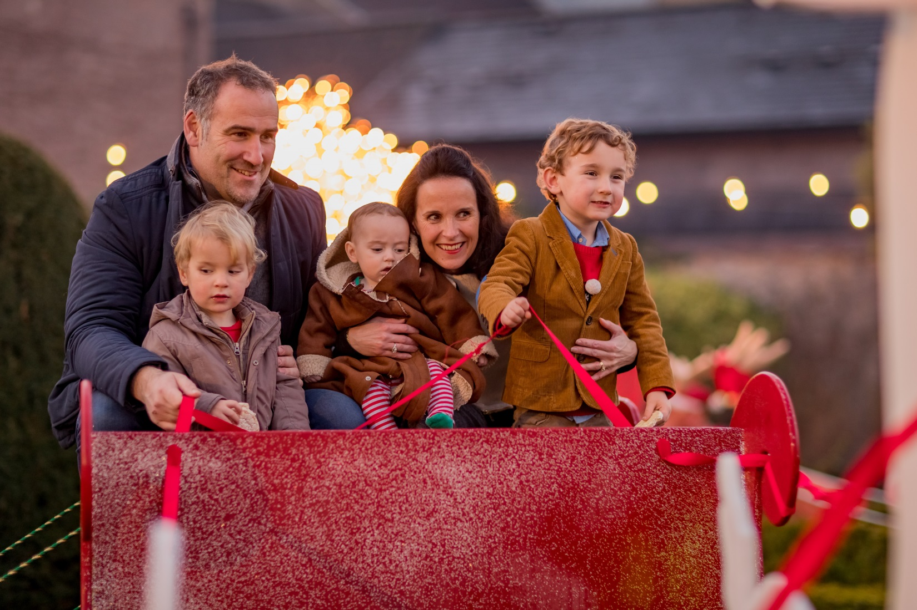
Quality Venues and Events

Slide 8
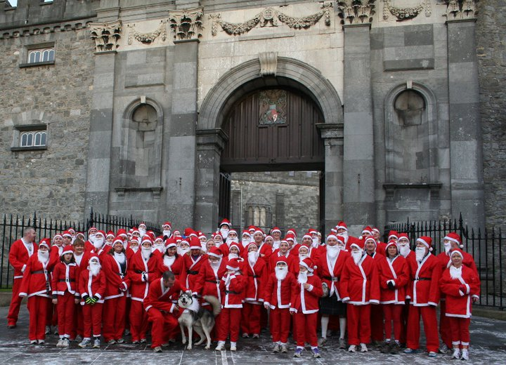
Community Cohesion

Slide 9
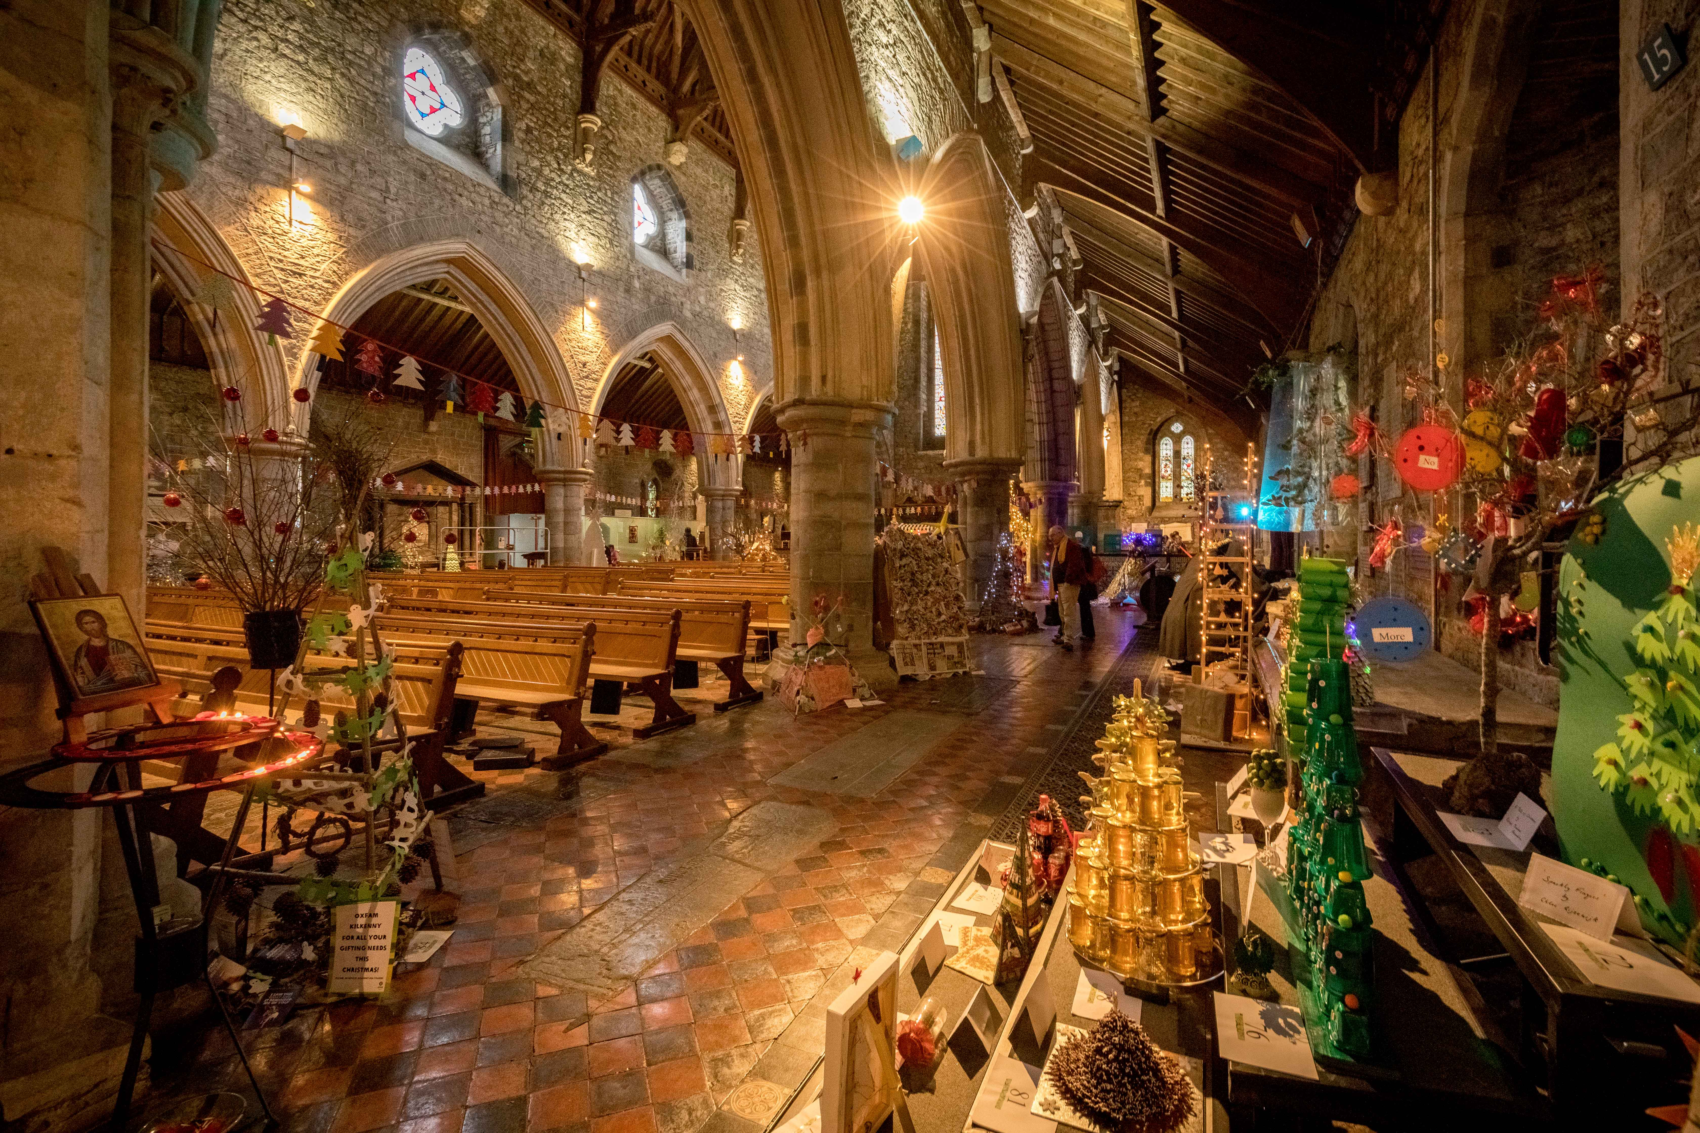

Slide 10

Showcase local

Slide 11
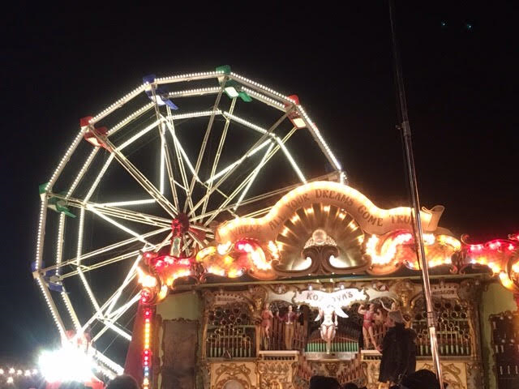
Create -Festival atmosphere

Slide 12
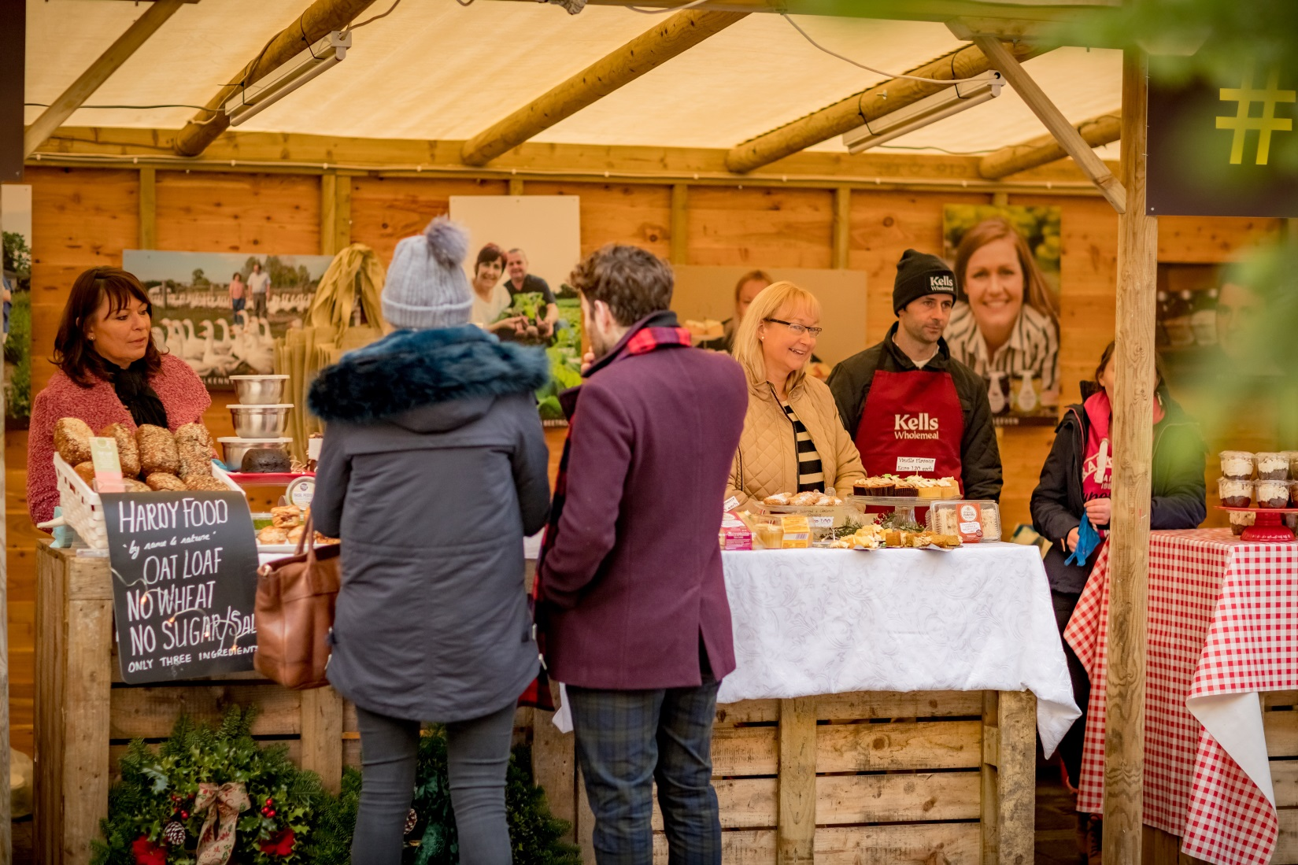
Support local Producers

Slide 13
Community Inclusion
KCAT will be displaying their wonderful Art & Ceramic creations at ‘Mac Donagh Junction’ as part of Yulefest Kilkenny this December.
L’ Arche will be delivering workshops, and displaying their creative ability.
The Good Shepard Centre, The Men's Shed, and Mother of fair love are all involved in creation of the Reindeer Garden @ Butler House.

Slide 14
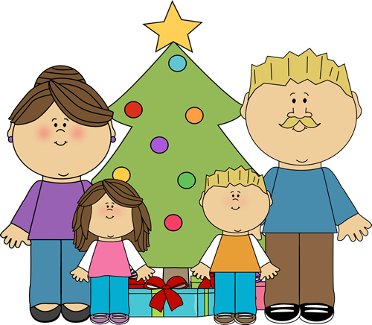
Family

Slide 15
Community participation
What worked really well last year was the community participation. Therefore we have put a serious amount of effort into developing community based events, the engagement around the star project is phenomenal.
link in to see a promotional video created by Young Irish Film Makers around the Star Project- https://youtu.be/ZT27SwbAWy4
Further information can be found on the website http://yulefestkilkenny.ie/medieval_week/star-project-community-connection-project/

Slide 16
James Stephens Army Barracks
The Stephens Barracks Museum has an important role in Kilkenny’s heritage. With an Irish Army background & base, the museum reflects a heritage older than the state.
This special event welcomes visitors via the side entrance to the museum with a line of the wooden soldiers standing to attention as a fun addition to the overall decoration.
1st stop – The museum – where stories of events of Christmas’s past will be told (15 mins)
2nd stop – Detention Barracks – visitors enter a courtyard that will be decorated with reindeer and lights, head into the detention centre where the naughty elf is locked up. The history of the detention cells will be recounted (10 mins)

Slide 17
James Stephens Army Barracks
3rd Stop – Outdoor Handball Alley – ‘Christmas Past and Present’ a pre-recorded message from
veterans recollection of their Christmases spent on tour (including messages from other emergency service personnel who will be on duty over Christmas) (5mins)
4th Stop – The Cobbled Courtyard – here the visitors will get to meet ‘Santapaws’ Fionn the Army’s Irish Wolfhound mascot (10mins)
5th Stop – The Officers’ Mess – where visitors will be treated to a hot drink and refreshments (20 mins)
Visitors will be escorted from the barracks by a lone piper.

Slide 18
U- Casadh Star Project –Yulefest Funding
The longest community connection project ever attempted!
A star template has been supplied countywide for children and adults to decorate.
The Kilkenny Libraries and Art It at MacDonagh Junction act as star stations throughout the month of November where the stars and decorating material are available for everyone to get involved.
The stars will be collected, counted and looped on a long ribbon signifying the connectivity of each person that made a decoration. The stars will then be wound around a giant Christmas tree in MacDonagh Junction on Sunday the 10th December and the number of stars will be revealed in a festive atmosphere! A wonderful project for young and not so young from all walks of life to come together and work on this special project!

Slide 19
What the PPN are funding over Yulefest
Callan FRC: community celebration in the street- Santa arrival, carol singers and a party
Clara parish Committee: Christmas Party and Solidarity Dinner with music and entertainment
Ferrybank Combined Residents Association: intercultural party to coincide with the turning on of the Christmas Lights- santas arrival with presents for all children, food, music and entertainment in th shopping centre parade
Moneenroe Community Council: A senior Citizens Christmas Party
Ossory Youth: Creation of a Christmas
Village by the youth of the County for display in Butler House over Yulefest
Newpark Close FRC: An intercultural celebration of dance, music and food

Slide 20
What the PPN are funding over Yulefest
Rothe House- reindeer Project: partnering with the Men’s Shed, SOS and the Mother of Fair Love School are coming together to create a reindeer garden.
Windgap: a whole town Christmas Celebration, with themed houses, decorated lake, mother and father Christmas with presents for children, music and dancing.
The Achoil group: demonstrate their cultural dance in traditional Costume throughout the Unity parade and get the crowd to join in at the end of the parade at Graces Castle.
Ballyragget Development Association: Light up the Village and decorate the Island in the Square.
South Sudanese Community Association: End of Year Celebration for everyone. Traditional dance, Children's games, talent show etc. music and food.

Slide 21
Potential
Retain and Attract Visitors
Boost to Local Economy Pre-Christmas
Raise Profile of Artisan Producers
Provide Stage for Local Talent
Promote High Quality Seasonal Events
Kilkenny County Council cannot complete this process alone. Without the input and support of the business and other communities the full potential of the project cannot be realised.

Slide 22
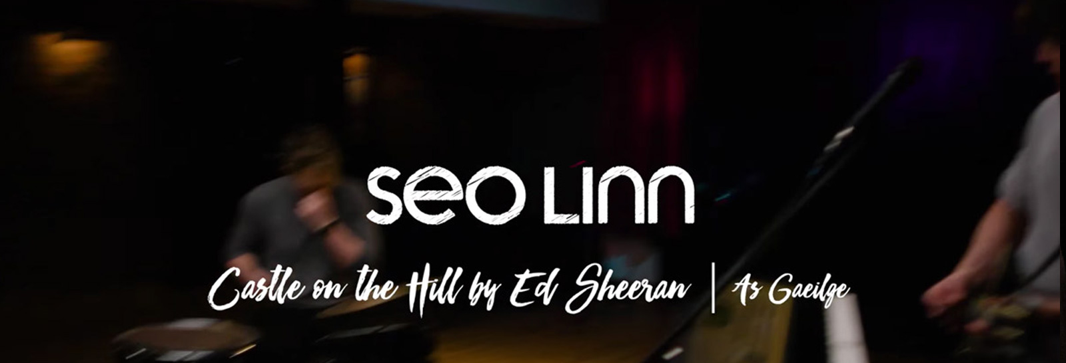
Seo Linn are an energetic and fun young band that burst onto the Irish music scene with their powerful originals and unique take on contemporary songs with a particular passion for Gaeilge.

Slide 23
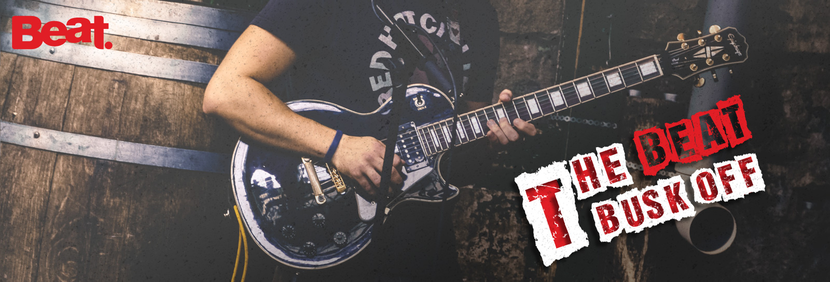
Presenters from the station will be on the streets of the Marble City each Saturday in December looking for the next big thing! Whether you’re a solo performer or in a band, they want to hear your talent. The winner will receive some amazing prizes, along with airplay on the market leading radio station. Check out beat102103.com and listen in to Irishbeats on Sunday evenings.

Slide 24
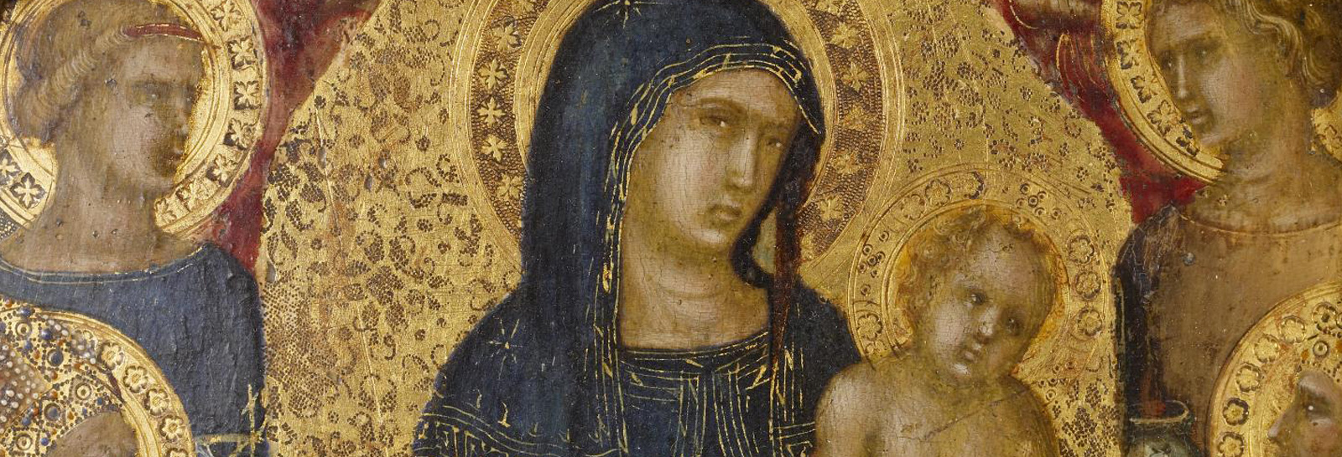
On 2nd December 2017, Notable Works will stage a very special production of Handel’s Messiah as part of Yulefest Kilkenny’s Christmas program.

Slide 25
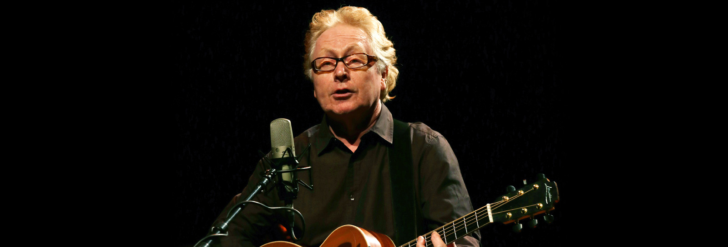
With a career spanning five decades, Paul Brady, singer, songwriter and multi-instrumentalist is one of contemporary music’s most enduringly popular artists. Saturday December 16th @ St Canices Cathedral.

Slide 26
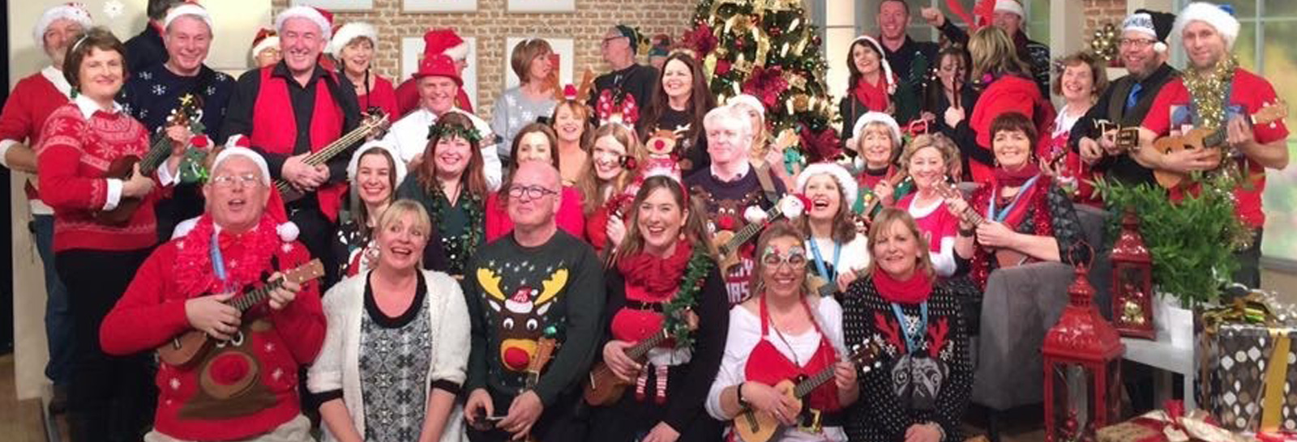
The Dublin Ukulele Collective (DUC) is a forty-plus piece ukulele harmony band with a high feel-good-factor and watching them perform, the fun is obvious. Members range in age up to 70+ and they perform a diverse repertoire of songs which reflect their age span.

Slide 27
Interest & media attention to date
Ireland’s ancient East
Irish ferries
Independent newspapers
Nationwide
Sunday Business Post
Ireland AM
Kilkenny Community Radio

Slide 28
Sponsors /Media Partners/ Support
The festival has agreed media partnership's with the Kilkenny people, KCLR, and will be spending on a regional basis to ensure good footfall to Kilkenny.
Huge support has come from the hotels, and businesses of Kilkenny this year, sponsoring events, reindeer, etc.
Support from the PPN has been hugely valuable, also the Chamber, LEO, and Leader, but without the council this festival would not be happening.

Slide 29
What would I like from you?
To support, promote and engage with the festival.
Attend the launch night Dec 1st, and other events where possible, share the program and the concept with family and friends.
Yulefest is a fantastic initiative by Kilkenny County Council, the festival could not happen without the support of the local authority. The future potential for a city like Kilkenny, and its many stake holders will be substantial on so many fronts with everyone's support- especially yours! Thank you for your time today and I look forward to seeing you this Christmas in Kilkenny!

Slide 30
Don’t Miss the Opportunity
Help us to Create the Best
Yulefest Kilkenny
Please visit;
www.yulefestkilkenny.ie

