Slide 1
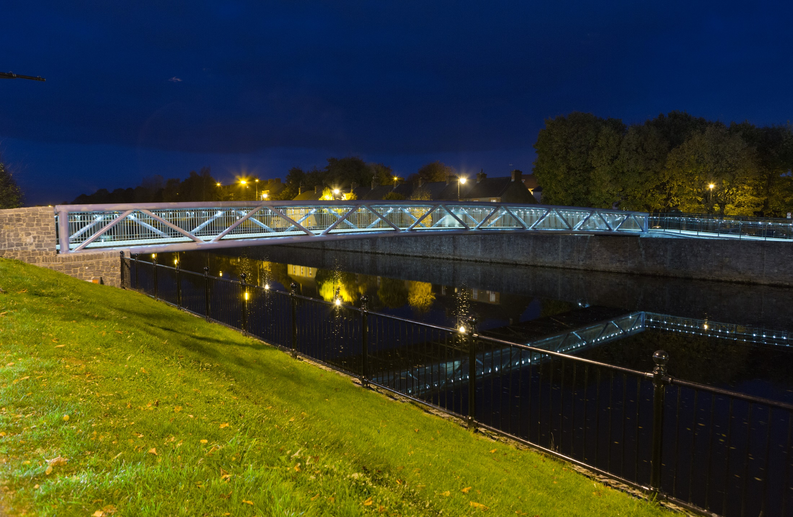
Kilkenny Streetlight LED Retrofit Pilot Project 2017
Kilkenny County Council Meeting
16th October 2017
Declan Keogh
Energy Engineer - Carlow Kilkenny Energy Agency
Energy Officer – Kilkenny County Council

Slide 2

Introduction
In April 2014 Kilkenny County Council became City Partner and Carlow Kilkenny Energy Agency acted as facilitator in the Intelligent Energy Europe Streetlight EPC project.
The aim of the project was to creating the demand and supply for Energy Performance Contracts In Ireland and across Europe
As part of this real life EPC projects were identified and carried
KCC and CKEA identified a large project consisting mainly of the declassified network in Kilkenny and other areas with inefficient lighting systems

Slide 3
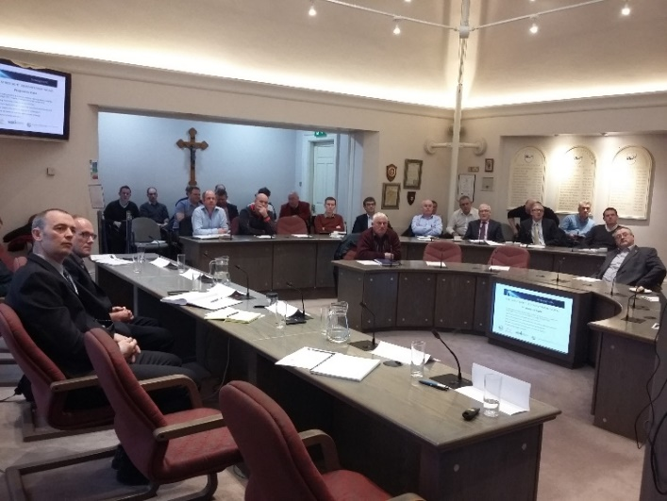
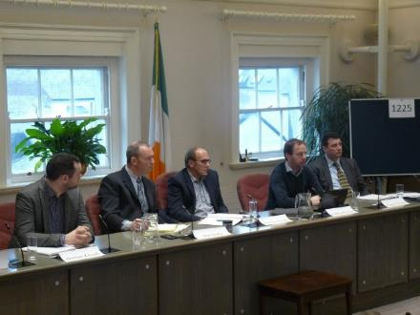
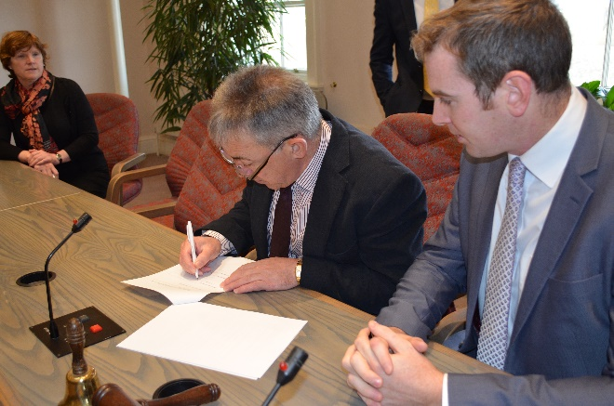
Background to the Project
  In excess of 10,000 streetlights operated by Kilkenny County Council
  Pilot project identified 1300 or 13% of the street lights in Kilkenny
  Contract procured in May and awarded in July 2017
  Project commenced in July 2017 with the ordering of lanterns (6 – 8 weeks)
  Substantial project completion October 2017
  One of largest project of its kind for streetlighting retrofit ever undertaken in Ireland

Slide 4
Implementation of Pilot Project
Inventories: Accurate inventory carried out in 2012 and revised in 2016 using the new Deadsure street light asset management to ensure efficiencies.
Auditing: Energy saving calculations were carried out based on best practice
Tendering: Two stage tender process, stage 1 design and stage 2 project implementation
Contract Preparation: developed by KCC, CKEA and appointed consultant lighting designers Hayes Higgins Partnership
Pilot Project: Model for this project being used by the RMO to prove how large scale projects can be delivered in a small timeframe informing the national context of 400,000 with each individual light having its own design characteristics.
Quality Control: Light levels (post verification) and energy savings (Implementing IPMVP protocols).

Slide 5
Benefits of an LED Streetlighting System
It reduces the number and severity of night time road accidents
It increases evening activity and promotes the evening economy
Provides a safer environment
Reduces carbon emissions and contributes to Kilkenny’s Covenant of Mayors SEAP targets
Reduces maintenance costs (LED have a lifetime of 100,000 or 20 years)
Allows KCC to use Trimming and Dimming burn profiles to generate further savings
It reduces street crime and fear of crime
It helps the emergency services and Gardaí (CCTV)

Slide 6
Project Costs and Payback
CKEA and KCC applied for grant assistance from SEAI to support the development of this project.
This grant application was successful with KCC awarded 30% towards the capital cost of the project
The project was developed in early 2017 and was tendered in May 2017 with contractors appointed in July
The total project cost is €592,000 including design, VAT and project management fees.
The grant amount expected is €195,000, balance of €395,000
The annual electricity savings to the council is €100,000
Therefore giving a simple payback for the project of <4 years

Slide 7
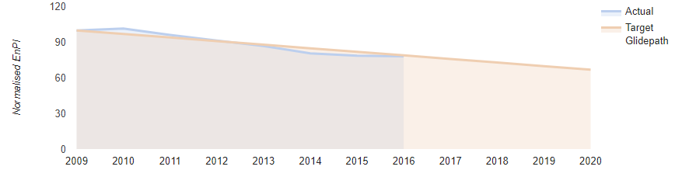
Energy Analysis and 2020 Targets
Public Sector in Ireland tasked with reducing their energy consumption by 33% from their baseline year
The baseline year for Kilkenny County Council is 2009
Currently at 22% based on 2016 figures
The pilot project will increase this by 3% to 25%

Slide 8
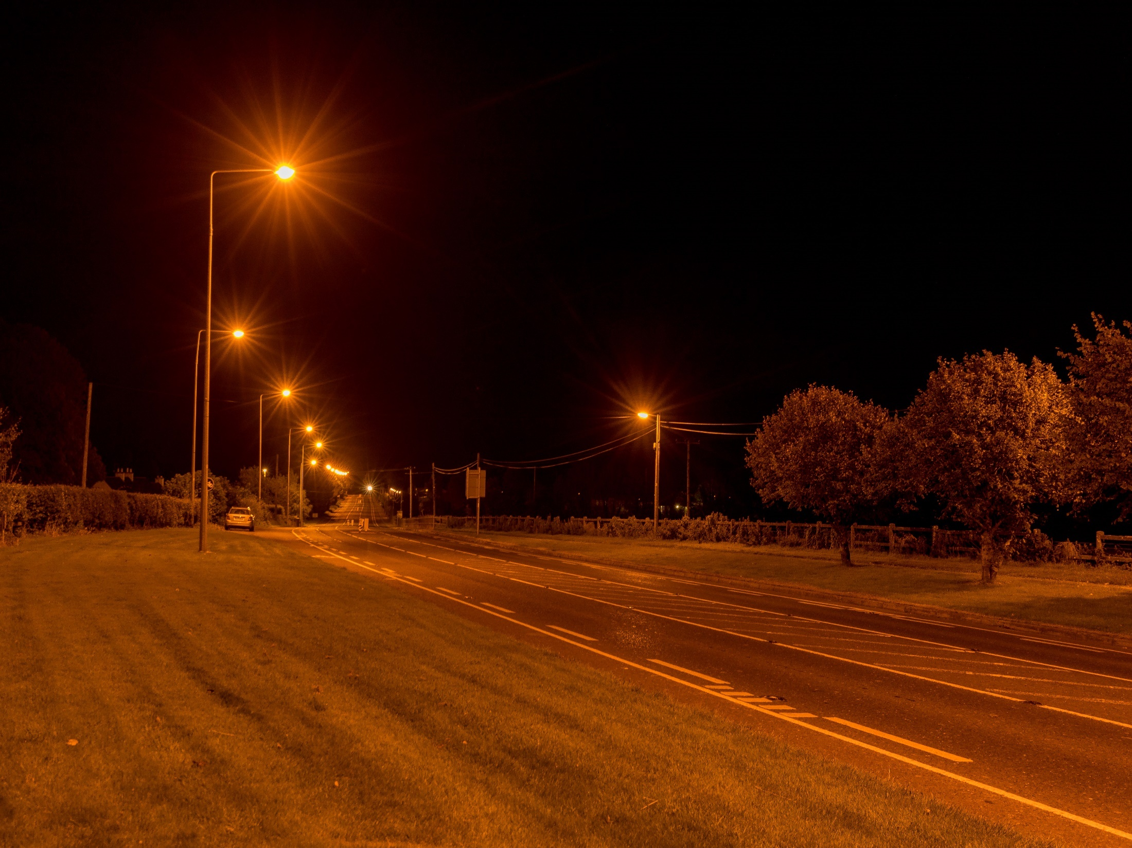

Slide 9
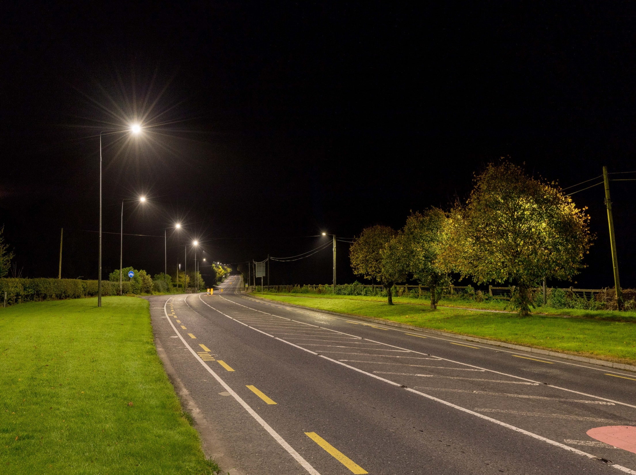

Slide 10
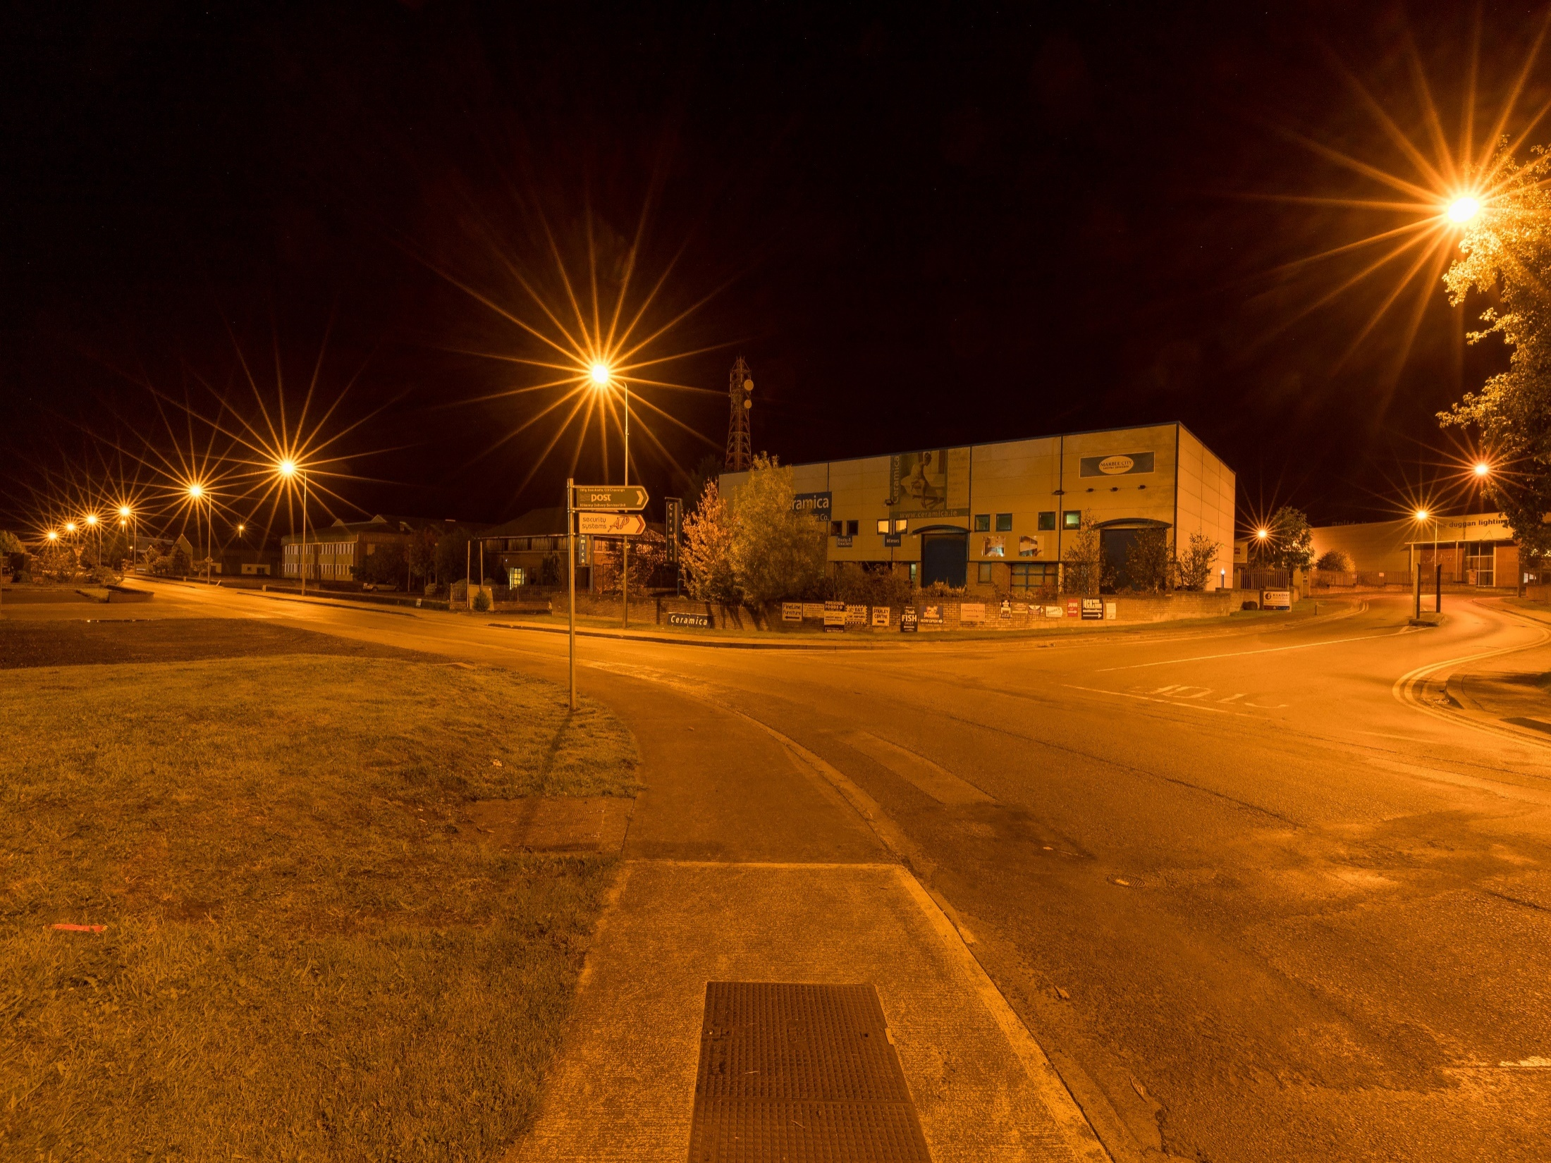

Slide 11
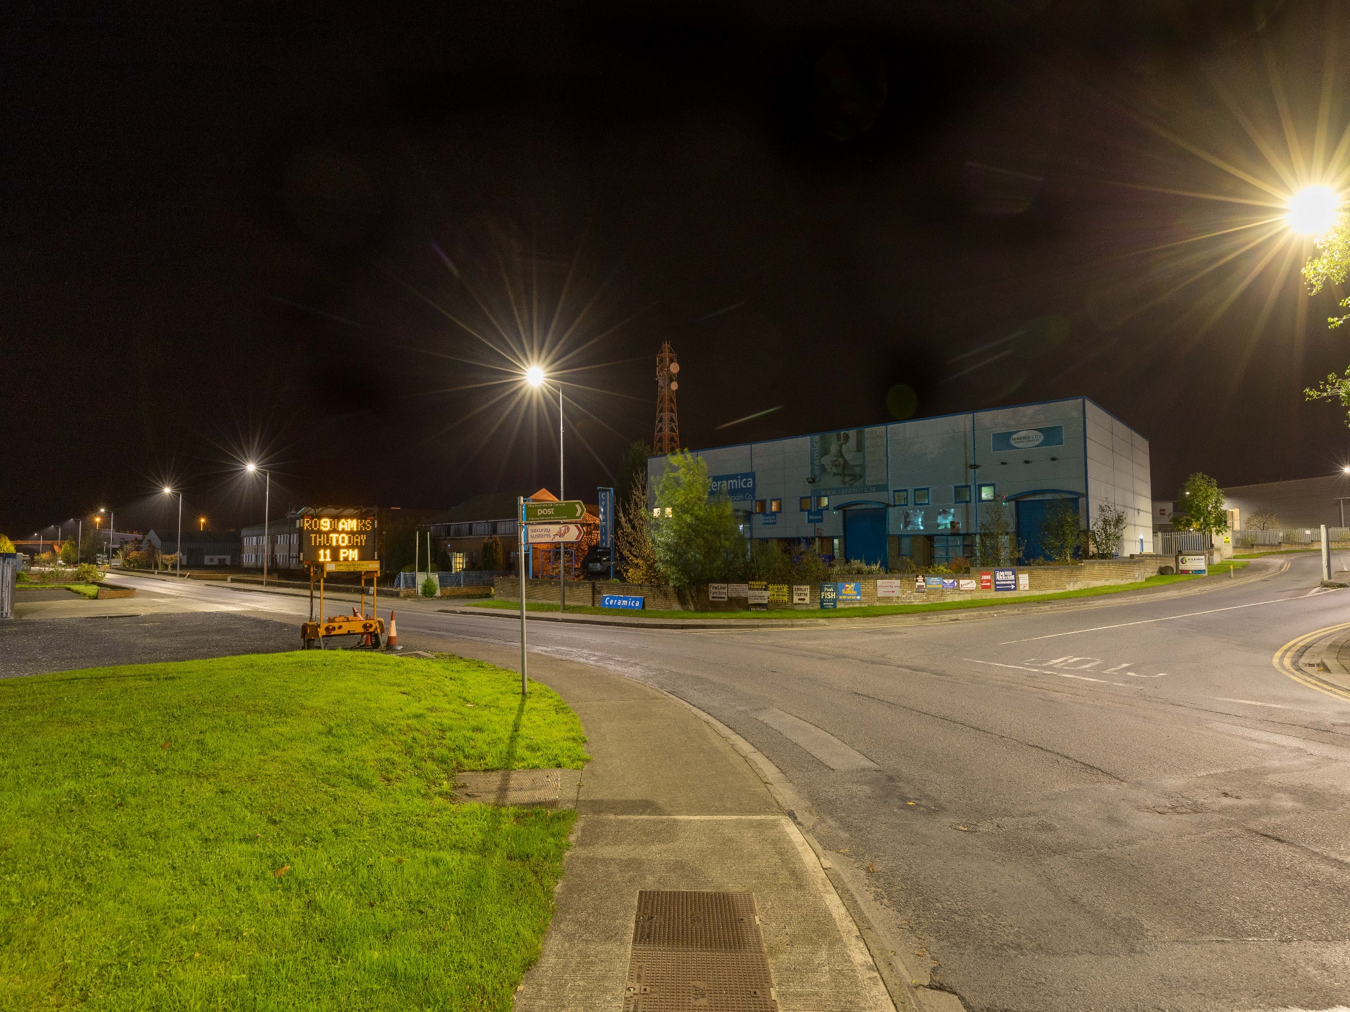

Slide 12
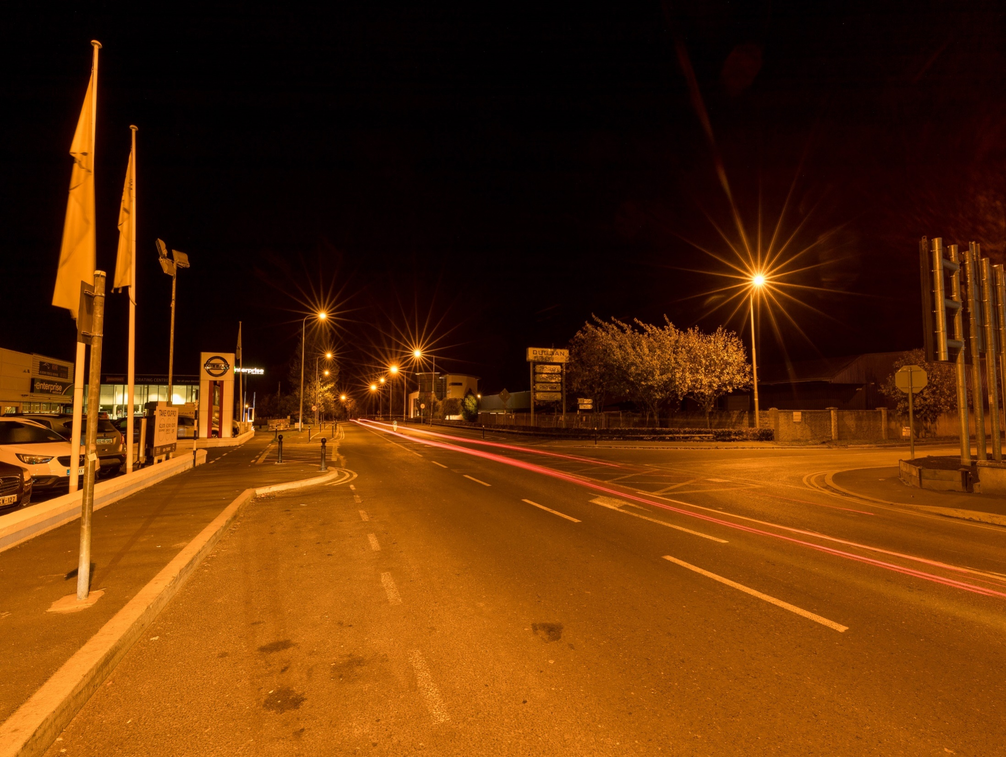

Slide 13
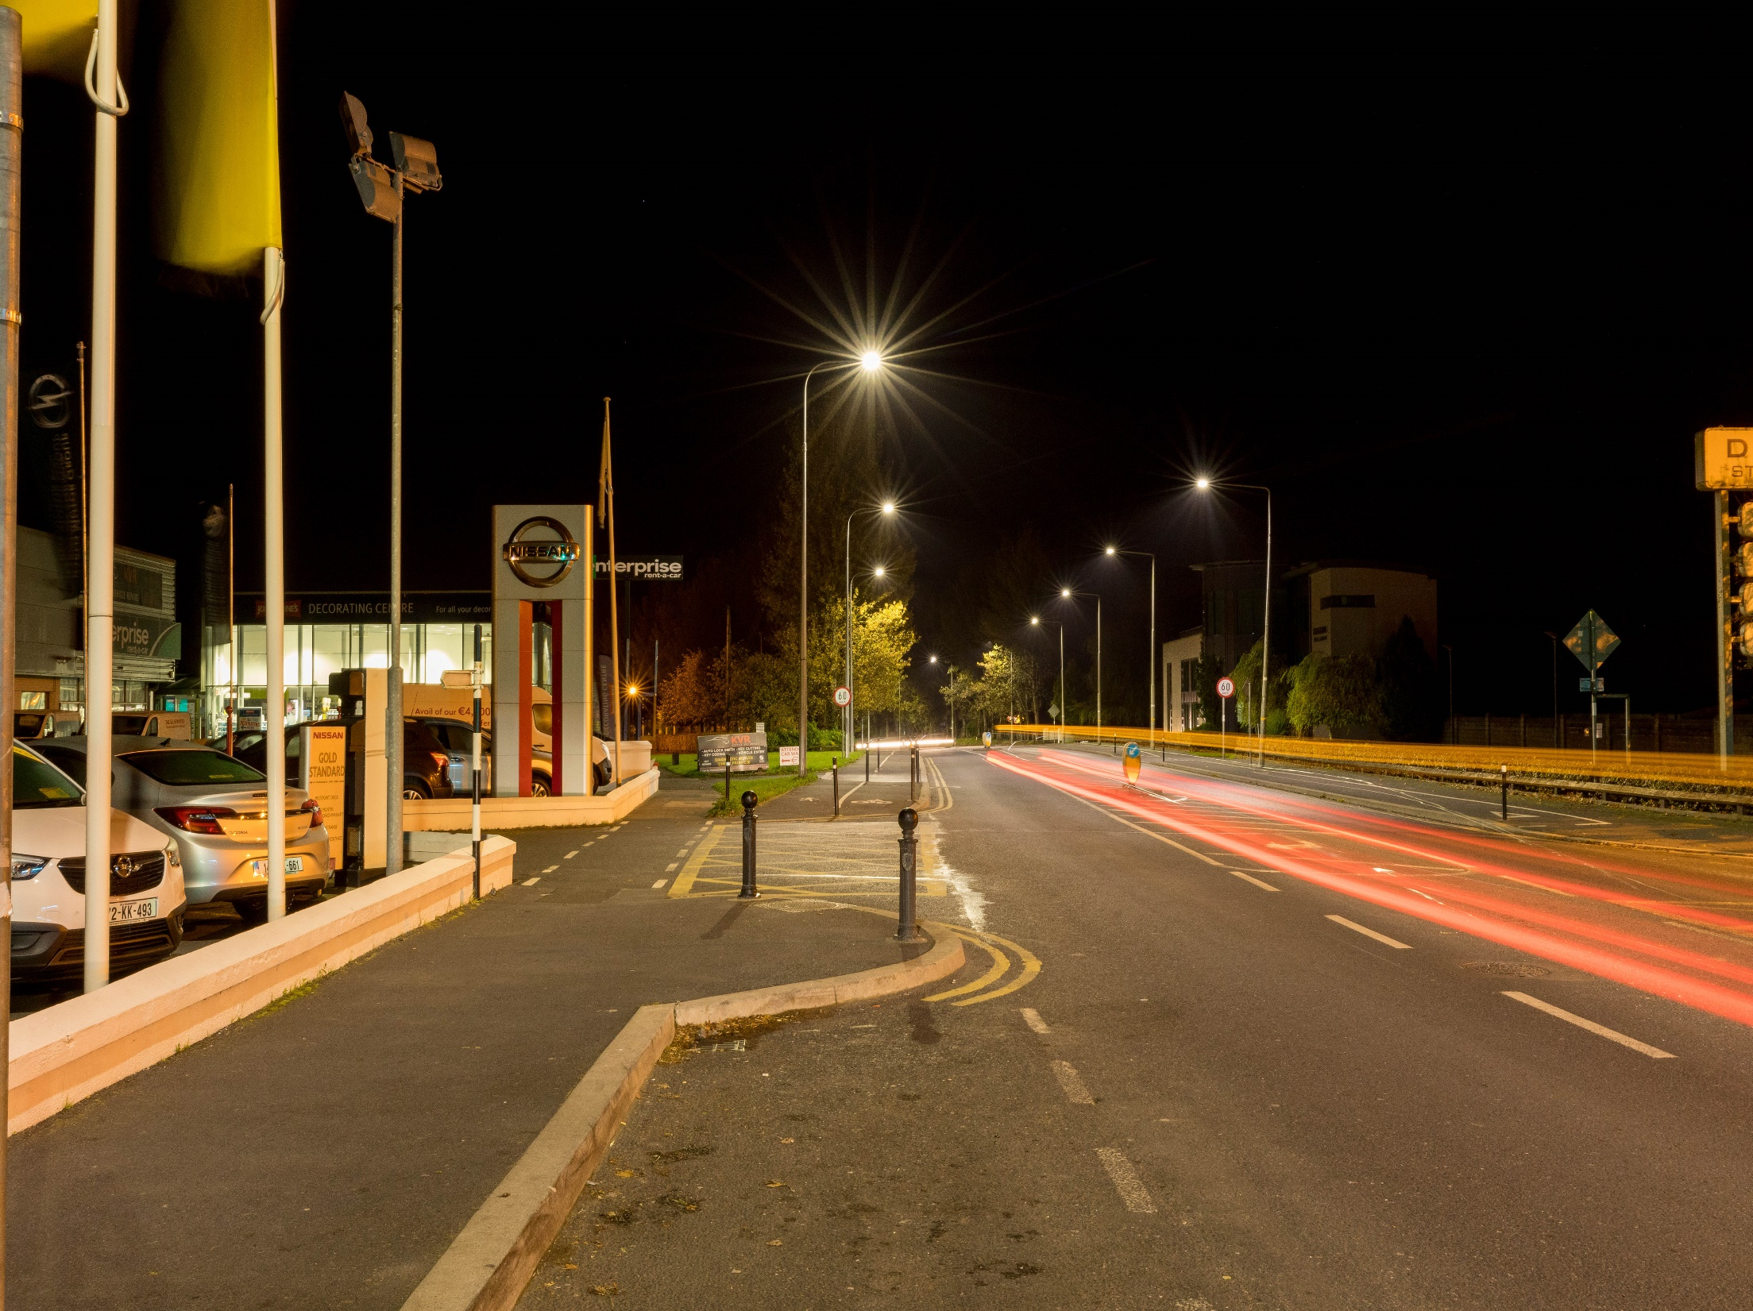

Slide 14
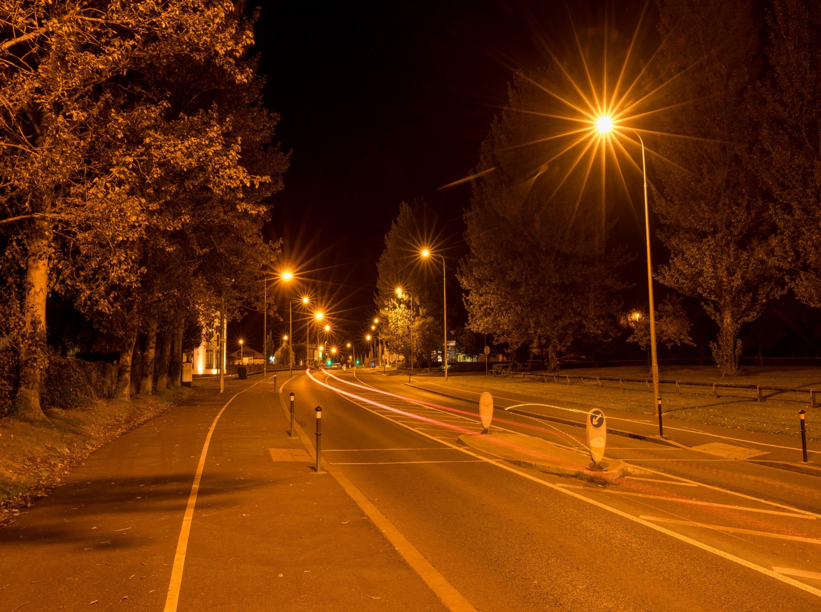

Slide 15
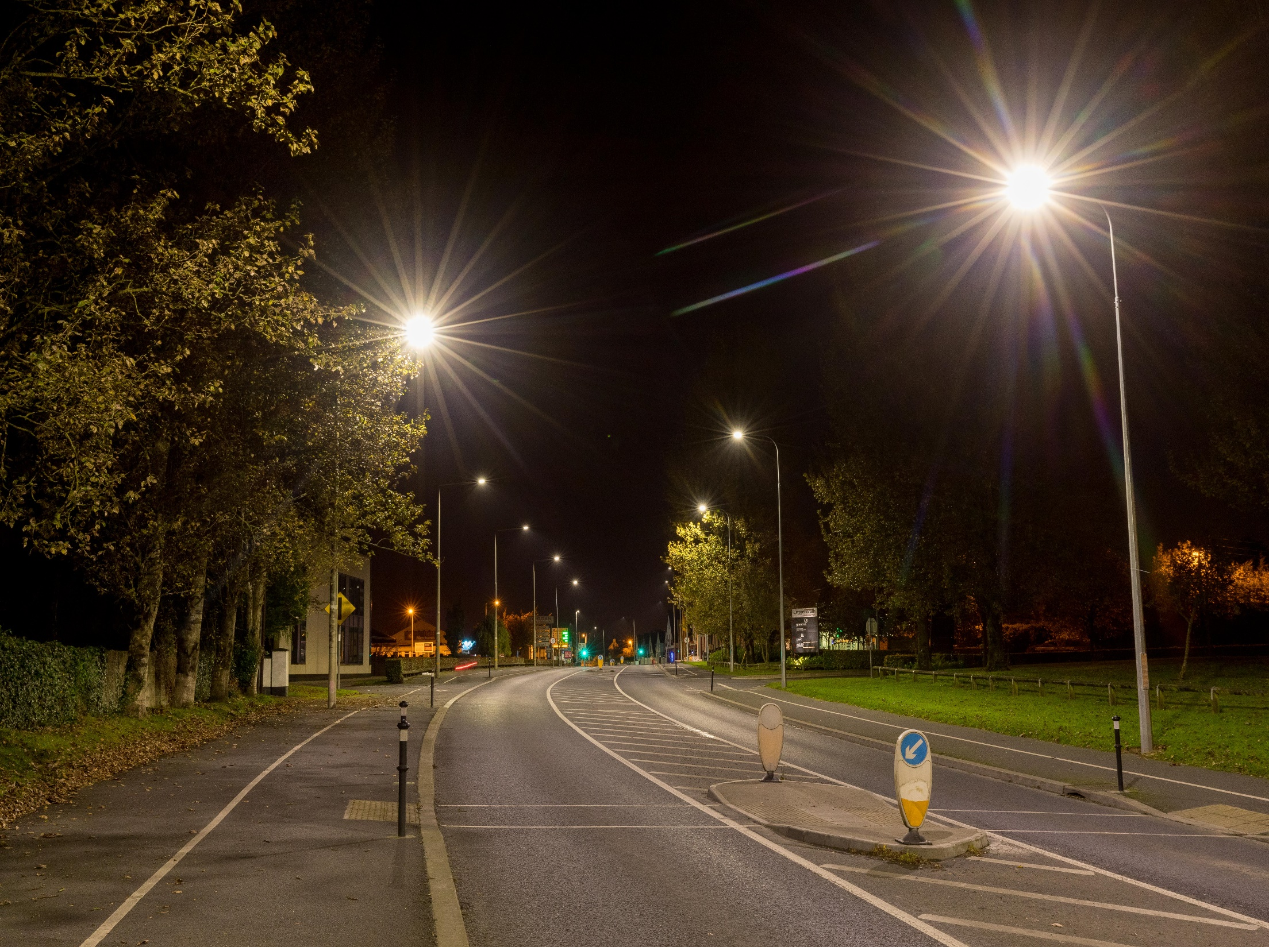

Slide 16
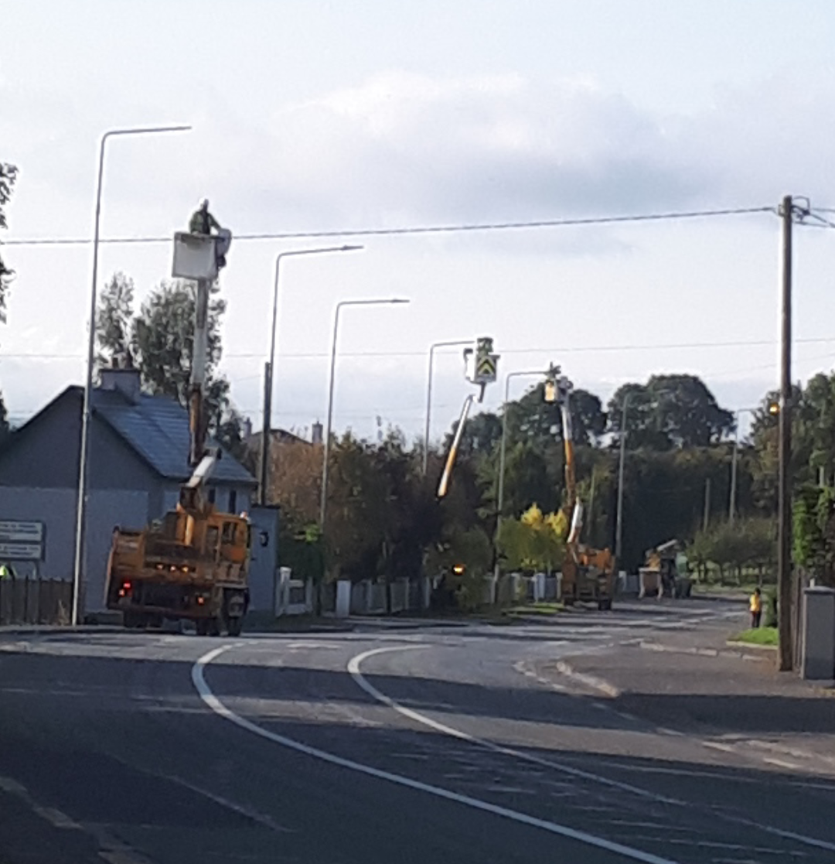
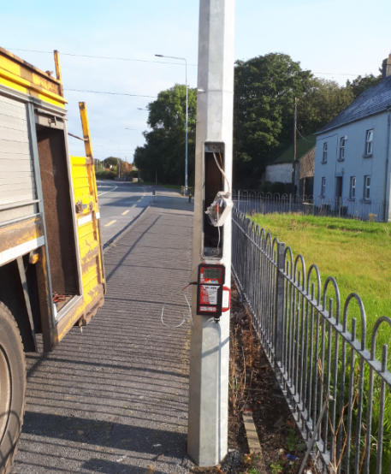
Lighting Locations
There were 29 lighting locations identified across County Kilkenny
4 Housing Estates
Industrial Estate
Main Routes through towns and villages such as Thomastown, Gowran, Urlingford, Johnstown

Slide 17
Lighting Locations
Location Number | Street Name | Location
1 | R639 (Old N8) | Johnstown
2 | R639 (Old N8) | Urlingford
3 | Gowran Road R448 (Old N9) | Paulstown
4 | R448 (Old N9) | Gowran
5 | R448 (Old N9) | Dungarvan Village
6 | R448 (Old N9) | Thomastown
7 | R448 (Old N9) | Jerpoint Abbey
8 | R448 (Old N9), R713 | Ballyhale
9 | R448 (Old N9) | Lukeswell
10 | R448 (Old N9) | Mullinavat
11 | R448 (Old N9) | Granny RAB
12 | Newrath Road (Old N9) | Newrath
13 | R712 Dublin Road | KK Environs South East
14 | R712 Castlecomer Road | KK Environs North East

Slide 18
Location Number | Street Name | Location
15 | R712 | Clara
16 | R712 | Clara
17 | Bothar Bui R712 | Paulstown
18 | Hebron Industrial Estate | KK Environs North East
19 | R705 By Pass (Brandon) | Graiguenamanagh
20 | R713 (Old N10) | Stoneyford
21 | R713 (Old N10)/R699 | Knocktoper
22 | R711 (Old N25) | Waterford Environs
23 | Beech Court | Castlecomer
24 | O’Loughin Court | KK Environs North East
25 | Clonmore Hall | Piltown
26 | Friars Hill | Thomastown
27 | R448 Newrath RAB, R861, | N25 Bypass
28 | R693 Freshford Town | Freshford
29 | Kilkenny City Environs | KK City

Slide 19

Energy Efficiency Obligated Scheme (EEOS)
Energy suppliers must support energy efficiency projects in residential and non residential sectors across Ireland
The energy savings from the streetlight project was sold to Lissan Coal Company, this funding goes back into community projects
As streetlighting is part of the transport directorate, we are currently carrying out a feasibility study on the energy credit funding going to support the purchase of an electric van for Meals on Wheels community in Kilkenny

Slide 20
TII National Route - Energy Upgrade 2017
Applied to Transport Infrastructure Ireland (TII) to fund the energy retrofit of lighting on the N77
Designer appointed and project procured in August
Contractor appointed in October, with project due for completion in November/December
Project is 100% funded from TII
310 high intensity lights from Castlecomer Road Roundabout to Dublin Road Roundabout being changed to low energy LED
Energy saving of approximately 67% or 231,782kWh with a payback of 4 years.
This project will also increase our energy targets by 1.5%
Roads Office are currently identifying projects for 2018 if funding becomes available from TII

Slide 21
Progress to 2020
Need to implement the investment strategy in energy efficiency and renewable energy projects across the local authority to meet 2020 targets
Buildings: Corporate, Libraries, Depots, Machinery Yards, Fire Stations
  Lighting
  Heating
  Fabric Upgrades
  Renewable Energy
Transport: Driver training, electric vehicles, newer energy efficient local authority vehicles
Streetlighting: Continue retrofit programme into 2018, 2019, 2020 to meet the 2020 targets

Slide 22
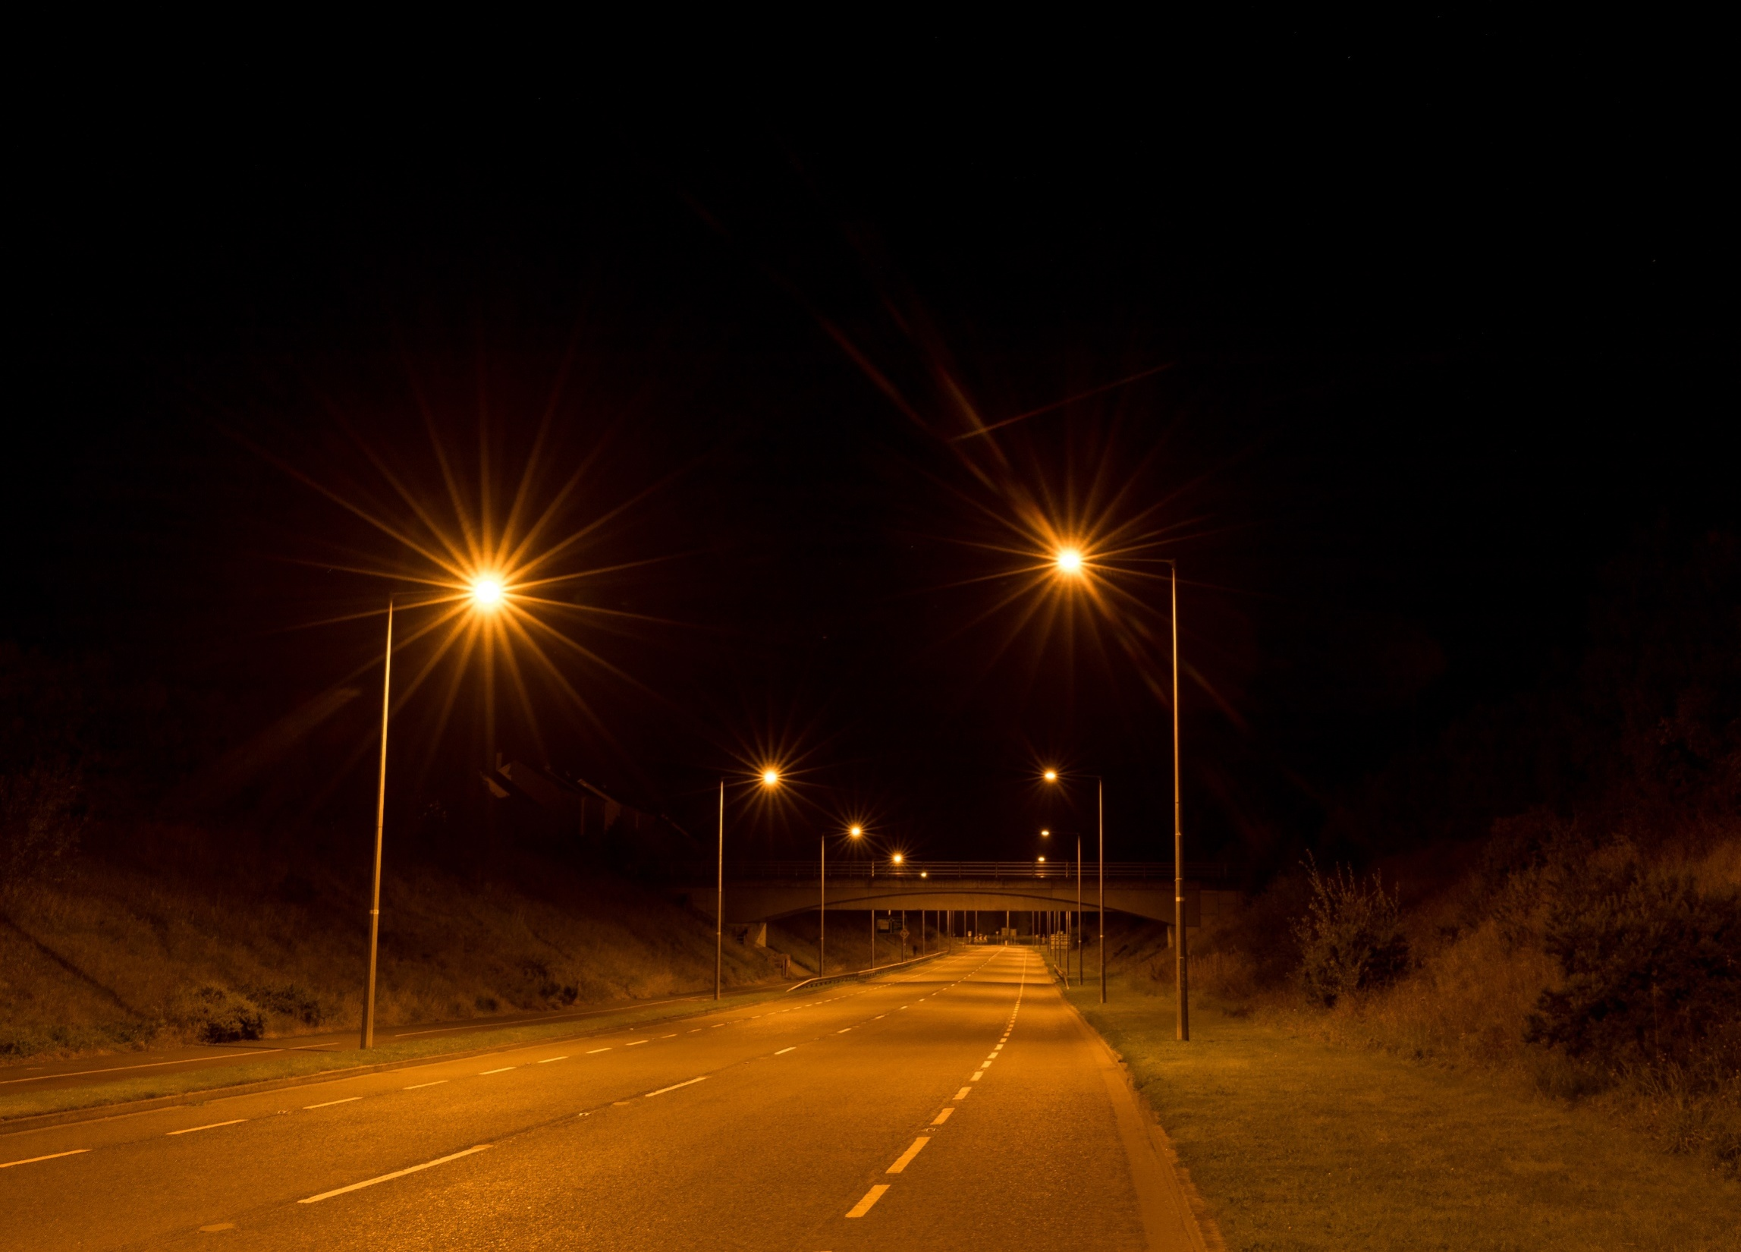
Thank you for your time
Declan Keogh

