Slide 1
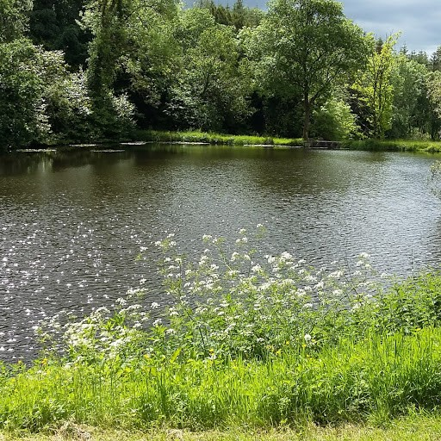
Local Authority Waters Programme - Update
Kilkenny County Council
15th October, 2018

Slide 2
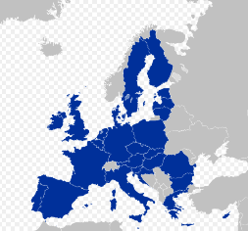
Background
The Water Framework Directive 2000/60/EC
European Parliament and Council in October 2000
‘A framework for community action in the field of water policy’ – information, consultation, active involvement
To protect and restore ‘healthy waters’ in rivers, lakes, estuaries, groundwater and coastal areas
Overall aim: “to achieve good ecological status in all waters”
Drivers: Social and economic benefits of healthy waters

Slide 3
Water Framework directive
River Basin Management Plans (RBMPs)
Programmes of Measures (PoMs)
Six year cycles
1st cycle
2009 -2015
2nd cycle
2016 -2021
3rd cycle
2021 -2027
Step 1 - Catchment Characterisation – defining the problems
Step 2 - Plan & Measures – setting targets and programmes
Step 3 - Implement Measures – delivering improvements
Step 4 - Monitor and Evaluate – gather data and information
Step 5 - Report to EC – summary of progress and outcomes
Notes:
The Water Framework Directive requires River Basin Management plans and Programmes of Measures to be developed and implemented in six year cycles.

Slide 4
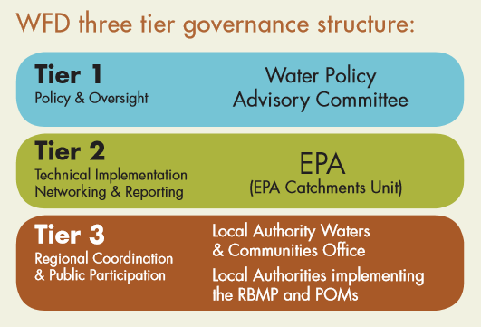
New governance structure
2014 EU Water Policy Regulations (S.I. No. 350 of 2014)
Competent authorities for WFD: Minister, EPA, Local Authorities
Greater responsibilities on Local Authorities
Minister: Water Policy
EPA: Science - Plan and Measures
Local Authorities: Co-ordination of Implementation, Public Engagement,
Advice to Minister, Support to EPA
Local Authority Waters Programme
Communities Office
Catchment Assessment Teams
Notes:
A new governance structure has been put in place for WFD implementation with greater responsibilities placed on the Minister, the EPA and Local Authorities.
With ultimate responsibility with the Minister.

Slide 5
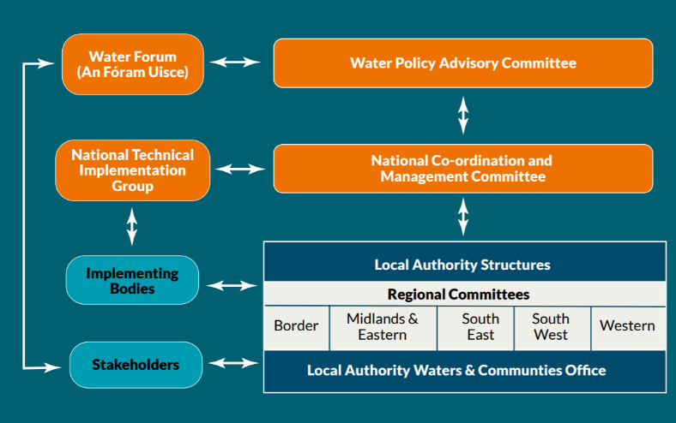
WFD Implementation Structure
Local Authority Waters Programme
Notes:
A new structure has been established to implement this cycle of the River Basin Management Plan. With formal arrangements for cooperative working relationships and knowledge transfer between Local Authorities, agencies and stakeholders.

Slide 6
Local Authority Waters Programme
National Lead
Communities Office
12 Community Water Officers
Regional Coordinators
Catchment
Assessment Teams
5 Catchment Managers
30 Catchment Scientists
(10 Locations)
31 Local Authorities
LA Waters Programme
Kilkenny & Tipperary Co. Cos.
Notes:
National Local Authority Structure for Implementation

Slide 7
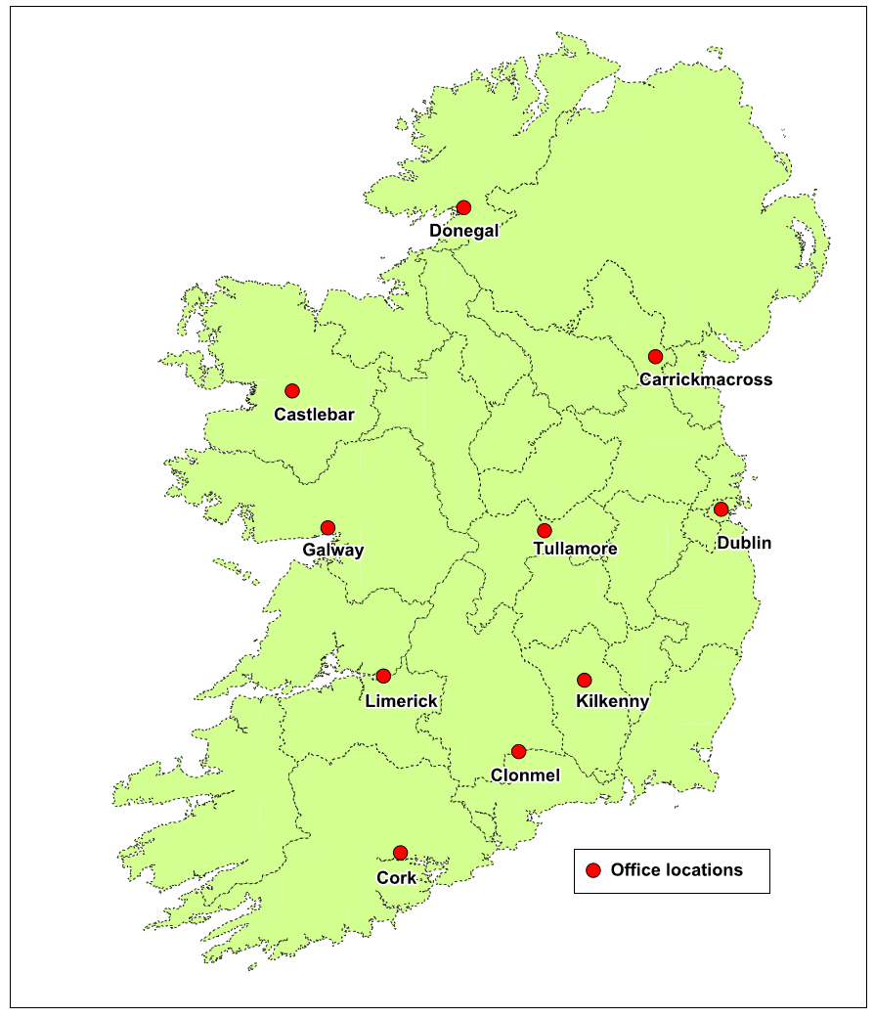
Catchment Assessment Teams
5 Regional Teams
Border
Midlands East
South East
South West
West

Slide 8
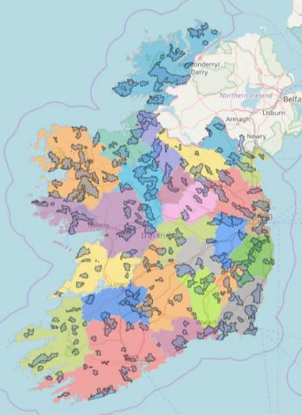
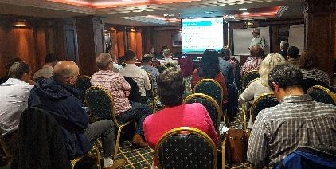
Priority Areas for Action (PAAs)
5 Regional Catchment Characterisation Workshops in 2017
Built on EPA evidence
All 31 Local Authorities
All relevant public agencies
Expert local knowledge and discussion
190 Priority Areas for Action identified
For more information see www.watersandcommunities.ie
Notes:
During the development of this Plan, a prioritisation exercise was undertaken by the local authorities, the EPA, agencies and other stakeholders to identify those water bodies that require immediate action within this plan cycle to 2021.

Slide 9
Water Policy Advisory Committee (WPAC)
European Union (Water Policy) Regulations 2014 (SI 350 of 2014)
Chaired by Assistant Secretary in DHPLG
Other members include:
DAFM, DCHG, DH
Environmental Protection Agency (EPA)
CCMA
OPW
GSI
Irish Water
Inland Fisheries Ireland (IFI)
HSE
Commission for Regulation of Utilities (CRU)
Such other organisation or body as the Minister may determine from time to time
Notes:
Culture Heritage & Gaeltacht

Slide 10
National Co-ordination and Management Committee (NCMC)
DHPLG
EPA
LAWPro
Chairs of 5 Regional Management Committees
Local Authority Chief Executives
including Colette Byrne

Slide 11
An Fóram Uisce Chair: Dr. Tom Collins
Statutory body, established in 2018
National Stakeholder Forum
Remit includes public water, rural water, natural waters
Approx. 30 members representing various sectors
Nominated from approx. 50 organisations
Agricultural & Forestry Sectors
Angling
Business and Tourism
Community & Voluntary Pillar
Consumer Protection
Disability Sector
Education
Environment Pillar
Fisheries / Aquaculture
Irish Water Consumers
Rivers Trusts
Rural Water
Trade Unions
Water Sports & Recreation

Slide 12
National Technical Implementation Group (NTIG)
Chaired by EPA
Membership
WFD Implementing Bodies
Role
Oversee technical implementation of the RBMP at a national level
Provide a forum to co-ordinate actions among relevant bodies
Address any operational barriers to implementation
Forum for information exchange
Promote consistent regional implementation

Slide 13
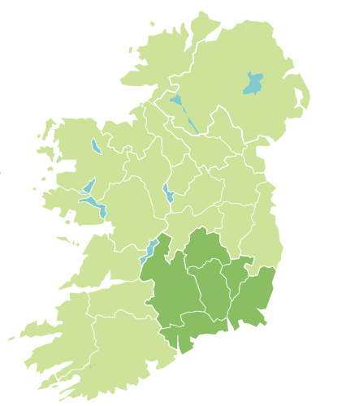
South East Region
6 Counties
Carlow, Kilkenny, Laois, Tipperary, Waterford, Wexford
Management Committee
Chair Colette Byrne
Directors of Service
EPA
Operational Committee
Chair John Carley (Wexford CC)
Local Authorities, Public Bodies

Slide 14
South East Team – who we are
Ruth Hennessy
Sinéad Barrett
Seamus O’Brien
Brian Casey
Michael Nugent
Philip Murphy
Stephen Davis
Tipperary Office
(Clonmel)
Kilkenny Office (Dean Street)
Environmental Scientists, Ecologists, Biologists, Agricultural Scientists
Notes:
In the south west:

Slide 15
South East Team – who we are
Ruth Hennessy
Sinéad Barrett
Seamus O’Brien
Brian Casey
Michael Nugent
Philip Murphy
Stephen Davis
Carol McCarthy
Ann Phelan
Tipperary Office
(Clonmel)
Kilkenny Office (Dean Street)
Environmental Scientists, Ecologists, Biologists, Agricultural Scientists
Notes:
In the south west:

Slide 16
Where we will be working
Notes:
Headwaters First
Many southern waterbodies are at review rather than at risk
KCC has targeted Kings River and the River Pil in 2018

Slide 17
SE Schedule
2018 | 2019 | 2020 | 2021
Athy Stream | Bannow | Aherlow | Ballyroan
Clashawley | Blackwater (Wexford) | Ara | Borrisoleigh
Clodiagh (Portlaw) | Burren | Ballyfinboy (Upper) | Brownstown (Pococke)
Dinin (South, Main & Muckalee) | Colligan-Bricky | Breagagh (Kilkenny) | Bunow
Owveg (Nore) | Derreen and Douglas (Kiltegan) | Drumcomoge | Dead and Cauteen
Sow | Derry-Coolboy-Rosnastraw | Glenaboy | Dunhill
Tay | Drumcomoge | Graney-Lerr | Inch (Bilboa)
 | Duiske | Johns | Licky
 | Erkina | Lingaun | Little Brosna _040
 | Lower Nenagh and Clareen | Owenavorragh | Lorrha Stream
 | Mountain | Urrin | Toem and Cappawhite
 | Nuenna | Waterford Harbour
 | Slaney | Wexford coastal lagoons
 |  | Wexford Harbour
Notes:
Draft schedule for action in PAAs. Time taken will depend on findings in each Area.

Slide 18
SE Schedule
2018 | 2019 | 2020 | 2021
Athy Stream | Bannow | Aherlow | Ballyroan
Clashawley | Blackwater (Wexford) | Ara | Borrisoleigh
Clodiagh (Portlaw) | Burren | Ballyfinboy (Upper) | Brownstown (Pococke)
Dinin (South, Main & Muckalee) | Colligan-Bricky | Breagagh (Kilkenny) | Bunow
Owveg (Nore) | Derreen and Douglas (Kiltegan) | Drumcomoge | Dead and Cauteen
Sow | Derry-Coolboy-Rosnastraw | Glenaboy | Dunhill
Tay | Drumcomoge | Graney-Lerr | Inch (Bilboa)
 | Duiske | Johns | Licky
 | Erkina | Lingaun | Little Brosna _040
 | Lower Nenagh and Clareen | Owenavorragh | Lorrha Stream
 | Mountain | Urrin | Toem and Cappawhite
 | Nuenna | Waterford Harbour
 | Slaney | Wexford coastal lagoons
 |  | Wexford Harbour
November 2018
Notes:
Public Meeting for the Dinin River PAA will be held in November.

Slide 19
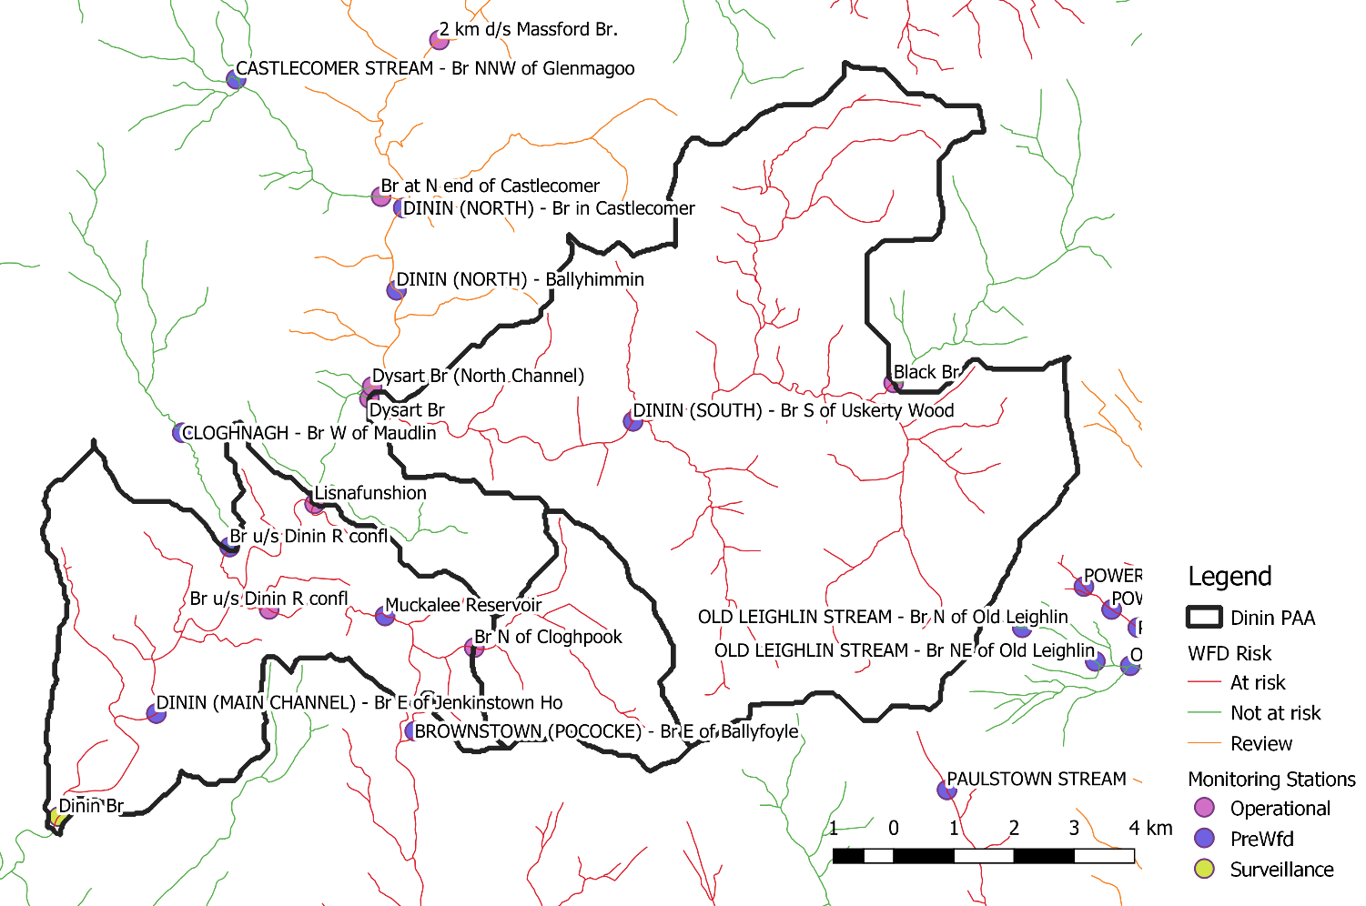
Dinin River

Slide 20
Dinin River
Three Waterbodies
Pressures
Agriculture, Forestry, Quarries, Other
Reasons for selection
At Risk, 3 deteriorated waterbodies
Active community groups
Important for Salmon spawning
3 Potential quick wins
1 WB has a High Ecological Status objective

Slide 21
What we will be doing
Further local assessments of the 190 priority Areas for Action
Local community meetings prior to further catchment assessments
Collaborative approach with stakeholders, agencies and LAs
Working with industry, farmers and local stakeholders to find local solutions

Slide 22
Free Support Service for Agriculture
Agricultural Sustainability Support and Advice Programme (ASSAP)
Government / Industry collaboration
Funded by DHPLG, DAFM and Dairy Co-ops
Supported by Farm Organisations
30 Advisors
20 based in Teagasc
10 based in Co-ops (Glanbia, Kerry, Dairygold, Aurivo, Arrabawn, Carbery, Lakeland, Lacpatrick, North Cork, Tipperary)
Working in partnership with Local Authority Catchment Assessment Teams

Slide 23
ASSAP Team – SE Region
National Programme Manager – Noel Meehan
Deirdre Glynn (Teagasc – Kilkenny)
Eamonn Grace (Teagasc – Wexford)
Vin O'Connor (Teagasc – Carlow)
Claire Mooney (Teagasc – Nenagh)
Cathal Somers (Teagasc – Waterford)
Fiona Doolan (Teagasc – South Kildare/Laois)
Emma O'Grady (Glanbia)
Paddy Purcell & Jerry Ryan (Arrabawn)
Paul Fortune (Tipperary Co-Op)

Slide 24
WFD – South East Team

Slide 25
Next Steps 2018-2021
PAA
Public meeting
LA Waters Programme
River surveys
ASSAP
Farm engagement
LA Waters Programme
Stakeholder engagement
Identify suitable measures & implement
Desk Study
Update info
Notes:
The Local Authority Waters Programme will hold a public meeting in each of the Priority Areas for Action between now and 2021.
Following that the scientific staff will carry out surveys and assessments in rivers and waters in that PAA. The ASSAP team (Agriculture Sustainability Support and Advice Programme) will be engaging with farmers through knowledge transfer sessions and one-to-one meetings to develop farm plans for farmers in vulnerable areas. LA Waters Programme staff will also work with other stakeholders in the catchment to identify issues and solutions. Ultimately a programme of measures required to tackle water quality pressures will be identified for each area.

Slide 26
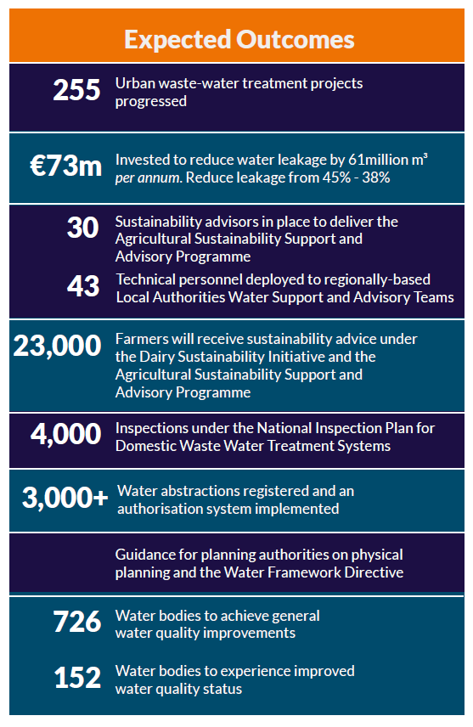
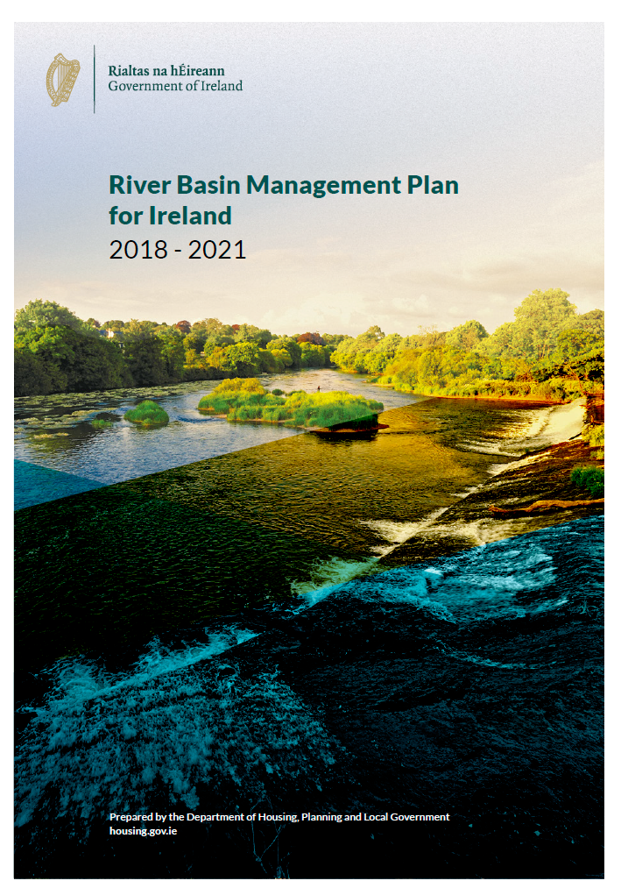
Expected outcomes over the life of the RBMP
Notes:
Based on information set out in the plan, it is expected that the following will be achieved over the period up to 2021.

Slide 27
Key Strategic Aims 2018 - 2021
Take a collaborative approach
Build a foundation and momentum for long-term improvements
Develop regional work programmes for implementation by local authorities and agencies working together
Underpin effective implementation through the new governance structures
Support community led projects and initiatives
Better approach to water quality management both locally and nationally – “The right measure in the right place”

