Slide 1
Severe Weather & Storm Emma 28th Feb – 5th March 2018
Tim Butler
DOS 9th March 2018

Slide 2
Content
Preparations
Severe weather
Road clearance
Voluntary and other assistance received
Learning

Slide 3
Early Warning
Weather Advisory Note from MET Eireann 23rd February, 2018
Email from National Directorate of Fire & Emergency Services
Severe cold for 27th Feb to 2nd March with significant snow and blizzard like conditions – later extended out to 5th March
Significant disruption to transport, education, water & waste water infrastructure envisaged
LA’s to consider activation of Severe Weather Teams
Second Code Red Weather Alert in 5 months

Slide 4
Local Preparations
Email sent to Principal Response Agencies (PRA’s) – HSE, Gardaí, Defence Forces, Civil Defence, Fire Services
Contact with internal staff – Crisis Management Team, Area Engineers, Water Services, IT, Environment, Housing
Set up Call Centre with dedicated phones and laptops
Salt roads in accordance with Winter Maintenance Plan
Review of salt stocks

Slide 5
Local Preparations
Preparation for treatment of Priority 3 Routes during severe weather
Contact IFA Re: grit at strategic locations throughout the County
Press release to local media
Distributed copies of Be Winter Ready to Council Offices, Libraries,
Messages on Social media Re: travel, neighbours, “Be Winter Ready”,
Extreme Weather Strategy implemented by Housing
Teleconference with PRA’s from South East
Severe weather Response Plan put into effect 27th February, 2018

Slide 6
Snow / Severe Cold
February 27th & 28th – snow showers and significant cold
Snowfall Kilkenny City 15 – 20 cm over the three days
Roads & footpaths in treacherous condition
March 1st, 2nd & 3rd persistent snow showers with drifts mainly in North, East and South of County
Drifts of up to 2.5m in places
Extremely difficulty driving and walking conditions with many rural roads impassable
Significant homes in rural areas cut off

Slide 7
The Effects
Difficulties in accessing hospital and care facilities
Critical routes and motorway impassable in certain areas - N24, N25, N29, N8
M9 drivable with care only one lane open
Access for emergency personnel to work and for emergency vehicles
Care staff and home help to access patients
Access to workplace for critical staff nursing, fire services
Dialasis patients

Slide 8
The Effects
Access to Dairy farms
Access to farm animals
Good Shepherd Centre full to capacity
Access to water and waste water plants problematic
Need to conserve water supplies
Housing maintenance calls – frozen pipes and heating
Difficulties to salt / plough roads in heavy snow showers

Slide 9
Call Centre and Out of Hours Emergency
Total Calls |  | Roads | Other
28/02/2018 | 19 | 4 | 15
01/03/2018 | 14 | 0 | 14
02/03/2018 | 34 | 11 | 23
03/03/23018 | 108 | 77 | 31
04/03/2018 | 16 | 10 | 6
05/03/2018 | 1 | 0 | 1
Total | 192 | 102 | 90

Slide 10
Salt
Priority 1 & 2 Routes
15 Runs of salt on 28th February to 6th March 2018
620 tonnes of salt spread
12 runs with Snow Ploughs
4 drivers on call and 4 on relief
Priority 3 Routes
370 tonnes of salt spread
Total Tonnage = 990

Slide 11
Machinery Yard

Slide 12
Snow Ploughs

Slide 13
Clearing the Roads
Concentrating on priority routes
Significant disruption on N25 and N29 – cars abandoned
Urgent access required to salt depot in Belview
Castlewarren, Coon, Coppenagh, Tullagher, Clogh amongst the worst with drifts plus any other higher ground
Loading shovels required in these areas
Link roads from Castlecomer to Ballyragget and Mullinavat to Listerlin particularly difficult
By Sunday evening roads passable with care apart from critical areas
Monday evening most roads passable but on single lane only

Slide 14
Own & Contractor Plant
Own & Contractor Plant
 | Kilkenny & Envs | Castlecomer | Piltown | Thomastown | Total
03/03/2018 | 5 | 16 | 7 | 13 | 41
04/03/2018 | 0 | 12 | 7 | 13 | 32
05/03/2018 | 1 | 12 | 10 | 6 | 29

Slide 15
Revanagh
Castlewarren to Coolgreany

Slide 16
Coppanagh

Slide 17
Graiguenamanagh

Slide 18
Piltown

Slide 19
Deployment of Staff
Staff
 | Kilkenny & Environs | Castlecomer | Piltown | Thomastown | Total
03/03/2018 | 28 | 24 | 16 | 15 | 83
04/03/2018 | 0 | 21 | 20 | 15 | 56
05/03/2018 | 5 | 24 | 24 | 18 | 71

Slide 20
Kilkenny City

Slide 21
Kilkenny City Urlingford

Slide 22
Assistance Civil Defence
Civil Defence
51 Calls
29 transport of dialysis patients and care staff
1 house call
3 jeeps
5 personnel
On standby for Wexford County Council

Slide 23
Civil Defence

Slide 24
Assistance Defence Forces
Defence Forces
36 assists in Kilkenny
4 footpath clearance
32 transport of staff / ration

Slide 25
Defence Forces Totals South East
Personnel
Date | Number of requests received | Number of requests dealt with | Type of request | No. of Personnel deployed
28-Feb-18 | 4 | 4 | Footpaths, Meals on wheels | 50
01-Mar-18 | 11 | 11 | HSE Patient/Staff Transfers, Meals on wheels | 20
02-Mar-18 | 11 | 11 | HSE Staff/Patient Transfers | 20
03-Mar-18 | 19 | 19 | HSE Staff Transfer, Clear Footpaths | 40
04-Mar-18 | 14 | 14 | HSE Staff Transfer, Fill sandbags | 50
05-Mar-18 | 1 | 1 | Clear Footpaths | 18

Slide 26
Defence Forces Total South East
Transport
Date | No. of Vehicles used | No.of Personnel deployed
28-Feb-18 | 5 | 20
01-Mar-18 | 5 | 20
02-Mar-18 | 5 | 20
03-Mar-18 | 5 | 20
04-Mar-18 | 5 | 20
05-Mar-18 | 4 | 16

Slide 27
Defence Forces

Slide 28
Fire Service
All stations on standby in Stations 3pm 1st March to 6pm 2nd March during Red Weather Alert
7 Call – outs during the period including 2 RTA’s, 1 House fire and 4 other incidents
Assistance to clear footpaths in Castlecomer, Freshford, Callan, Kilkenny, Graiguenamanagh, Urlingford and Thomastown
Made courtesy calls to vulnerable people in certain towns also

Slide 29
Fire Services

Slide 30
Other assistance
IFA, local farming and communities – assistance to clear local roads.
Gritting of roads in certain areas by IFA members
Transport by neighbours and other groups of people and supplies
Calls by neighbours / vulnerable citizens
General public heed warnings to stay in during Red Weather Alert
Early closure of schools, business and public offices lessened the traffic on roads and helped avoid any major incidents

Slide 31
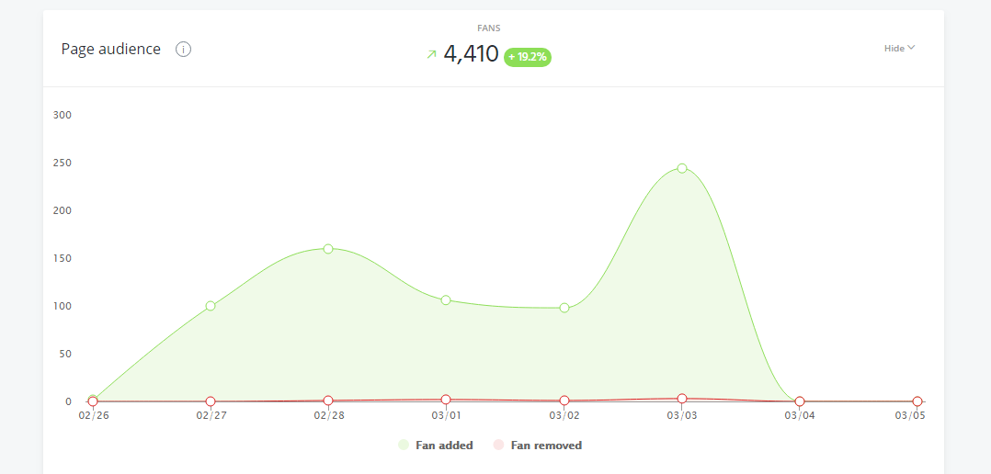
FACEBOOK LIKES – GROWTH OVER PERIOD OF WEATHER EVENT

Slide 32
TWITTER – FOLLOWER GROWTH DURING SNOW EVENT

Slide 33
TWEETS PUBLISHED - STATISTICS
Tweets published
Tweets
Number of tweets you've published.
110
+1.4K%
Text
43
Links
50
Photos / Videos
17

Slide 34
FACEBOOK POSTS PUBLISHED - STATISTICS
Posts published
Posts
Number of posts you've published.
83
+730%
Photos
19
Videos
2
Links
40
Status updates
22
Total Post
83

Slide 35
WEBSITE NOTICES PUBLISHED - STATISTICS
54 ARTICLES PUBLISHED
44,654 web page views
62% of visitors were new visitors to the website
388,000 number of facebook impressions
189,000 number of twitter impressions

Slide 36
Next Step
Review and Learning from both Severe Weather Events

