Slide 1
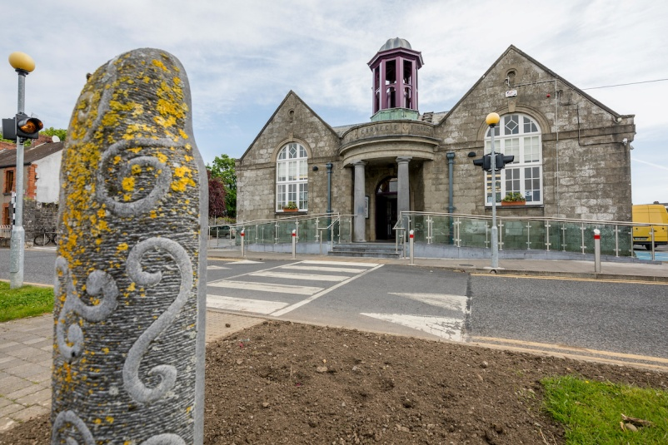
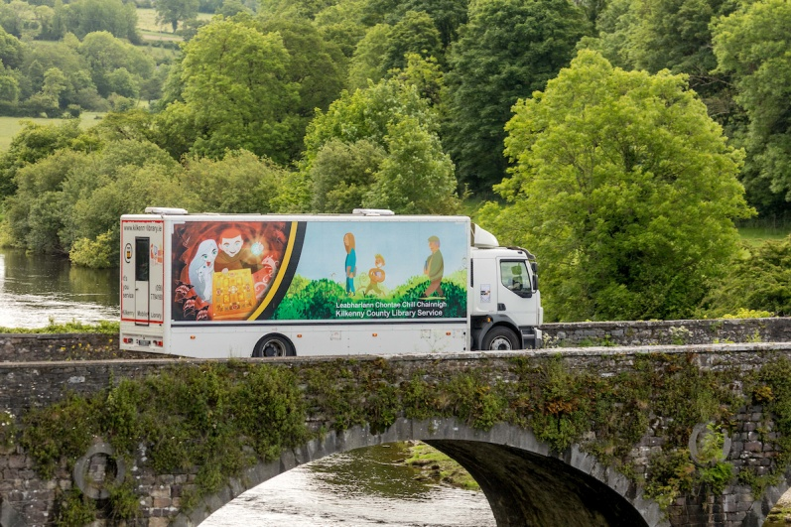
Strategy for Public Libraries 2018-2022

Slide 2
Framework
Kilkenny County Council
Public Library Service
Delivered via Network of 8 branches, Mobile Library, Local History service
& online via www.kilkennylibrary.ie
Minister for Community
& Rural Development
Advisory support from
Libraries Development (LGMA)

Slide 3
Strategy
Ambition:
To develop an attractive, vibrant and multifunctional service as a centre for information, learning, local culture and community.

Slide 4
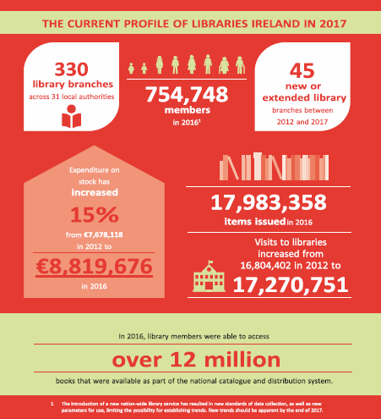

Slide 5
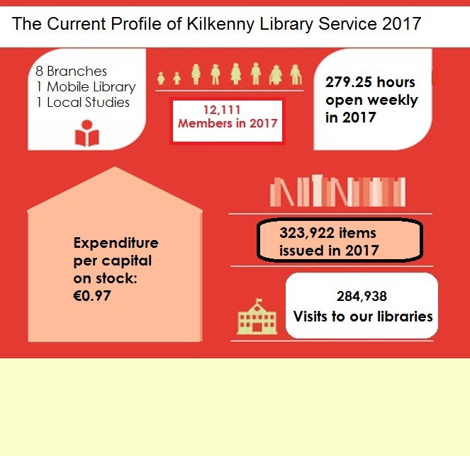
Expenditure per
capita on stock:
€0.97
Website: 349,528 260,600
24,659 views reached reached

Slide 6
Strategic Programmes

Slide 9
Targets
Increase % memberships
per population from 15% to 30%
Place library at the centre of local community
Affirm library as the ‘go-to’ place
Remove Library fines & fees to ensure universal access
National & Local marketing campaign
Transform Library buildings
Provide increase resources to meet these targets

Slide 10
Six Enablers
Infrastructure and Service Delivery
Library Team
Promotion & Marketing
Collections
Funding
Research & Development

Slide 11
Consultation Process

Slide 12
Key Issues
Increase Membership
Abolish fines and charges
Capital Programme
Bookfund target of €4 per head of population
Provide for increased resources to deliver on the ambition

