Slide 1
Update on Rural Grants 2016 - 2017
Kilkenny County Council
15th January, 2018

Slide 2
CLAR 2016 Background
Investment programme for rural areas
Re-opened 2016 with the hope of funding for future years
Targeting areas that have experienced significant depopulation
Aim to attract people to live and work in the area
Works in conjunction with locally identified priorities
Map overleaf sets out the areas in Kilkenny that are covered under the CLAR programme

Slide 4
Measures Covered - Priority
Support for Schools / Community Safety Measures
Enhancements for outdoor play facilities
Targeted Community Infrastructure Needs
Note: priority to be will be given in the order outlined above

Slide 5
Measure 1: Safety Measures Schools / Community Facilities
Interventions designed to ensure safety of children attending schools and adults / children attending community facilities
Replacement flashing amber lights
Child safety signs
Car speed signs for entering specific zones
Removal of hedging, upgrade road markings
Erection of pedestrian crossings in small towns/villages.
90% funding is provided with 10% from LA / Community / other and minimum 5% cash School/Community

Slide 6
Measure 2: Outdoor Play Facilities Enhancement Scheme
Enhance existing outdoor play areas or develop new for Schools / Communities
Grassing / tarmacadam of play areas
Supply of equipment
New Multi Use Games Area – if planning in place
Must be clear evidence of need
Maximum grant €50,000 with 90% funding is provided - 10% from LA / Community / other and minimum 5% cash School/Community

Slide 7
Measure 3: Targeted Community Infrastructure
Non County Roads leading to important community amenities e.g. graveyards, beaches, piers,...
LA’s can submit list of roads identified as local access roads
Exclude those to benefit from LIS or other existing schemes
Identify and prioritise balance LA wishes to include under the CLAR programme.
Should be approved by LCDC
Maximum grant €50,000 with 85% funding is provided - 15% from LA / Community / other and minimum 5% cash School/Community

Slide 8
2016 Projects - €223,000
Provide public lighting along the public road between the Village and the Community Hall & Sports Ground. | Community Hall & Sports Ground | €30,000.00
Installation of signalised pedestrian crossing. | St Aidan's National School, Kilmanagh | €15,000.00
Replace amber flashing lights and speed safety signs. | Listerlin Mixed National School | €25,000.00
Installation of signalised pedestrian crossing and speed safety signs. | St. Eoghan's National School Kilmaganny | €30,000.00
Provision of footpaths and roadmarkings between Playschool and Crèche. | Muckalee Community Playschool and Community Crèche | €30,000.00
Upgrade of church / graveyard car park. | 12th century Ullard Church (Ruin), Graveyard and Handball Alley | €20,000.00
Safety improvements and pavement upgrade to provide safer connectivity between Community facilities . | Benefiting from proposals include Scoil San Nioclás (Windgap N.S., Windgap GAA Ground and the Community Playground | €30,000.00
Replace amber flashing lights and Install a signalised pedestrian crossing. | Scoil na Críon Coille ( Gattabawn National School) | €29,000.00
Replace amber flashing lights. | Scoil Mhichil Naofa (Galmoy National School) | €14,000.00

Slide 9
2017 Projects €161,000
Safety improvement byway of a) public lighting upgrade and b) provision of footpaths. | Crosspatrick Village / Crosspatrick Tidy Towns | €50,000
Provision of a) public lighting and b) the provision of a safe pedestrian area along the public road in front of the facility. | Skeoughvosteen GAA Sports Grounds & Community Centre | €36,000
Sand based all weather playing surface to be constructed on the pitch / playing area adjacebt to school buildings on school grounds at Clontubrid Mixed National School | Scoil Naomh Fiachra | €29,160
The proposed project aims to completely refurbish the existing kitchen, upstairs meeting room and entrance hall in the Galmoy community Hall. | Galmoy Community Hall, Galmoy Village, Johnstown | €46,772

Slide 10
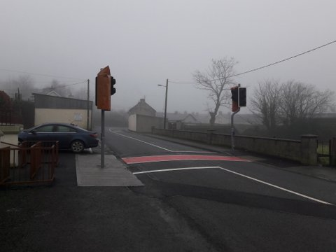
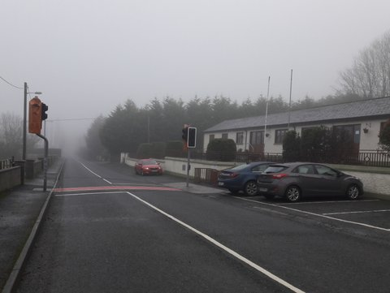
CLÁR 2016 Kilmaganny
Pedestrian crossing constructed on the R698 at Kilmaganny National School. We are currently waiting for the crossing to be commissioned.

Slide 11
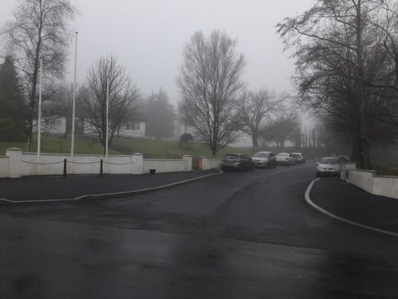
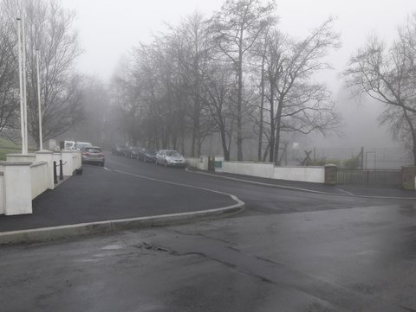
CLÁR 2016 - Windgap
The scheme consisted of drainage, kerbing/footpath and surfacing works to an access road that serves the National School, GAA grounds and playground in Windgap.

Slide 12
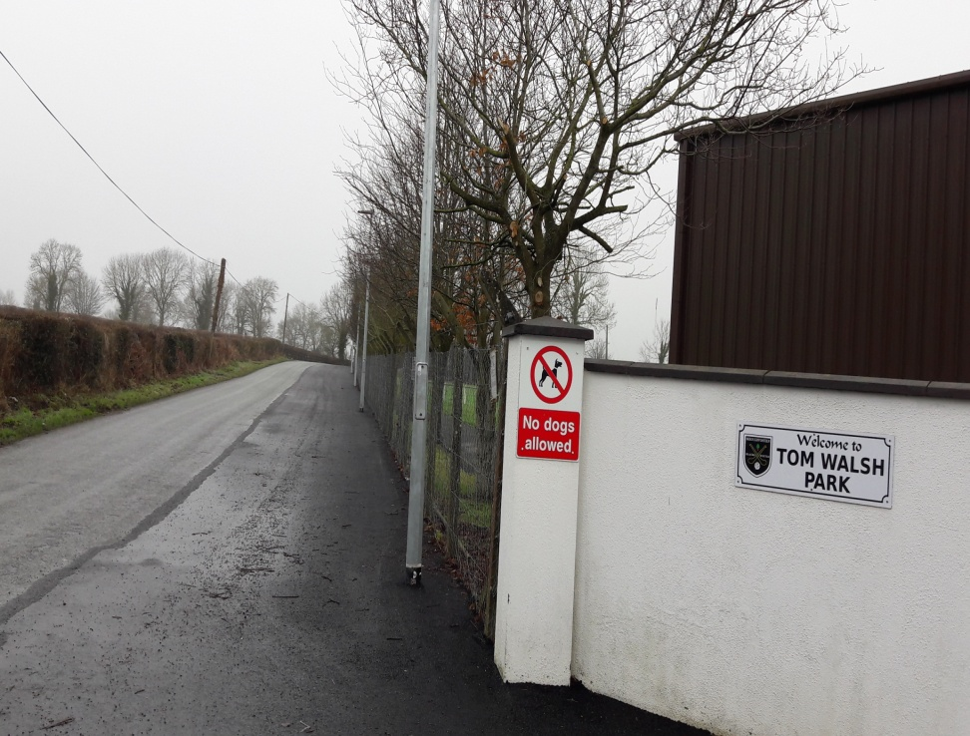
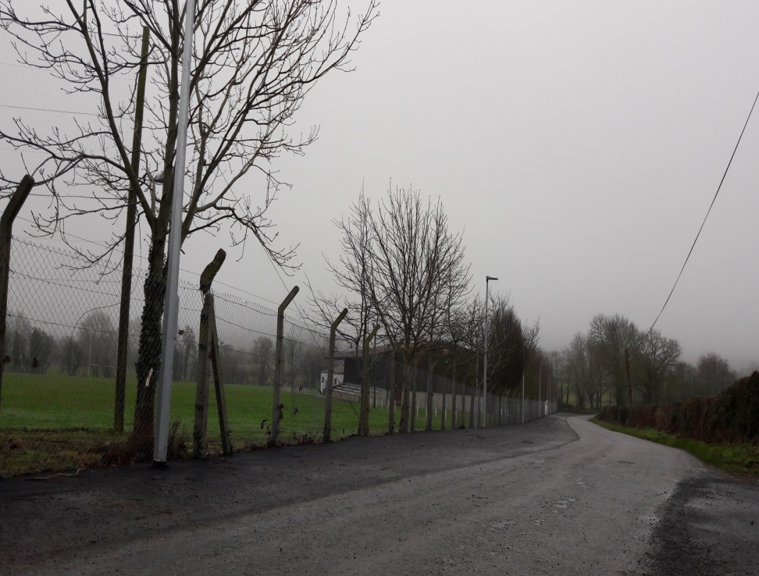
CLÁR 2017 - Skeogh GAA

Slide 13
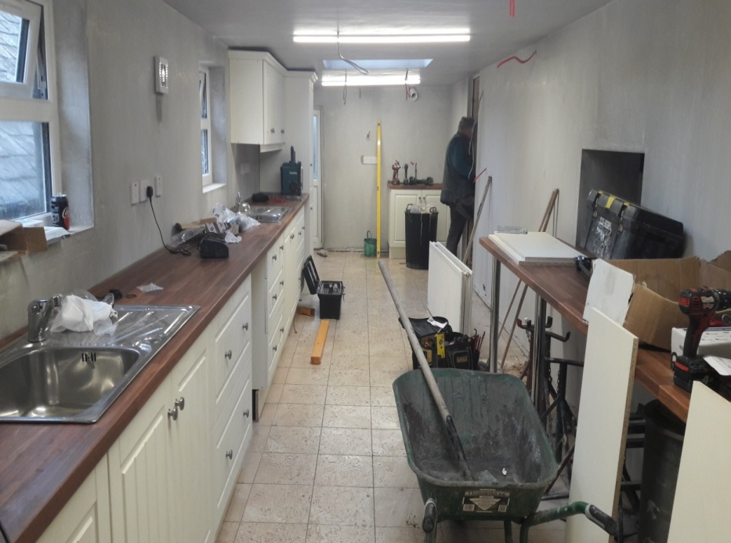
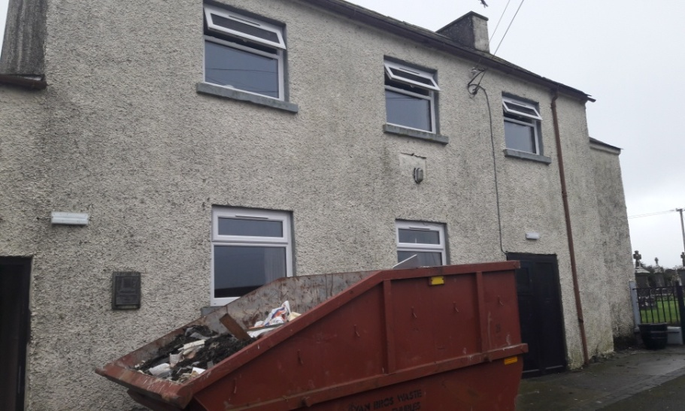
CLÁR 2017 - Galmoy Community Hall
Improvement works , new windows, new flat over the kitchen area, refurbishment of the kitchen

Slide 14
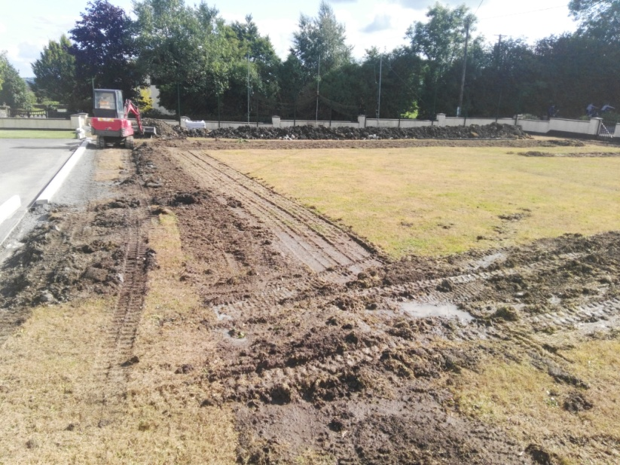
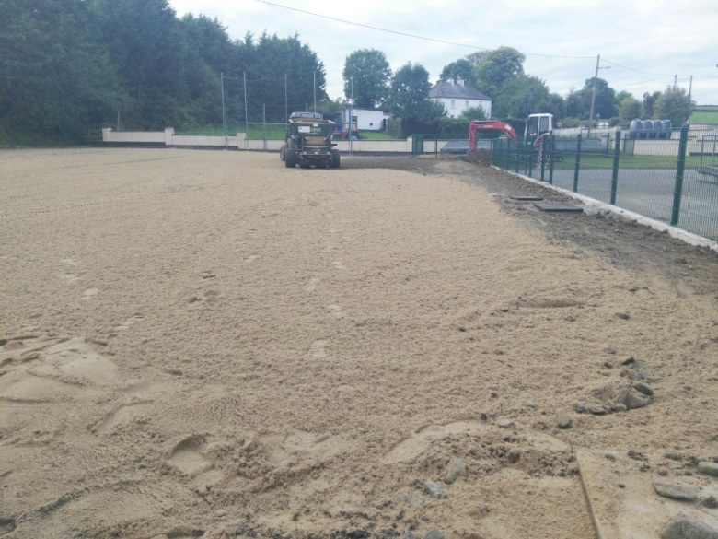
CLÁR 2017
Clontubrid National School
All-weather Playing Field

Slide 15
Town & Village Renewal 2017
Aims.
To support the revitalisation of towns and villages with populations under 10,000 in order to improve the living and working environment and increase potential to support increased economic activity into the future.
Increase the attractiveness of the town or village as a local commercial and social centre,
Enhance the towns/village environment and amenities in the interests of residents, businesses, and visitors,
Promote the town/village’s potential for tourism and as a centre for culture and local heritage
Encourage community/LA collaboration

Slide 16
Town & Village Renewal 2017
A competitive call for proposals to the Local Authority under 2 categories (primary category=Renewal, secondary category=Arts project)
Max Grant €100,000 .(+20% match funding required)
Max Grant for a limited number of projects demonstrating an exceptionally economic case was €200,000.
12 town/village Renewal proposals and 1 Art proposal developed with communities
11 projects were successful in being awarded funds to the value of €873,320 including 1 for €200,000. (1 of 10 nationally)
No decisions yet on the Arts applications
The Scheme represents a joint investment of €1.1m (min) in towns and villages
Projects currently progressing through various stages.

Slide 17
Town & Village Renewal 2017 – €850,000
Location | Project | Offer
Piltown | Enterprise Centre | €200,000
Graiguenamanagh | Festival | €41,000
Callan | In River Project | €72,000
Ballyraggett | Youth and Adult facilities in Community Centre | €55,000
Hugginstown | Public Realm works 1st Phase | €95,000
Newmarket | Extension to local heritage centre | €80,000
Kilmacow | Public Realm Works 1st Phase | €77,760
Inistioge | Stabilising works to protected structure | €26,000
Windgap | Fit out of Co-Op shop | €79,960
Goresbridge | Park entrance and public realm works at Quayside | €46,600
Castlecomer | Pedestrian bridge | €100,000

Slide 18
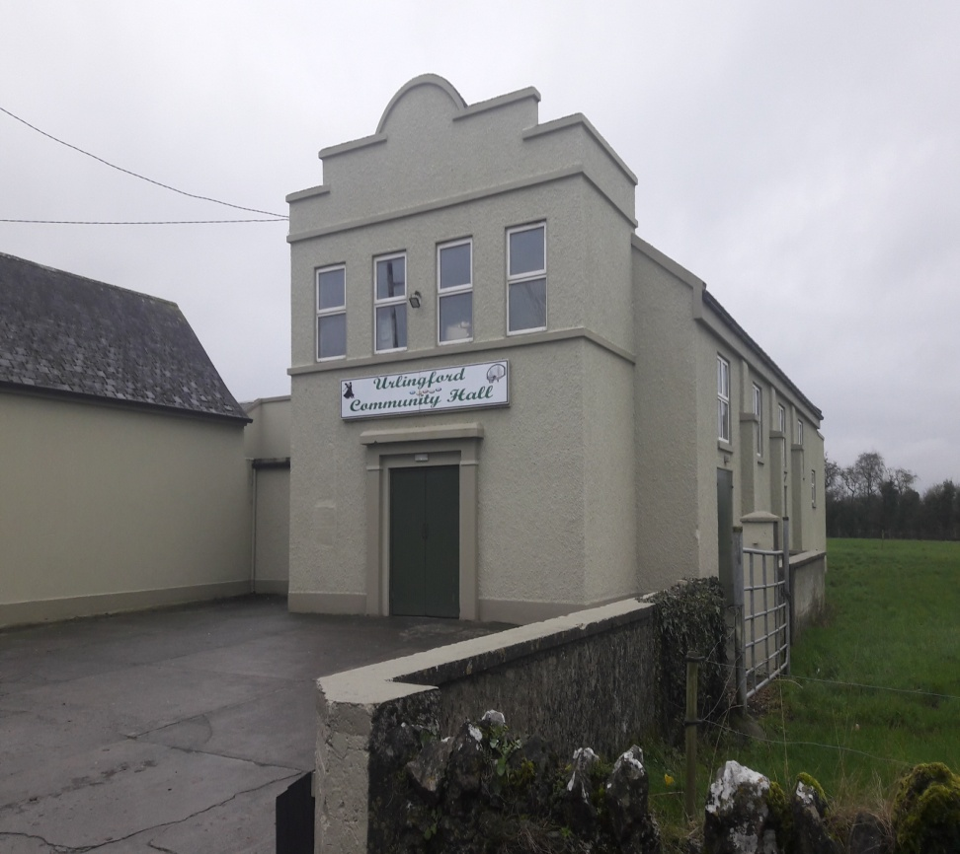
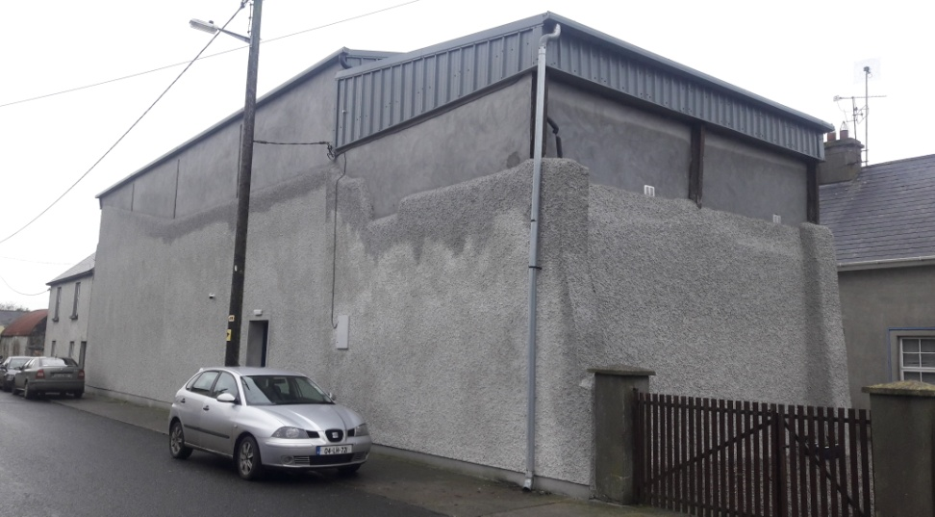
Town & Village Renewal Scheme in Urlingford
Plastering of the outside masonry walls of the handball alley on Mills Street
Painting of the outside of the Community Hall on Mill Street

Slide 19
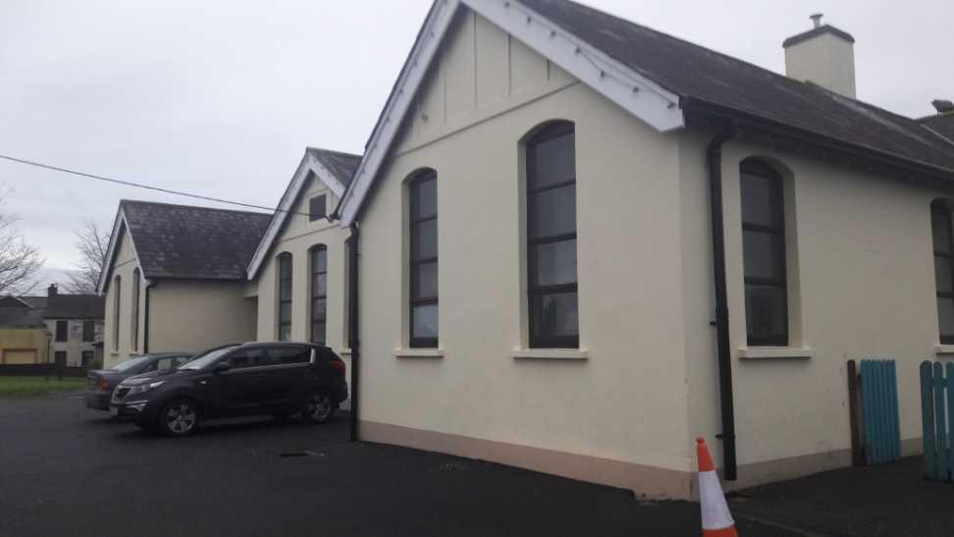
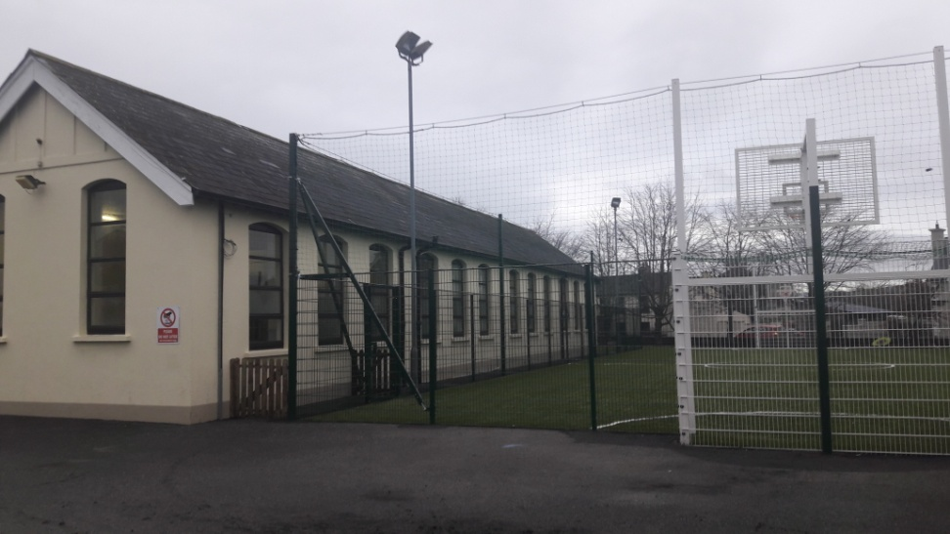
Old school Urlingford and all weather facility
Refurbishment of the all weather facility at the back of the Old School on Main Street, now used as a creche
Painting the outside of the Old School and refurbishment if the toilets within the facility

Slide 20
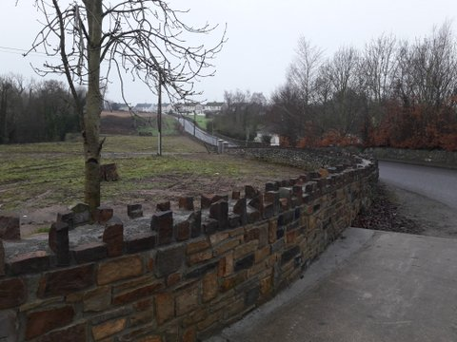
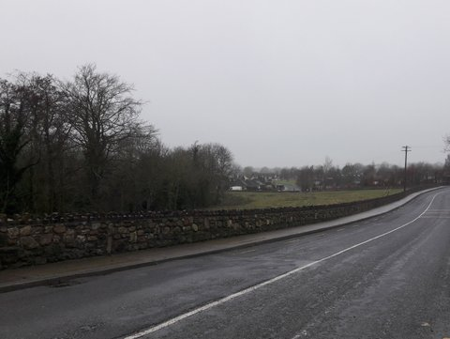
Piltown Town & Renewal Scheme

Slide 21
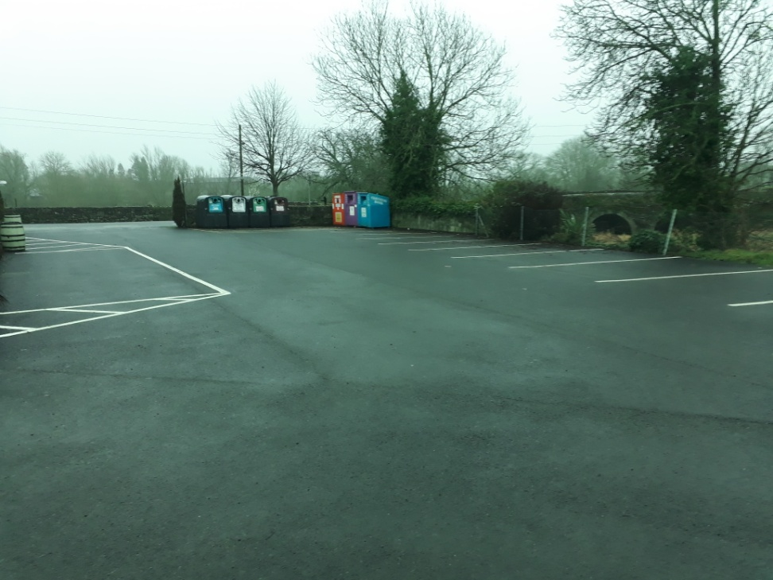
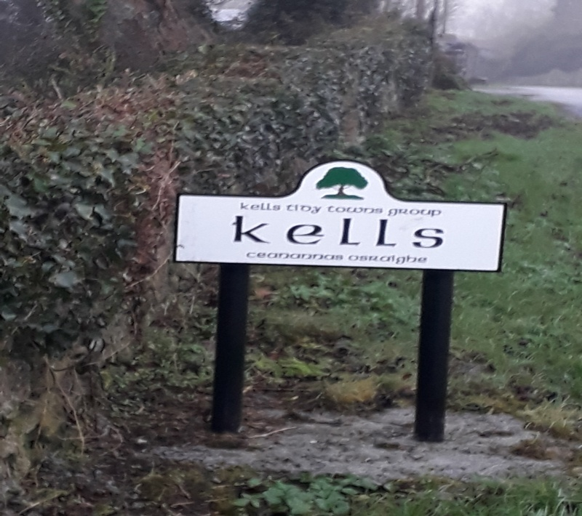
Town & Village Renewal Kells
Creche Car Park
New Village Signs

Slide 22
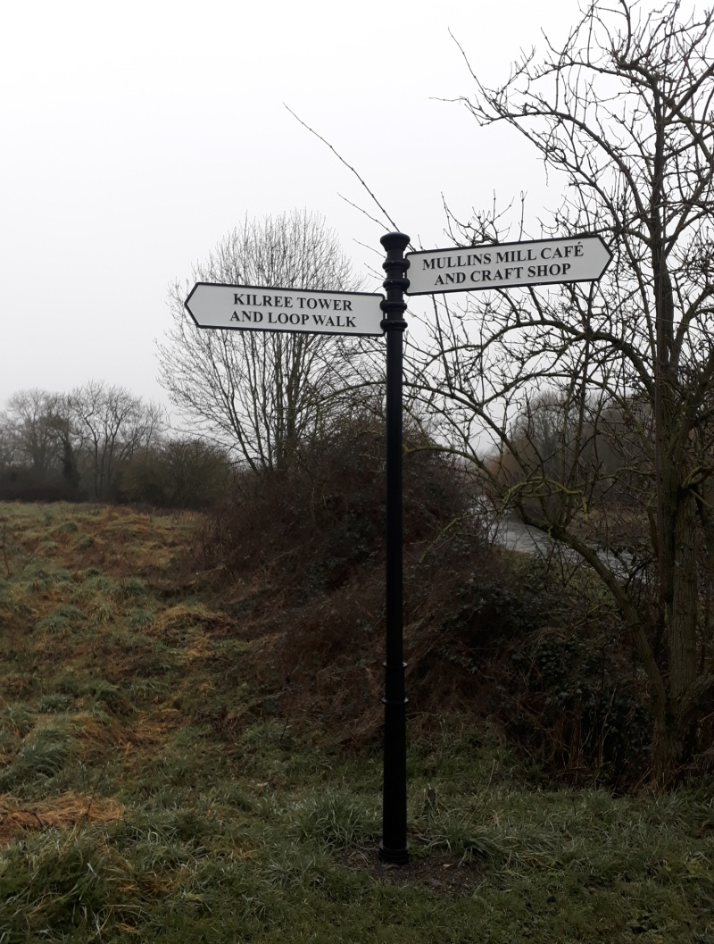
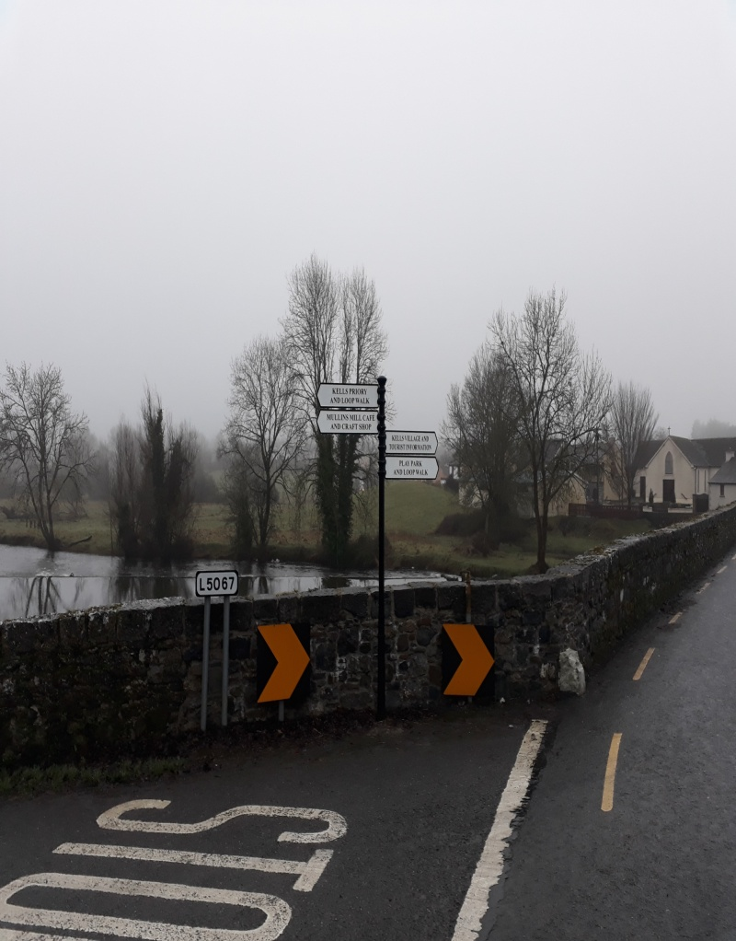
Tourist Trails Signage

Slide 23
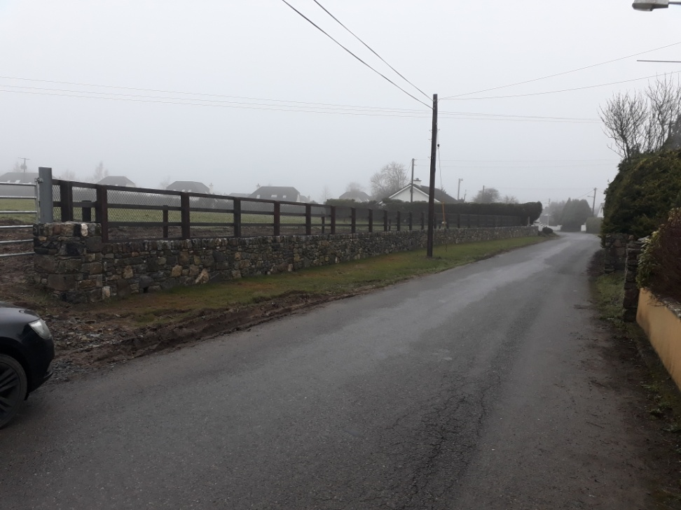
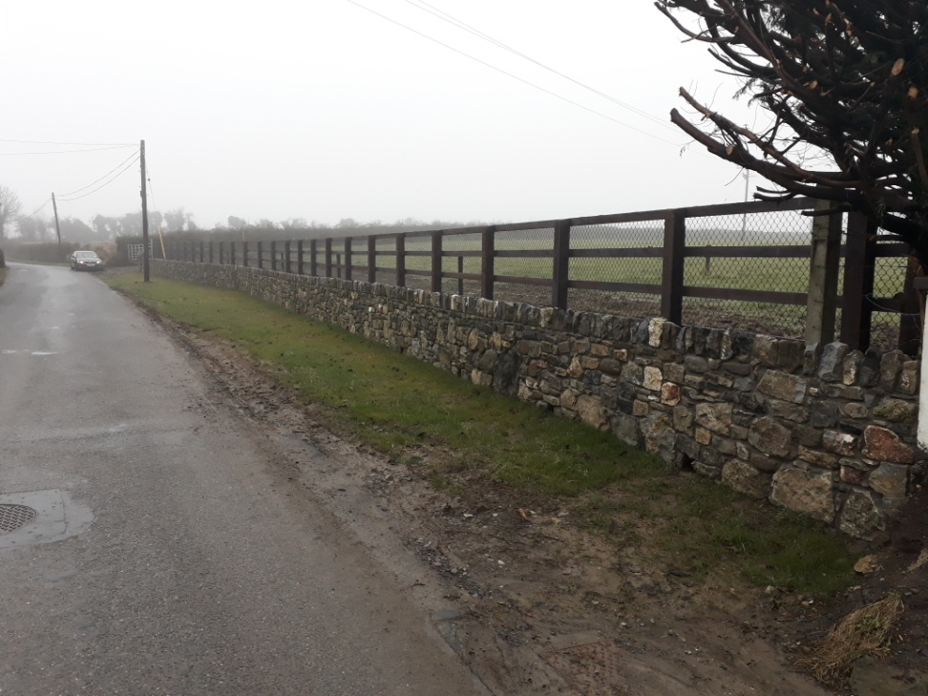
New Wall Haggard Road

Slide 24
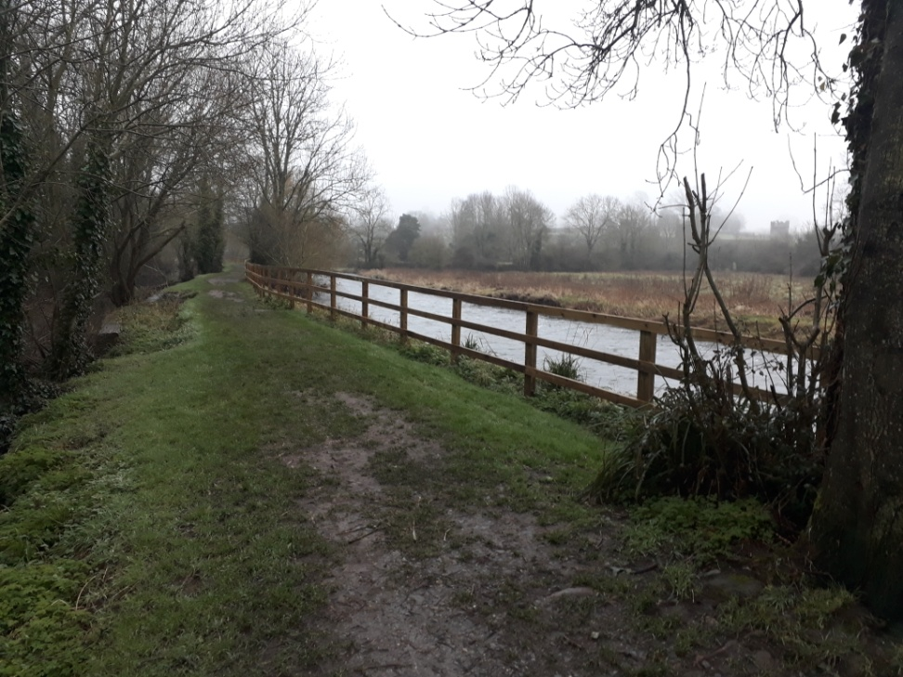
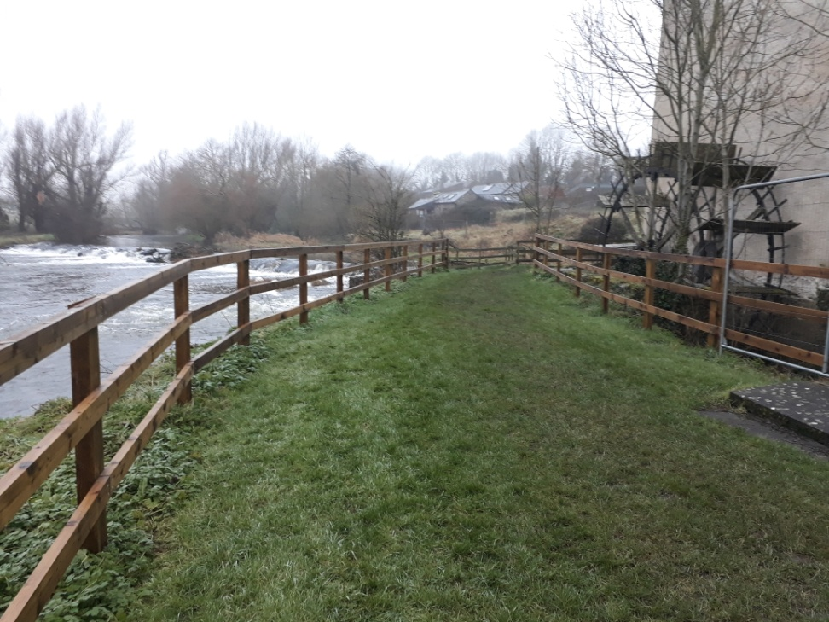
Island Walk Fencing

Slide 25
REDZ Scheme 2016
€5M for 2016 REDZ scheme following on to the CEDRA report.
REDZ are functional, rather than administrative geographic, areas that reflect the spatial patterns of local economic activities and development processes.
They are, in effect, the sub-county zones within which most people live and work.
The central objective of the REDZ model is to utilise the synergies and interdependencies between rural towns and their hinterlands to generate economic activity in the local area.
The involvement of local communities, including the business community, is a key element in the REDZ model.

Slide 26
REDZ Scheme 2016
3 major Flagship projects – 1 in each region* to a max grant of €400,000 per project.
9 Medium scale projects – 3 in each region* to a max grant of €200,000 per project.
No county will be approved for more than one Medium REDZ project.
1 or 2 small REDZ projects – 1 or 2 in each remaining county to a maximum grant of €100,000 to each County.
Based on the three Regional Assembly regions: Northern and Western region, Eastern and Midlands region and Southern region.
Decisions made at National Level.

Slide 27
REDZ Scheme 2016
Woodstock potential driver of economic development in Inistioge and surrounding area
Annual cost in revenue budget of Kilkenny County Council 245,000 Visitor numbers est 35,000
Ambition to develop Woodstock further, building on work done to date.
Focus this application on Inistioge and Woodstock.
Signage/interpretation and improved paths and visitor facilities in Woodstock – area owned by Kilkenny County Council.
Master/Business Plan required for overall estate but pending same we progress with improvements to area in Council ownership.
Inistioge – Improve Visitor facilities including: -
Car parking
Create “Visitor Arrival” area – Car parking/signage
Riverside Walking Route interpretation and signposting etc, unifying Inistioge and Woodstock and riverside walk towards Thomastown.
Development of a business plan for Woodstock, with the aim of applying to Failte for a Large Capital Grant

Slide 28
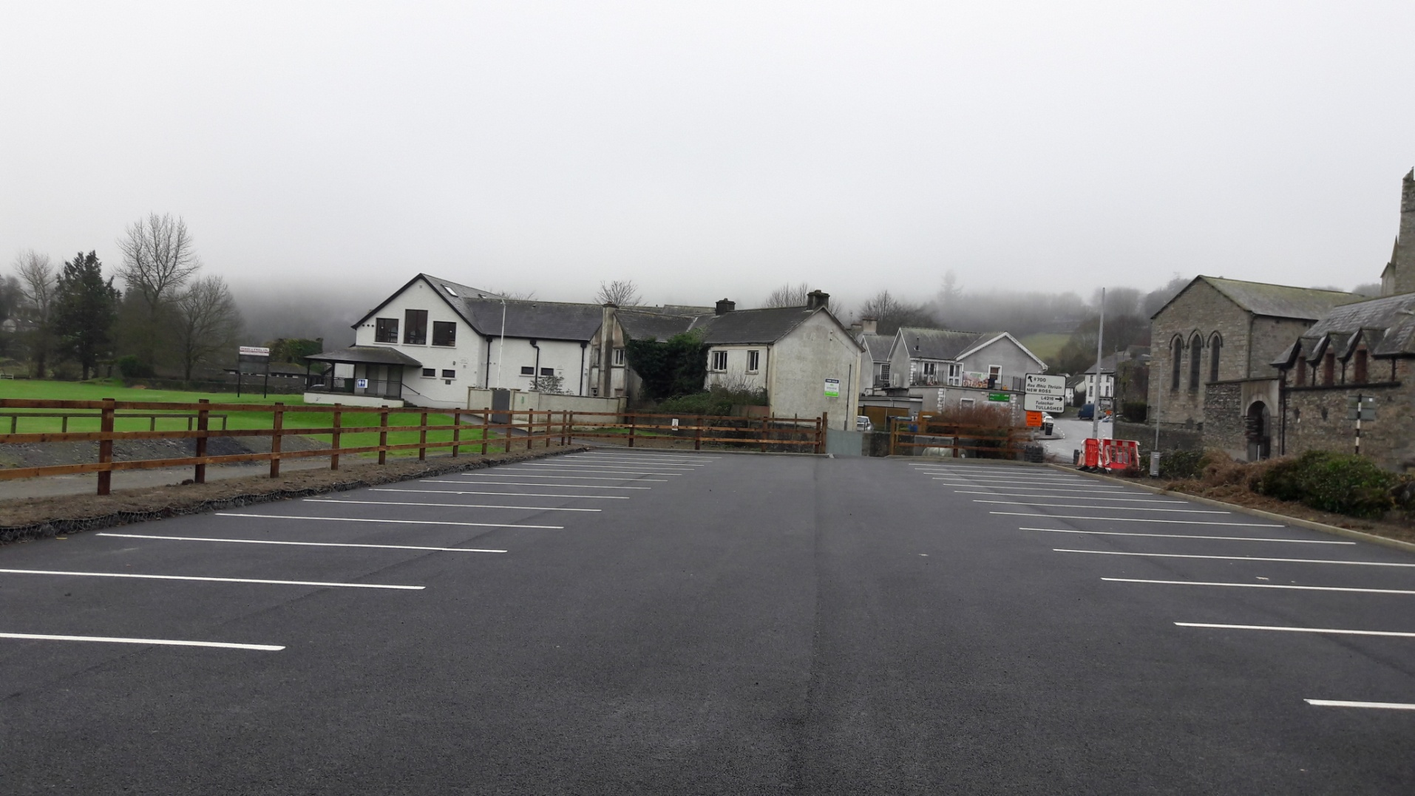
REDZ 2016 Car park Inistioge

Slide 29
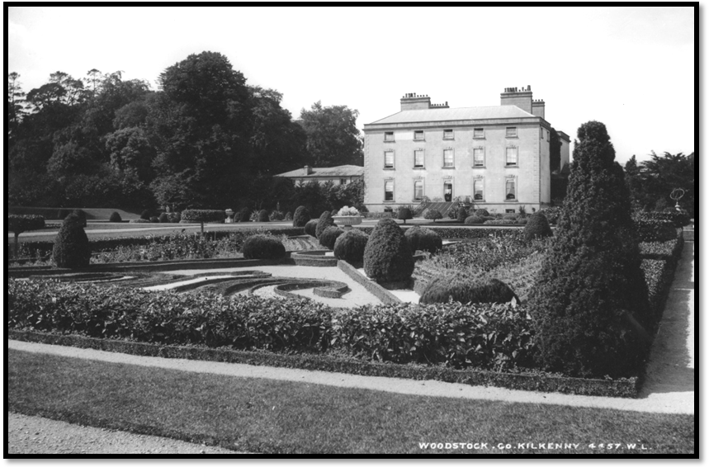
Woodstock Winter Garden

Slide 30
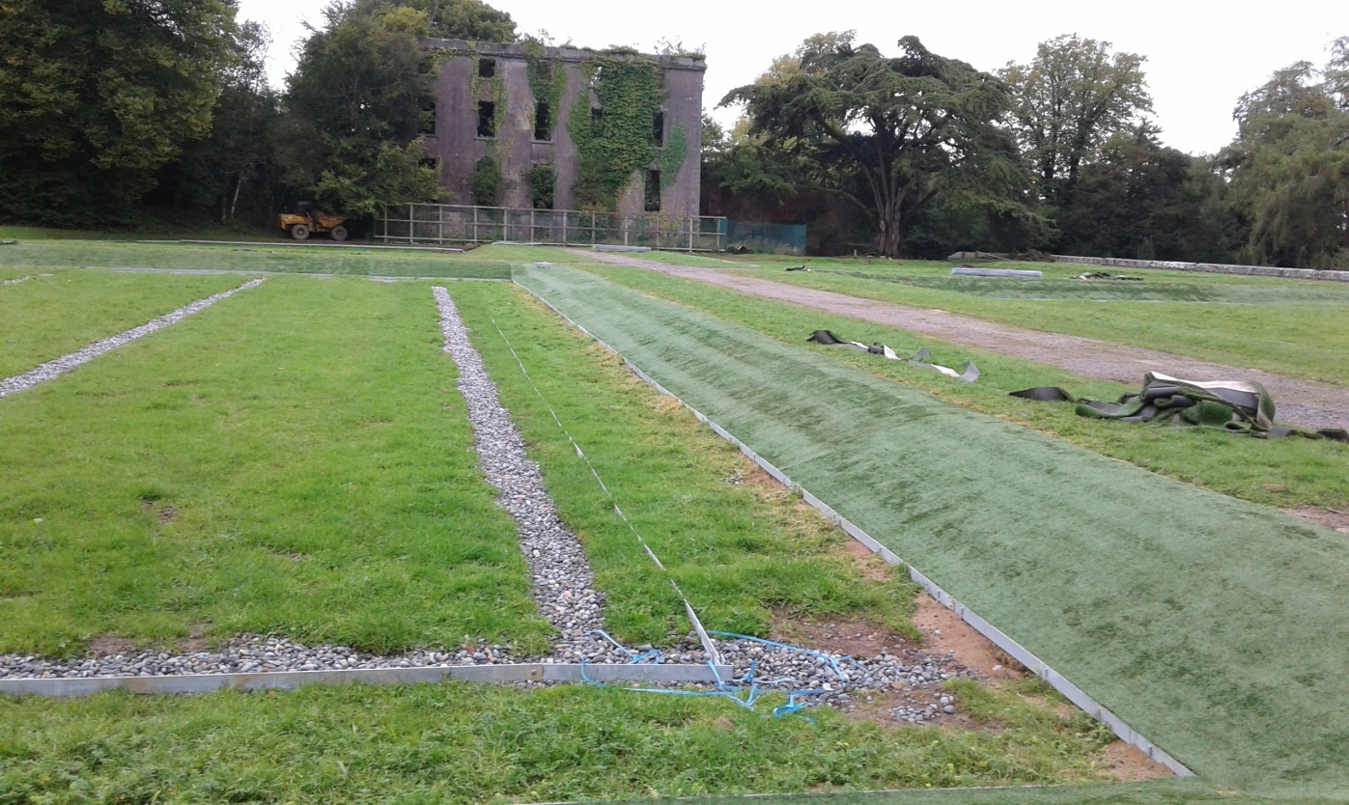
Woodstock Winter Gardens

