Slide 1

Notes:
Good morning. Thank you for inviting me here today to provide an update on LEO activities. I am currently Acting Head of Enterprise with the Local Enterprise Office Kilkenny and formerly the County Enterprise Board.

Slide 2


Local Enterprise Office is the first point of contact for anyone in business or thinking of starting a business
Notes:
The Local Enterprise Office Kilkenny (otherwise known as the LEO) is part of the national network of 31 LEOs. The functional responsibility for the LEO rests with Kilkenny County Council and we operate within the terms of a Service Level Agreement (SLA) between Kilkenny County Council and Enterprise Ireland and implement overall policies on behalf of the Department of Business Enterprise and Innovation. Our Enterprise Development Plan 2017 – 2020 outlines the targets under the key indicators contained in the SLA. The Enterprise Plan is submitted to the SPC for Economic Development, Enterprise Support and Tourism and the SPC provides oversight of the implementation of the Development Plan on behalf of the Council. We also submit annual metrics to Enterprise Ireland. We provide progress reports on the implementation of the Development Plan to the SPC at their quarterly meetings. We also have the services of a Specialist Evaluation and Approvals Committee to assess applications for financial support. The Local Enterprise Office is the first point of contact for anyone in business or thinking of starting a business in County Kilkenny. We are based at 42 Parliament Street and have a team of 5 full-time staff.

Slide 3
Our mission is:
- to promote entrepreneurship;
- to foster business start-ups;
- to develop existing micro enterprises; in order to drive job creation and to provide accessible, high quality supports for entrepreneurs.

Slide 4
- Business Information & Advisory Services;
- Enterprise Support Services;
- Entrepreneurship Support Services;
- Local Economic Development Services.
What we do:
Notes:
Our mission is supported by 6 strategic objectives under 4 strategic areas as set out in the Service Level Agreement between Enterprise Ireland and Kilkenny County Council

Slide 5
Business Information
& Advisory Services
411 people availed of Business Advisory Clinics with LEO staff;
381 entrepreneurs received one-to-one mentoring support;
282 people attended 7 Business Seminars.
Notes:
We provide a first stop shop service in respect of business support, enterprise development and promotion, including signposting and referral. The need for good relevant and timely information and advice is central to the success of any business. We encourage entrepreneurs and small business owners to avail of a ‘Business Advisory Session’ with LEO executives to discuss their needs. We constantly seek to improve the quality of the information we give to those thinking of starting or further developing a business. We also promote and encourage small businesses to participate in relevant business development programmes to enhance their management and business skills within client companies. We build relationships with other agencies and organisations so that clients can be signposted and referred on as appropriate.
We provide supports, guidance and solutions that make it easier for entrepreneurs, owners and managers to identify opportunities and implement actions to start-up, grow and survive within a competitive business environment. The LEO is now firmly established within the local authority and the support services it provides are a very important function of the Council. The Council used to be the place where business people only went to seek advice on rates, planning permissions, roads, waste permits and so on. Through the LEO, the Council now takes a much more proactive role in helping small businesses to start, to develop and to grow. We work with the Economic Development Unit of the Council to help make it easier for people to do business in County Kilkenny.

Slide 6
Enterprise Support Services
€503,648 approved to 26 businesses, creating 40 jobs in Year 1, 95 projected in Year 3;
594 people participated in 49 LEO training courses ranging from Start Your Own Business Courses to Social Media for Business.
Notes:
We deliver support services that equip entrepreneurs, small business owners and managers with the knowledge to plan, grow and sustain productivity, innovation and competitiveness, as well as encourage greater technology uptake. We cover the full spectrum of support from the provision of basic information and advice through to enterprise training, mentoring and management development support. We recognise that different supports are needed at different stages of the ‘life cycle’ of a business. For example, different developmental challenges face a business that has grown to employing ten people than one that has remained smaller. Businesses that are entering a growth phase may require intensive management development support, while one-to-one mentoring might be more effective in the case of a start-up business struggling to expand its customer base. We will aim to provide the most appropriate supports to enable small businesses to maximise their potential.

Slide 7
Entrepreneurship Support Services
539 students from 12 secondary schools participated in Student Enterprise Programme;
31 Young Entrepreneurs between the ages of 18 – 35 participated in Ireland’s Best Young Entrepreneur Competition;
Notes:
We act as the catalyst and advocate for the establishment of a best practice enterprise culture among start-ups, micro and small businesses; also promoting enterprise and self-employment as a viable career option among the wider population. We play our part in cultivating a positive attitude towards entrepreneurship generally in the county, at the same time as creating a more supportive environment for entrepreneurs. In particular, we endeavour to promote entrepreneurship in our second level schools, and we will celebrate and reward successful entrepreneurs in the local media and through Awards schemes. We will proactively engage with other LEOs and with the Centre of Excellence in Enterprise Ireland to establish best practice approaches that have been identified across the LEO Network and elsewhere.

Slide 8

Notes:
We act as the catalyst and advocate for the establishment of a best practice enterprise culture among start-ups, micro and small businesses; also promoting enterprise and self-employment as a viable career option among the wider population. We play our part in cultivating a positive attitude towards entrepreneurship generally in the county, at the same time as creating a more supportive environment for entrepreneurs. In particular, we endeavour to promote entrepreneurship in our second level schools, and we will celebrate and reward successful entrepreneurs in the local media and through Awards schemes. We will proactively engage with other LEOs and with the Centre of Excellence in Enterprise Ireland to establish best practice approaches that have been identified across the LEO Network and elsewhere.

Slide 9
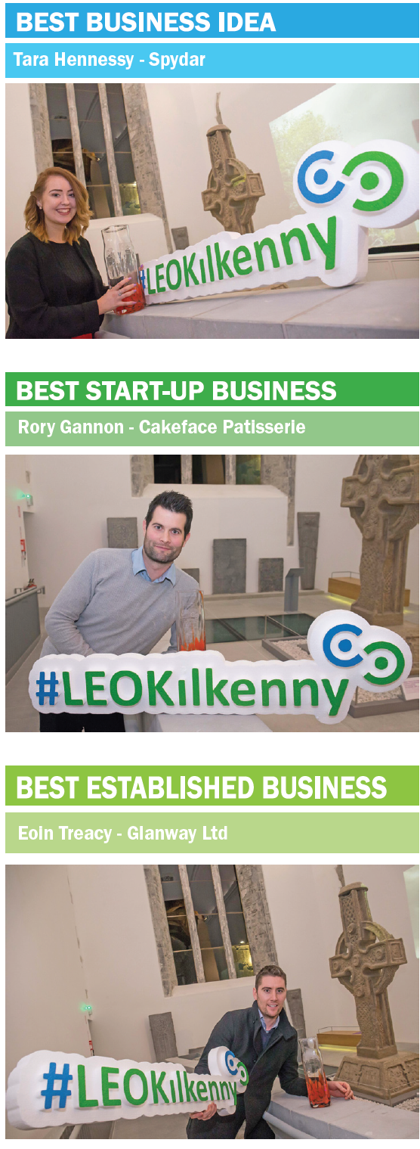
Notes:
We act as the catalyst and advocate for the establishment of a best practice enterprise culture among start-ups, micro and small businesses; also promoting enterprise and self-employment as a viable career option among the wider population. We play our part in cultivating a positive attitude towards entrepreneurship generally in the county, at the same time as creating a more supportive environment for entrepreneurs. In particular, we endeavour to promote entrepreneurship in our second level schools, and we will celebrate and reward successful entrepreneurs in the local media and through Awards schemes. We will proactively engage with other LEOs and with the Centre of Excellence in Enterprise Ireland to establish best practice approaches that have been identified across the LEO Network and elsewhere.

Slide 10
Local Economic Development Services
Launch of #investkilkenny;
Compilation of Property Database;
Community Centre Engagement.
Notes:
Create Better Environment for Start-Ups
We implement actions and initiatives that create awareness among potential entrepreneurs of the types of supports available, thereby improving the conversion rate of business ideas to fully-formed enterprises. We play our part in making County Kilkenny a great place to do business.

Slide 11
14 businesses assisted with applications under Smart Options Loan Scheme
8 businesses assisted with applications under Microfinance Ireland Loan Scheme
28 Trading Online Vouchers awarded totalling €59,940
Partnerships

Slide 12
12 applications approved Technical Assistance for Micro Export Grants;
4 businesses participated in Lean for Micro training.
BREXIT Supports

Slide 13
Types of Grant:
- Feasibility /Innovation Study Grants (up to €15,000)
- Priming Grant (up to €50,000 locally) up to €150,000 through Enterprise Ireland Investment Committee;
- Business Expansion Grant (up to €50,000 locally) up to €150,000 through Enterprise Ireland Investment Committee;
Refundable-Aid (30% of grant-aid approved is refundable, excepting Feasibility/Innovation Study Grants)
Financial Assistance

Slide 14
Eligibility Criteria:
The enterprise must:
- not employ more than 10 people;
- be established, registered and operate within the
County;
- operate in the commercial field;
- demonstrate a market for the product or service;
- have the potential for growth in domestic or export markets; and
- have potential for job creation.
Financial Assistance

Slide 15
Priority is given to:
- Enterprises in the manufacturing or internationally traded services sectors which, over time, can develop into strong export entities and graduate to Enterprise Ireland;
- Unique tourism services enterprises that target generating revenue from overseas visitors. These tourism services should not take business from other existing players in the market or give rise to dead-weight . Such unique tourism services may be offered salary supports.
Financial Assistance

Slide 16








Sample of Companies
Grant Assisted

