Slide 1
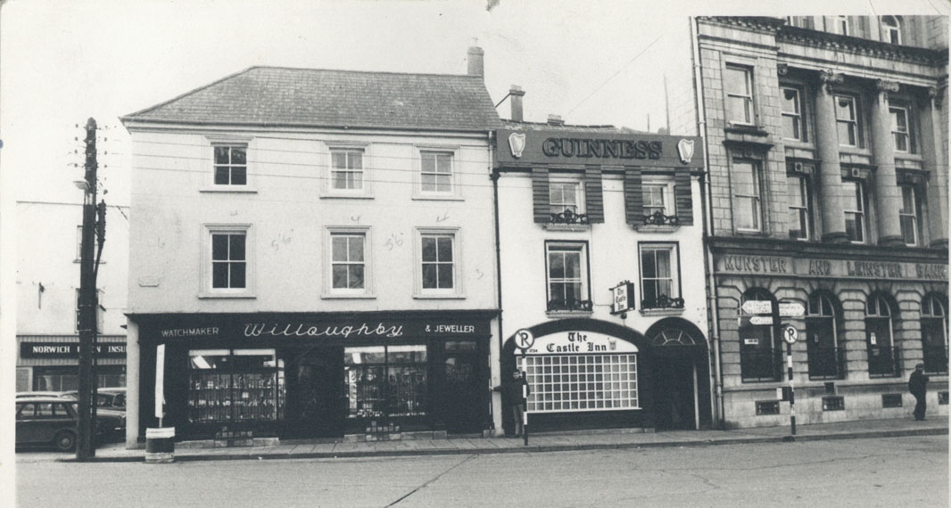
Shopfronts through the Ages
16th December 2019

Slide 2
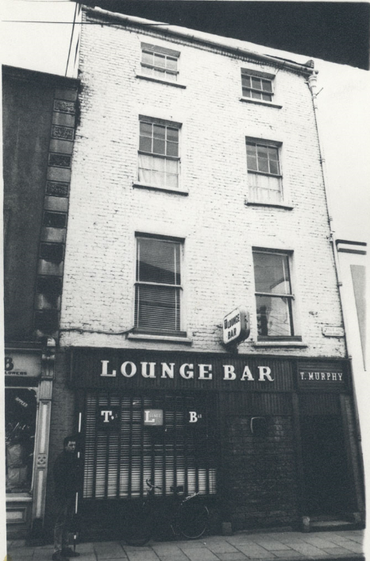
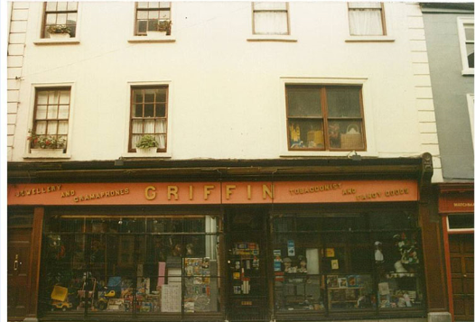
Overview
Genesis
Historical data
Aim
Notes:
Genesis – The origin of this project started out as a pure-planning research project, which evolved into a broader project as a collaboration between Planning, Libraries, I.T and the Heritage Office.
In Planning we knew we had a lot of historic photos/records of shopfronts from photographic surveys through the years.
The Aim was to collate all old photos for each street in the central area (main business area) of the city.

Slide 3
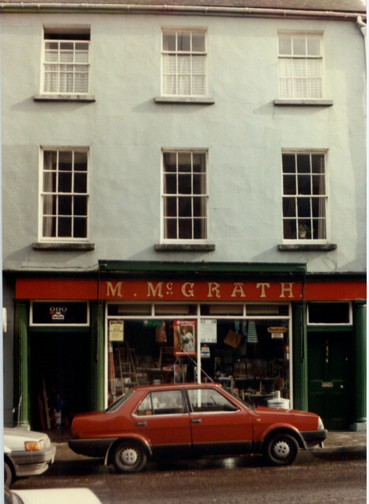
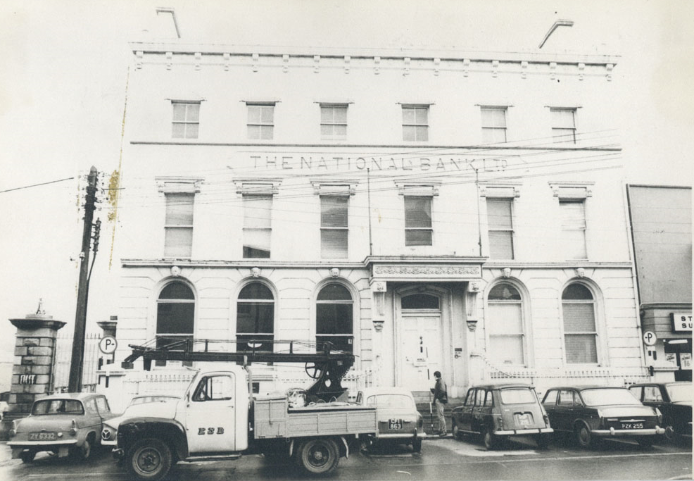
What we did:
Sorted and collated all photos
Photographs for 2019 were taken
Guidance from IT–Digital Archive
Notes:
1. All old and present photos held over the years in Planning (Borough Council) were scanned and saved – how many?. All these were uploaded to a central drive which was made accessible to all the planning department
2. Photos were taken of every street in 2018 and some in 2019 to give the present day comparison
3. We met with IT and at this stage it was decided to use the Kilkenny Digital Archive as the platform. This would make the photos available to the public in addition to the Council’s own use.

Slide 4
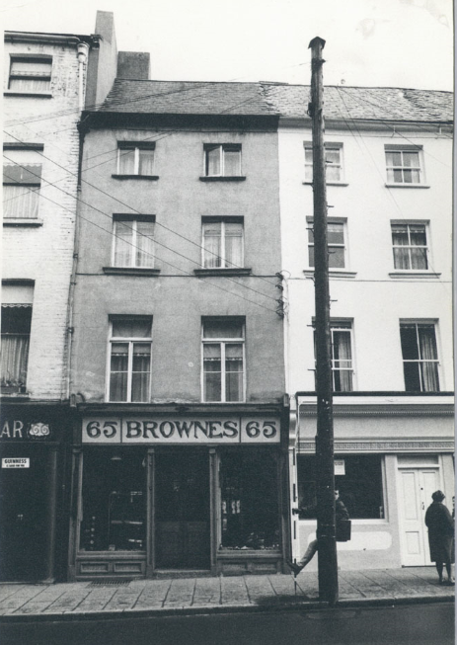
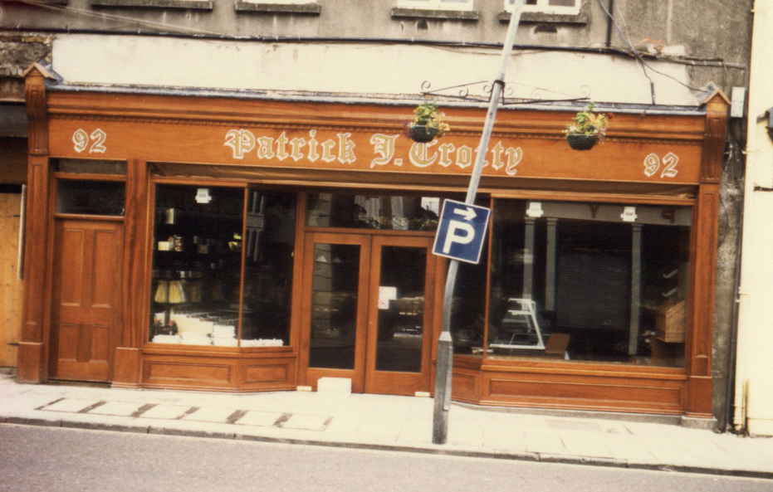
Shopfront Strategy
Policy and Guidance
Enforcement
Awareness raising and
promotion
Notes:
Kilkenny county council has a three strand strategy for Shopfronts.
This project is one element of the Strategy to address shopfronts and signage in Kilkenny City.

Slide 5
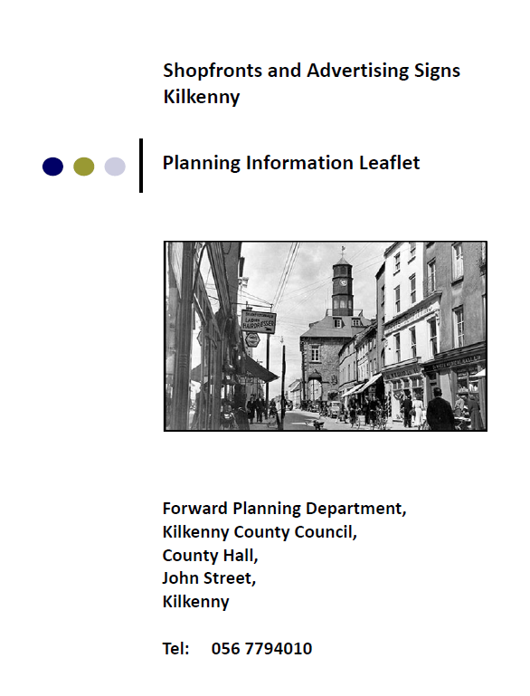
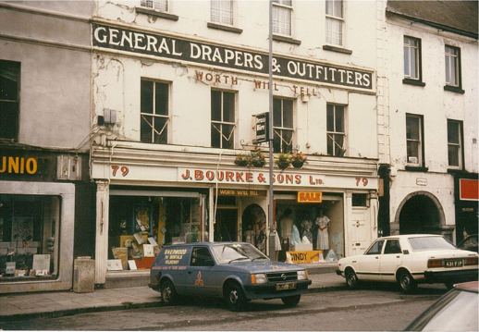
1. Policy and Guidance
City Development Plan policy (currently under review)
Shopfronts Guidance Document (2016)
Notes:
Dev plan currently under review for the years 2020-2026
The 2016 Guidance document will be revised, following on from the Dev Plan, building on this project

Slide 6
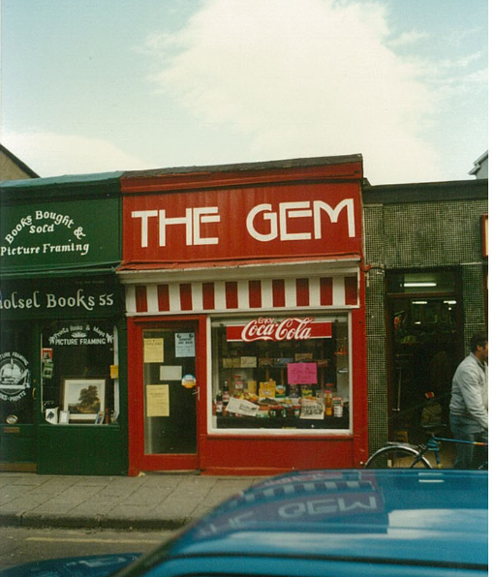
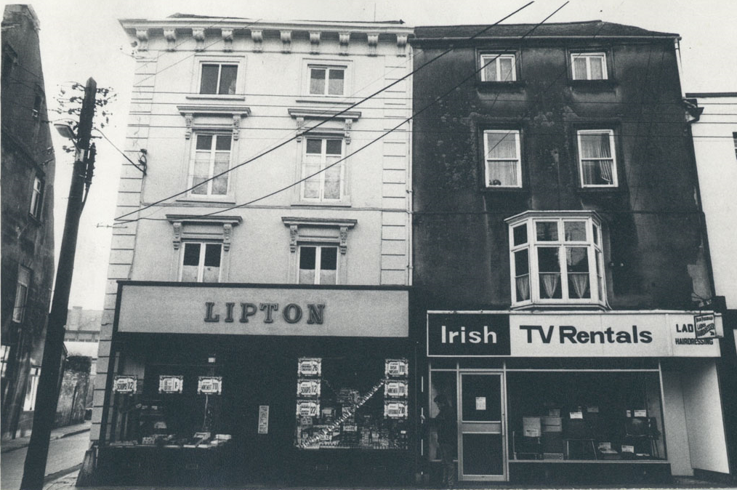
2. Enforcement
Dedicated resources to Enforcement
Systematic approach
Commenced in 2018
Notes:
Dedicated programme to enforcing breaches of policy around shopfronts and signage will be implemented.
Systematic approach which commenced in 2018.

Slide 7
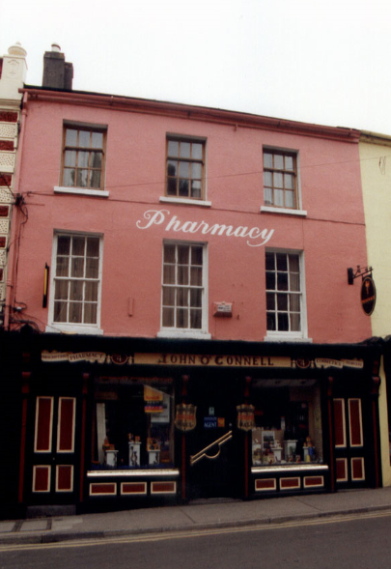
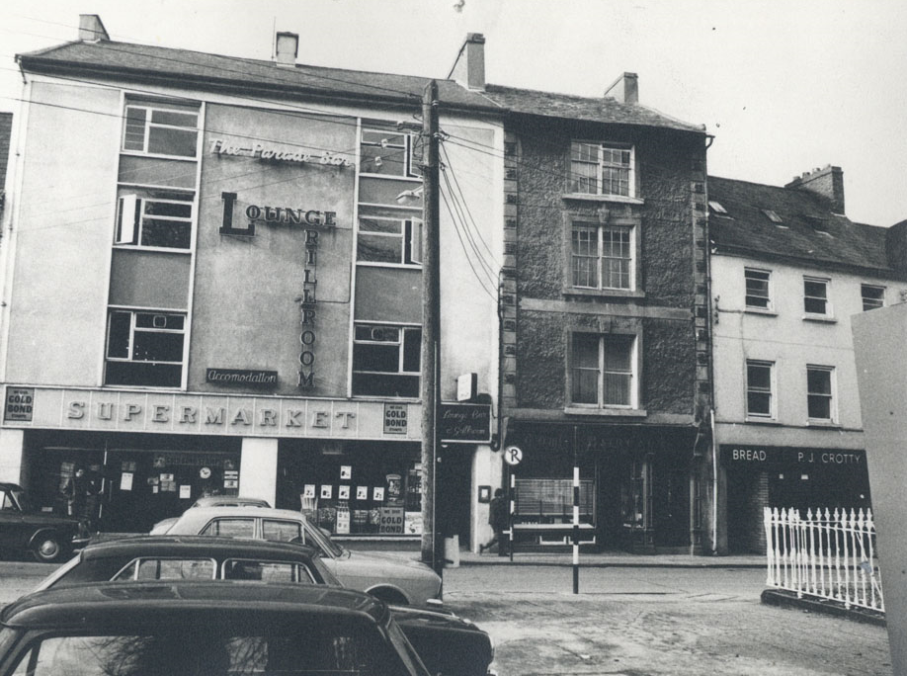
3. Awareness Raising and Promotion
Kilkenny Shopfronts through the Ages project
Raising awareness of policies and guidance
Photographic Audit
Notes:
Photographic audit – details of this will be released in 2020.

Slide 8
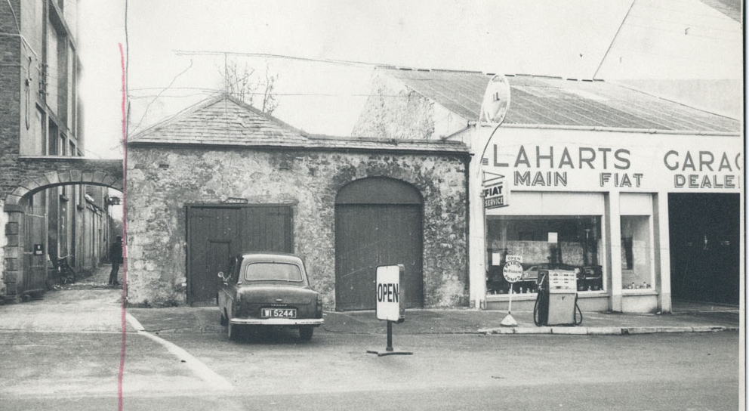
Sources of Photos
Surveys by the Planning Department,
Bolton Street College survey and
Photographic Audit of Kilkenny’s Shopfronts
Notes:
The Photos came from three sources, -
The Planning photographic surveys were conducted in 1987, 1994, 1996, 1997, 2011, 2013, 2014 2018 (approx. 4,200 photos in total)
photographic surveys by the planning department,
The Streetscapes of Kilkenny city
The Streetscapes of Kilkenny City was carried out by students of Bolton Street D.I.T. circa. 1970 (178 photos)
and most recently the Photographic Audit of Kilkenny’s Shopfronts commissioned by the Heritage Officer.
When put together, these photos enable us to look at each business in central Kilkenny over a range of years.
The entire collection is a fantastic way of viewing Kilkenny’s ever changing streetscapes and shopfronts.

Slide 9
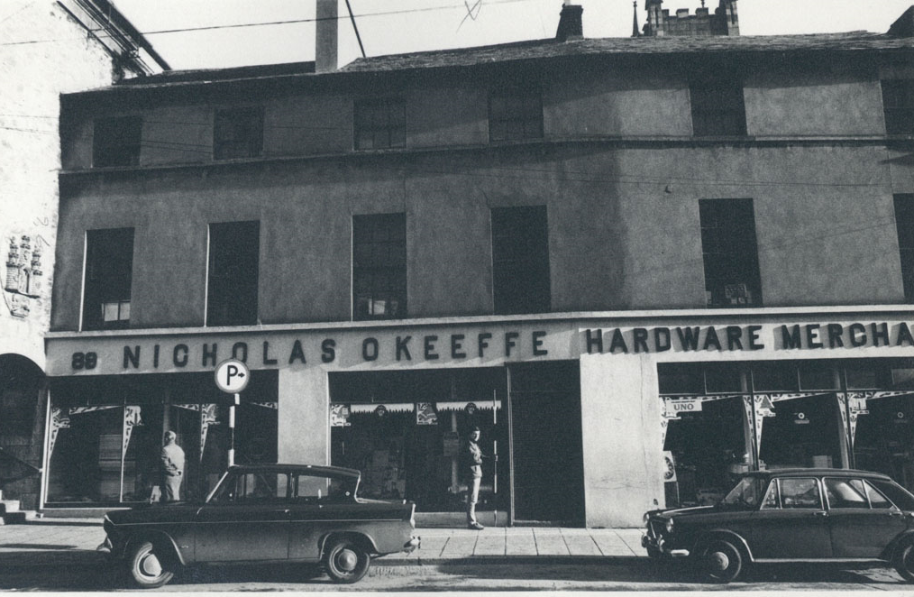
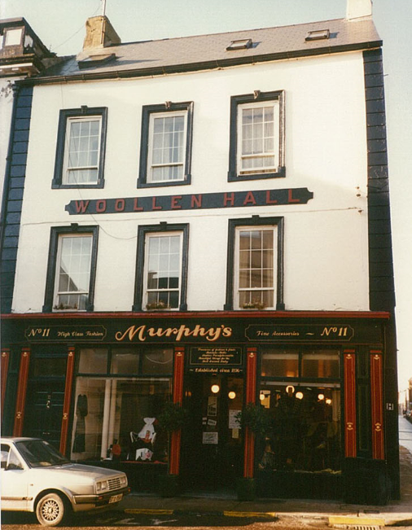
Benefits for Planning
Dedicated publicly available database
Provides historical context for planning decisions and policy
Notes:
Anyone can navigate to the digital archive website, select a property and view a series of photos tracing how the shopfront and business has changed over the decades.
Within the planning department, this archive provides historical content for planning decisions and policy.

Slide 10
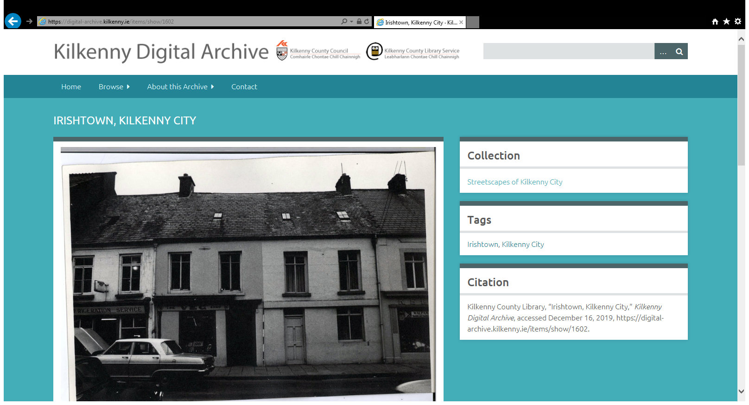

Slide 11
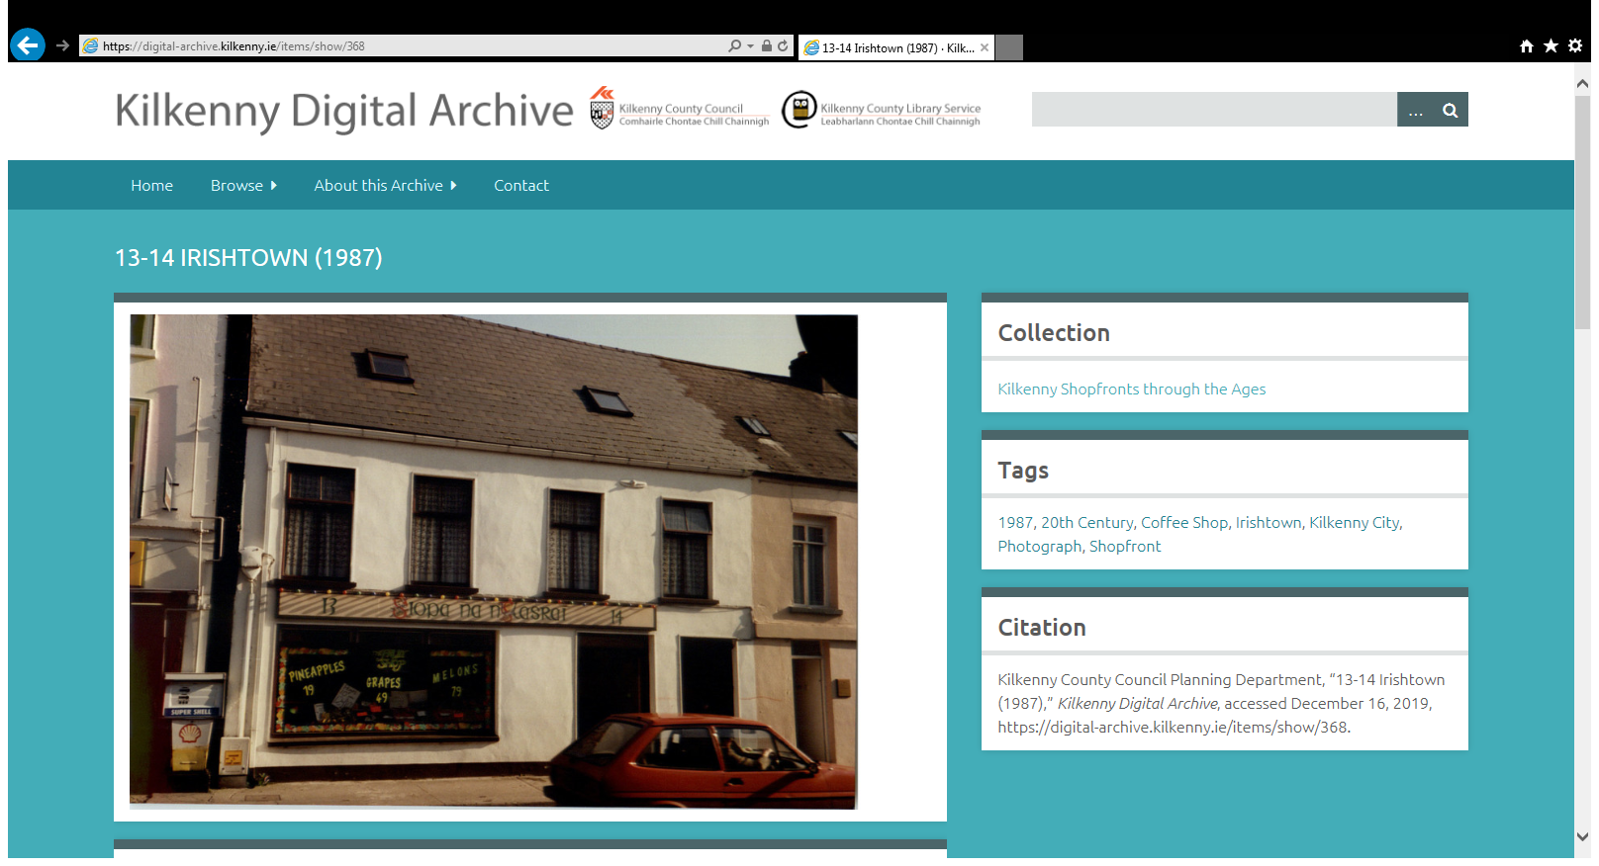

Slide 12
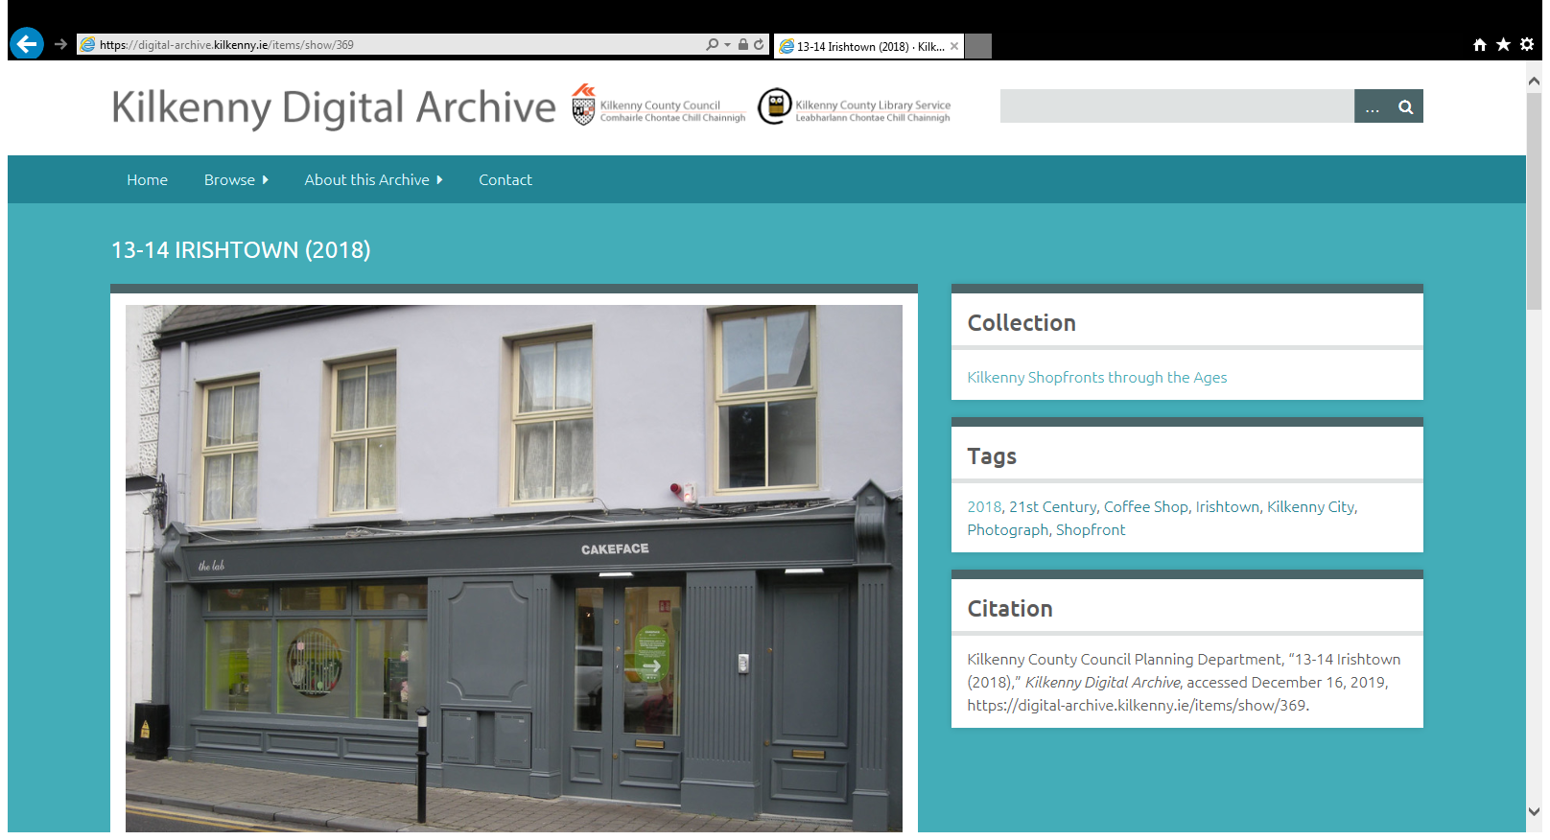

Slide 13
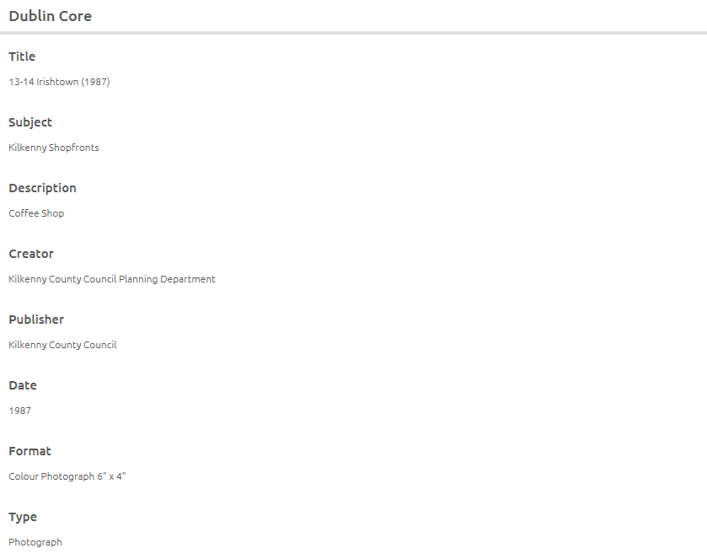

Slide 14
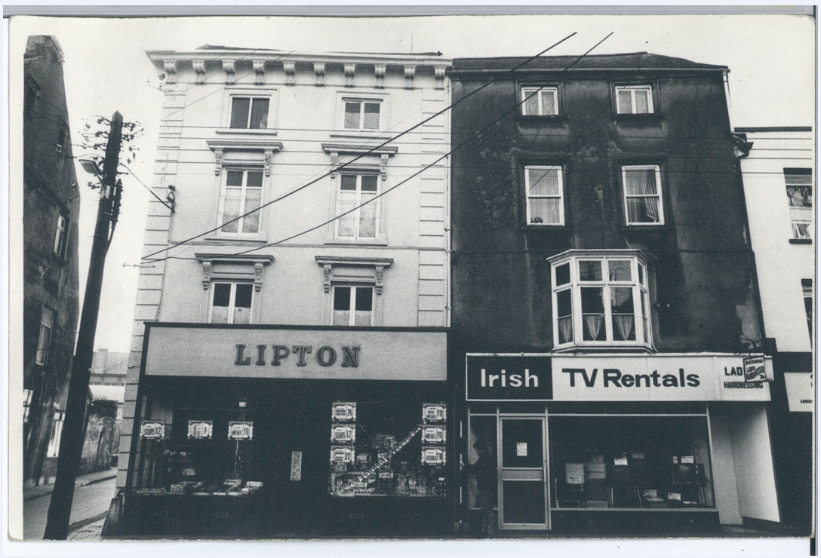

Slide 15
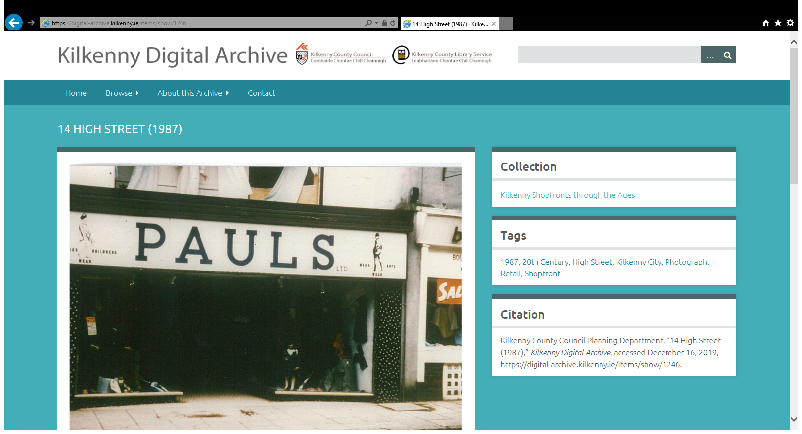

Slide 16
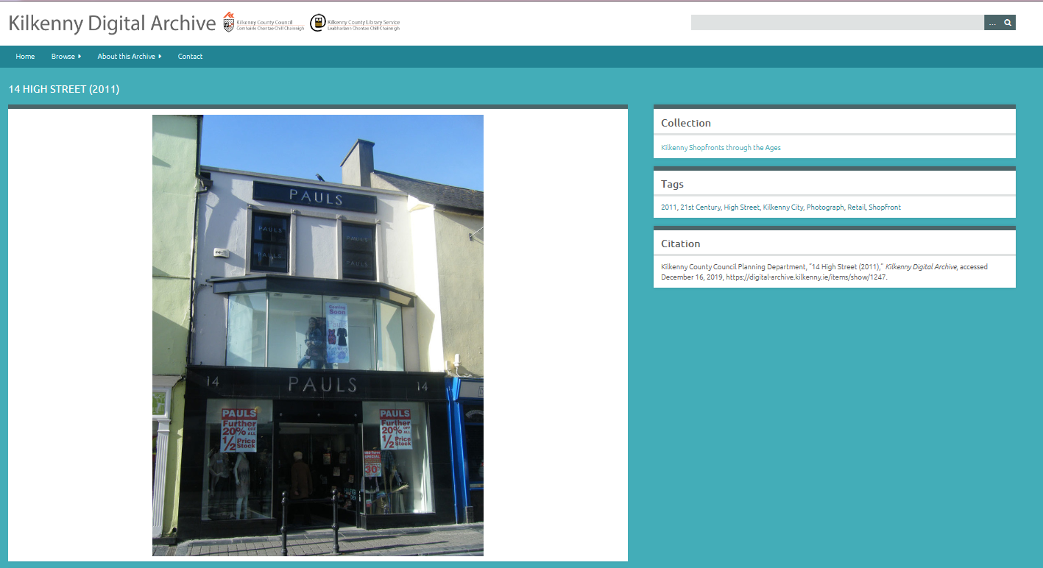

Slide 17
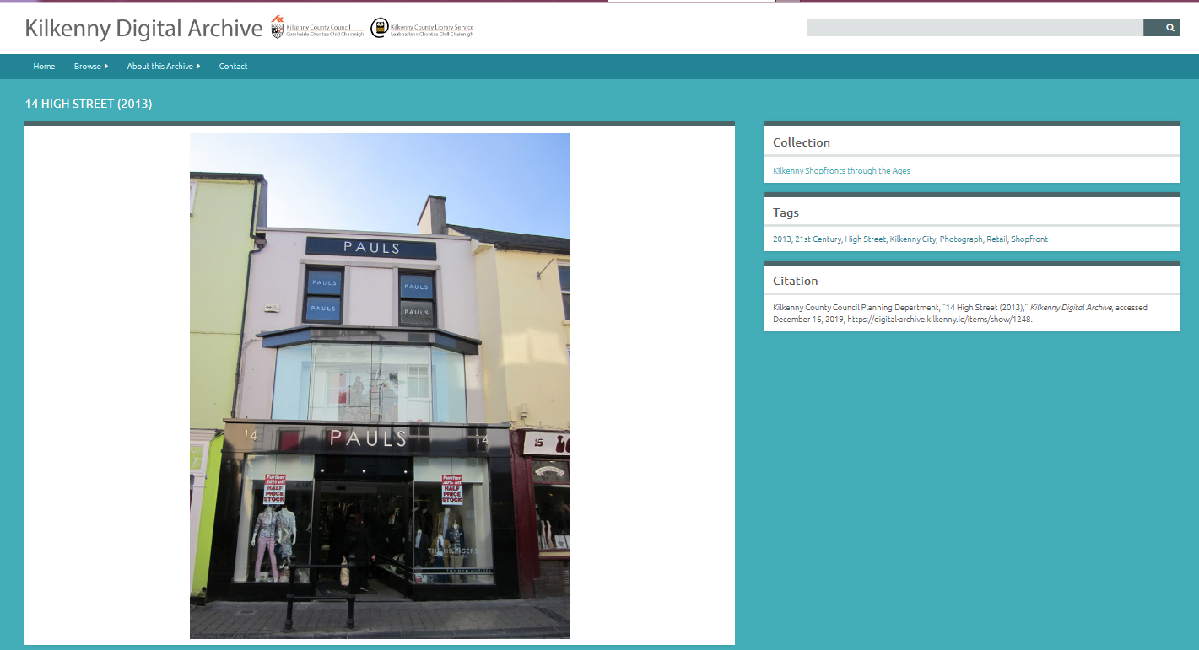

Slide 18
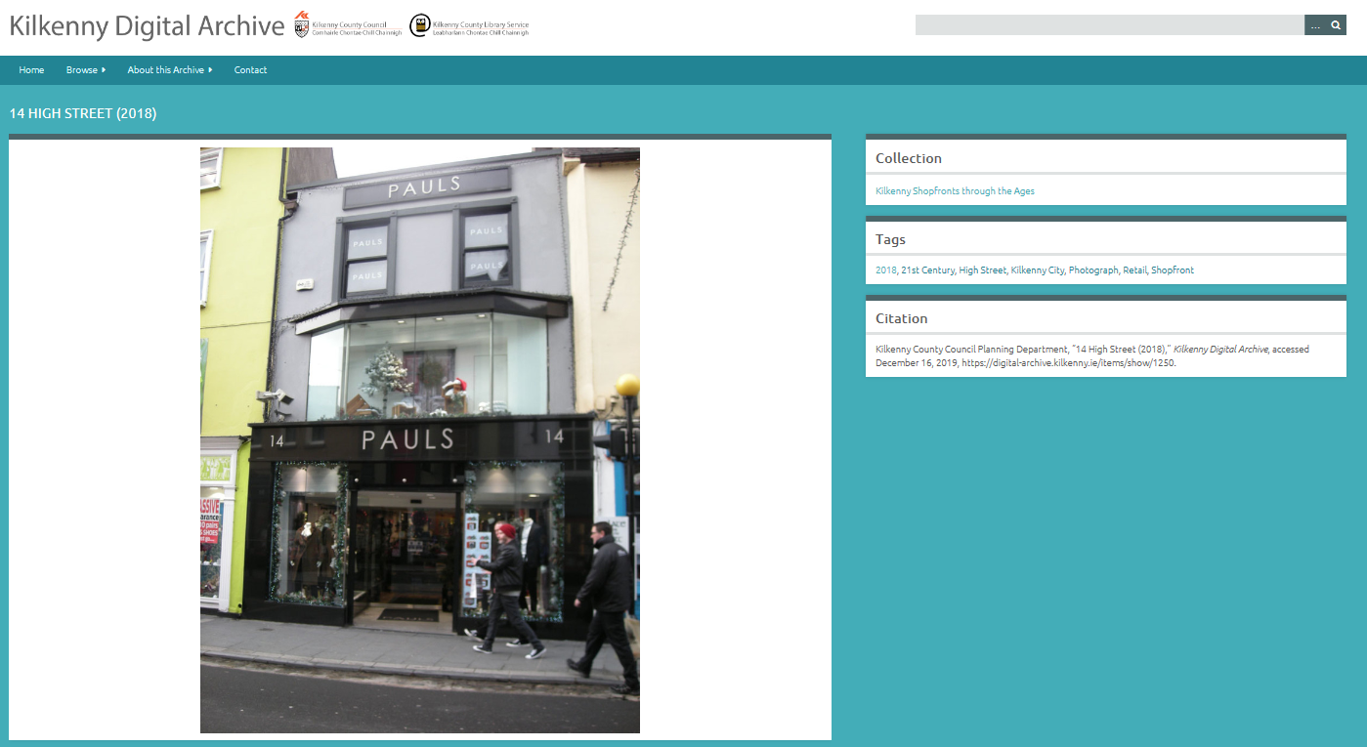

Slide 19
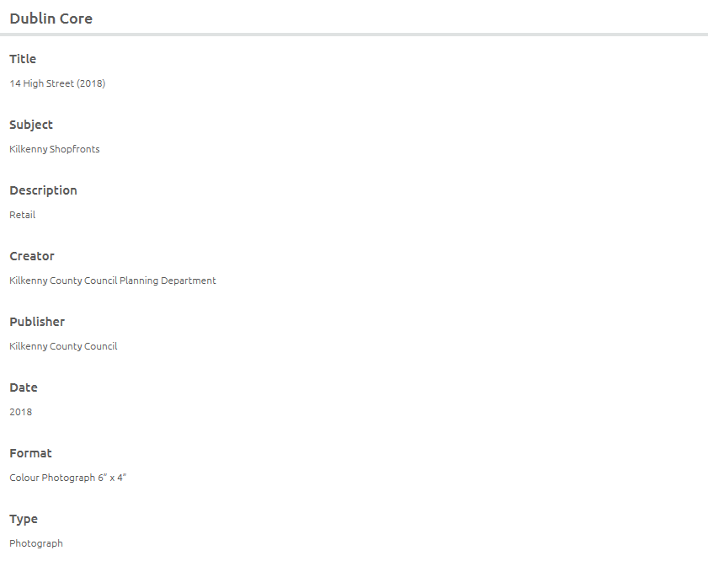

Slide 20
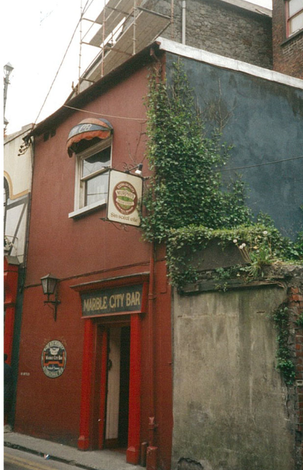
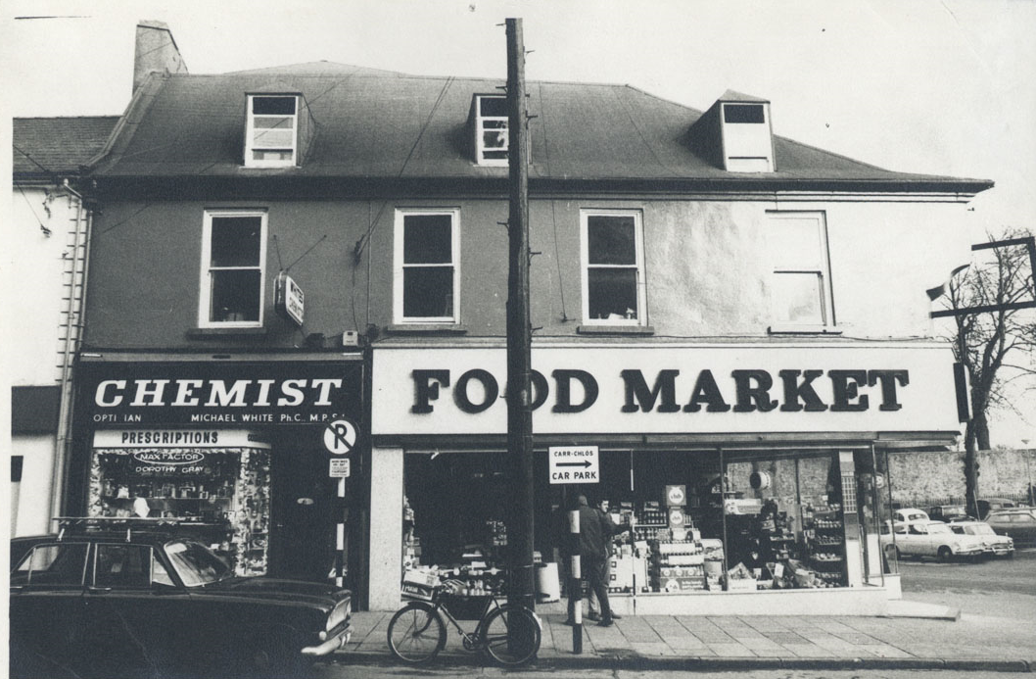
“Kilkenny Shopfronts Through The Ages” forms part of the awareness raising and promotion strand, and combined with the Photographic Audit project currently underway by the Heritage Office, will help focus attention on the heritage and changing nature of Kilkenny’s Shopfronts.

