Slide 1
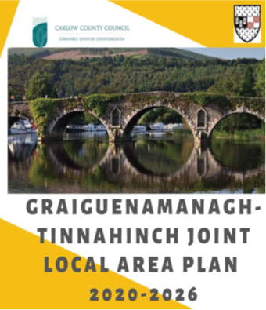
City & County Development Plan
Local Area Plans & masterplans
Denis Malone Nov 18th

Slide 2
Contents
Regional Spatial & Economic Strategy (RSES)
City & County Dev Plan
Local Area Plans
Masterplans
Next Steps

Slide 3
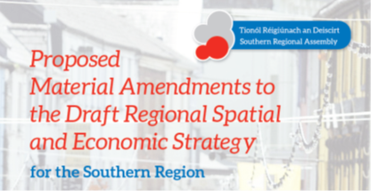
Regional
Spatial &
Economic
Strategy
RSES
Draft RSES Published
Dec 2018
Re-Commence Dev Plan
Jan 2020
Regional Spatial & Economic strategy
National Planning Framework
RSES Adoption
Nov 2019
Public consultation
Till March 2018
Dev Plan
Process suspended
Nov 22, 2018
RSES Amendments Published
Sept 2019

Slide 4


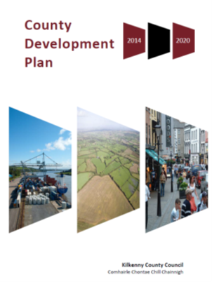
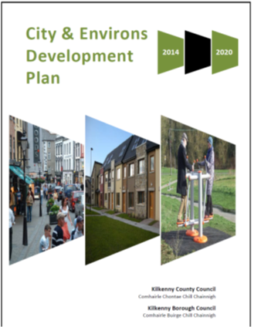
City & County
Development Plan 2021- 2027
+
City & County Development Plan 2021 - 2027
One Plan
Two Volumes
+ Appendices

Slide 5
Process to Date
Commenced April 2018
Public Consultation April – June 2018
Chief Executives Report - Oct 2018
Process Suspended -- Nov. 2018
Background work – ongoing
Retail Strategy - nearing completion ( consultants)
Core Strategy - ongoing ( in house)
Housing strategy – (in house)
Renewable Energy Strategy – ( in house)
Completion of LAPs
Masterplanning
Transport Plan for the City
Holistic approach – movement
Notes:
Consider talking about:
Resource and economic
Environmental
Food security

Slide 6
Process to Date
Official process re start Jan 2020
Loughmacask Masterplan ( consultants)
Fair Green Masterplan ( consultants)
St Canice’s Masterplan ( in house)
Ferrybank Masterplan. ( consultants)
Strategic Environmental Assessment ( in house)
Appropriate assessment ( consultants)
Notes:
Consider talking about:
Resource and economic
Environmental
Food security

Slide 7
Local Area Plans
Graig/Tinnahinch
Meeting held
7th Nov.
38 attended
Closing date for Pre draft
Submissions
22nd Nov.
Ferrybank/Belview-2017
Castlecomer - 2018
Callan- 2019
Thomastown- 2019
Graiguenamanagh- 2020
Notes:
Consider talking about:
Economic
Social
Energy efficiency
Carbon footprint
Reduction in ozone and particulate matter
Soil decontamination
Noise pollution
Nutrition and quality of food
Economy of scale
Health inequalities and food justice

Slide 8
Masterplans
Abbey Quarter
Loughmacask
Fairgreen
St Canices
Ferrybank
Notes:
Consider talking about:
Queensland, Australia
Cairo, Egypt
Havana, Cuba
Mumbai, India
Bangkok, Thailand
China
Harare, Zimbabwe
United States
Canada
UK

Slide 9
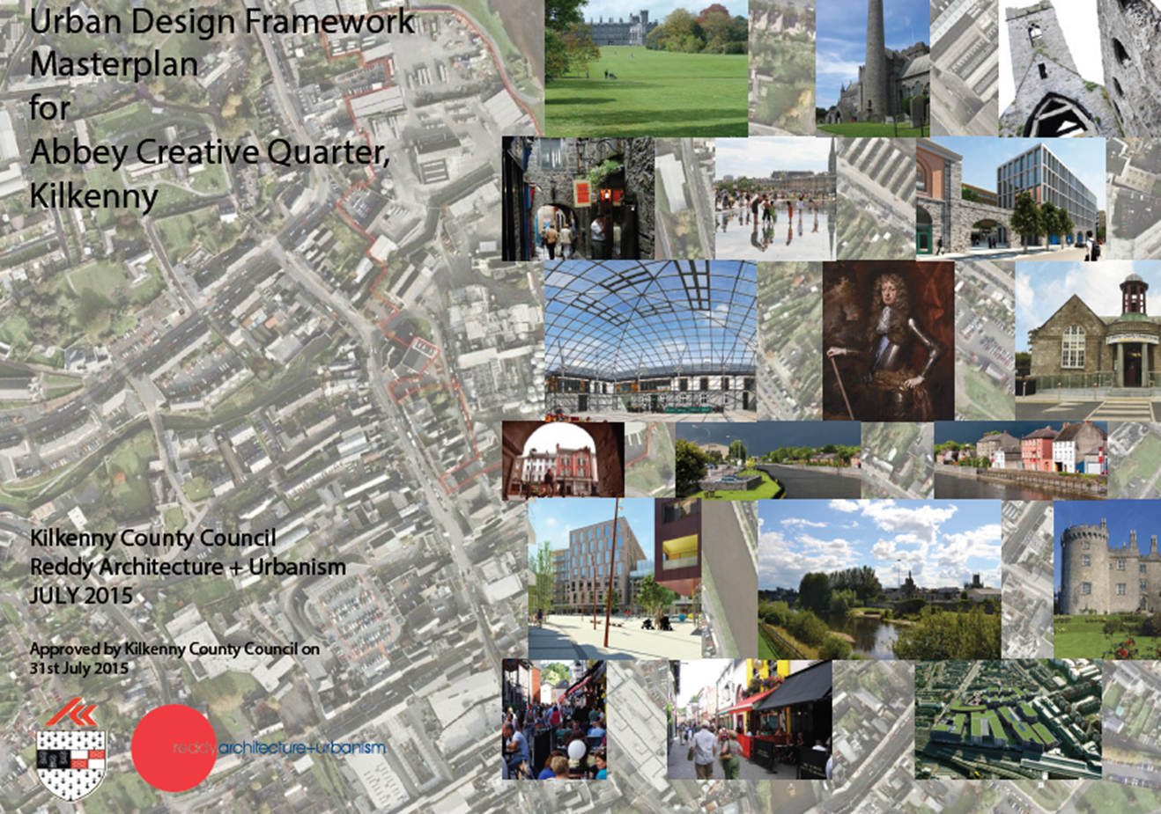
Abbey Quarter
Masterplan Document –
  Vision
  Policies to achieve it
Urban Design Code
  Puts flesh of the vision
  Identifies blocks
  Identifies mix of uses

Slide 10
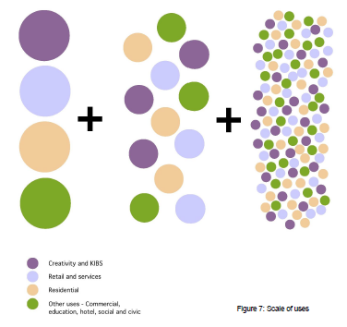
Types & Mix of uses
Broad Land use Category | Target
Creative & KIBS | At least 10%
Retail & Services | 15% - 20 %
Residential | 30% - 35%
Other uses including commercial, education boutique hotel, social and civic uses, or additional creative and KIBS and/or residential use | The remainder

Slide 11
Other Masterplans
Loughmacask
Fairgreen
St. Canice’s Hospital
Ferrybank

Slide 12
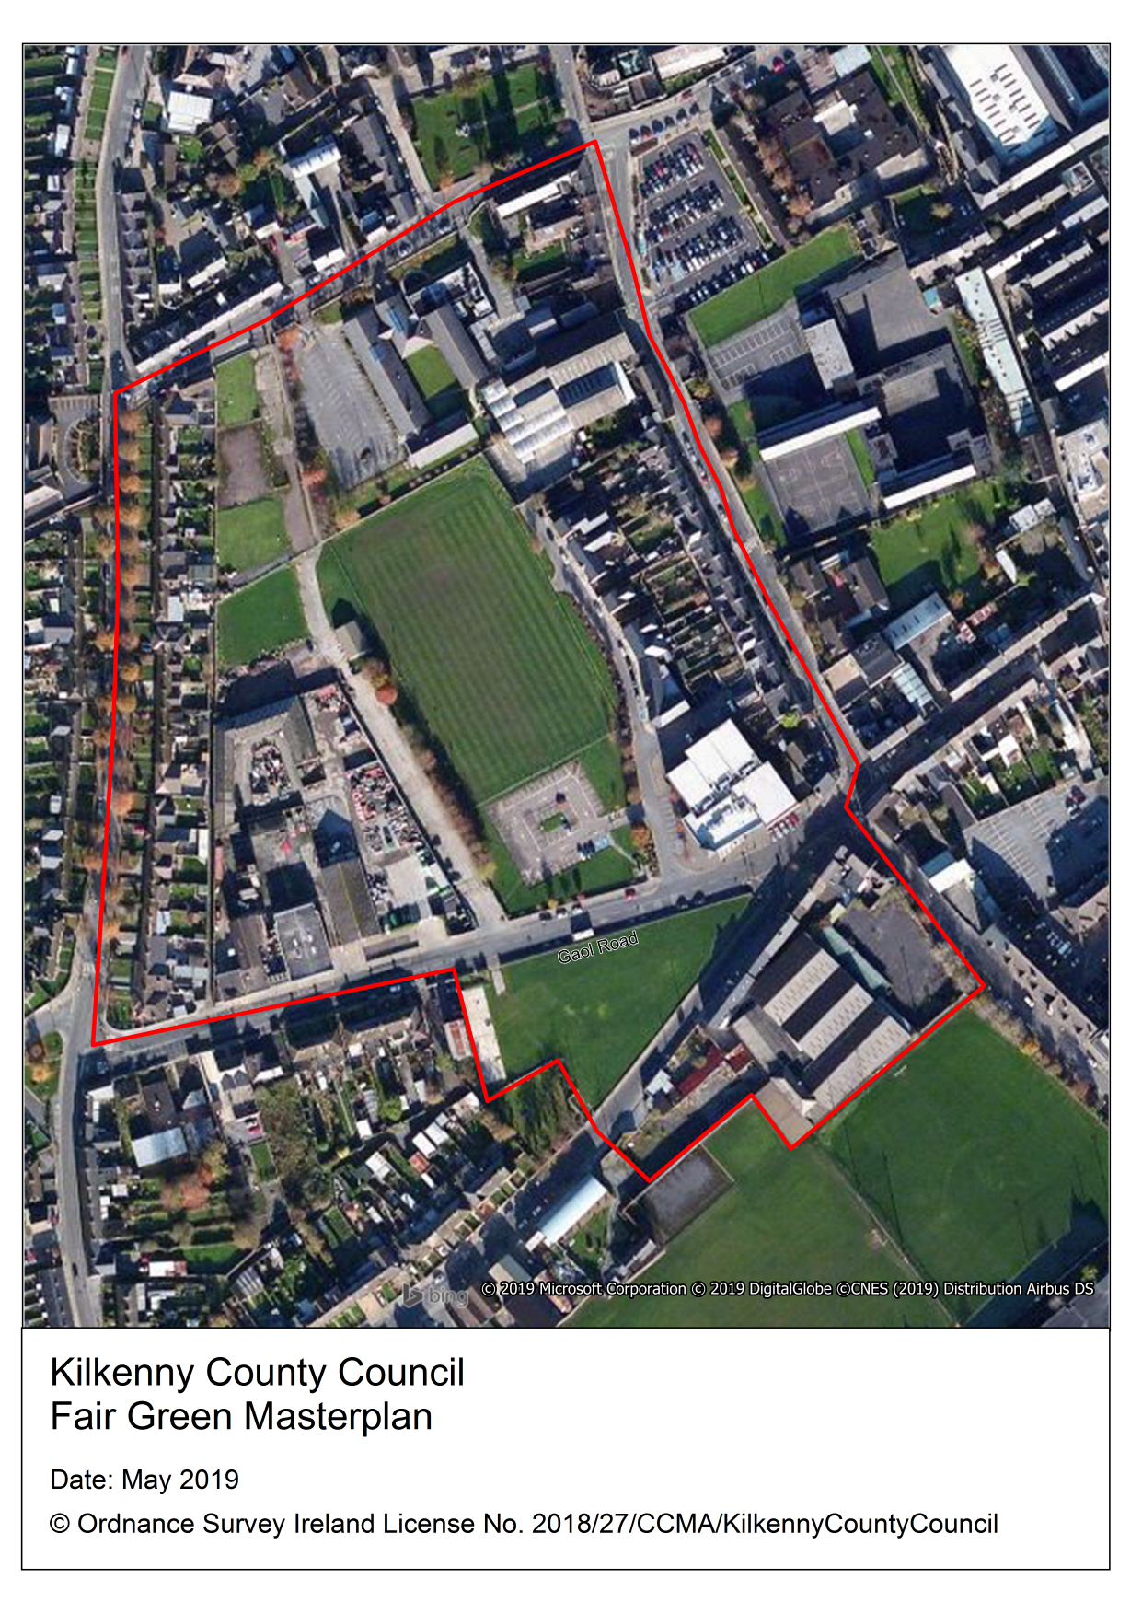
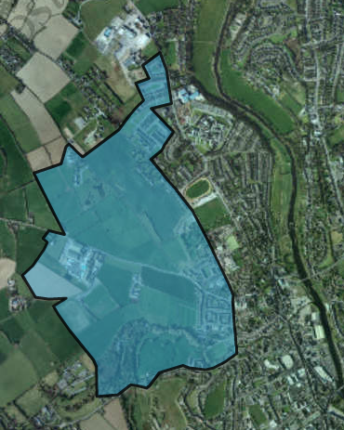
Loughmacask Masterplan

Slide 13
Next Steps
Complete background work on:
  Retail strategy
  Housing strategy
  Core strategy
  Renewable energy
  Heritage
  Environment
  Climate Change Actions
  Draft Q2 2020 (April)
Adoption Q1 2021
MasterPlans
  Public consultations
  Draft documents
  Final adoption Q2 2020

