Slide 1


ENVIRONMENT SECTION
Highlights 2019 & look forward to 2020

Slide 2
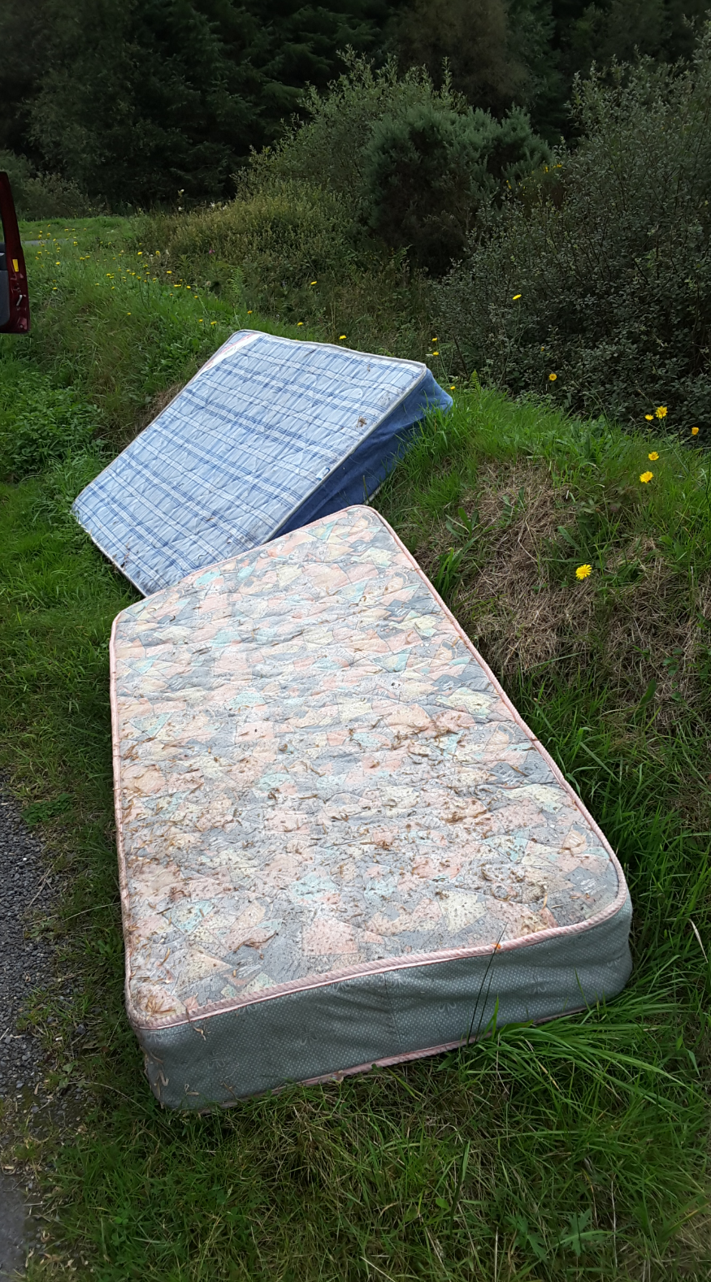
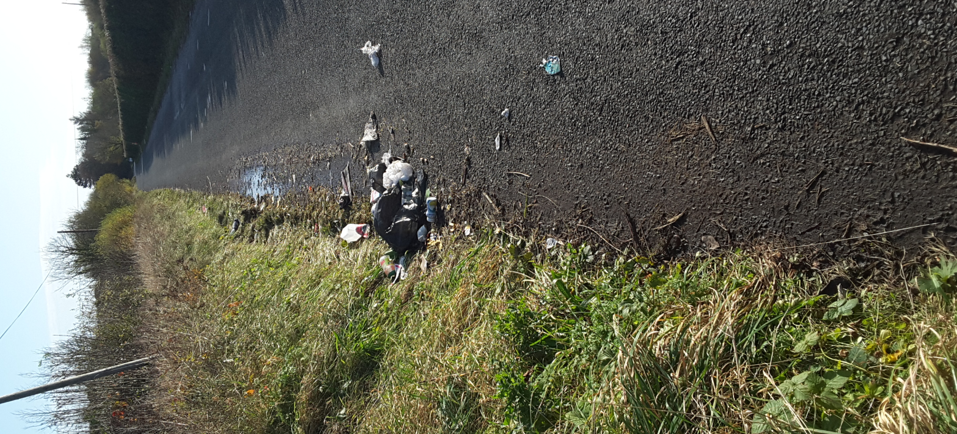
CRM – Customer Relations Management
System
2019 – Complaints Received
1066 Received - given unique I.D. No.
688 Litter/ Fly-tipping
216 Illegal dumping
42 Water/Waste Water
62 Air /Odour
45 Dead Animals
9 Noise
4 Miscellaneous
1014 Investigated & Closed
52 Carried into 2020 still investigation.

Slide 3
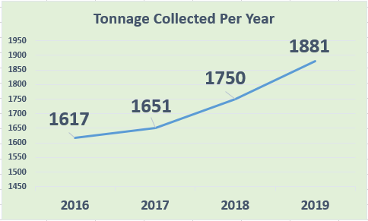
Continued growth in usage of Recycling Bring Centres
Bring Centres increased from 43 to 46
ALDI Ferrybank June – 25 tonnes
Urlingford June – 21 tonnes
The Rower June – 5 tonnes
Bring Centre in Graig & Stoneyford relocated
Signage upgrades - 11no. Bring Centres
Enforcement Equip. – 10 no. CCTV
1,775t glass & 106t of alum and steel.
Loughboy Shopping Centre remains the busiest with 130 tonnes.
----------------- 2020 ---------------------
Continue roll-out signage improvements
Relocation / Enhancement of Inistioge
Complete branding of Textile Banks

Slide 4

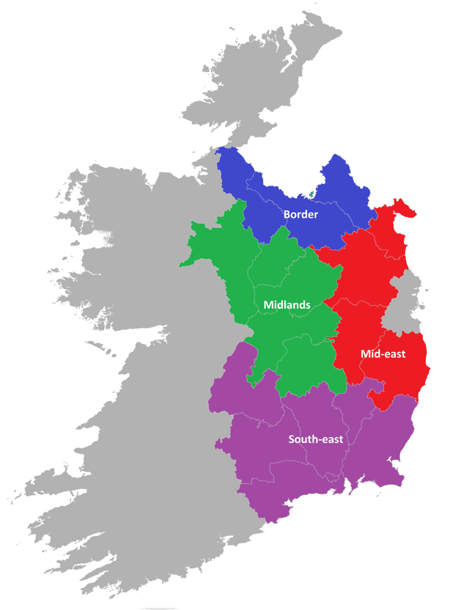
Climate Action Regional Office (CARO)
April 2018 – 5 year funding from DCCAE
CARO Mandated to:
Build on Experience & Expertise
Coordinate and Facilitate Climate Action & Build Capacity within LA Sector
Coordinate Engagement across Various Agencies and Government Departments
Translate Sectoral Efforts to Local Level
Competitive Process – Kilkenny Co. Co. Partner Authority – April 2019
CCAS adopted Sept 2019, 95 Actions, 116 Sub-actions up to end 2020.
Nov 2019- Senior Staff Workshop, Sub-actions increased to 235 with designated Lead Section, Lead Person, KPI – End of year report on progress
Whole Organisation Plan encompassing all Sections

Slide 5
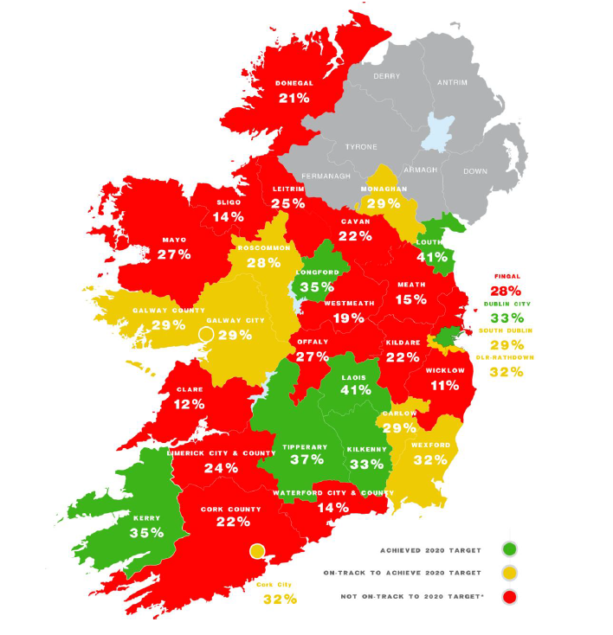
Energy Usage 2020 & 2030 Targets
The Public Sector in Ireland is tasked with reducing their energy consumption by 33% by 2020 from their baseline year.
The baseline year for Kilkenny County Council is 2009
Draft Local Authority Energy Performance Review 2019
2030 Target 50% from base Year
The international standard ISO 50001 specifies requirements for establishing, implementing, maintaining and improving an energy management system

Slide 6
Control of Horses
Statistics 2020 (To-date)
Between Sept 18 & March 19 50 - 70 in City & Environs
Reduced to 30 – 35 horses now
28 No. of Horses Seized
4 No. Horses Surrendered
1 No. Horse returned
15 sites identified in Private Ownership- seeking agreement (11)
Cost per animal Circa. €1,143 for 5 days
Low value, easy to replaced
Bye-laws 2020
Enact existing 2015 Bye-Laws
Exclusion Zone Areas – 20 Streets
Legal clarification sought
FPN / Prosecutions
Demarcation
Present Draft to SPC in 9th March, subject to recommendation
Public consultation March/April

Slide 7
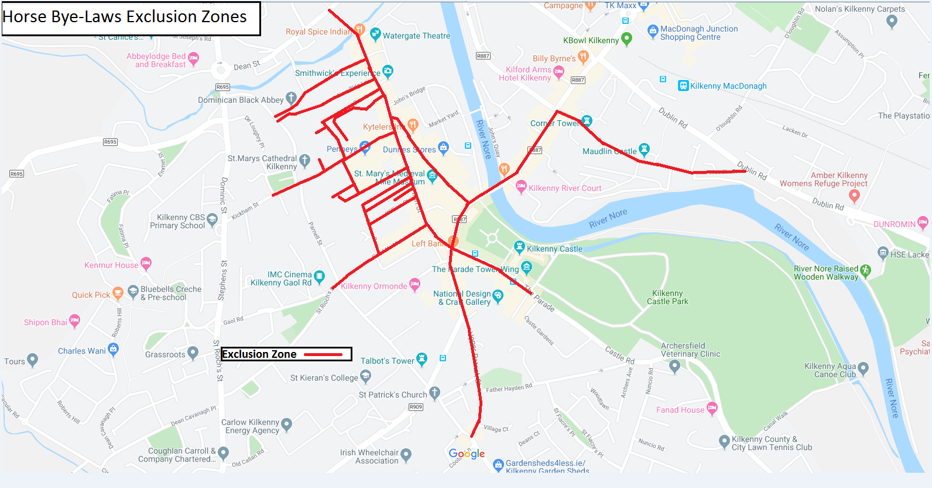
Control of Horse Bye-laws 2020

Slide 8
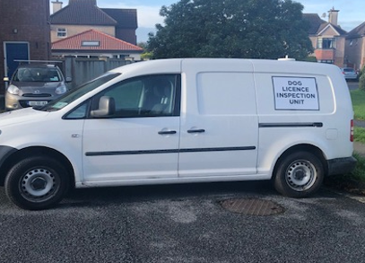
Dog Licence Inspection Unit
Control of Dogs Acts
DLIU commenced Mid Oct 2019 (Media Campaign)
Difference 18/19 v 19/20 = 554 v 1623
Increase of 1069 Licences circa. €21,000 over last 4 months.

Slide 9

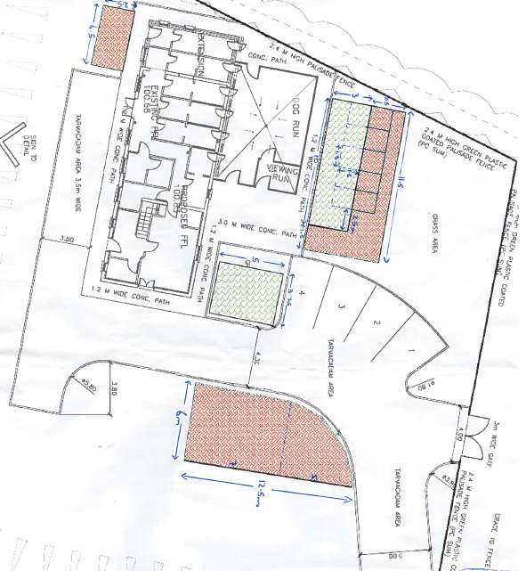
2019 Figures
517 Dogs surrendered or picked up
322 Rehomed
192 Reclaimed
3 PTS Due to health problem or aggressive behaviour
Service Provider / Dog Welfare & Charity Organisations
_____________________________
Enhancement Works 2020
(Part funded by Carlow Co. Co.)

Slide 10
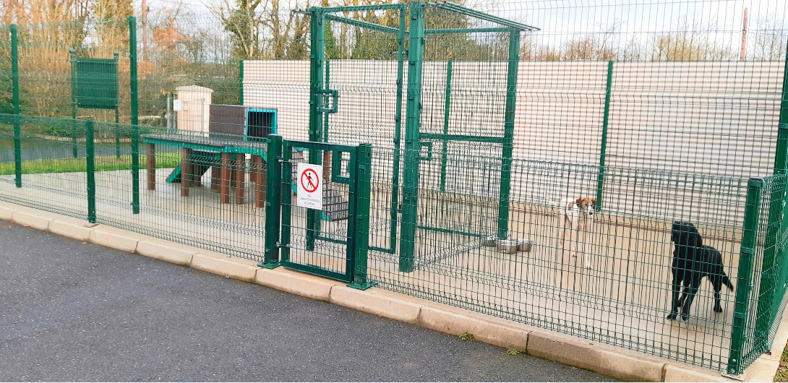
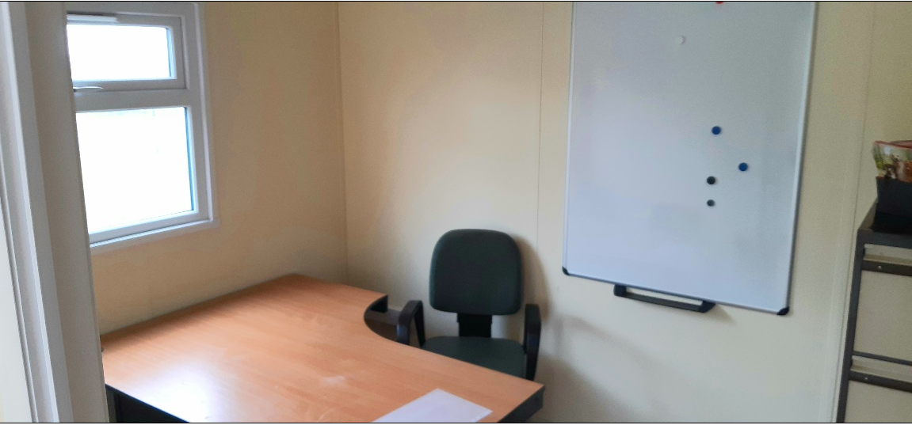
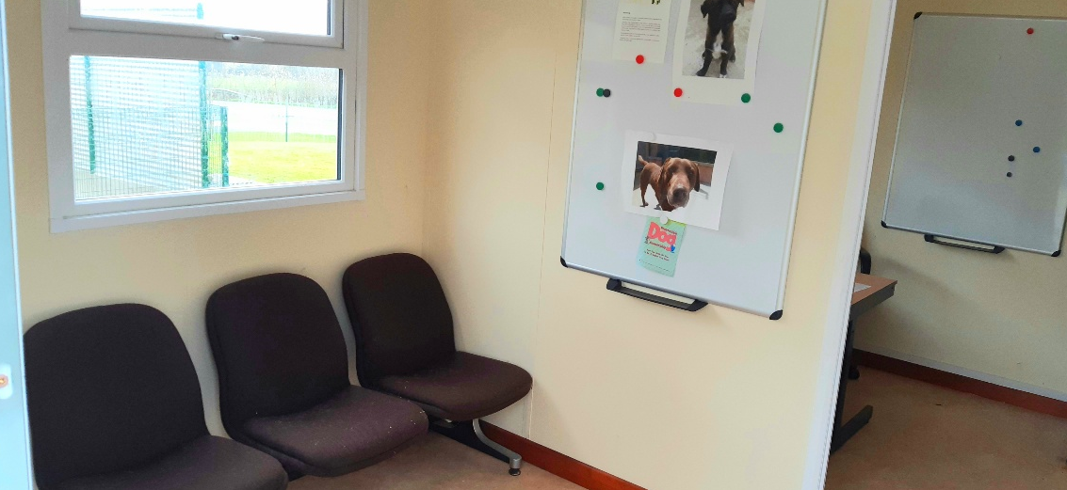
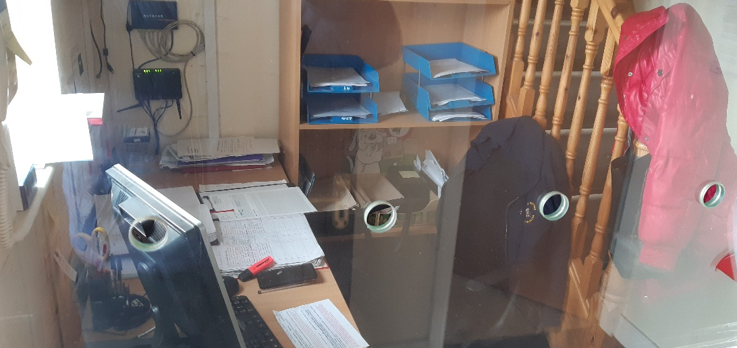
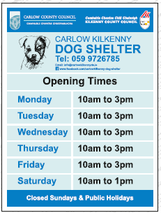
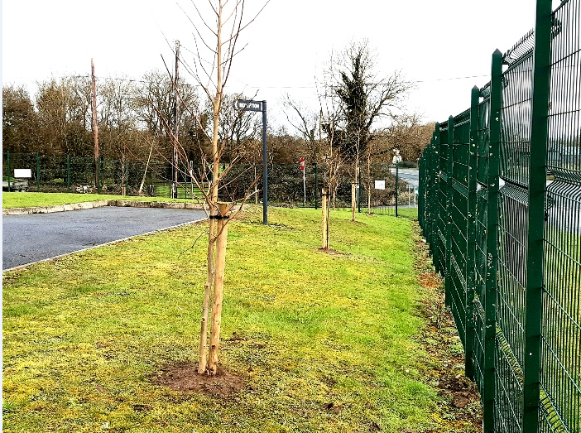
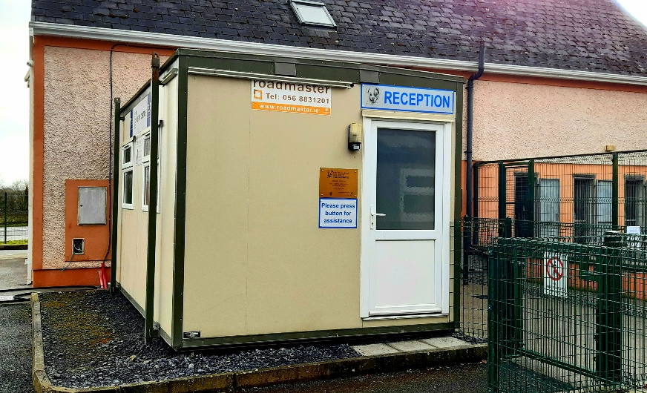
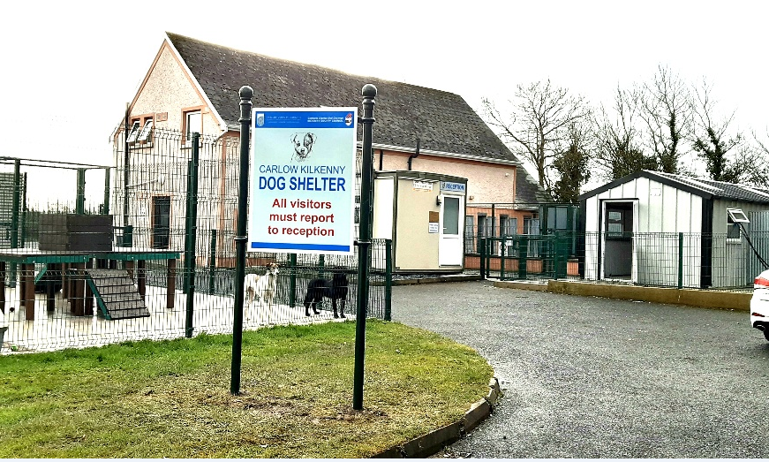

Slide 11
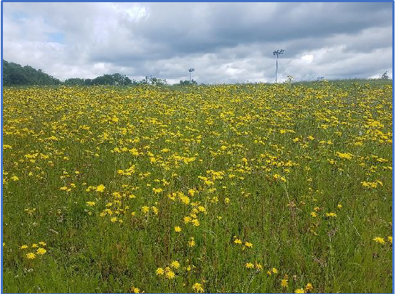
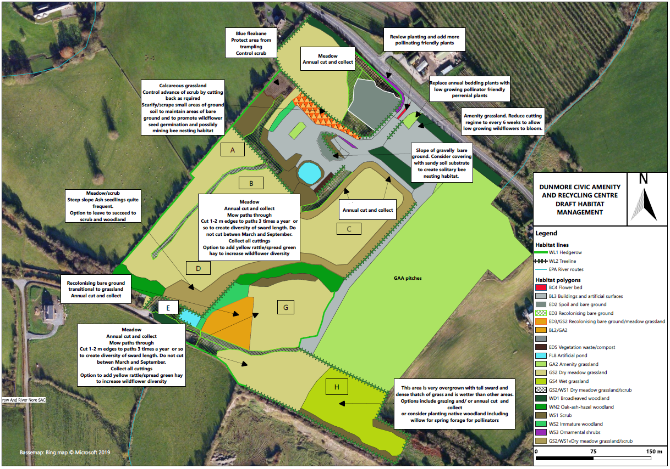
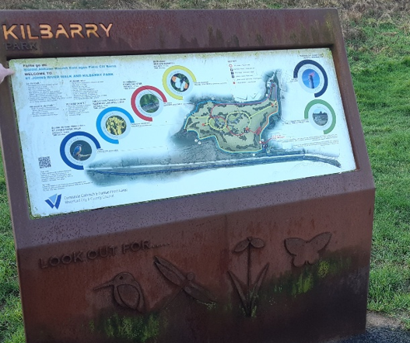
DUNMORE NATURAL AMENITY AND BIODIVERSITY PARK
17 Acre site circa. 5km from City Centre
Habitat Survey & Management Plan for Pollinators – Draft Report Sept 2019 – Good mix of habitats
Pollinators Plan for Kilkenny
Engage consultants to develop proposal to create a natural amenity & biodiversity park-
Target – Families –young kids with bikes, walkers, runners, clubs, dog owners, schools - outdoor nature classes
Needs to be high end design and finish to attractive visitors from City and County.
Potential future links back into city
Funding potential - ORIS

Slide 12
What We Do
R.M.C.E.I. Recommended Minimum Criteria for Environmental inspections
1,100 Environmental Complaints received Annually
4909 Inspections planned for 2020
Annual Reporting Back to EPA. Kilkenny Currently have an “Excellent” status
  Waste
    Litter
    Packaging
    Waste Collection Permits
    Waste facility Permits
    Tyres
    End of Life Vehicles
    Construction & Demolition waste
2. Water
  Farm Inspections
  Planning Inspections
  Septic Tank Inspections
  River Water Quality
  Small Stream Risk Scores
  LAWPRO & LAWCO offices
3. Noise
  Noise Action Plan
  Planning restrictions
  Events
4. Air
  Smokey Coal
  Air Monitoring Stations

Slide 13
National RMCEI score “Excellent”
KKCOCO used by EPA as reference Local Authority.

Slide 14
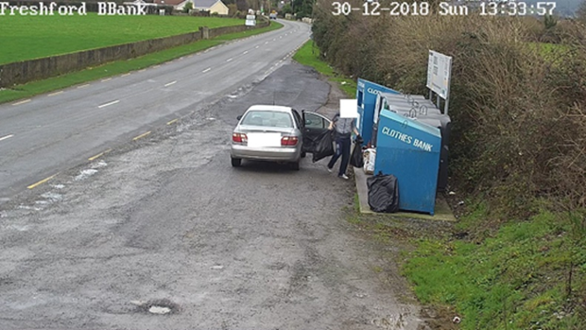
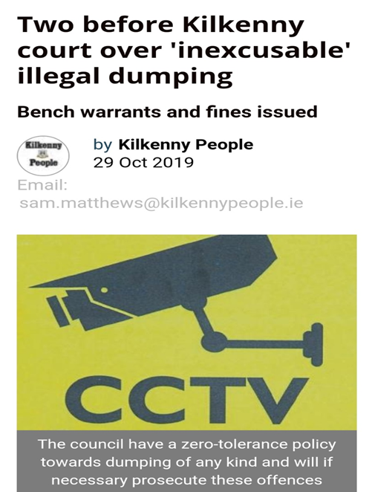
Enforcement.
Southern Waste Enforcement Regional Lead Authority
Enforcement Activity for 2019.
330 Enforcement Actions Across Waste/Water/Air/Noise
24 Fixed Payment Notices issued @ €500 each
16 sites that will investigated with a Multi Agency task force i.e. Revenue, Dept. Social Protection and an Garda Siochana
109 Litter Fines issued
9 prosecutions. 4 further cases pending.

Slide 15

“Wherever waste is, there’s criminality somewhere.”

Slide 16
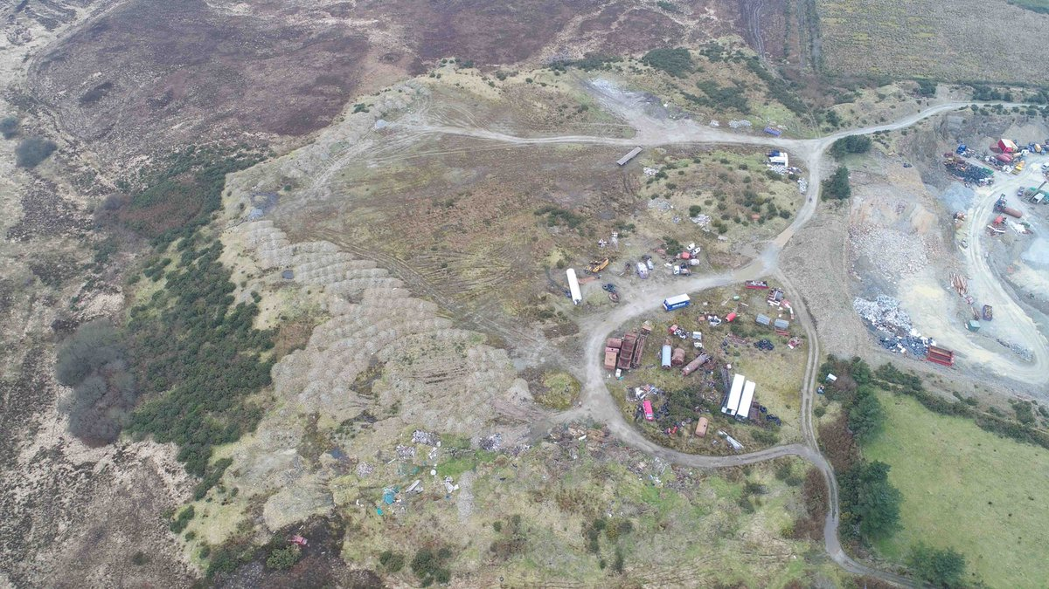
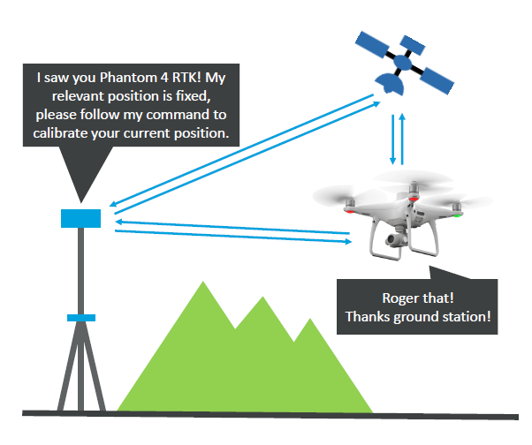
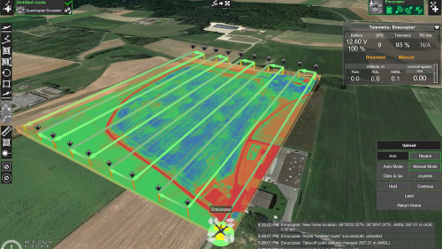
Anti Dumping Funding 2019-3D Survey Drone –
Before
After
Surveying both authorised and unauthorised sites used to be very time consuming and expensive. With this new technology sites can be 3D mapped and volumes detected to incredible accuracy in very little time.

Slide 17
Anti Dumping Initiatives

Slide 18
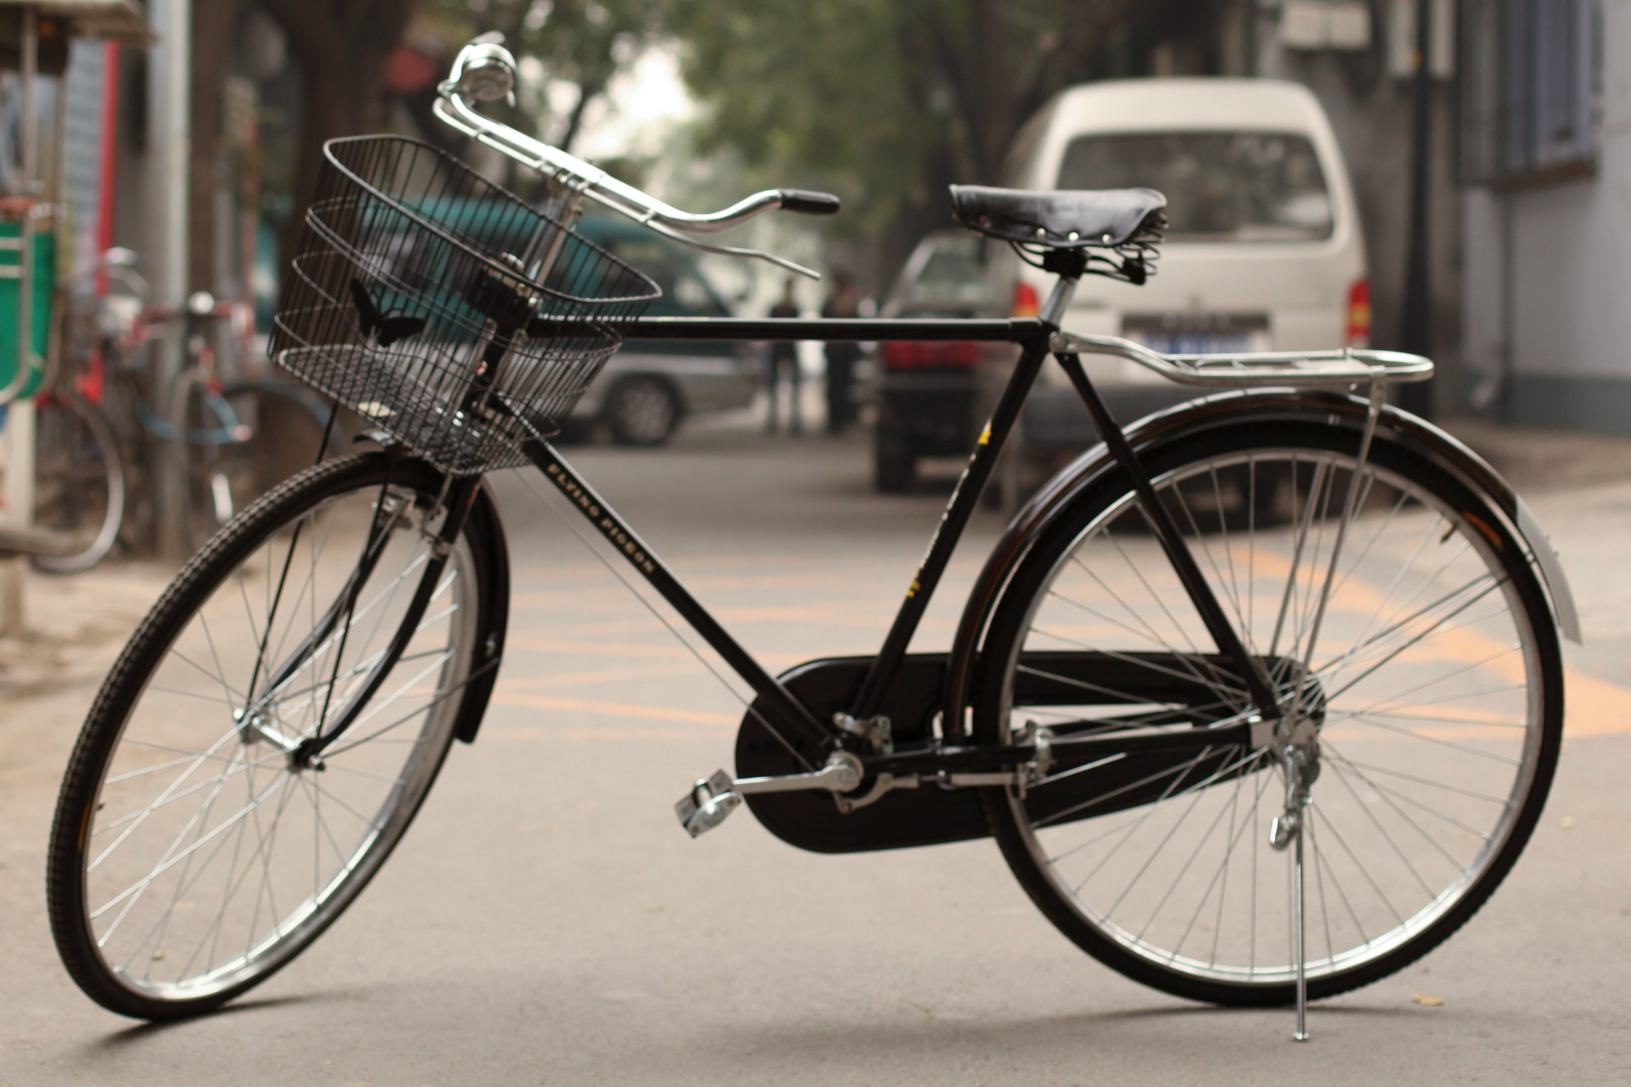
ADI-Bikes for Africa and Kilkenny County Council Bike Scheme 2020

Slide 19
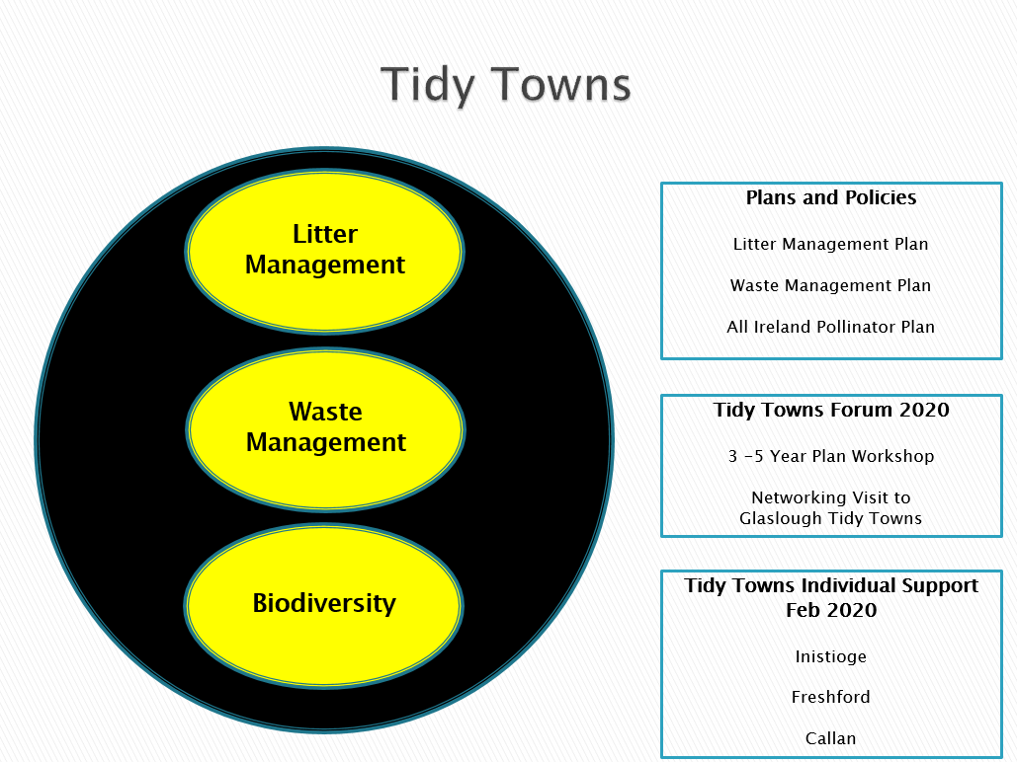
Environmental Education & Awareness

Slide 20

Litter Management Plan 2018-2020
Dog Friendly Walking Routes
Dog Friendly Area
Dog Fouling Campaign
Dogs Trust – Big Scoop Campaign
County Litter Campaign (12yr-25yr)

Slide 21
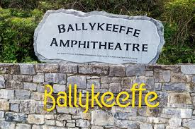

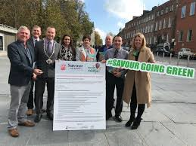
Kilkenny County Council Green Charter for Festivals and Community Events

Slide 22


