Slide 1
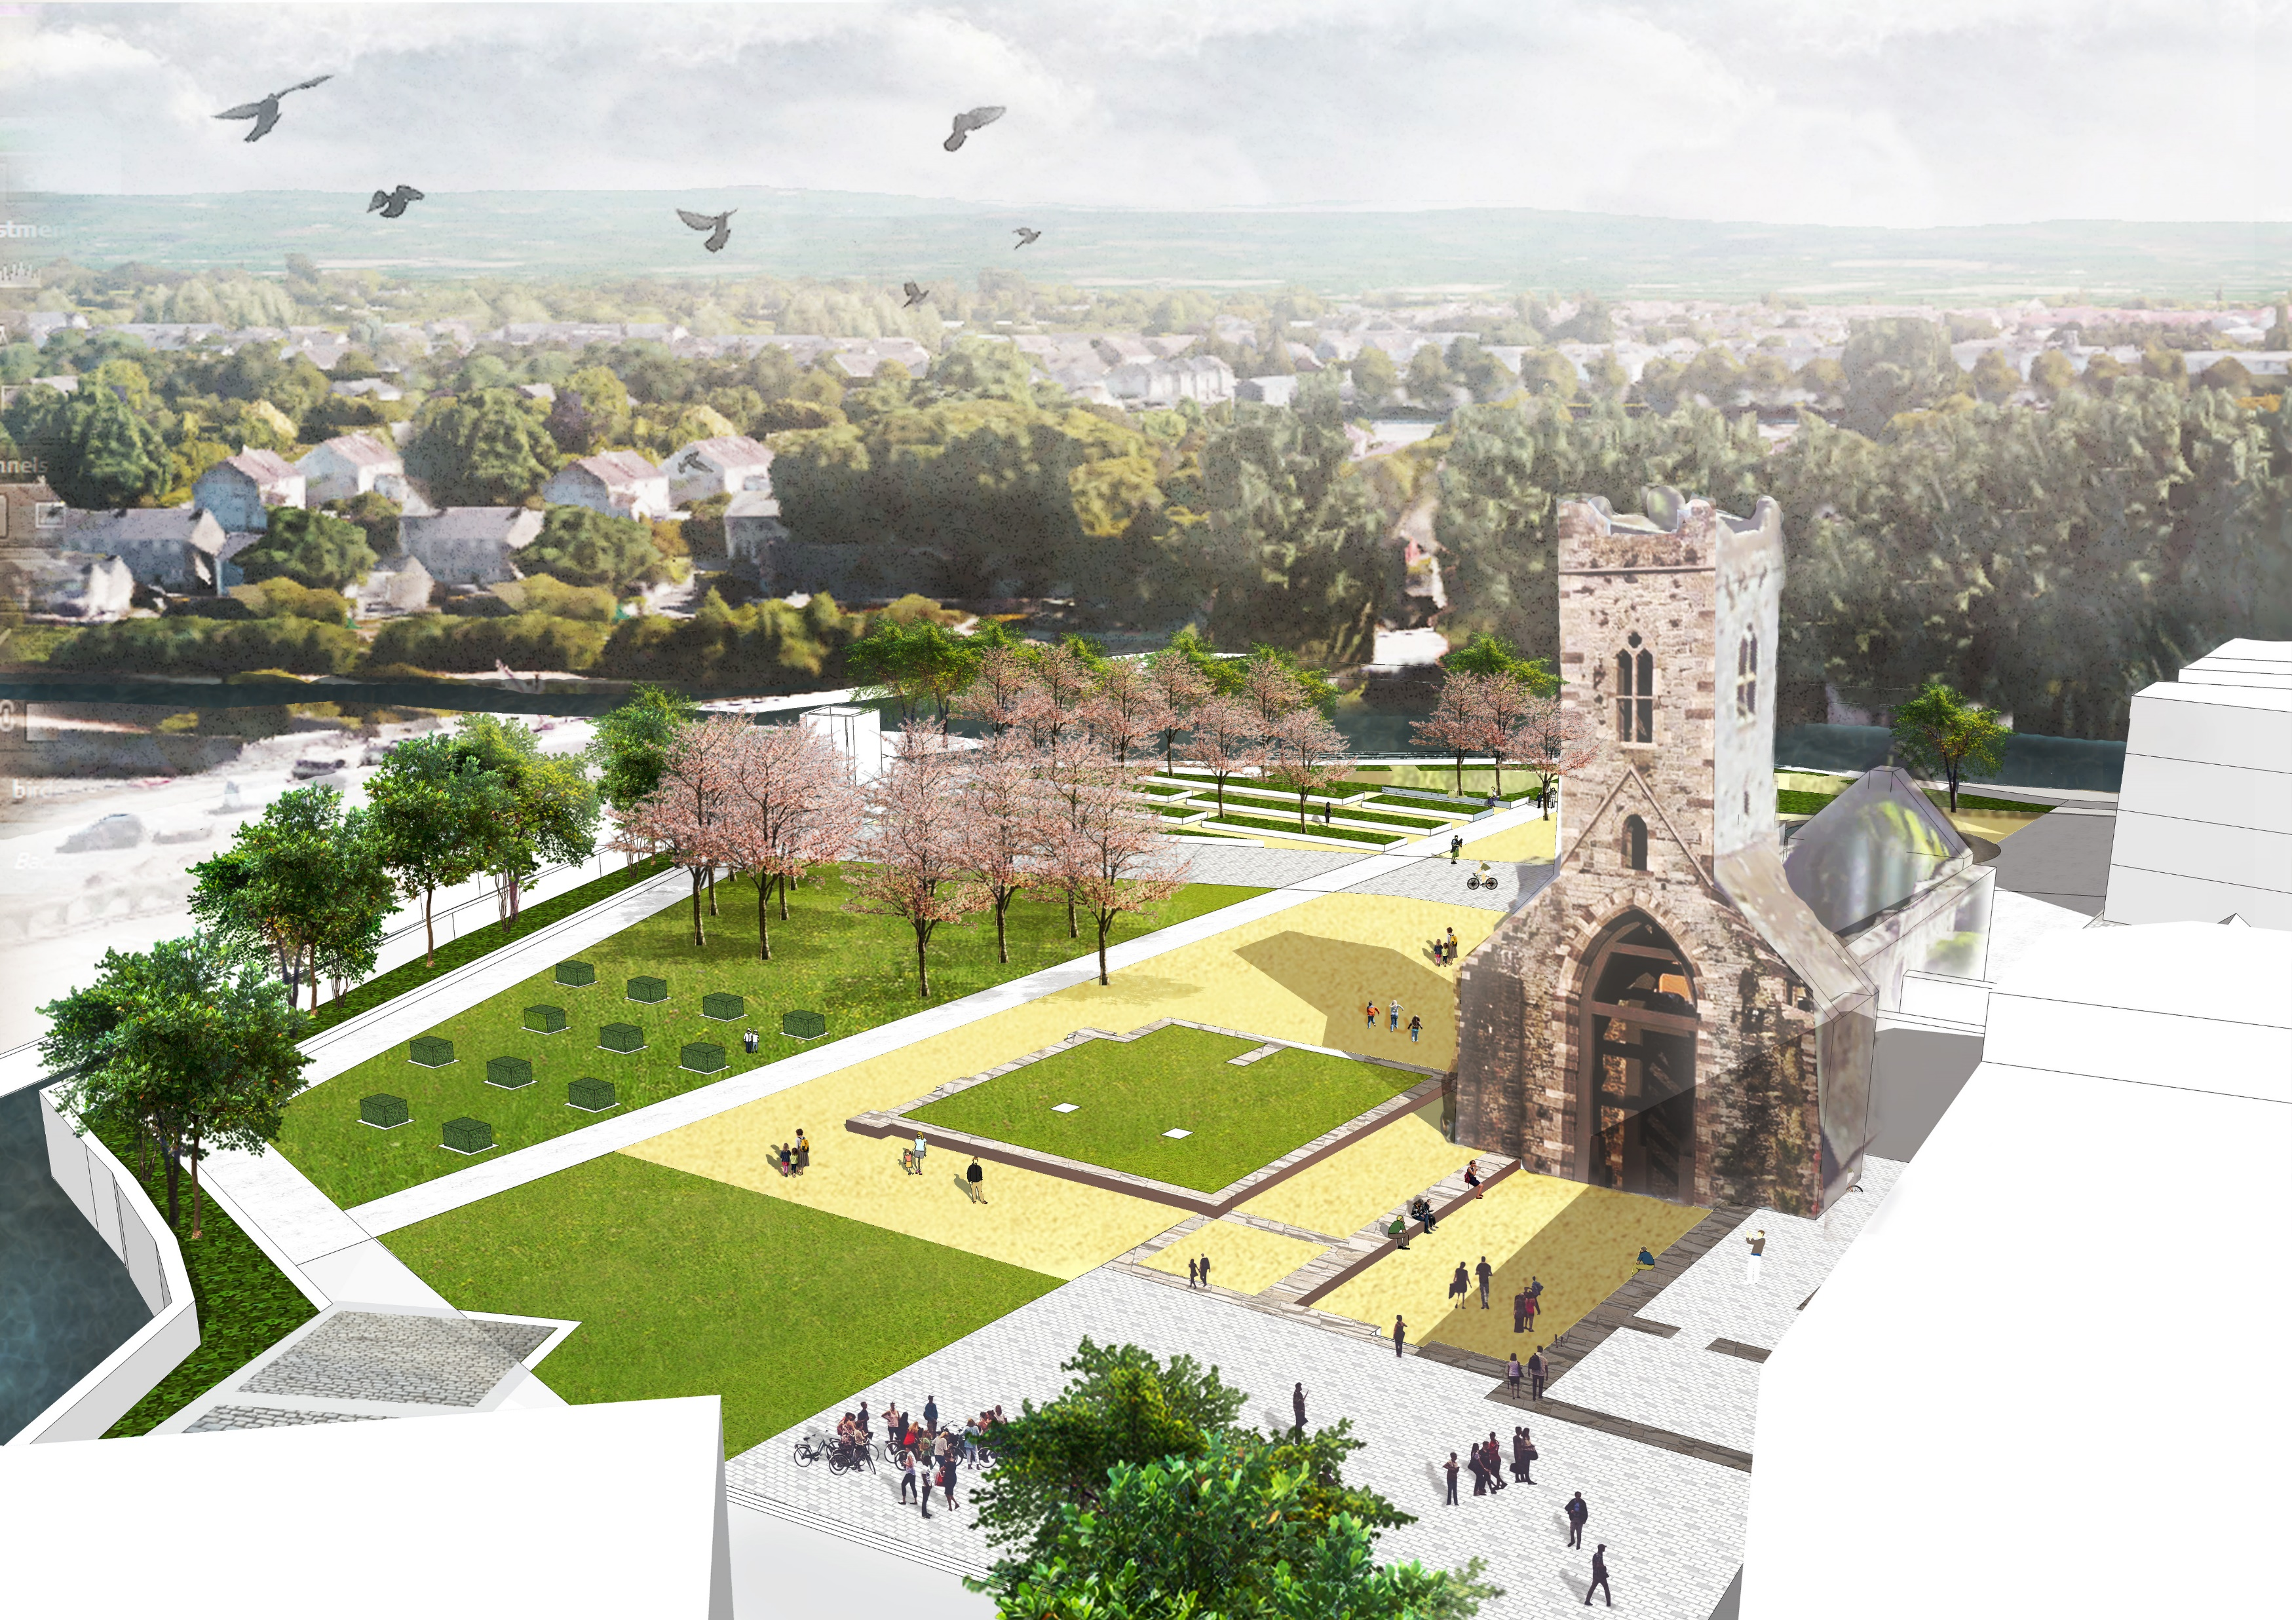
Abbey Quarter Update
June 2020

Slide 2
Brewhouse Project (incl. Horse Barrack Lane & Courtyard)
River Side Garden Project (incl. Skate Park)
Mayfair Library
Tea House Restoration
Urban Street & Park Project
Phasing

Slide 3
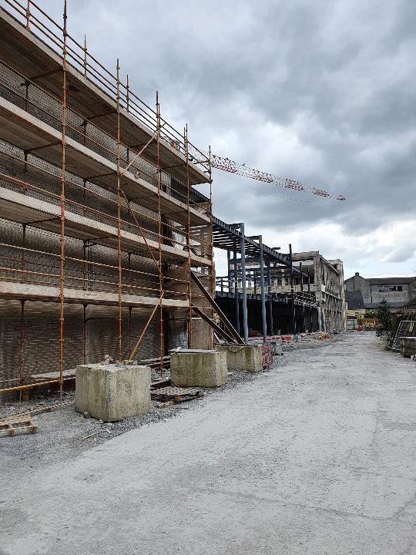
Brewhouse Project
including Horse Barrack Lane & Brewhouse Courtyard
Mythen Construction commenced on site on 15th July 2019
Work to date has focused on the Brewhouse Building with work on the public realm areas only commencing now.
Funding sources for Public Realm
  European Regional Development Fund
  Urban Regeneration and Development Fund
  KCC
Programme
  70 week programme to November 2020.
  Works suspended on site from 23rd March to 18th May inclusive ( 8 weeks)
  Some delays experienced on site to date.
  Revised programme is awaited but expect to be completed by March 2020.

Slide 4
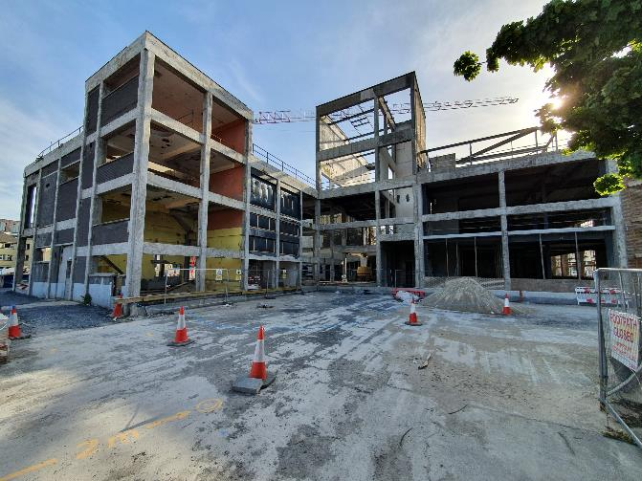
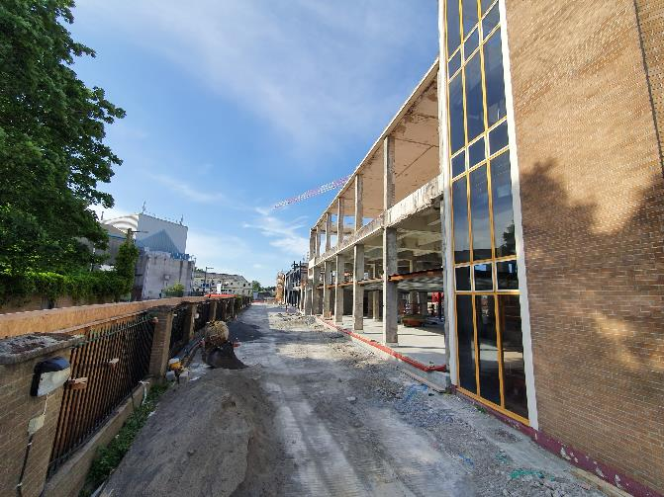

Slide 5
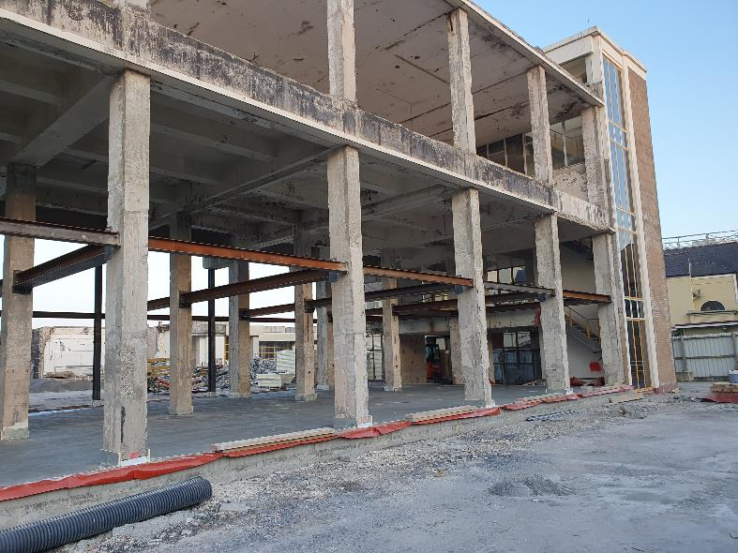
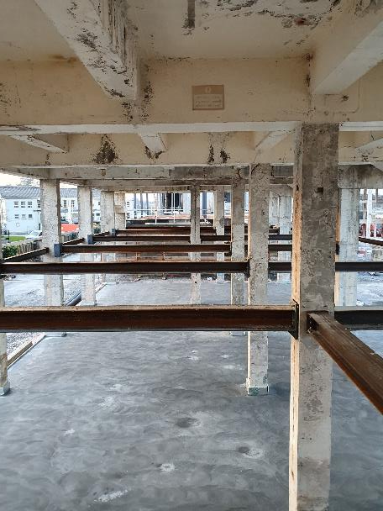

Slide 6
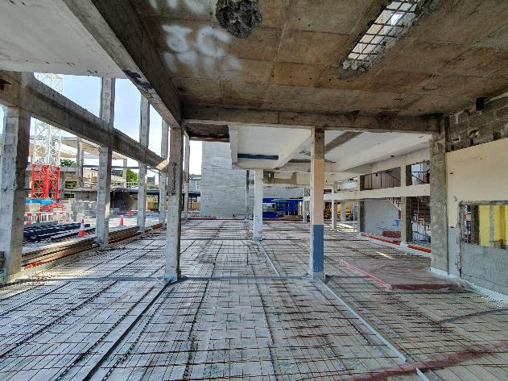
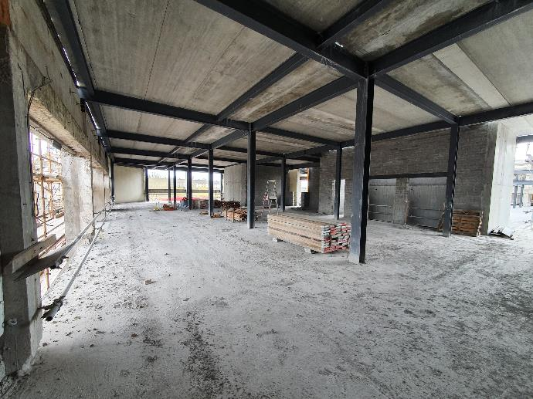

Slide 7
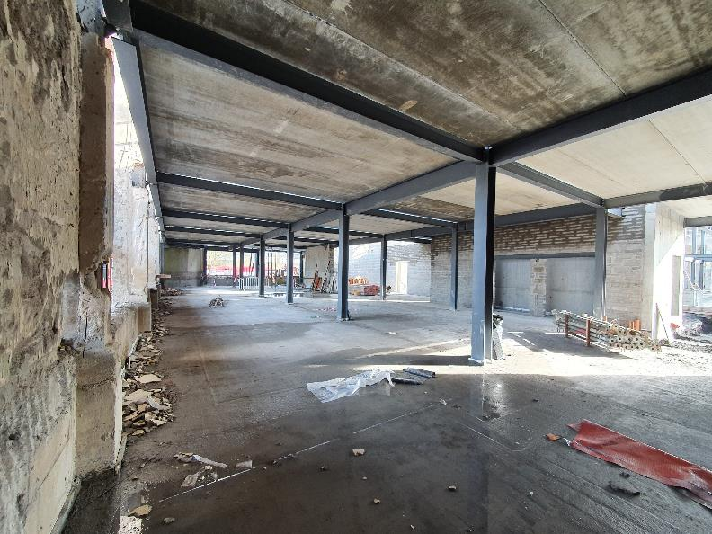
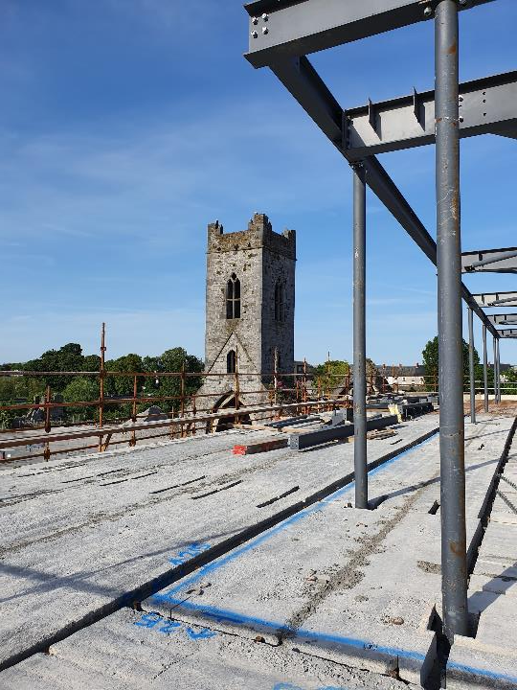

Slide 8
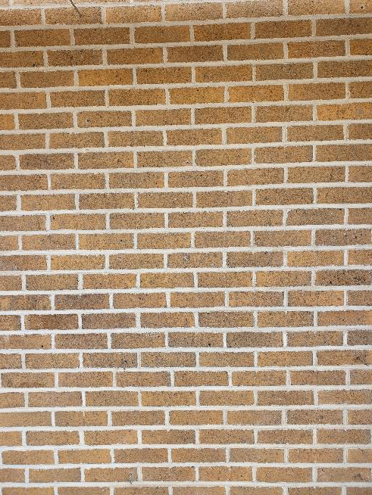
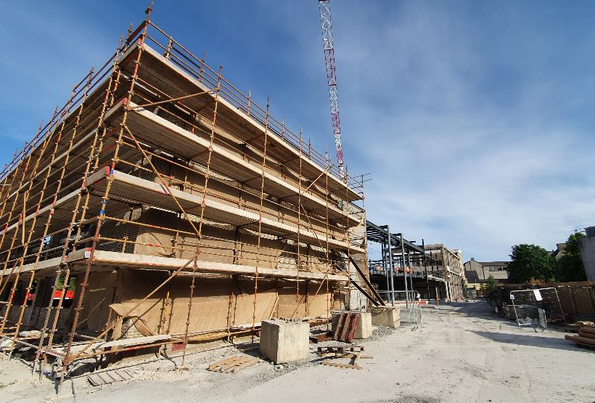

Slide 9
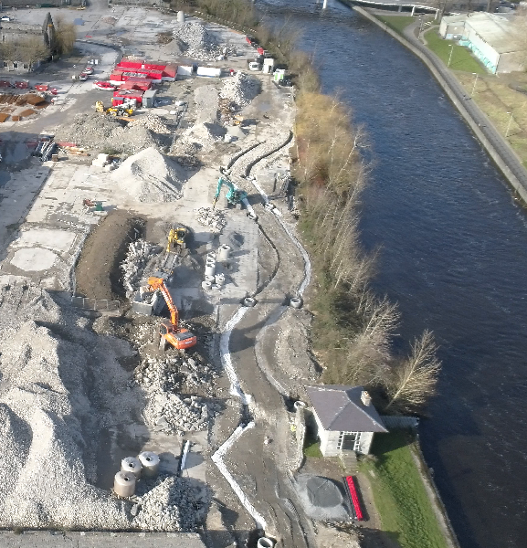
Riverside Garden Project
Niall Barry & Co. commenced on site on 13th January 2020
Funding sources
  European Regional Development Fund
  Urban Regeneration and Development Fund
  Failte Ireland
Programme
  6 month programme to mid July 2020
  Works suspended on site from 23rd March to 20th May inclusive ( 8 ½ weeks)
  Revised programme is awaited but expect to be completed by October 2020.

Slide 10
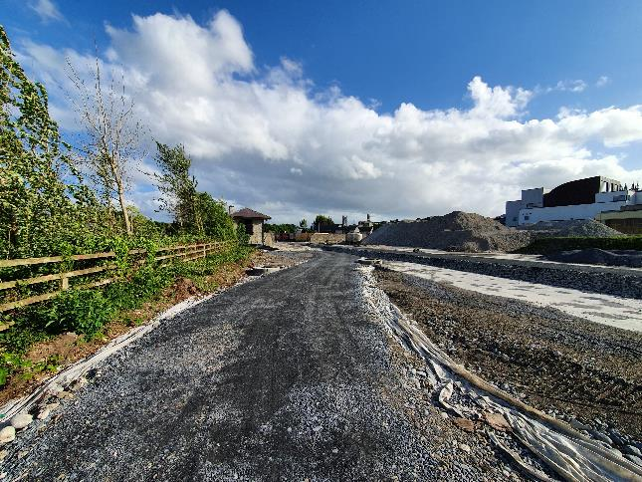
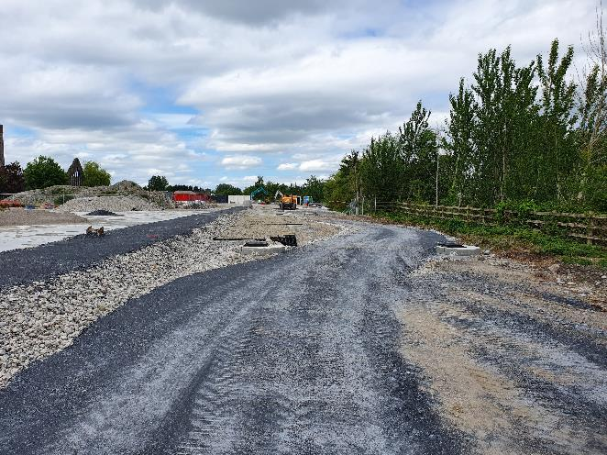

Slide 11
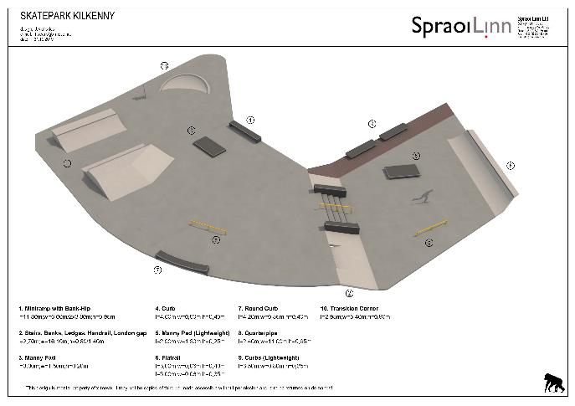
Skate Park
Spraoi Linn were appointed as the designers and contractors for the Skate Park in June 2019.
On site consultation with the skate boarders and the design team on 29th August 2019.
Ongoing consultation.
Final design agreed in Jan 2020
Skate Park will be constructed with the Riverside Garden Project
Skate park construction to commence on site on 24th August and will be completed with the garden project.

Slide 12
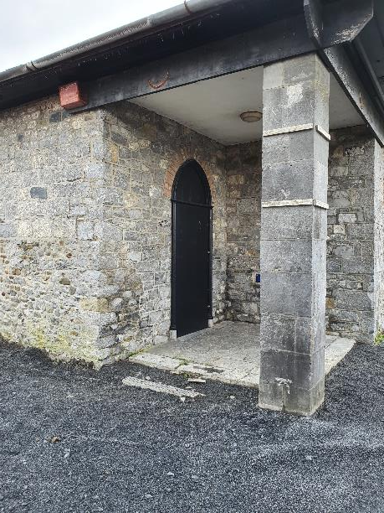
Tea House Restoration
Blackwood & Associates (Conservation Architects) appointed to design the restoration works.
Design is substantially complete.
Project will be tendered in late summer, with a view to restoration works commencing on completion of the Riverside Garden Project.
Funding
75% Urban Regeneration & Development Fund
25% KCC
Programme
To be completed in 2021 (after completion of Riverside Garden Project)

Slide 13
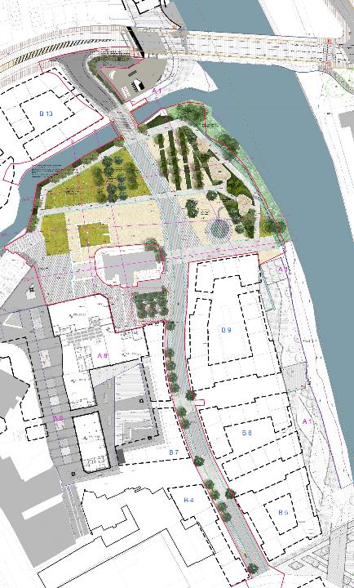
Urban Street & Park Project
Application to be made to An Bord Pleanala in June 2020 for planning permission.
Application made to the Urban Regeneration and Development Fund to fund the project.
Kilkenny City & Environs Development Plan
3I To provide for an urban park in the vicinity of St. Francis Abbey (National Monument) incorporating the City Walls, Evan’s Turret and St. Francis’ Well …….
3P To provide for an urban street of pedestrian and cyclist priority between the Central Access Scheme and Bateman Quay crossing the River Breagagh at the existing bridge crossing. To provide for traffic management measures on the street such as to inhibit the flow of through traffic and heavy goods vehicles.

Slide 14
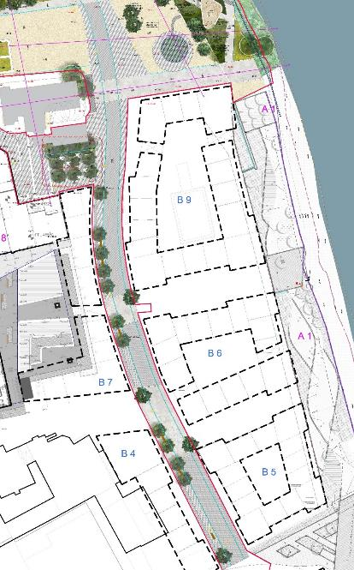
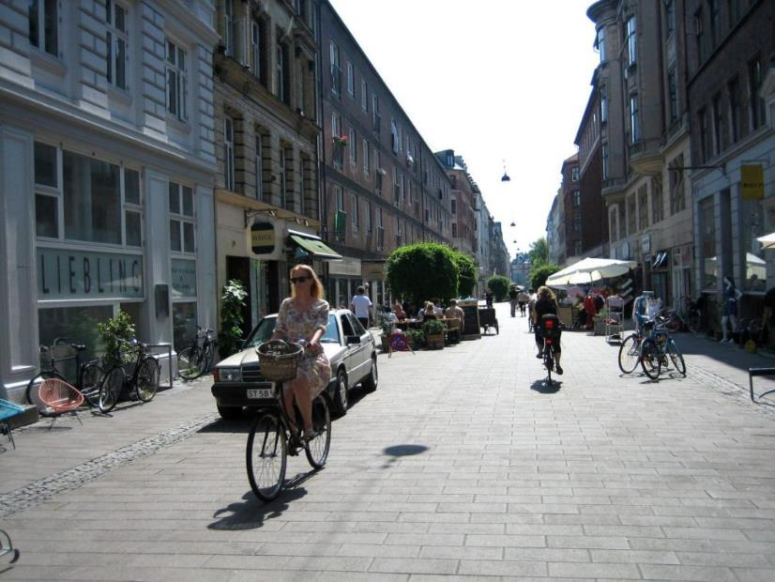

Slide 15
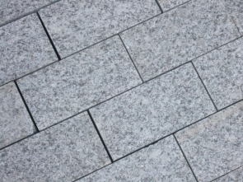
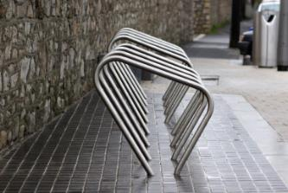

Slide 16
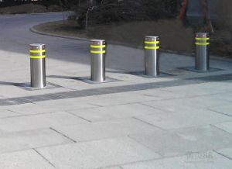
3P To provide for an urban street of pedestrian and cyclist priority between the Central Access Scheme and Bateman Quay crossing the River Breagagh at the existing bridge crossing. To provide for traffic management measures on the street such as to inhibit the flow of through traffic and heavy goods vehicles.

Slide 17
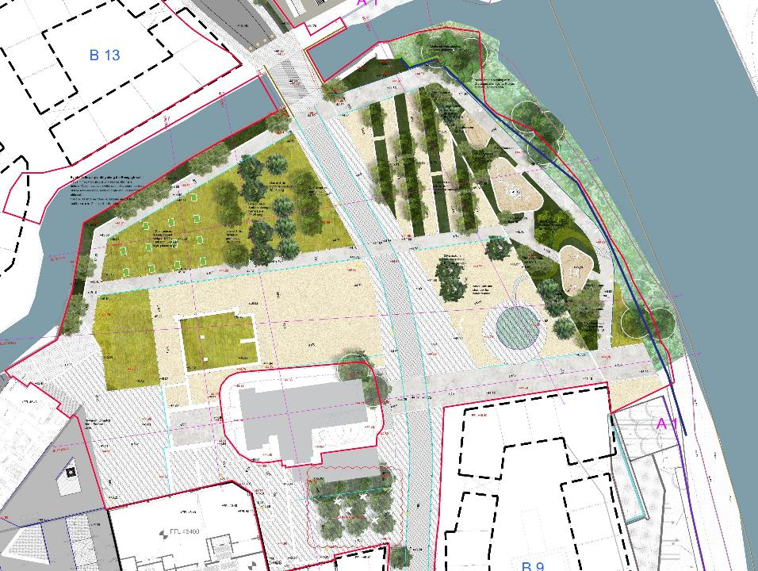

Slide 18
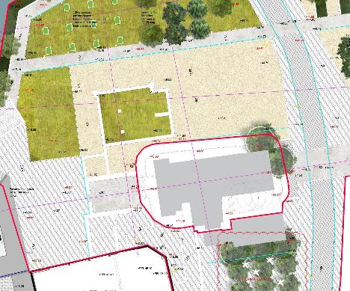
Archaeology

Slide 19
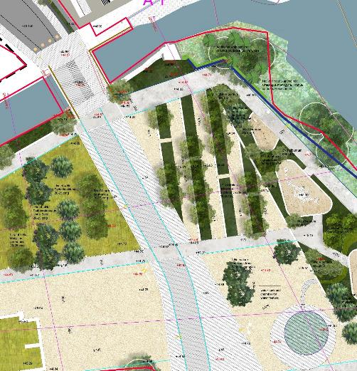
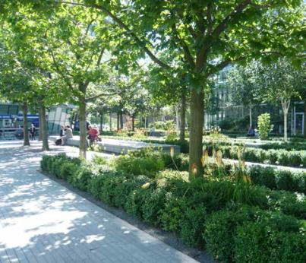
Orchard

Slide 20
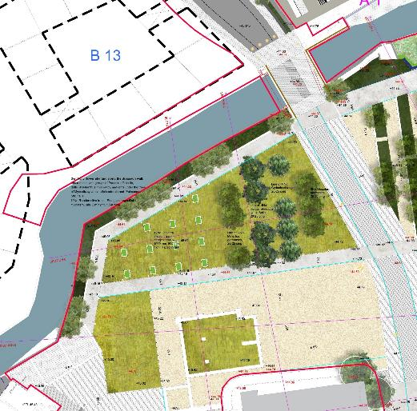

Slide 21
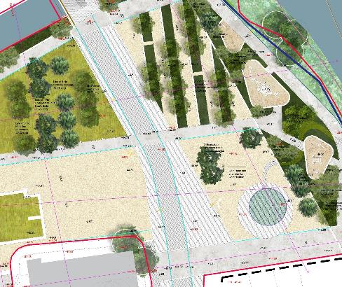

Slide 22
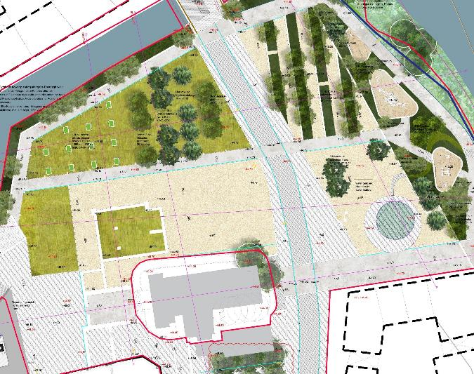
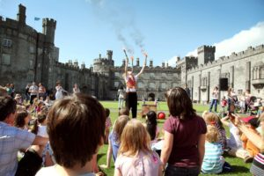

Slide 23
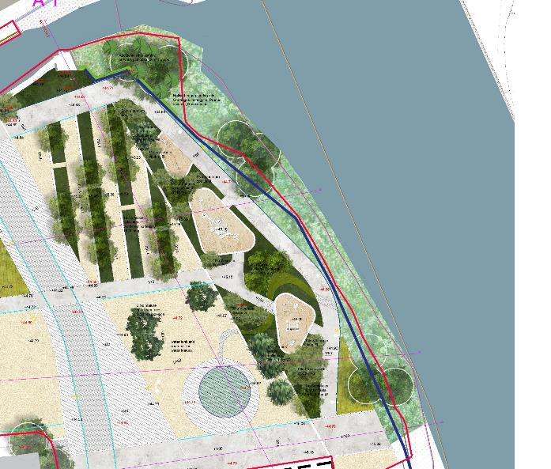

Slide 24
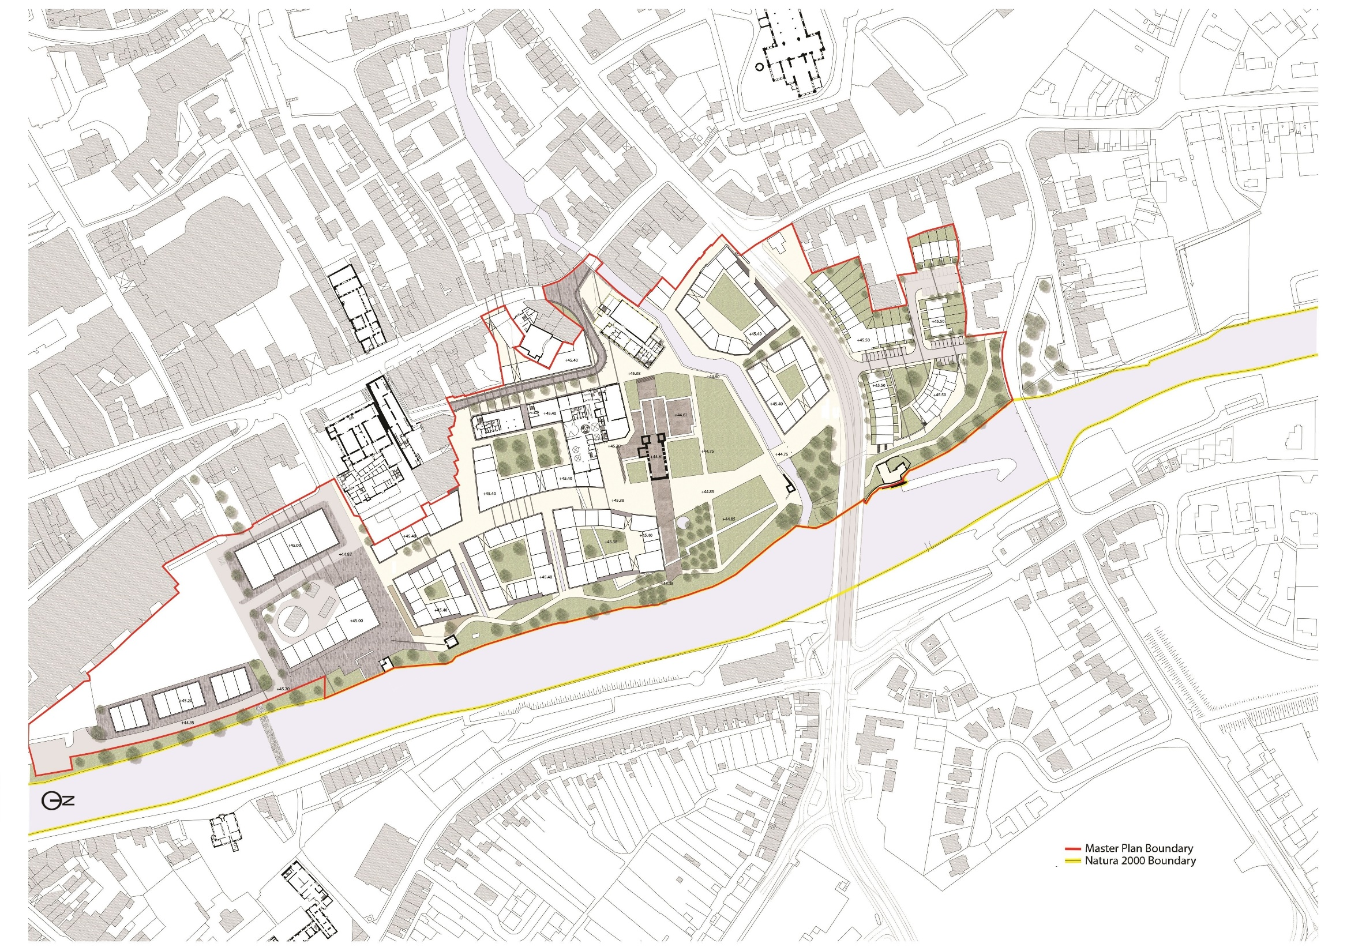
12
10
14
11
13
8
7
3
4
9
6
5
2
1
Brewhouse – KAQD
Phase 1 Public Realm - KCC
Mayfair Library - KCC
Phase 2 Public Realm - KCC
Phase 2 KAQD

Slide 25
