Slide 1
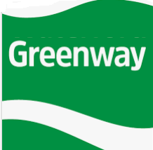
Greenway Car Parks
Part 8 Planning to Commence in coming weeks:
3 Car Parks in County Kilkenny:
1. Ferrybank;
2. Glenmore;
3. Boat Yard, New Ross.

Slide 2
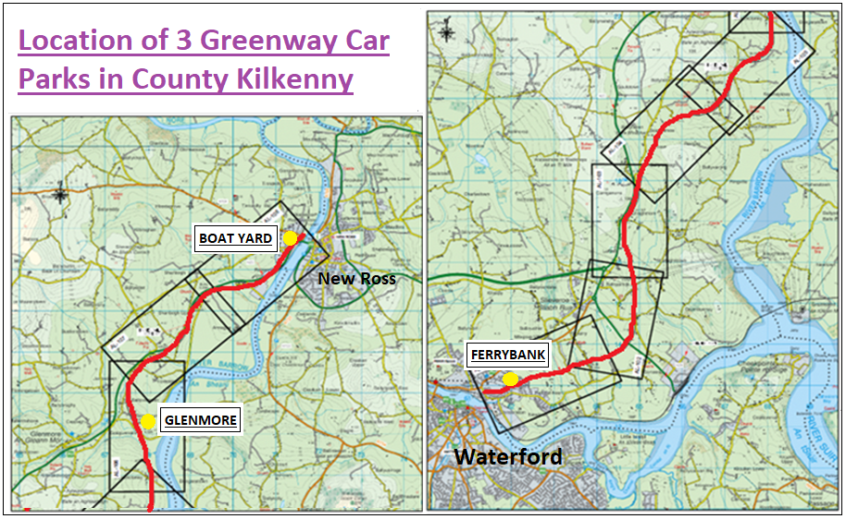

Slide 3
Greenway Update
Greenway Part 8 Approved: March 2018.
Funding Approved: €8m in June 2019 - National Greenway Fund.
Detailed Design: To be completed end July.
Contract to lift sleepers and track: To commence this week.
Animation programme: with 2 LEADER companies.
Abandonment Order: CIE Board to meet to approve in August.

