Slide 1
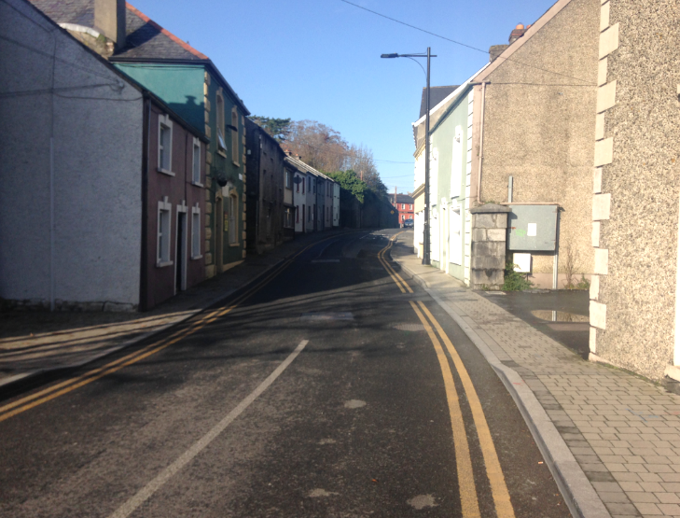


Kilkenny County Council,
County Hall,
John Street,
Kilkenny
Vicar street, Kilkenny
Improvement Scheme
January 2020

Slide 2
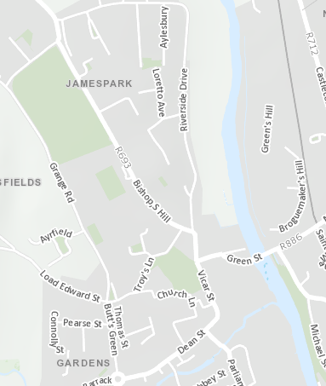
Freshford Road
Green Street
Troys Lane
Greensbridge Street
St. Francis Abbey Bridge
Dean Street

Slide 3
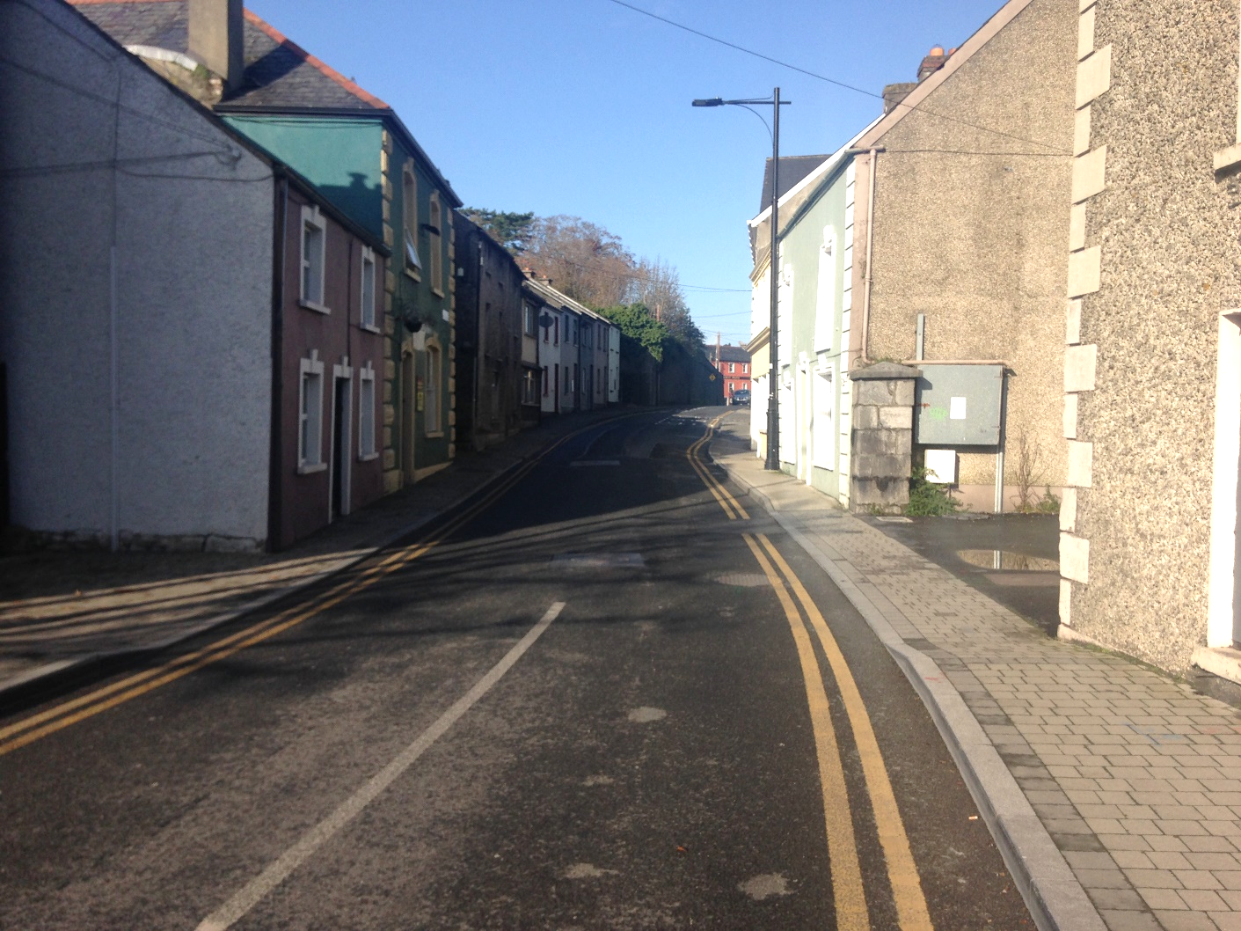
DESCRIPTION OF VICAR STREET
Vicar Street extends from its junction with St. Canice's Place to the Troy's Gate Mini‐Roundabout
The street is approximately 150m long and is within the 30kph speed limit zone
Average daily traffic through Vicar St is approximately 5362 vehicles
The cross-section comprises a two-way carriageway with a footway on each side
The carriageway width is typically 5.3m, but reduces to 5.0m at locations
The footway widths are typically 1.2m but reduce to 1.0m at critical locations.
The distance between building lines increases at the northern half of Vicar Street, allowing for the provision of car parking spaces
A 3.5 tonne weight restriction is in place on the street

Slide 4
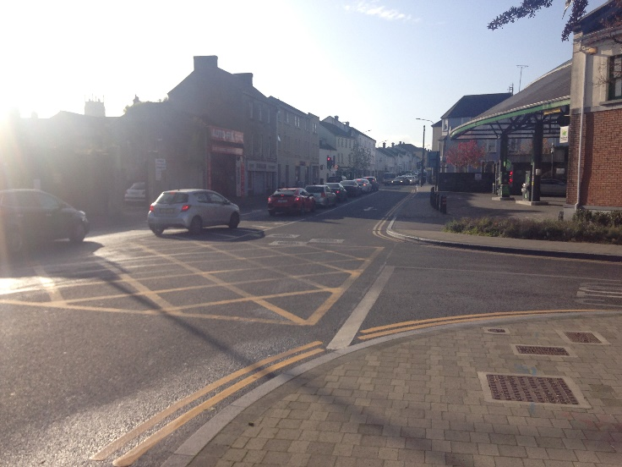
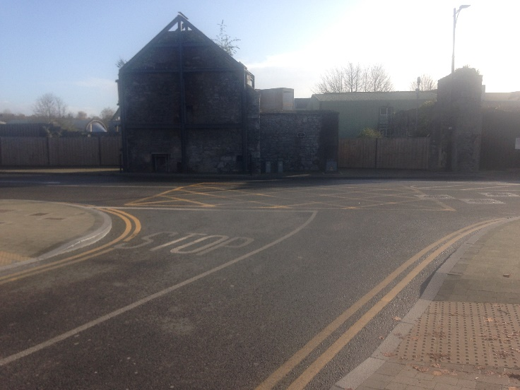
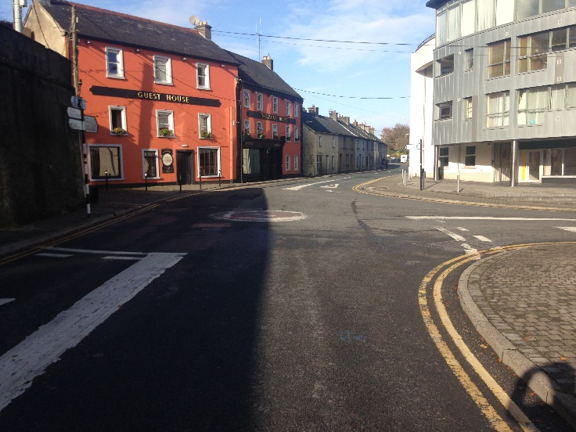
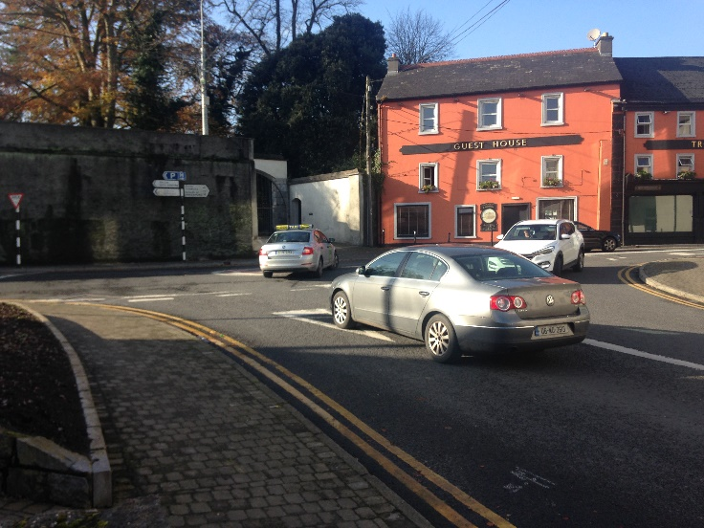

Slide 5
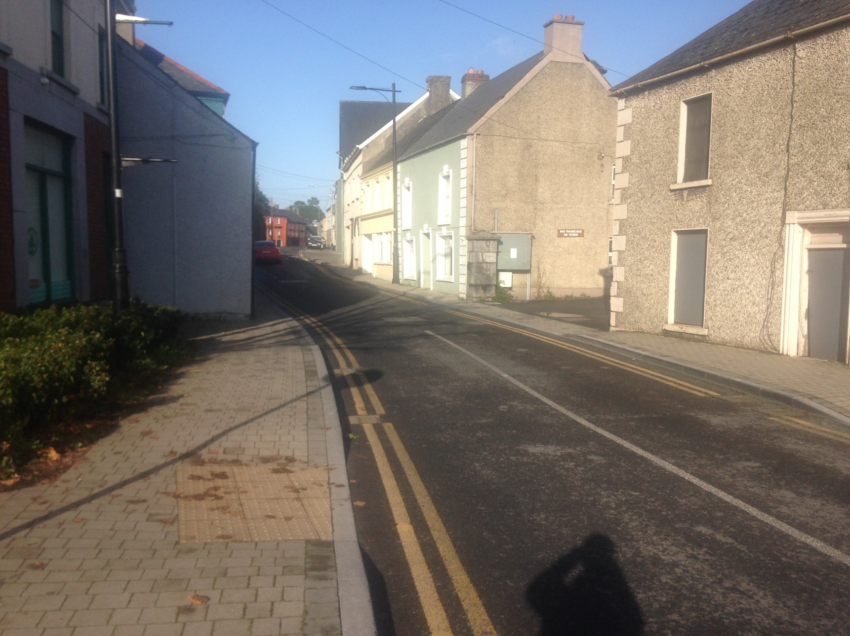
EXISTING ISSUES
Road pavements and footpaths are in a deteriorated condition and need to be replaced
Footway widths are narrow and fall below desirable minimum widths at critical locations
The carriageway width falls below that desirable for a two-way street particularly at critical locations
Minimum width of 7.3m between building facades
Turning movements from St. Francis Abbey Bridge to Vicar Street impact on the efficient operation of the junction

Slide 6
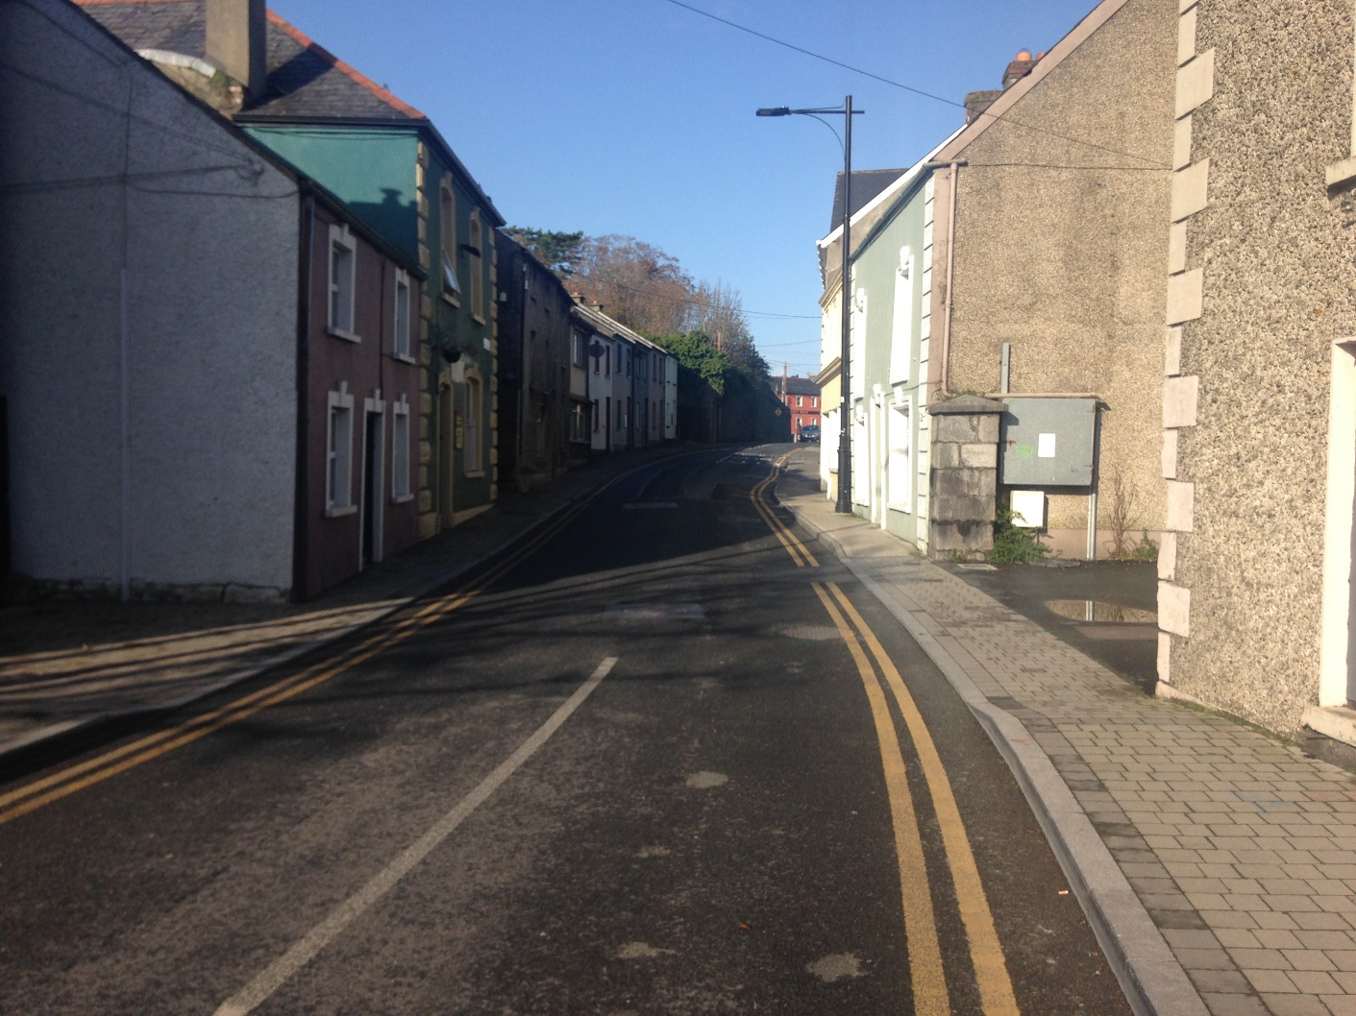
RATIONALE FOR SCHEME
Pavement improvements are urgently required which presents the opportunity for resolving other issues
Significant improvement for pedestrian safety by increasing footway widths
Vicar Street is not wide enough to accommodate two-way carriageway with widened footways therefore has to be one-way
Reducing carriageway to one-way will allow provision of a contra-flow cycle lane
Reducing the number of turning manoeuvres at the junction with the Central Access Scheme will improve the efficiency of this junction

Slide 7
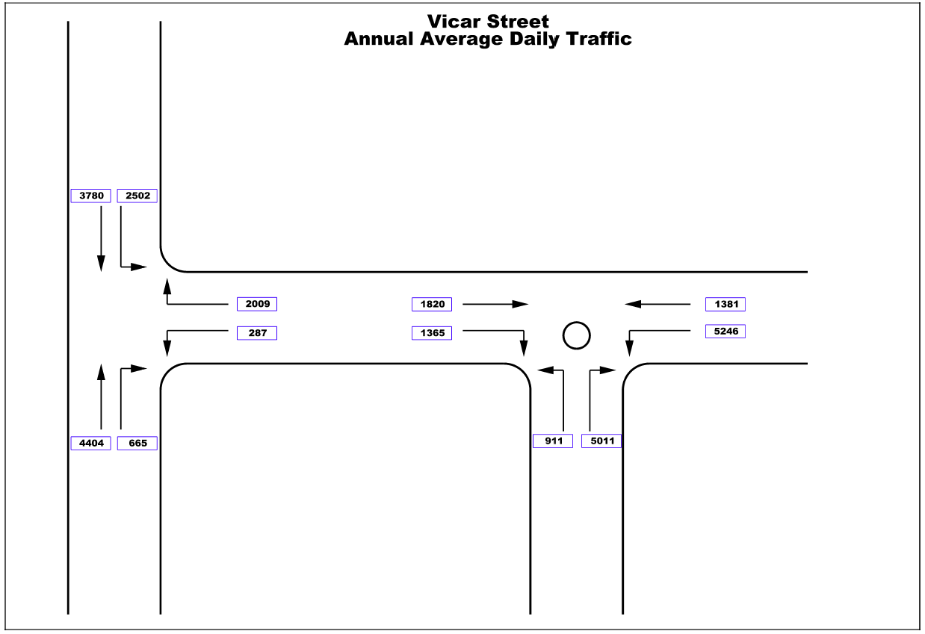
Vicar Street

Slide 8
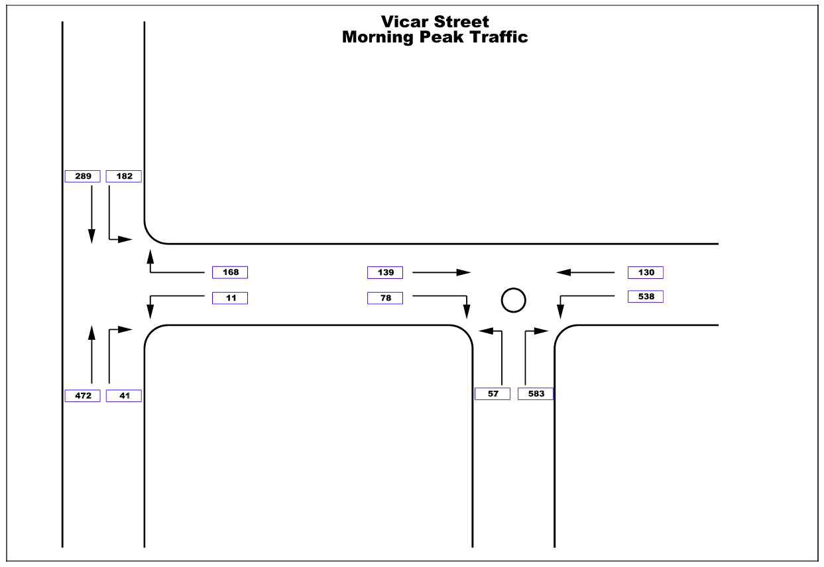
Vicar Street

Slide 9

Vicar Street

Slide 10
Conclusions & Recommendation
In order to improve the safety of vulnerable road users, this carriageway has to be reduced to one way
When discounting traffic that does not absolutely need to use Vicar Street, the inbound and outbound traffic volumes are similar
Making Vicar Street one way going south would be slightly more efficient to accommodate the AM peak traffic flows
With the removal of right turning traffic from St. Francis Abbey Bridge, turning movements will be improved and traffic flows from St. Francis Abbey Bridge to Dean Street will improve
If Vicar St. was to be made one way going north, it would lead to increased traffic movements on Troy's Lane
The introduction of a contra-flow cycle lane is safer with traffic going one-way south as it does not conflict with on-street parking
Therefore the recommendation is that Vicar Street be made one-way south as part of this improvement scheme

Slide 11
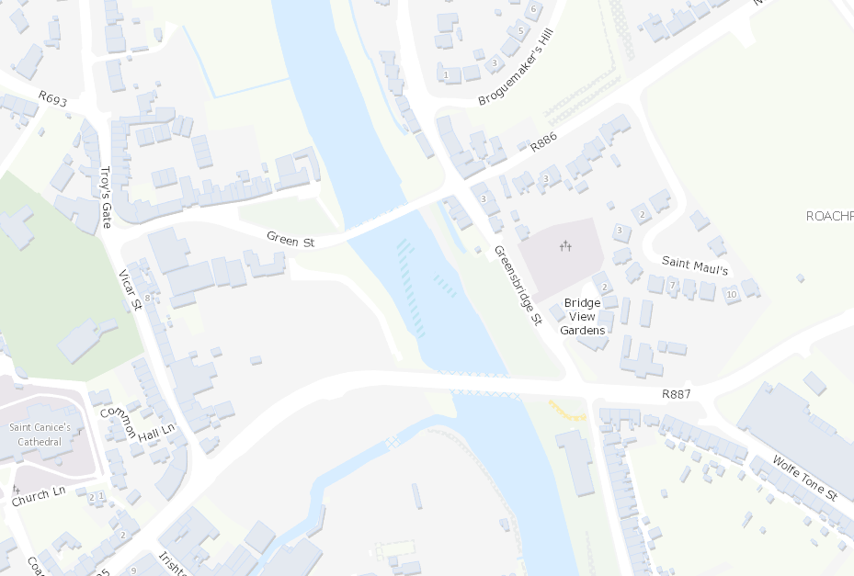
Possible Future Development Access Road through Sweeney's Orchard

Slide 12
