Slide 1


Kilkenny County Council
Housing Capital
Presentation of Part 8’s
Thomastown, Kilkenny City and Kells
12 th June 2020

Slide 2
(1) Kells – Housing List
Area | 1 bed | 2 bed | 3 bed | 4 bed | Total
Kells | 4 | 1 | 3 | 1 | 9

Slide 3
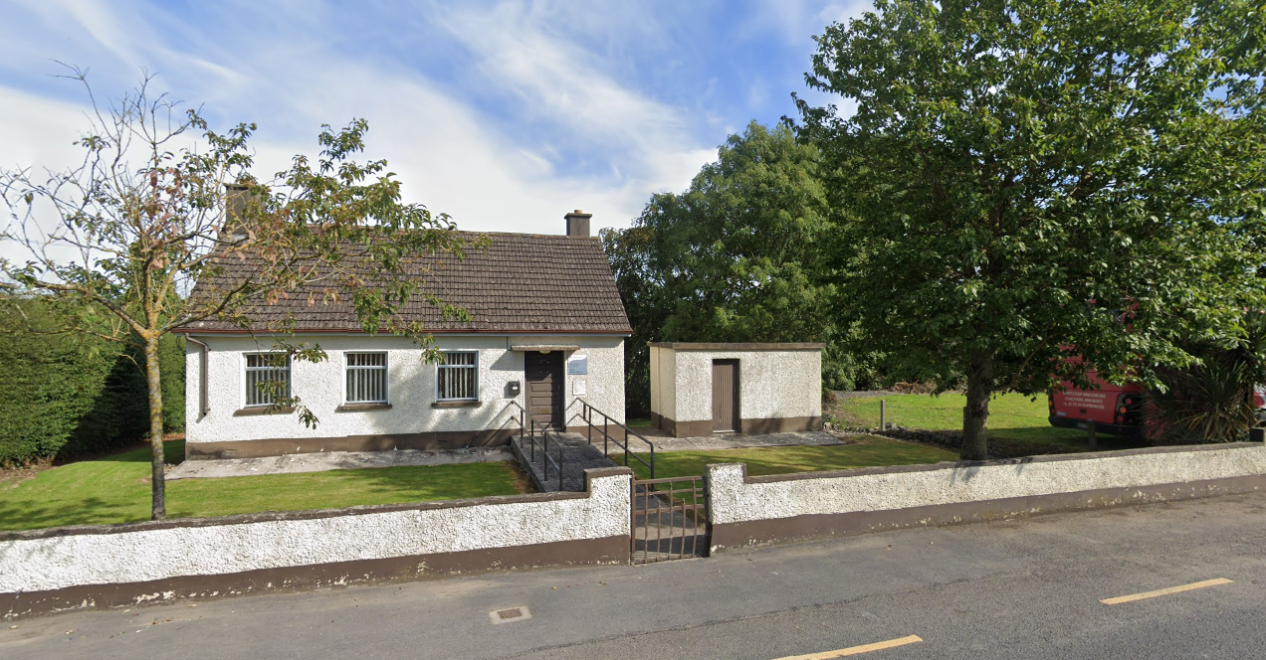
(1) Refurb & Extension to Kells Health Centre
Existing Health Centre
No longer in use by the HSE
Being sold to Kilkenny County Council

Slide 4
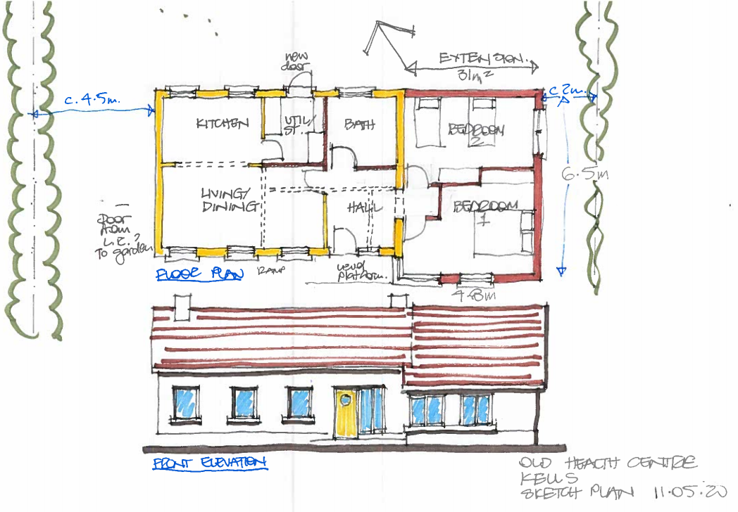
(1) Refurb & Extension to Kells Health Centre
Sketch proposal
Full refurbishment and conversion to 2 bed house
proposed
Expected to be advertised for Part 8 consultation in July 2020

Slide 5
(2) Kilkenny City – Housing List
Area | 1 bed | 2 bed | 3 bed | 4 bed | Total
Kilkenny City | 430 | 428 | 203 | 32 | 1093

Slide 6
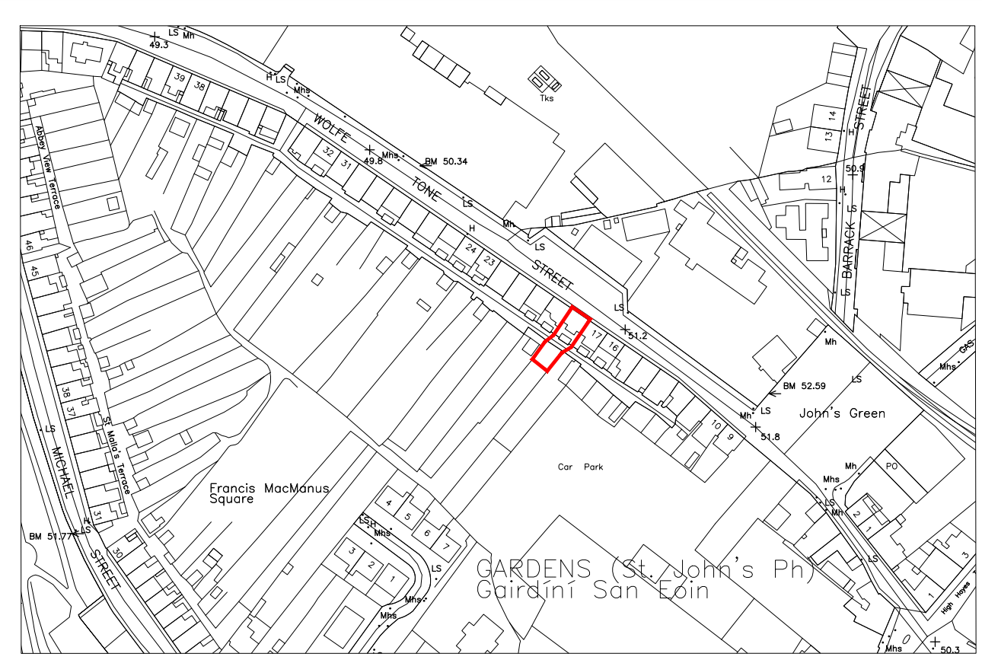
(2) Full Refurb & Extension to No 18 Wolfe Tone St, Kilkenny City
Existing Council Stock in central location
Currently vacant and in need of full refurbishment and updating to current standards

Slide 7
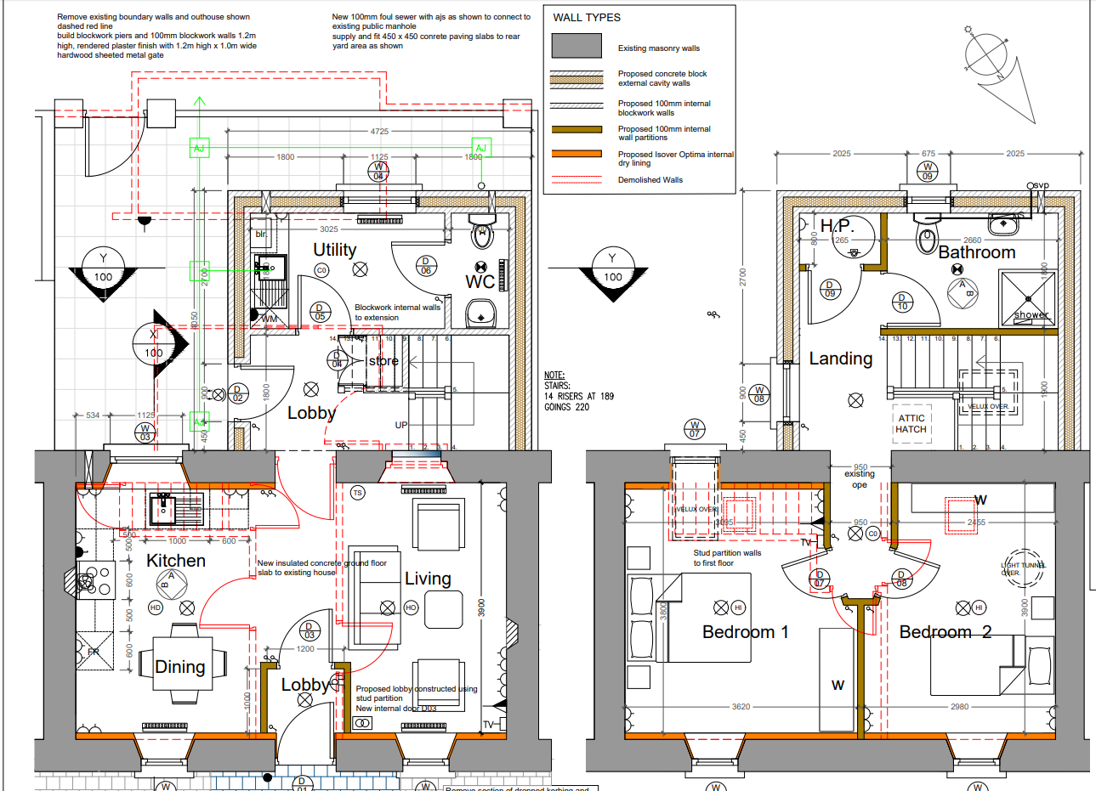
(2) Full Refurb & Extension to No 18 Wolfe Tone St, Kilkenny City
2 bedroom house proposed
Existing house made open plan downstairs, 2 bedrooms upstairs
Proposed Extension of utility and stairs on ground floor and bathroom on first floor

Slide 8
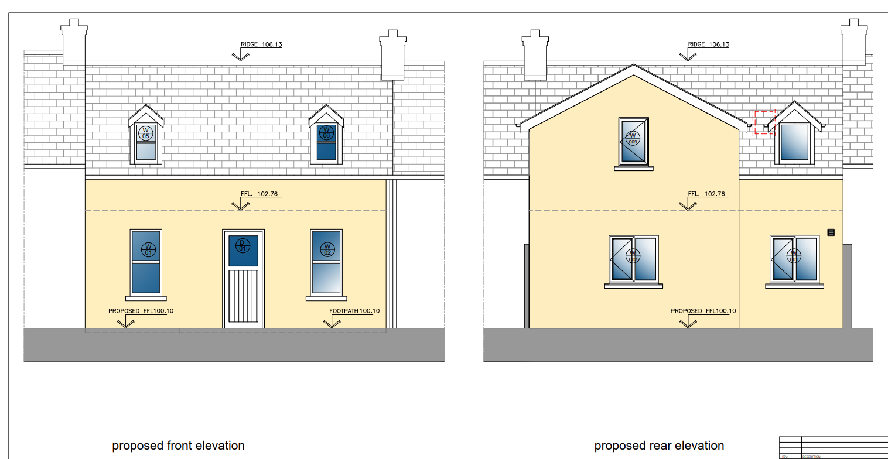
(2) Full Refurb & Extension to No 18 Wolfe Tone St, Kilkenny City

Slide 9
(3) Thomastown – Housing List
Area | 1 bed | 2 bed | 3 bed | 4 bed | Total
Thomastown | 29 | 27 | 12 | 3 | 71

Slide 10
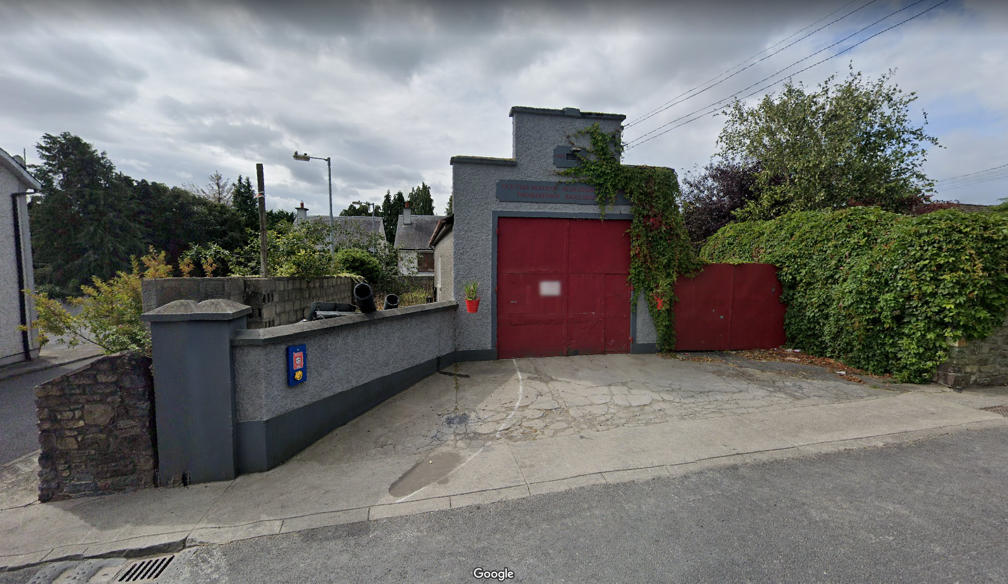
(3a) Refurbishment of Former Fire Station, Thomastown to 1 bed housing unit

Slide 11
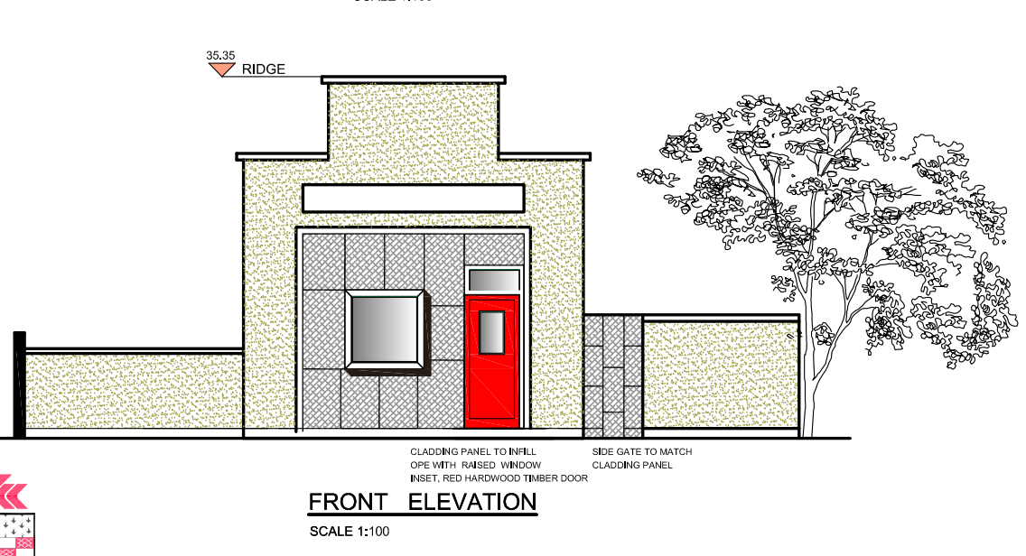
(3a) Refurbishment of Former Fire Station, Thomastown to 1 bed housing unit
Proposed front elevation, retaining existing features

Slide 12
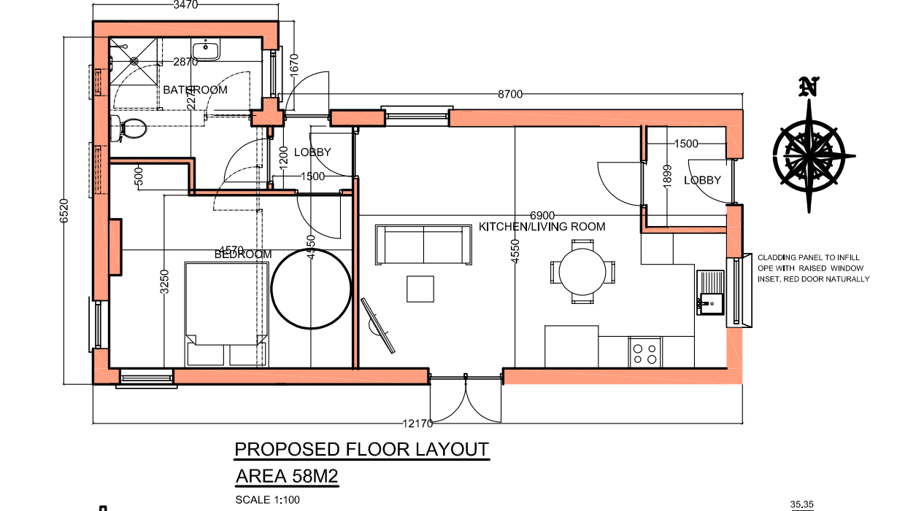
(3a) Refurbishment of Former Fire Station, Thomastown to 1 bed housing unit
Proposed new floor layout
1 bed accessible unit

Slide 13
Part 8 Process for
(2) Extension to 18 Wolfe Tone St
(3a) Thomastown Fire Station
Ad in Kilkenny People week of 15th June 2020
Public Display:-
Friday 19th June until Friday 17th July 2020
Submissions Until:-
Friday 31st July 2020
Details will be available on https://consult.kilkenny.ie/

Slide 14
(3b) Construction of 25 Housing Units at Ladywell, Thomastown
Previously presented to members.
Legan Court – 4 units
Legan Grange – 21 units
NIS (Natura Impact Statement) necessary due to proximity to stream draining to River Nore – therefore proposal is required to be submitted to An Bord Pleanala for approval under Section 177AE of the Planning and Development Act
Expected to be advertised for consultation shortly
Similar process to Part 8’s but submissions to be made directly to An Bord Pleanala

Slide 15
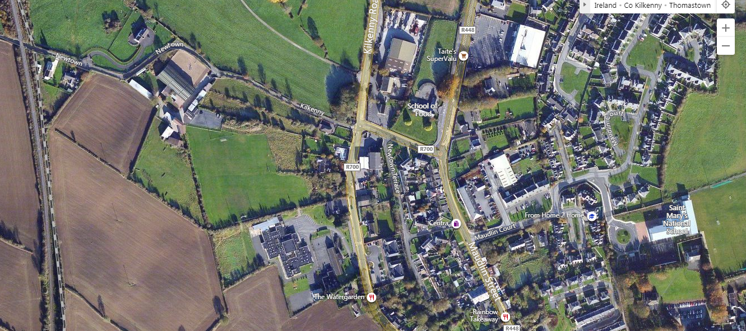
(3b) Construction of 25 Housing Units at Ladywell, Thomastown
Equestrian Centre
Area Office
Petrol Station
Pitches
Grennan College
Site Location - East of Grennan College Playing Pitch

Slide 16
(3b) Proposal for Housing at Ladywell, Thomastown
Unit Type | 1 Bed | 2 Bed | 3 Bed | Total
No. | 10 | 10 | 5 | 25

Slide 17
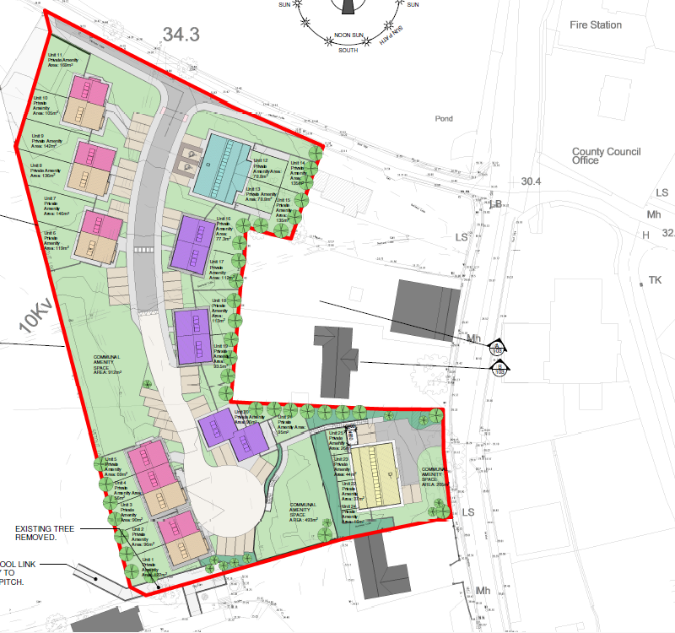
(3b) Proposal for Housing at Ladywell, Thomastown
Site Plan
Grennan College
Petrol Station
Area Office

Slide 18
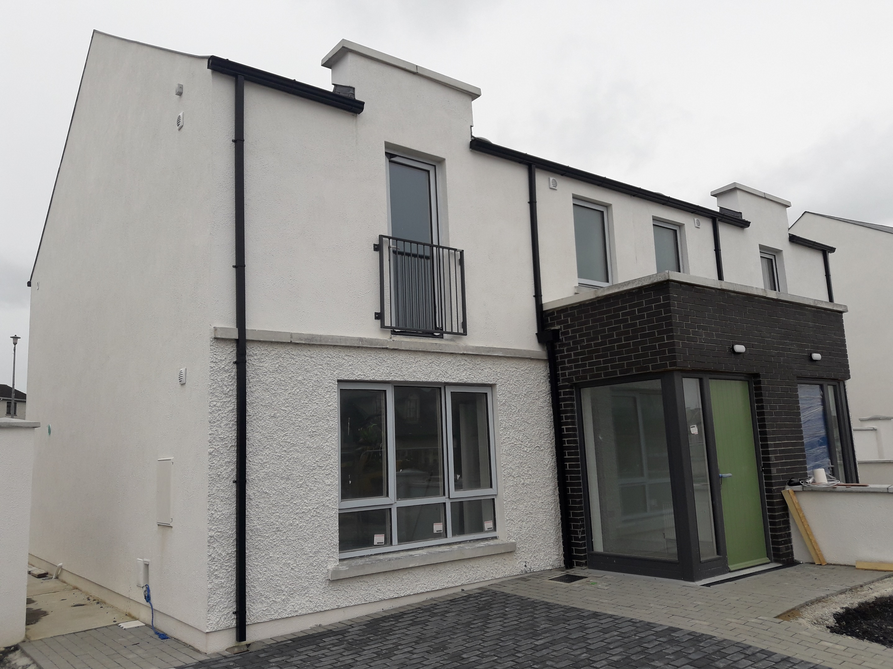
Current Schemes on Site – KCC Direct Builds
Hoban Park, Bolton, Callan
38 houses
Expected completion late June 2020

Slide 19
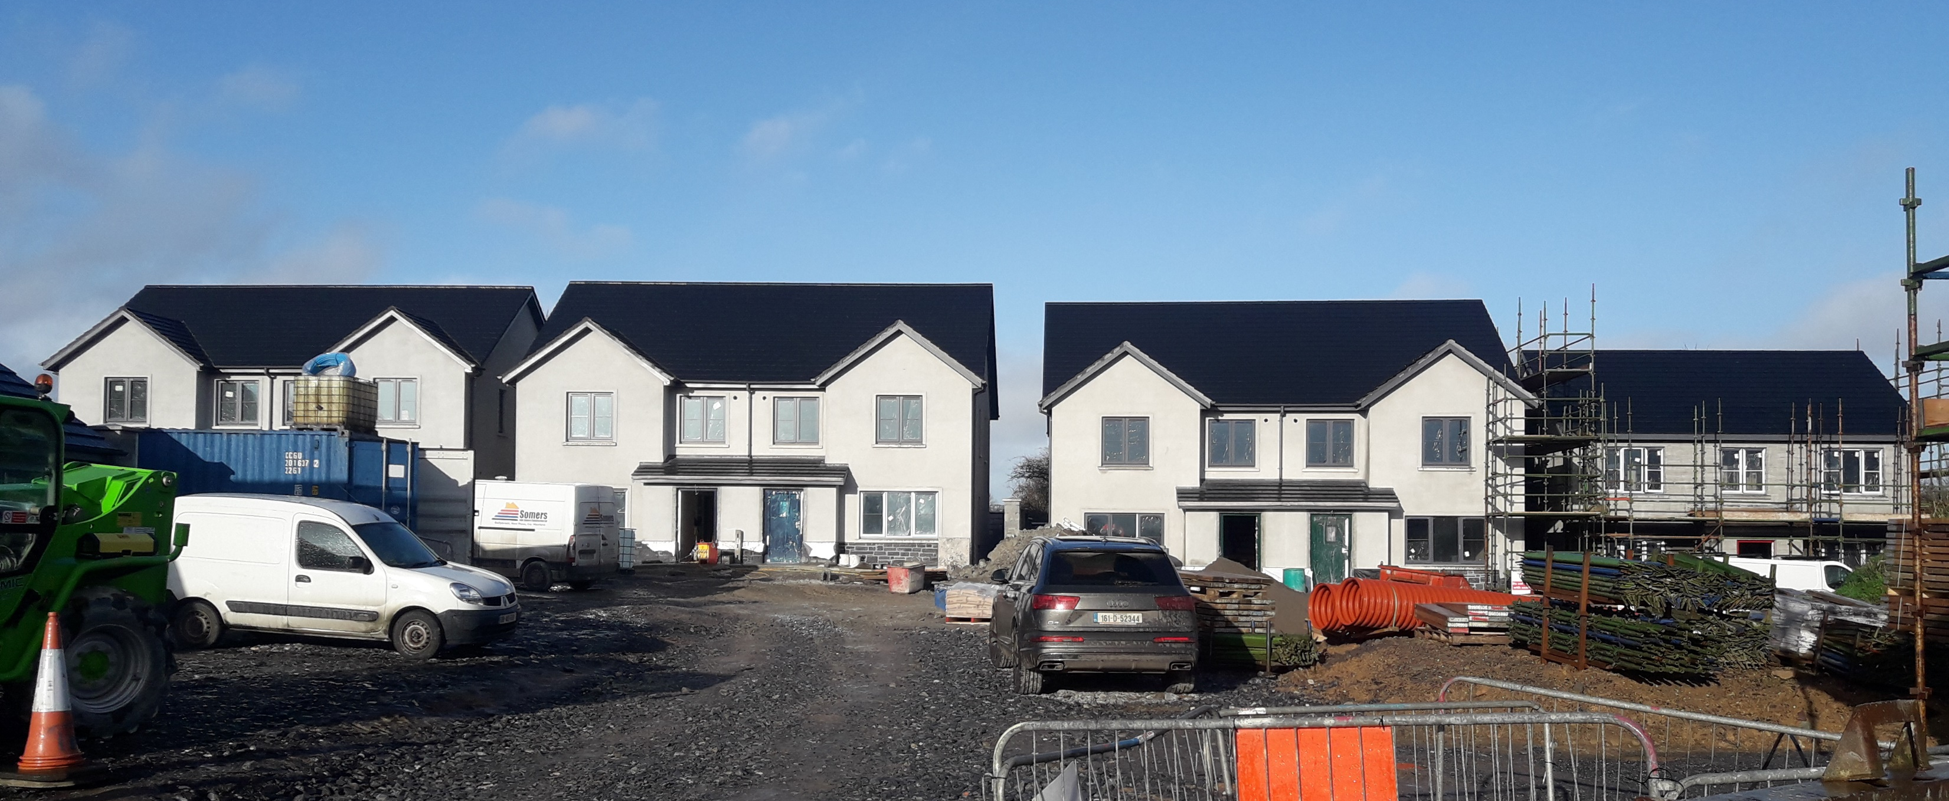
Current Schemes on Site – KCC Direct Builds
Breagagh Place, Piltown
17 houses
Expected completion Sept 2020

Slide 20
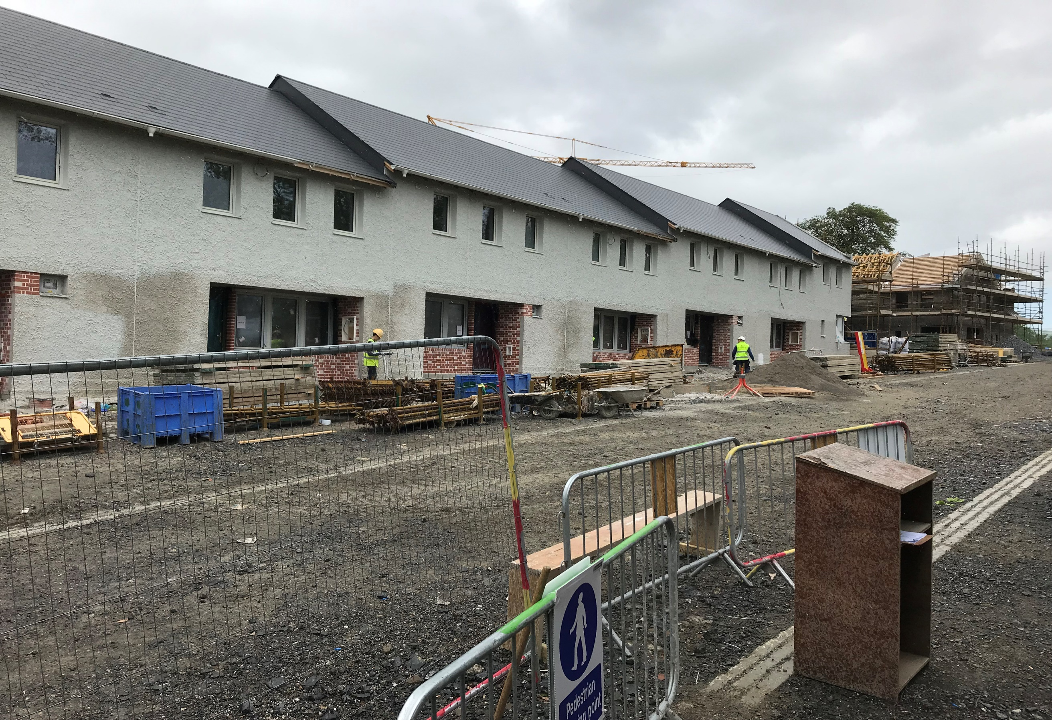
Current Schemes on Site – KCC Direct Builds
Glebeside,
Donaguile,
Castlecomer
33 units
Expected completion Q4 2020 / Q1 2021

Slide 21
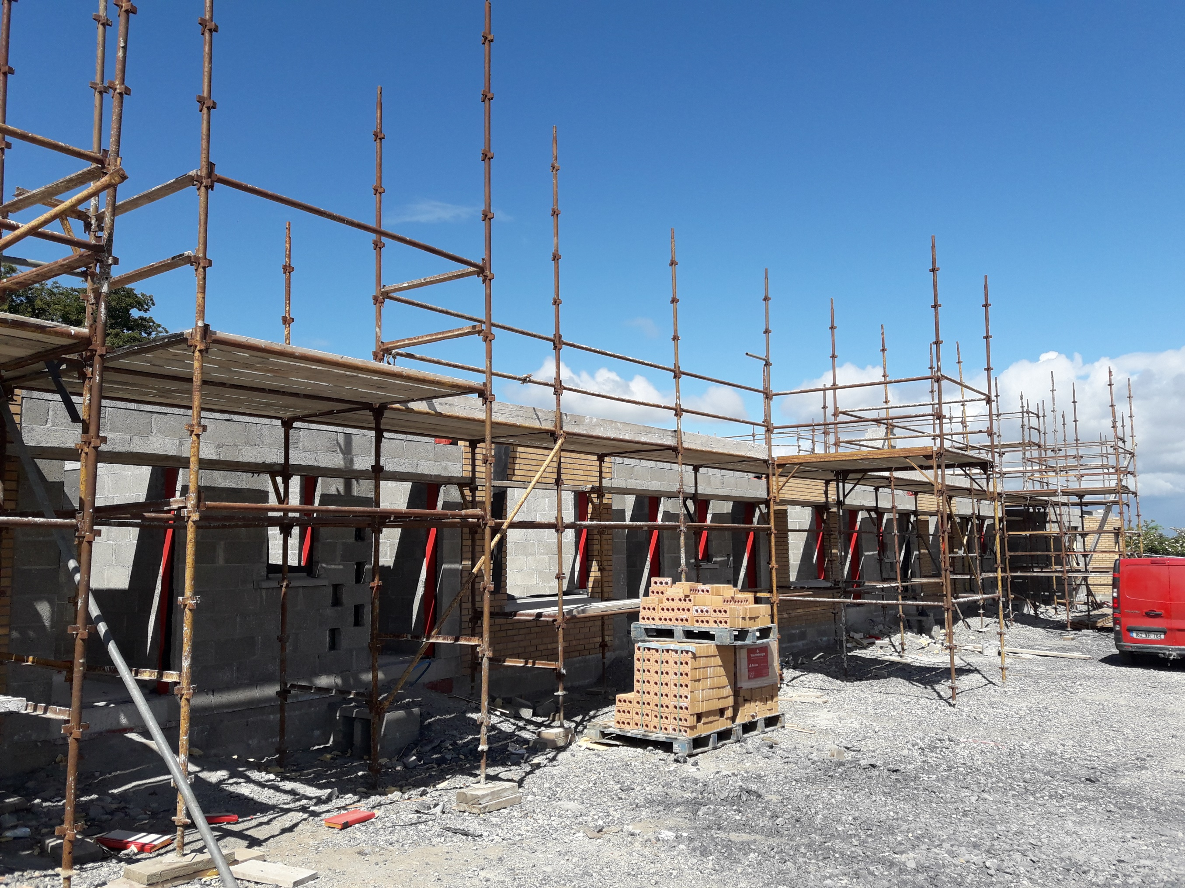
Current Schemes on Site – KCC Direct Builds
Station Ave
Ballyragget
22 units
Expected completion Q1 / Q2 2021

Slide 22
thank you.

