Slide 1
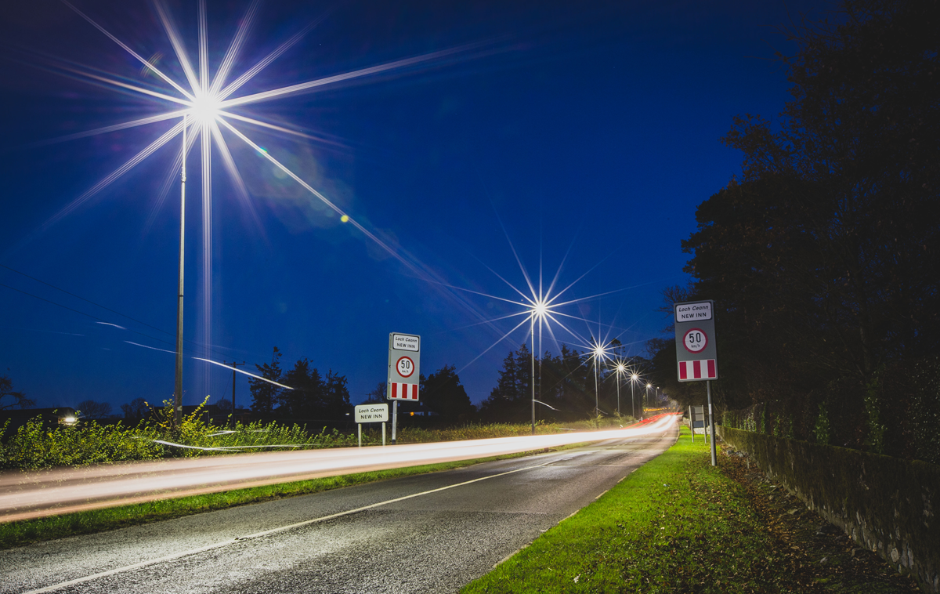
Local Authority Public Lighting Energy Efficiency Project
Eastern Region Project
Kilkenny County Council

Slide 2


Overview of works done in Kilkenny
Public Lighting Energy Enhancement Project(PLEEP) nation wide
Public Lighting Energy Enhancement Project(PLEEP) Eastern Region
Questions

Slide 3
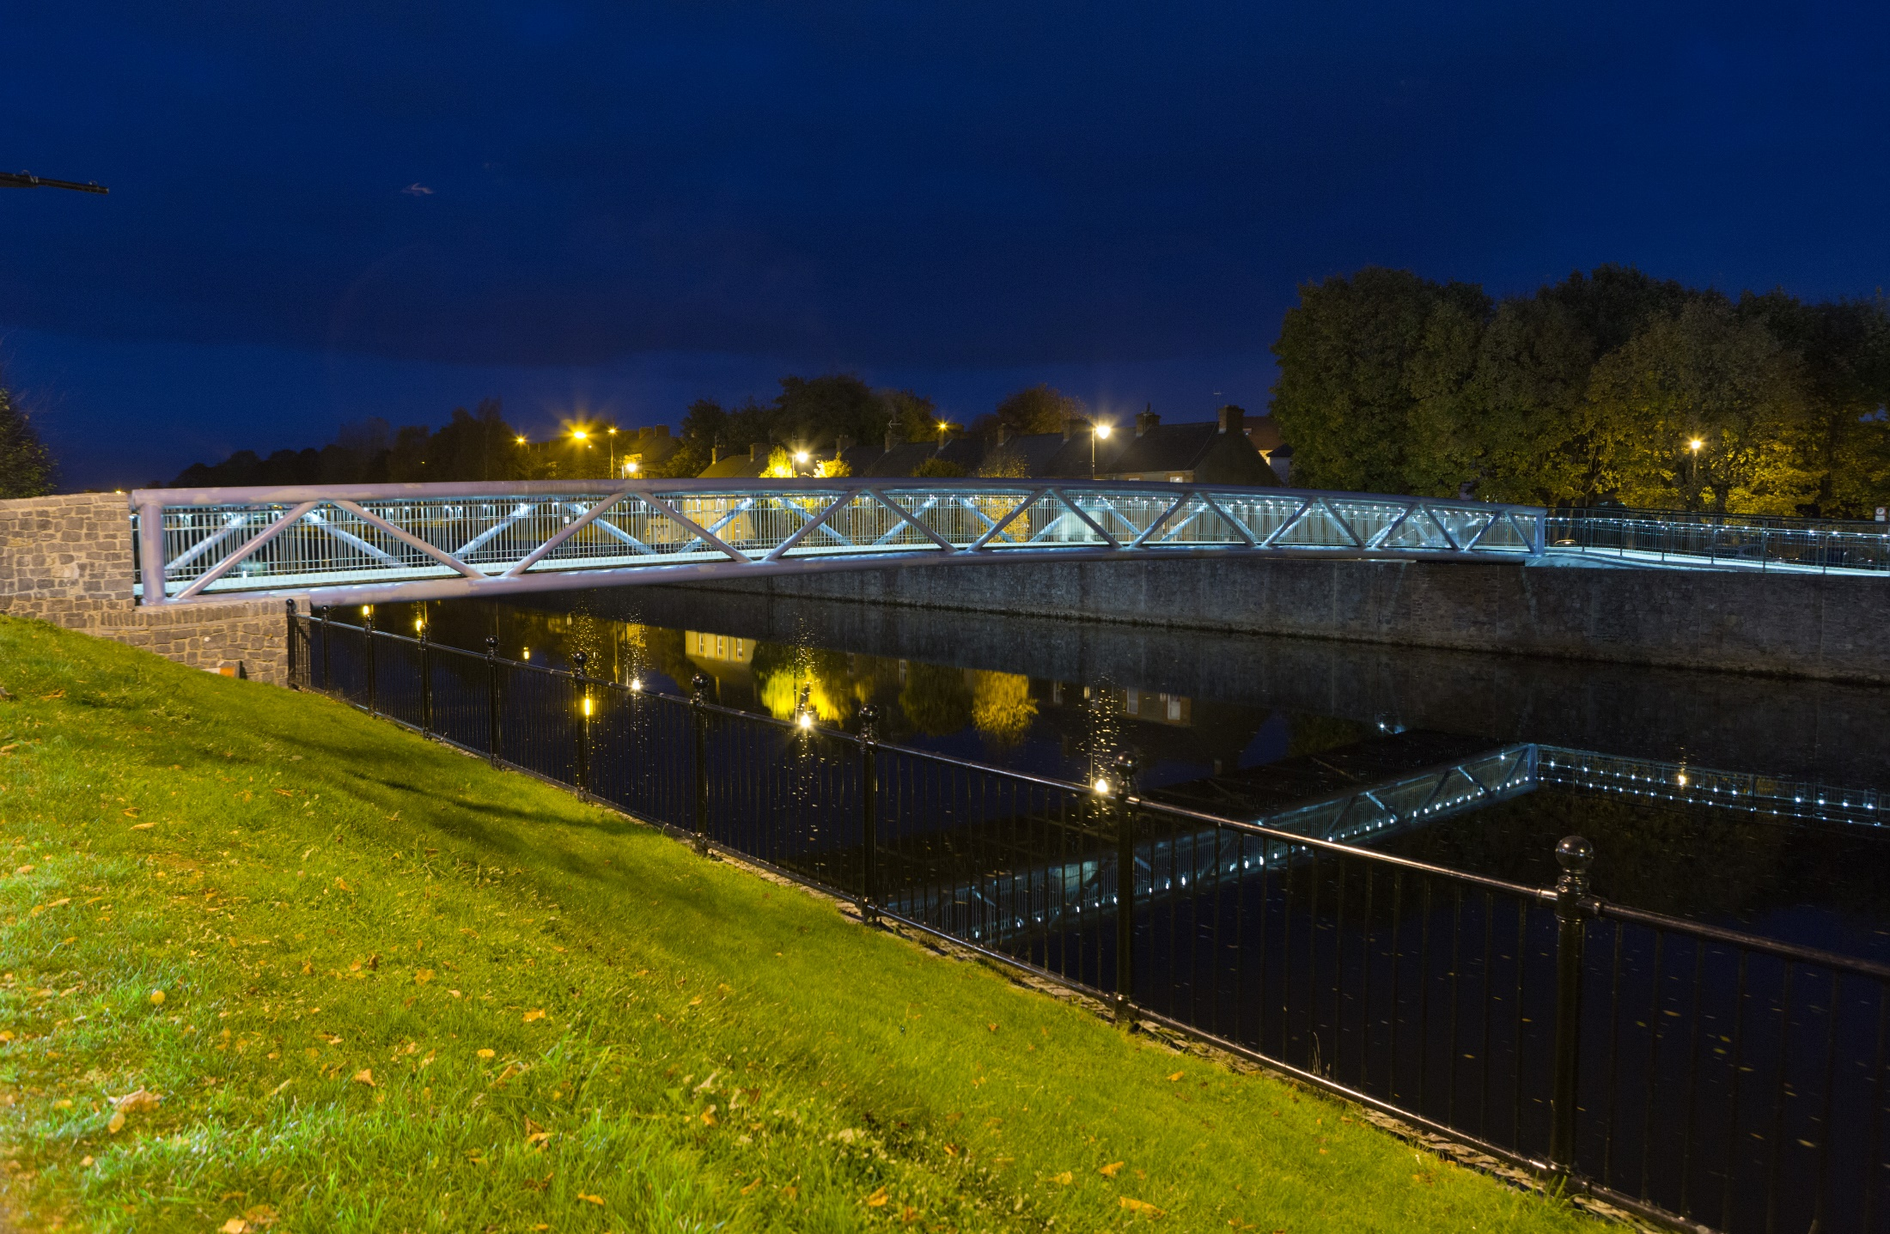
Notes:
Good example of updated lighting in Kilkenny city in an SAC
Limited light to the appropriate areas- walk ways

Slide 4
Kilkenny County Council Energy Enhancement Works to date
Total number of lanterns in Kilkenny = 10,726
Number of lanterns changed to energy efficient fittings (L.E.D.) = 5,367
Number of lanterns to be upgraded = 5,359

Slide 5
Kilkenny County Council Public Lighting Retrofit
Year: 2019 | No. Lanterns (LED) | Cost (€) | Grant (€) | Savings Annual (€) excluding VAT
Better Energy Communities (BEC) | 1005 | 219,892.19 | 65,967.65 (30%) | 35,000.00
Transport Infrastructure Ireland (TII) | 512 | 229,013.90 | 229,013.90 (100%) | 48,000.00
Year: 2018 | No. Lanterns (LED) | Cost (€) | Grant (€) | Savings Annual (€) excluding VAT
Better Energy Communities (BEC) | 2240 | 467,745.95 | 140,323.78 (30%) | 58,000.00
Transport Infrastructure Ireland (TII) | 310 | 123,835.05 | 123,835.05 (100%) | 30,000.00
Year: 2017 | No. Lanterns (LED) | Cost (€) | Grant (€) | Savings Annual (€) excluding VAT
Better Energy Communities (BEC) | 1300 | 486,182.13 | 145,854.63 (30%) | 90,000.00
Total: | 5367 | 1,526,669.10 | 704,995.01 | 261,000.00
Notes:
Details of light s fitted in KCC over the last 3 years as part of pilot projects
70 % changed in city, 60 % overall –
Gaining savings early.

Slide 6
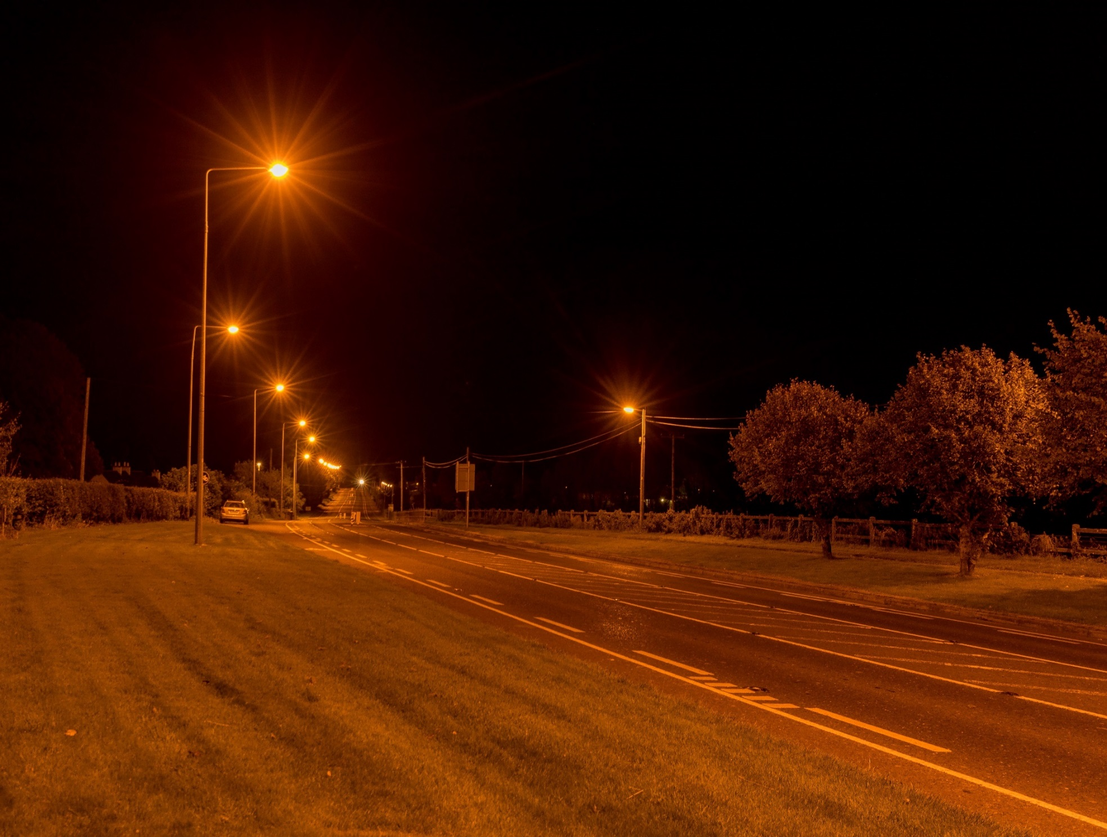
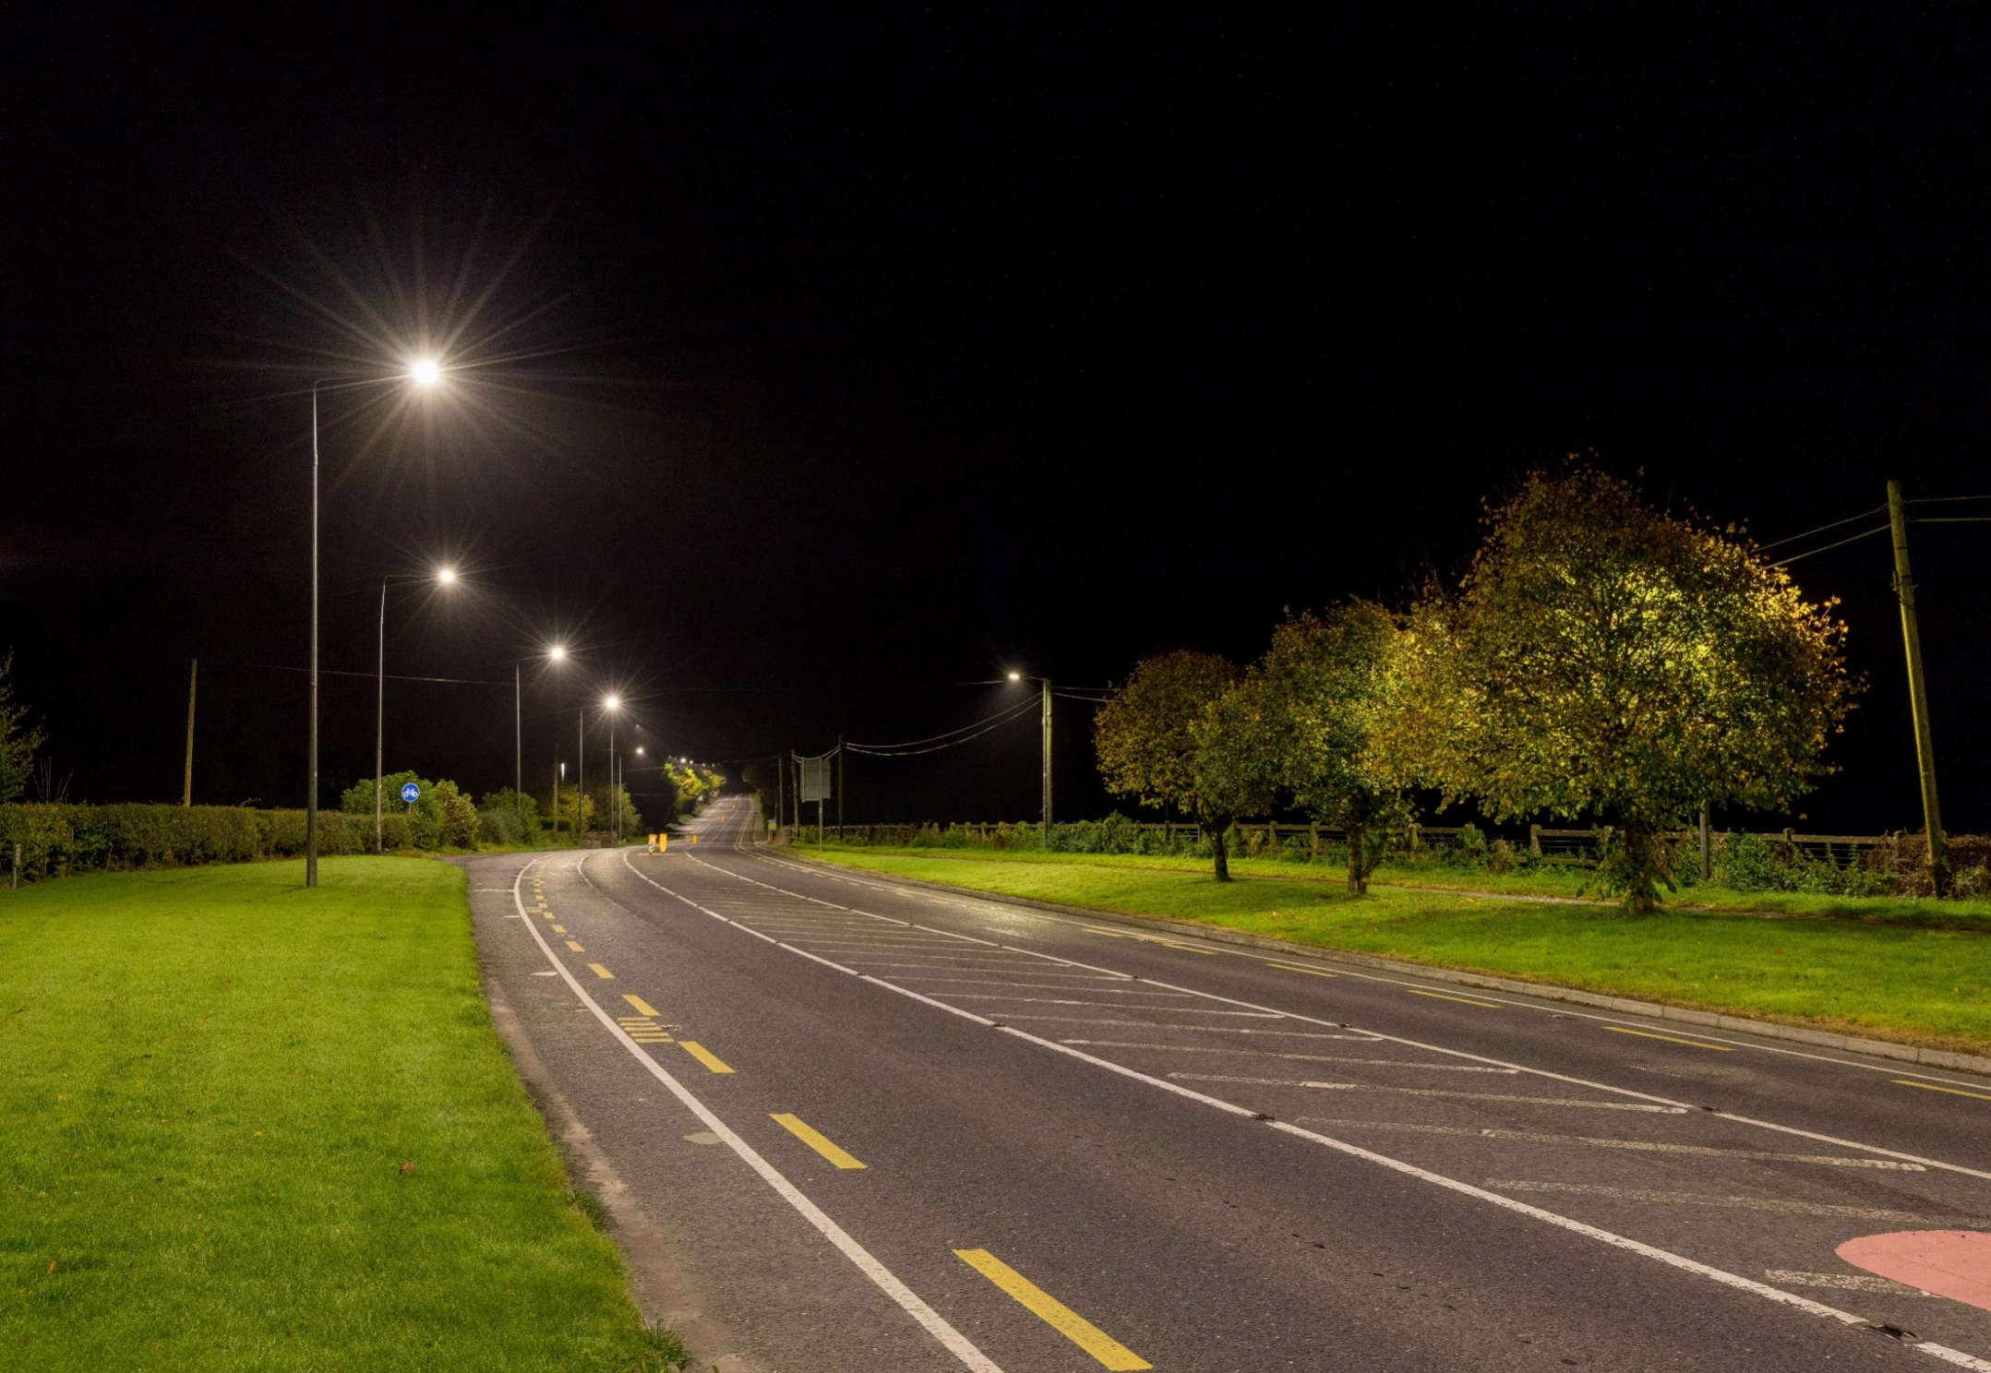
Notes:
Better visibility , true colour, less light pollution
60 % energy saving.

Slide 7
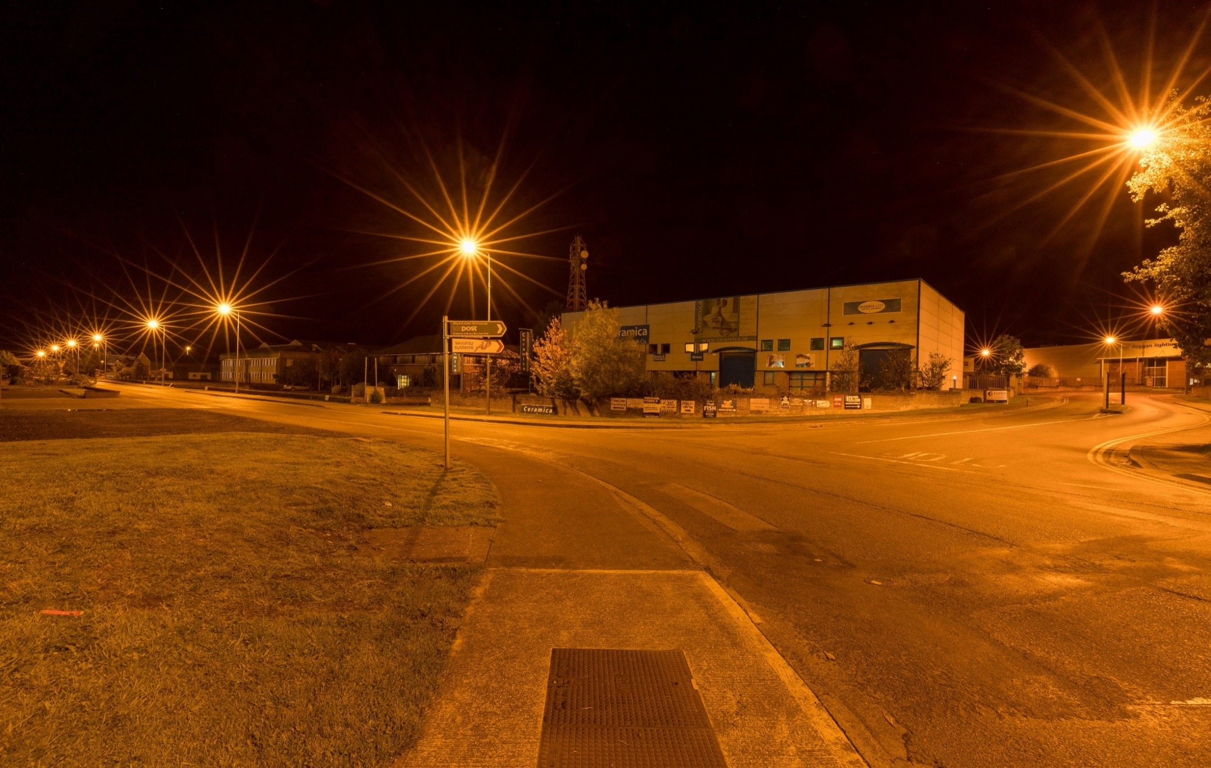
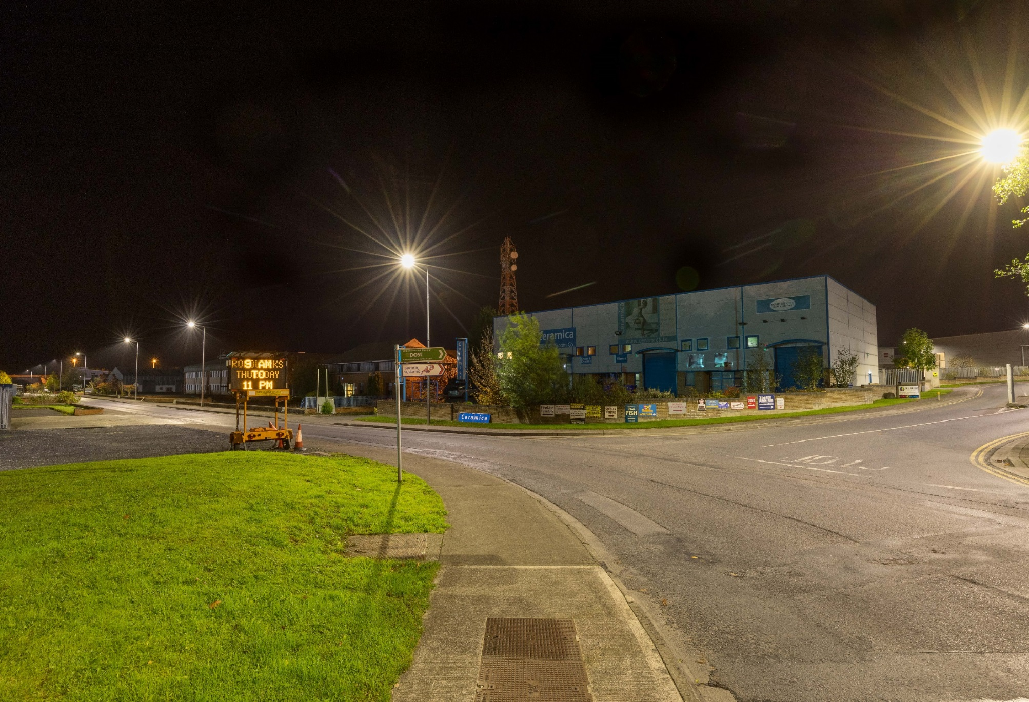

Slide 8
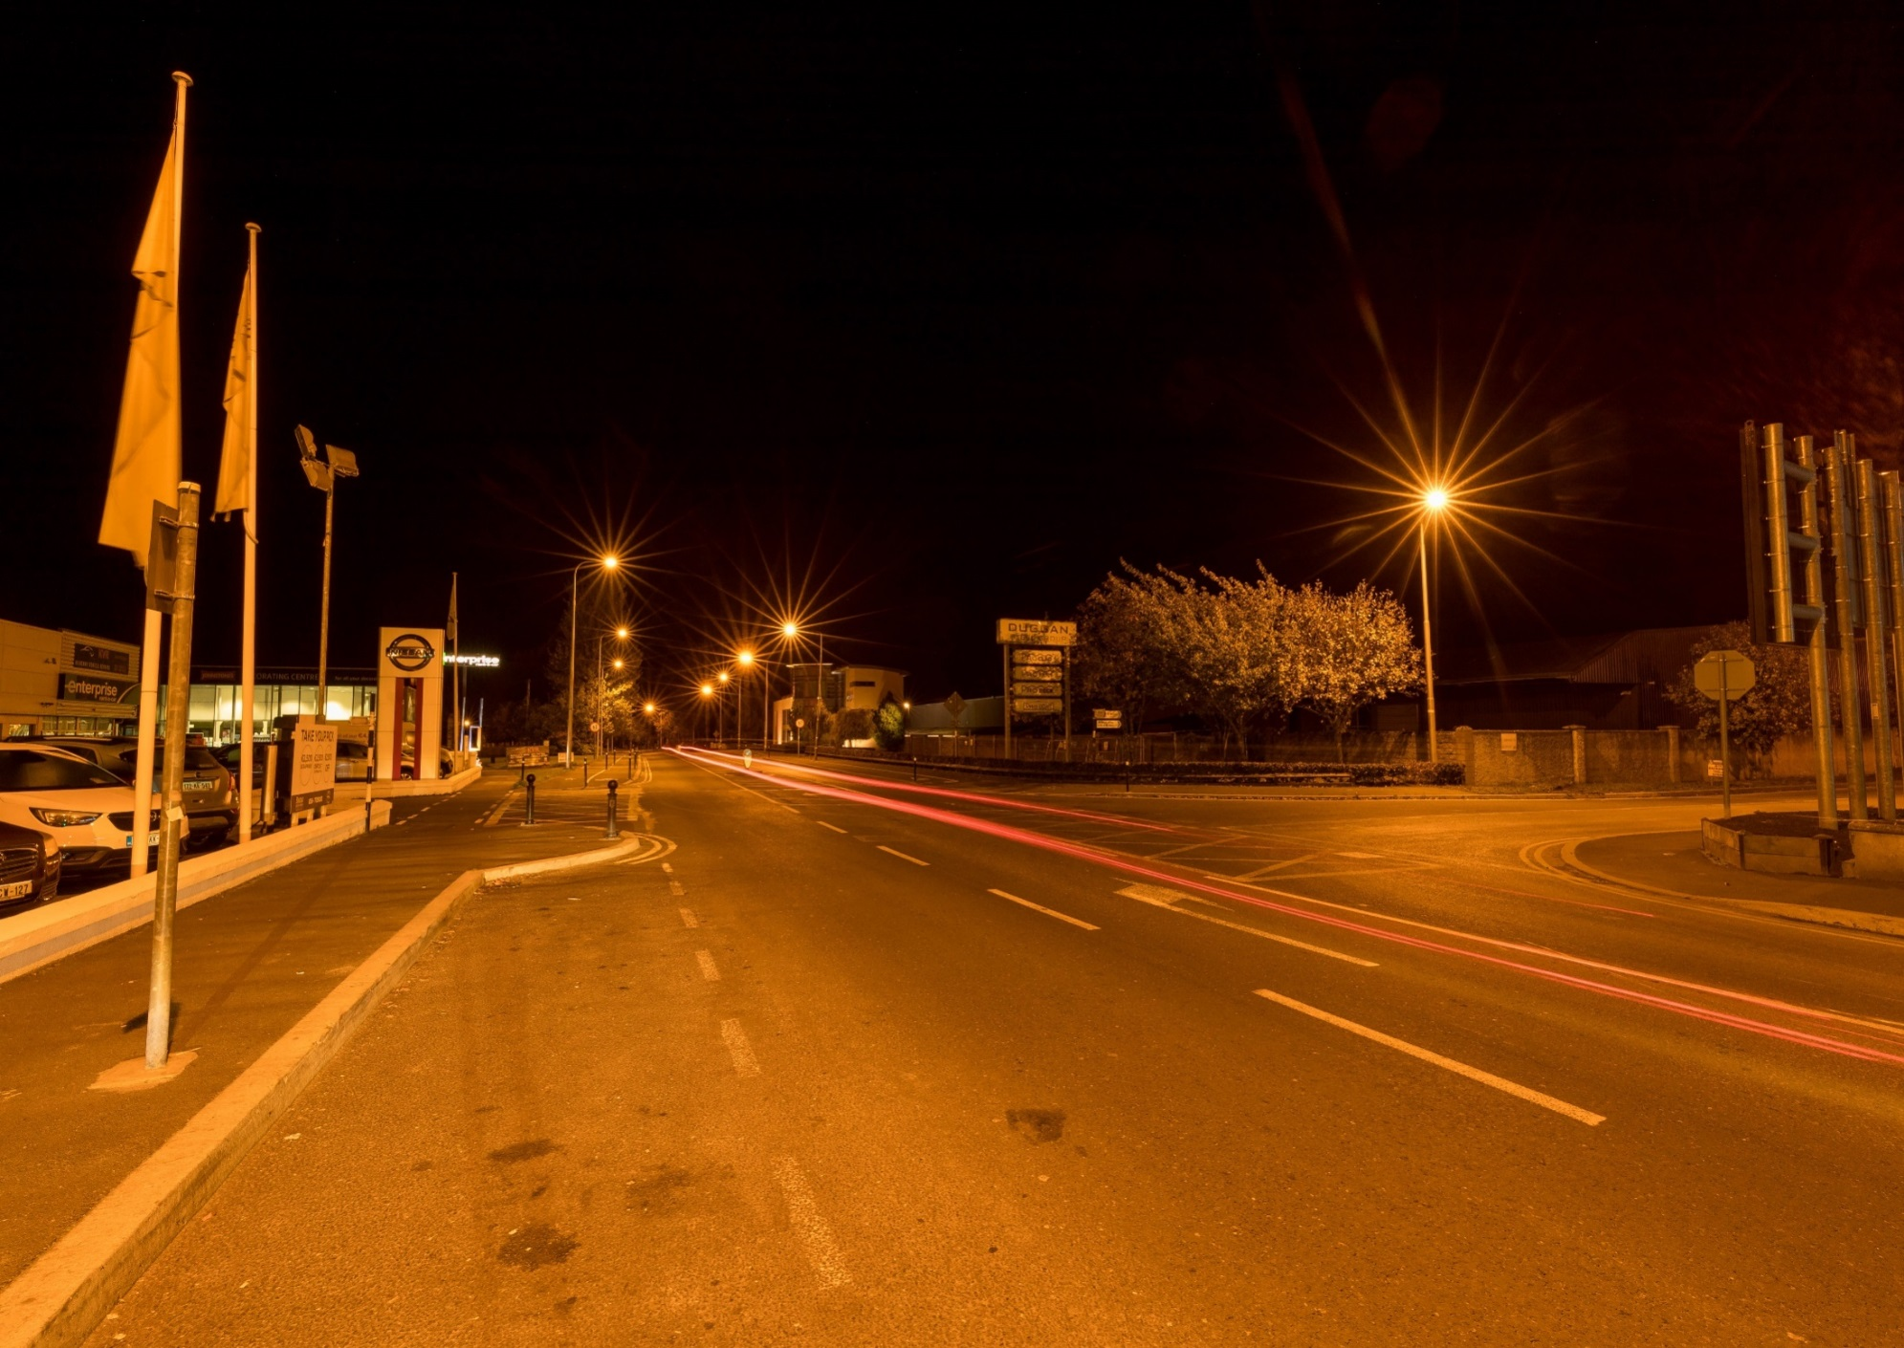
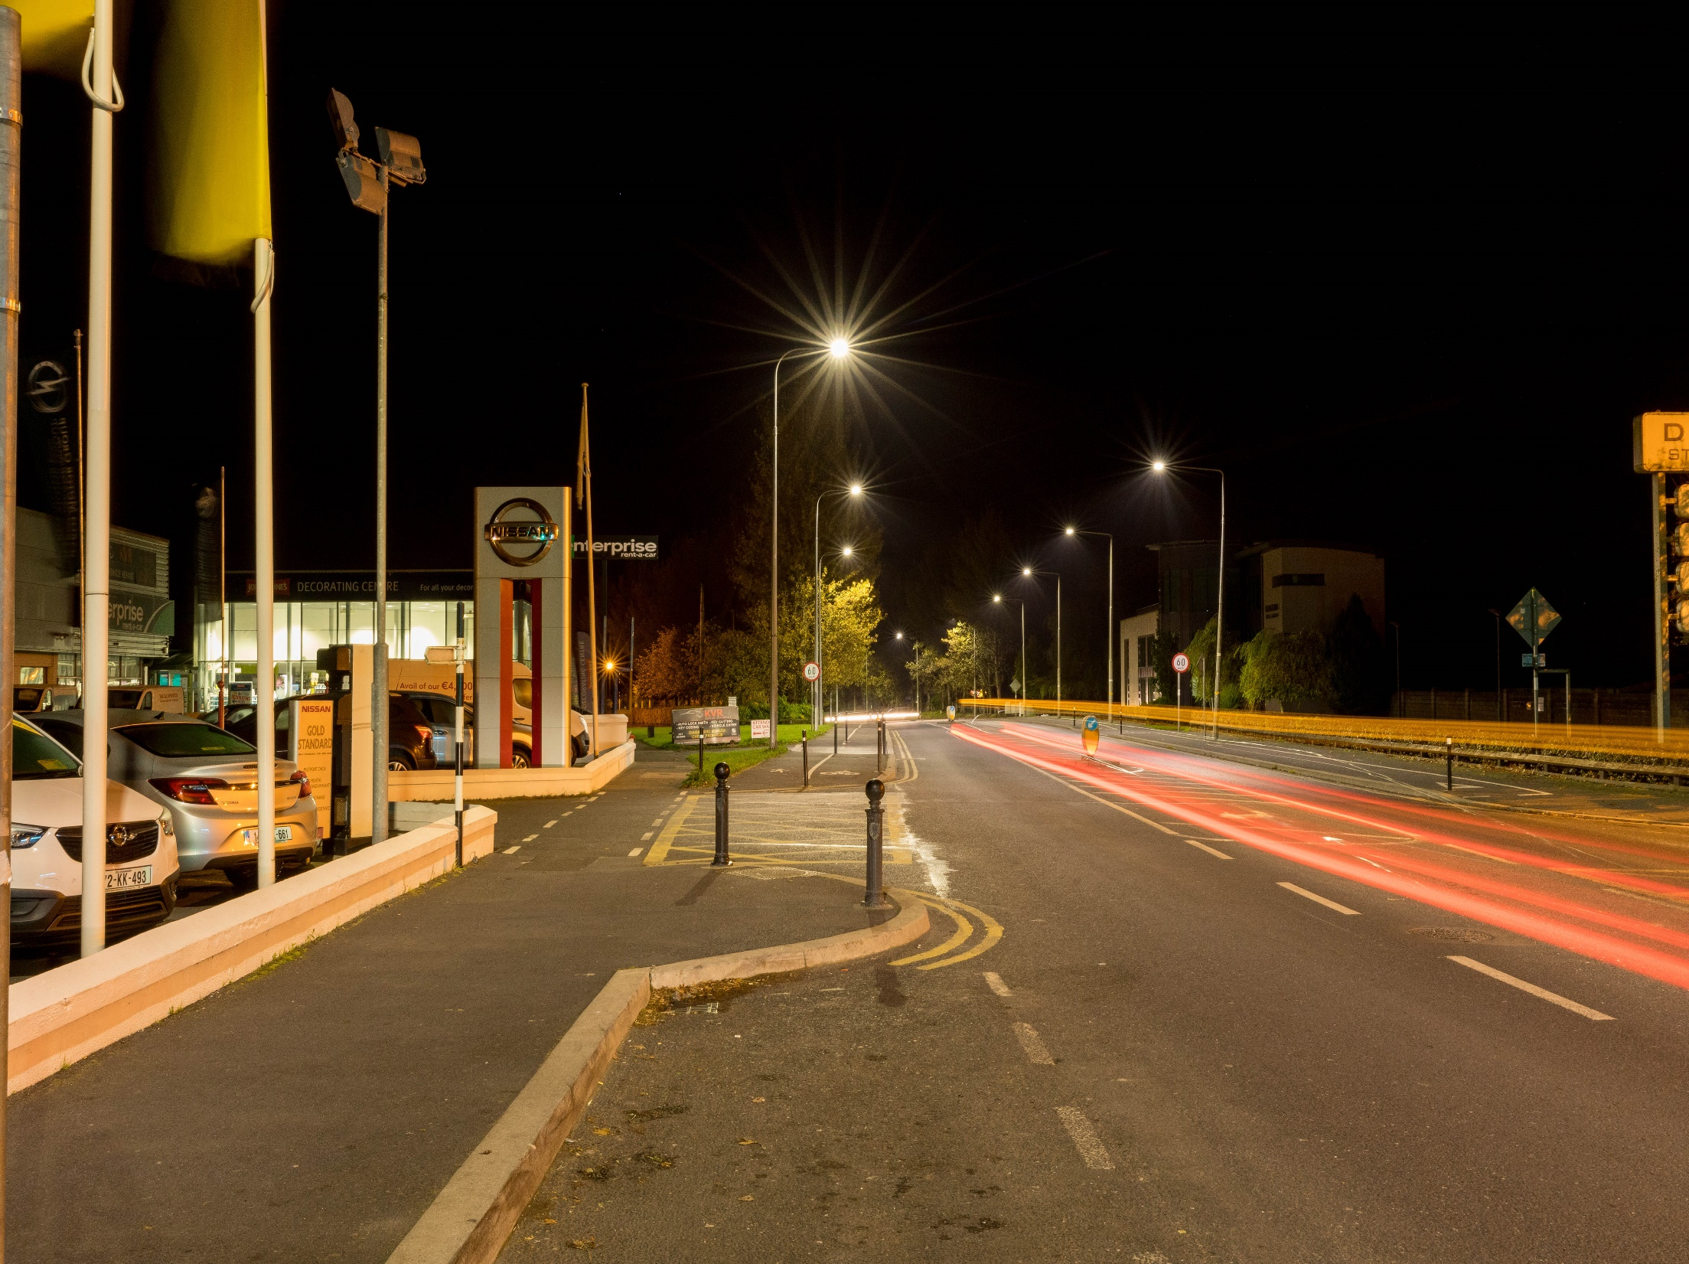

Slide 9
Public Lighting Energy Enhancement Project
National Programme – 3 regions each approximately 90,000 lanterns
Region 1 – South West – 5 counties- Cork Co Co lead Authority
Region 2 – East – 10 counties – Kilkenny Co Co lead Authority
Region 3 – North West – 7 counties – Mayo Co Co lead Authority
Notes:
Lead by RMO Donegal
National standards and solutions
National data base and asset management system
International tendering – better prices, large scale deals with suppliers, local contractors in JV
Finance from National body- better rates
Assist in getting earlier implementation.
Develop expertise in all counties – education
Section 85 agreements with each council

Slide 10
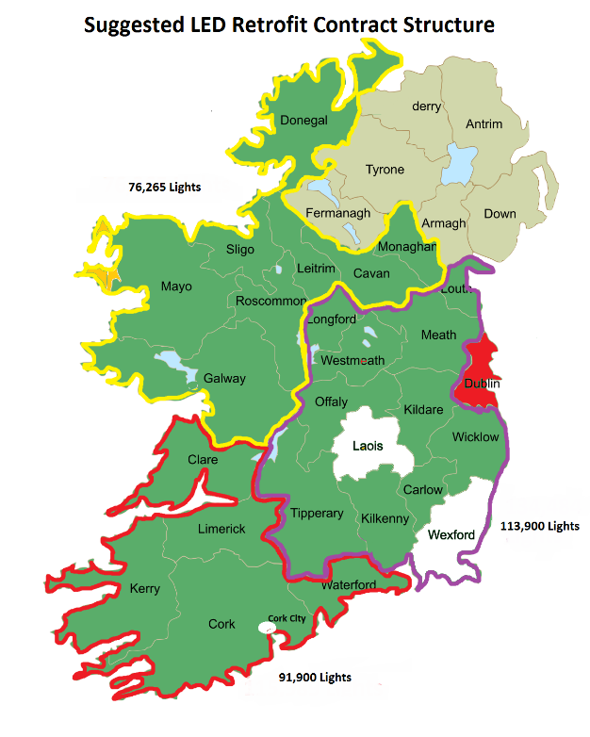

Slide 11
Rationale for the Project
Local Authority Energy Efficiency Targets
  National Energy Efficiency Action Plan 4 (NEEAP) requires a 30% improvement in energy efficiency by 2020
  Public Sector Energy Efficiency Strategy
Phase out of existing old lighting types (SOX)
  Production of low pressure sodium lamps (SOX) is being terminated in 2020 resulting in no replacements for existing stock. Replacement of older fittings with energy efficient fittings
Cost savings
  The pay back period for the upgraded lanterns is in the order of 10 years. The design life of the lanterns is 25 years.
Improved Environmental outcomes
  Better light in the correct location a the correct time
Notes:
LA to achieve major reductions
PL largest energy user in La
Big savings possible.
Sox out of date – need to replace – go with Led shown to be cheaper overall cost over time kcc had 4000
Energy
Emissions
Light pollution
Light- colour warm white with neutral white in selected areas such as pedestrian crossings, public order areas etc.
Warm colour selected for residential area.
Dimming and trimming to match usage – adjustable in the future

Slide 12
Outcomes of the Project
Reduction in energy consumption by the installation of energy efficient fittings
Reduction in harmful emission to the environment
Reduction in maintenance requirements
Development of a detailed inventory / asset register to inform future investment and management of the asset
Cost savings to the Local Authorities.
Notes:
Target 60% incentive to get higher low 70% possible
Carbon saving dependent on mix of electricity generation but any reduction positive
Life of SOX, SON 3-4 years, LED >20 years, drivers @12 years +
MAProad- allow management of funding for maintenance on a needs basis
Surveys will identify condition of poles etc to allow planed replacement.
Design for all light areas- identify areas with issues.
Funded from borrowing that will be re payed with saving- no need for current budget, will produce savings to LA in year 10-12 onwards.

Slide 13
Benefits of project
Reduced energy consumption and cost- in the order of 60% reduction
Reduced Carbon dioxide emissions
Reduced maintenance costs and higher availability of assets due to less lamp failures
Meeting the new lighting standards and guidelines in more cases
Reduced light pollution and disturbances to the general environment
Better colour rendition, better facial recognition, better security
More flexible lighting- dimming and trimming.
Inventory of lights and safety
Notes:
Section 85 agreement
Kilkenny lead for being ahead of the curve with lighting up grade, good data base

Slide 14
Eastern region
Lead Authority – Kilkenny County Council
Participating counties: Louth , Meath, Westmeath, Longford, Kildare, Offaly, Wicklow, Carlow, Tipperary
Scope of works: replacement of circa 80,000 lanterns in the Region, 4000 lanterns in Kilkenny
Notes:
Section 85 agreement
Kilkenny lead for being ahead of the curve with lighting up grade, good data base

Slide 15
Project time lines
Issue of tender Region1 (south west) March 2020
Appointment of Contractor October 2020
Issue of tender Region 2 (East) July 2020
Appointment of a Contractor December 2020
Duration of Contract 24-30 months
Notes:
Contract documents being prepared and tested
Data bases being tied up, special areas being identified with each La to get localised solutions within a national project
2 month tender period, followed by tender review and appointment
Timing of 2 tender – documents will be prepared using majority of region 1 with local data bases and needs
Timing partially dependent on level of interest, tender queries etc that would need amendment of form of documents / information / capacity of the market.
Also simpler for follow on tenders as majority of rates etc known to Contractors

Slide 16
Finance
Estimated value of Project €50 m
  This includes all costs involved in the project including Design, Contractors costs, development and management of the Asset Register of lighting assets.
Projected Savings to the Region over the life of the Project = €75M
Kilkenny budget = € 3.2 m (estimate)
Kilkenny borrowing requirements = €2.5m (estimate)
  Funding arranged through the Housing Finance Agency (HFA)
  Project self funding from the savings in energy costs.
  Loan repayment period 10-12 years.
Savings for Kilkenny L.A. over period of contract € 3.0m
Notes:
Business case estimates – checked against other similar projects eg Edinburgh
Figures dependent on final inventory figures – better details – lower risk
Analysis being carried out on risk values.
ESB costs being negotiated on national basis.

Slide 17

Thank you for your time – Ken Boland

