Slide 1
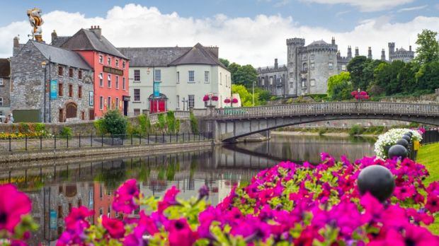

COVID Update
July 2020 Council Meeting

Slide 2
Content
COVID -19
Lockdown
Re-opening Council Services
Business supports
Supports to communities
Community Helpline
Re-opening the County and City

Slide 3
Lockdown 27th March 2020
First notice from HSE in relation to COVID-19 27th February
Emerging situation similar to a Major Emergency - South East Regional Major Emergency Group invoked – Chaired by Colette Byrne CE Kilkenny Co. Co.,
HSE, Local Authorities from Carlow, Kilkenny, Wexford, Waterford and Tipperary
Updates on cases, clusters, public health concerns, garda matters, shutting down of facilities
Assistance to HSE:
  with staffing,
  logistics – setting up and managing test centres,
  supplies,
  accommodation for staff and vulnerable in our society
Meetings on line twice per week to May 2020, then weekly, fortnightly and now monthly

Slide 4
Lockdown 27th March 2020
Following Public Health advices – total lockdown 27th March 2020,
Message to staff weekend of 27th March – not to attend work and await contact from line manager,
Access restricted for all public offices - appointments where necessary
All business conducted over phone, by email or on-line
Regular updates Councillors and all staff by email and via line managers
Staff commenced working from home part-time with 50:50 split of office and home working
Critical services to be maintained to include
  All water services with the exception of water conservation
  Emergency road repairs and traffic lights
  Essential Housing services, homelessness, housing for vulnerable
  Waste and environmental services
  Street cleansing, litter bin collection
  Dunmore Civic Amenity Centre open and increased use of recycling facilities
  Increase dumping and complaints of illegal dumping

Slide 5
Post 18th May, 2020
Induction for all staff – conducted by line managers
All staff completed Return to Work Form
Standard Operation Guidance for all operations functions
Social distancing paramount and good hand washing hygiene, sneezing and coughing etiquette
Changes to office layouts
COVID-19 Risk assessment
Line managers to ensure that all guidance is adhered to
COVID-19 Compliance Officers appointed to review service areas
Local safety representatives in each area to raise concerns of staff also
Engagement Unions and Management

Slide 6
New Working Arrangements post 18th May
Remote working available for staff and those who can work from home to remain so for present
Rota for Office Work with extended working days to facilitate social distancing
Continue to offer services to customers on-line, email or by phone
Return to work under new procedures – standard operating guidance and compliance check for adherence to public health requirements
Water had additional complication of drought conditions for a 3 month period Significant issue with supplies due to drought – driest May since 1850, restrictions now lifted
Recent rain has helped along with the work of our find and fix and water conservation crews

Slide 7
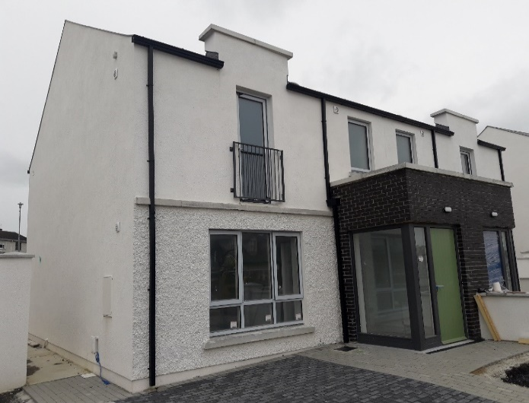
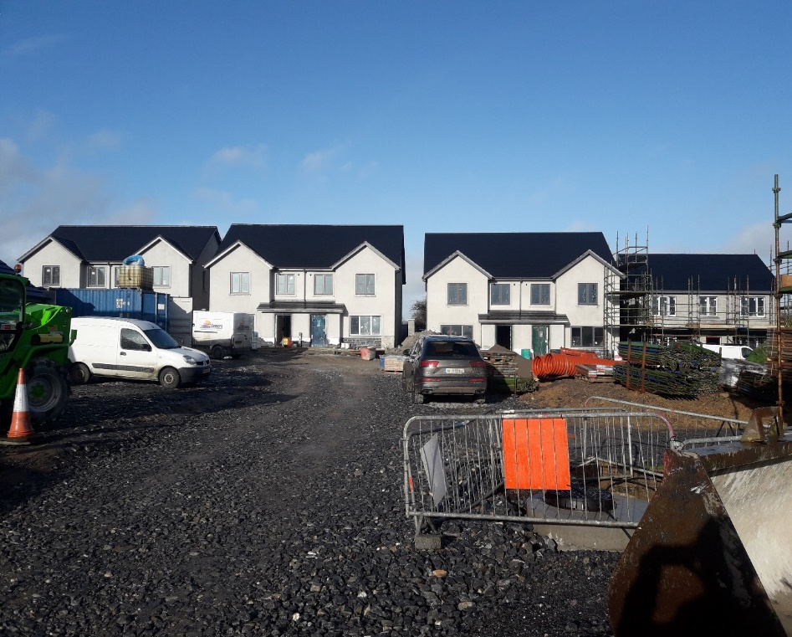
Housing - Covid19 Challenges:
All applications for all services accepted. Desktop assessments were carried out where possible.
Appointments available for face to face meetings
Homeless assessments continued. Emergency accommodation provided.
All rent assessments carried out on those in receipt of COVID payment.Activity resumed post 18th May on construction sites.
Backlog of works on housing grant works after the restrictions lifted.
Occupational Therapists were unable to carry out assessments during restrictions. They are now resuming work but they will need to follow restrictions/guidelines from HSE.
Hoban Park Callan Breaghagh Place Piltown

Slide 8
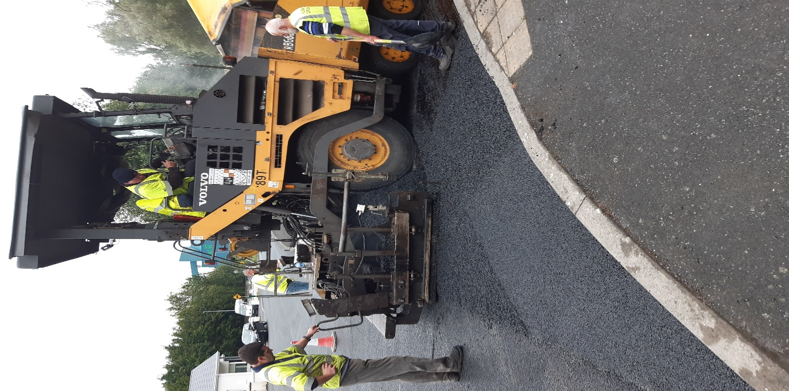
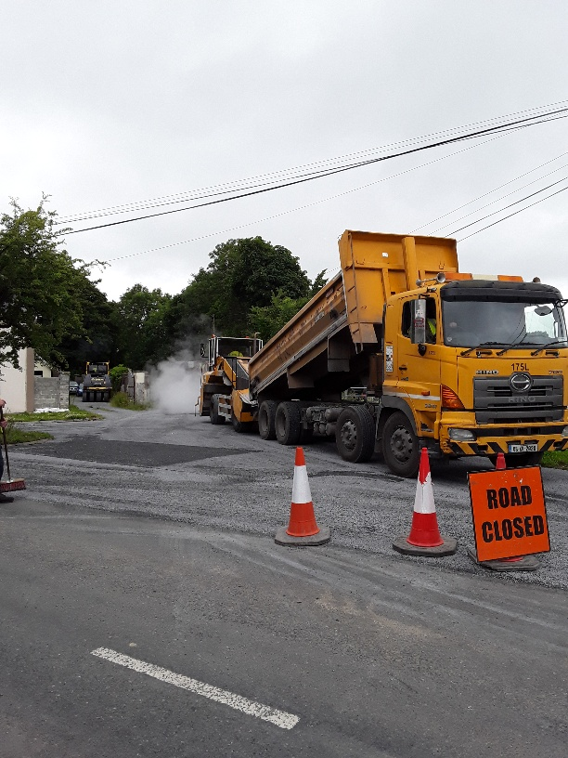
Machinery Yard and
Area Offices
Recommencement of Road Works Programme €29m - €18m on regional and local roads 18th May,
New working arrangements in place,
Programme 7 weeks in arrears but progress is being made
Paving works at Kilkenny Road Callan
Surface dressing at Milebush

Slide 9
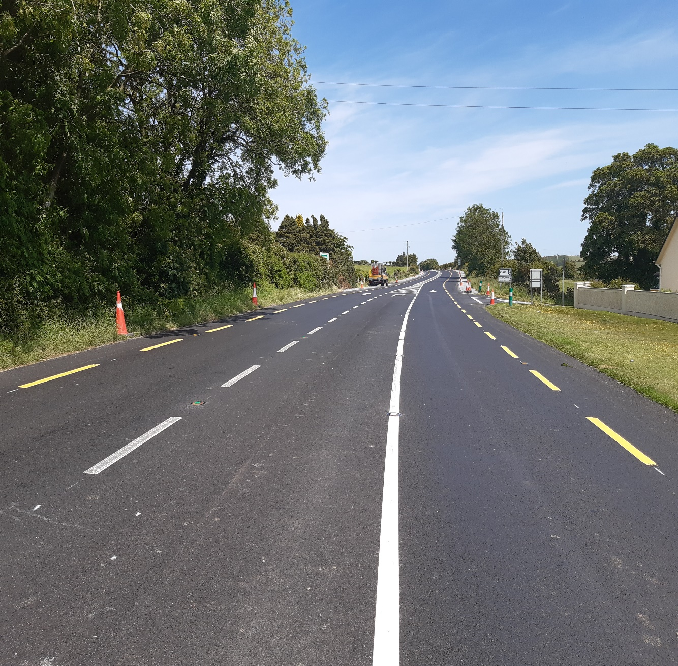
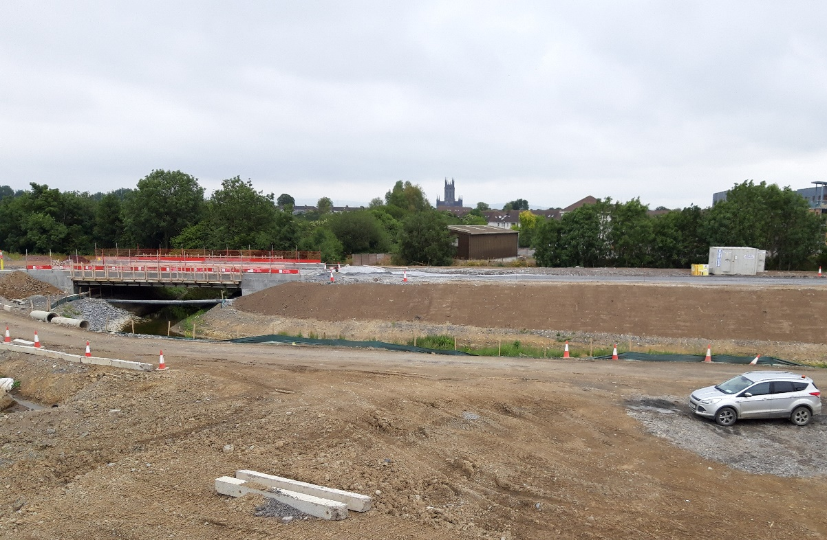
Contract Work - Roads
Recommencement of contract works Western Environs, N25 and other contracts,
Delays to contract inevitable,
Design works continued on a number of schemes – N25 Waterford to Glenmore and N24 Waterford to Cahir,
N76 €2.5m pavement improvement Ballymack to Castletobin and Brownstown to Ballybur commencing w/c 20th July.
€0.56m combined pavement/safety scheme on the N25 at Curraghmore
New bridge and realigned river on Circular Road

Slide 10
Planning
Planning Department is now open for business subject to Covid-19 guidance
Visits to the Planning Office is by pre-booked appointment.
Planning Clinics continue by phone
Work continued on all draft development plans
Built Heritage Investment Scheme -14 grant offers –allocation is €98,000
Historic Structures Fund - Grant allocation of €40,000 was approved
Planning Summary | TOTAL (to June 19) | TOTAL (to June 2020)
Planning Applications Received | 71 | 80
Planning Applications Granted | 61 | 57
Planning Applications Refused | 5 | 11
Complaints Received | 66 | 47
Warning Letters Issued | 72 | 40
Enforcements Notices Issued | 21 | 8
Cases closed | 67 | 30

Slide 11
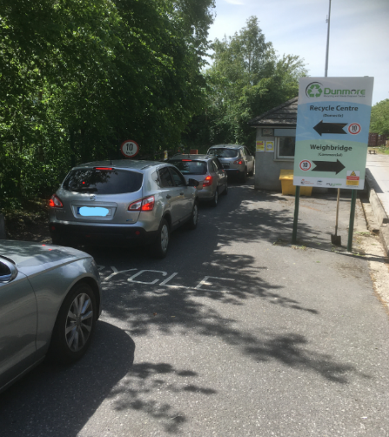
Environment
Dunmore Recycling and Waste Disposal Centre, as an essential service, remained open
10-week period to the end of May there were 14,427 visits
903 tonnes of waste and recycling material were received an increase of 5%.
Recycling Bring Banks - between 15th March and end of May -56.5% increase. 604 tonnes compared to 387 tonnes for the same period in 2019.
Increase dog fouling incidences - pilot community dog fouling project began on the 18th of May
Veterinary Section - busy during the COVID 19 restriction providing services to the slaughterhouses - increase in throughput of circa 10% in abbatoires 2020 v 2019.

Slide 12
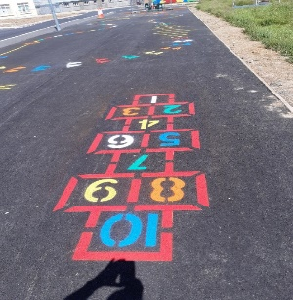
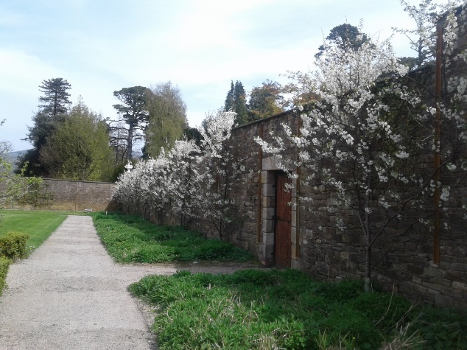
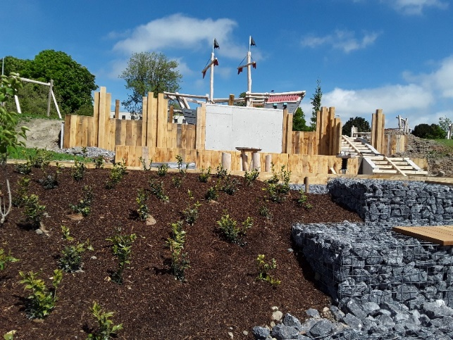
Parks, Open Spaces
Playgrounds remained closed – all open now
Work has resumed on the new amenity area in Ferrybank
Woodstock remained open for locals to enjoy – now fully open to the public
Grass cutting has resumed across the County
Amenity Grants approved at June meeting

Slide 13
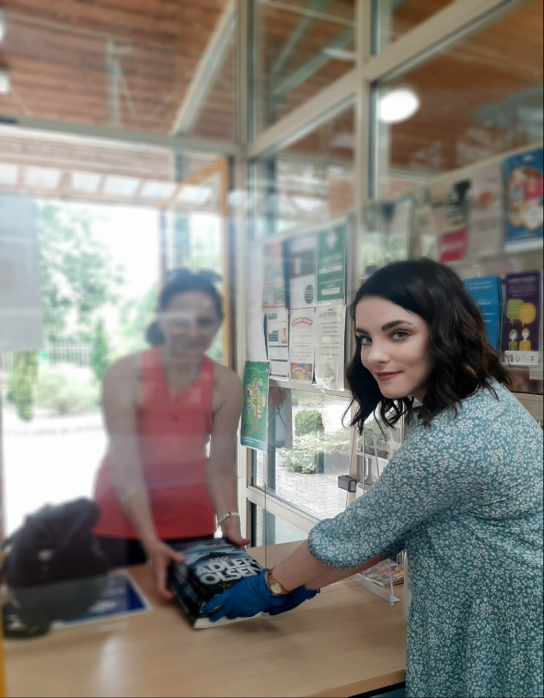
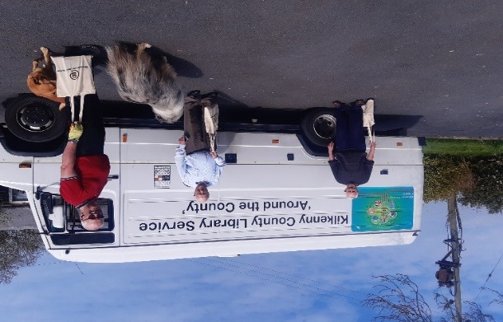
Libraries
Door to Door delivery Service to Cocooning Library Members
Online services increased dramatically during lockdown
Contact & Click service now available
Summer Stars Reading Adventure kicked off on 22nd June for children
Virtual and Radio Bookclubs with Sue Nunn for The Way It Is Book Club live on air, Tuesdays at 4.30pm.

Slide 14
Support to Business Local Enterprise Office
Trading Online Vouchers
Under the Government’s National Digital Strategy, the expanded Trading Online Voucher Scheme helps small businesses with up to 10 employees to trade more online, boost sales and reach new markets. There is up to €2,500 available through the Local Enterprise Offices with co-funding of 10% from the business*
Business Continuity Vouchers
The voucher is worth up to €2,500 in third party consultancy costs and can be used by companies and sole traders to develop short-term and long-term strategies to respond to the Covid-19 pandemic.
106 Trading Online Vouchers approved;
190 live enquiries;
2020 allocation - 279 totalling €697,500.
311 applications received;
265 applications approved to date;
Value of approvals: €634,000.

Slide 15

Restart Grant Applications
APPLICATIONS BEING ASSESSED | 74
APPLICATIONS ASSESSED | 827
APPLICATIONS PAID | 709
AMOUNT PAID | €2,566,843
GRAND TOTAL | 901

Slide 16
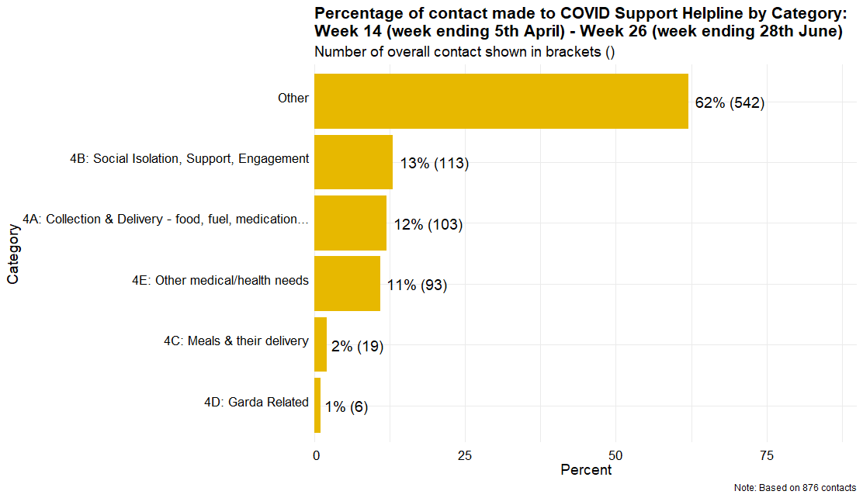
Community Call Helpline / Community Forum

Slide 17
Re-opening City and County
Tourism Recovery Task Force
Festivals
Projects throughout the County – Town and Village COVID-19 works
Re-start grant
LEO grants
Recommencement of Town & Village, CLAR, ORIS
Seeking Volunteers – Kilkenny Welcome Team
Audio Guide – outdoor tour of Kilkenny City
Shop Local Campaign July / August 2020 – outside broadcast
  7th July - Kilkenny City
  16th July – Thomastown
  21st July – Castlecomer
  30th July – Kilkenny City
  4th August - Piltown

Slide 18
Re-opening the City
A one-way system on Rose Inn Street and High Street
Additional space for pedestrians.
Improvements to traffic signal timings at key junctions
The introduction of the one-way system on Ormonde Street

Slide 19
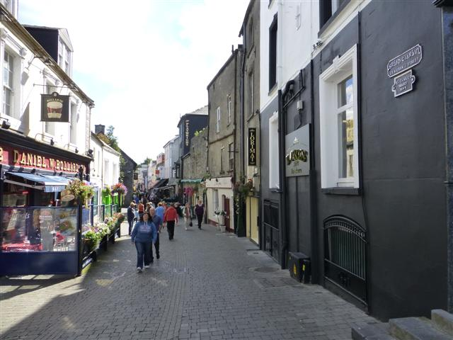
Pedestrianisation
James’s Street will be pedestrianised between the hours of 0900 to 2100 daily from the entrance to Market Cross Shopping Centre Car Park to High Street.
The pedestrianisation of St. Kieran’s Street will be extended to match

Slide 20
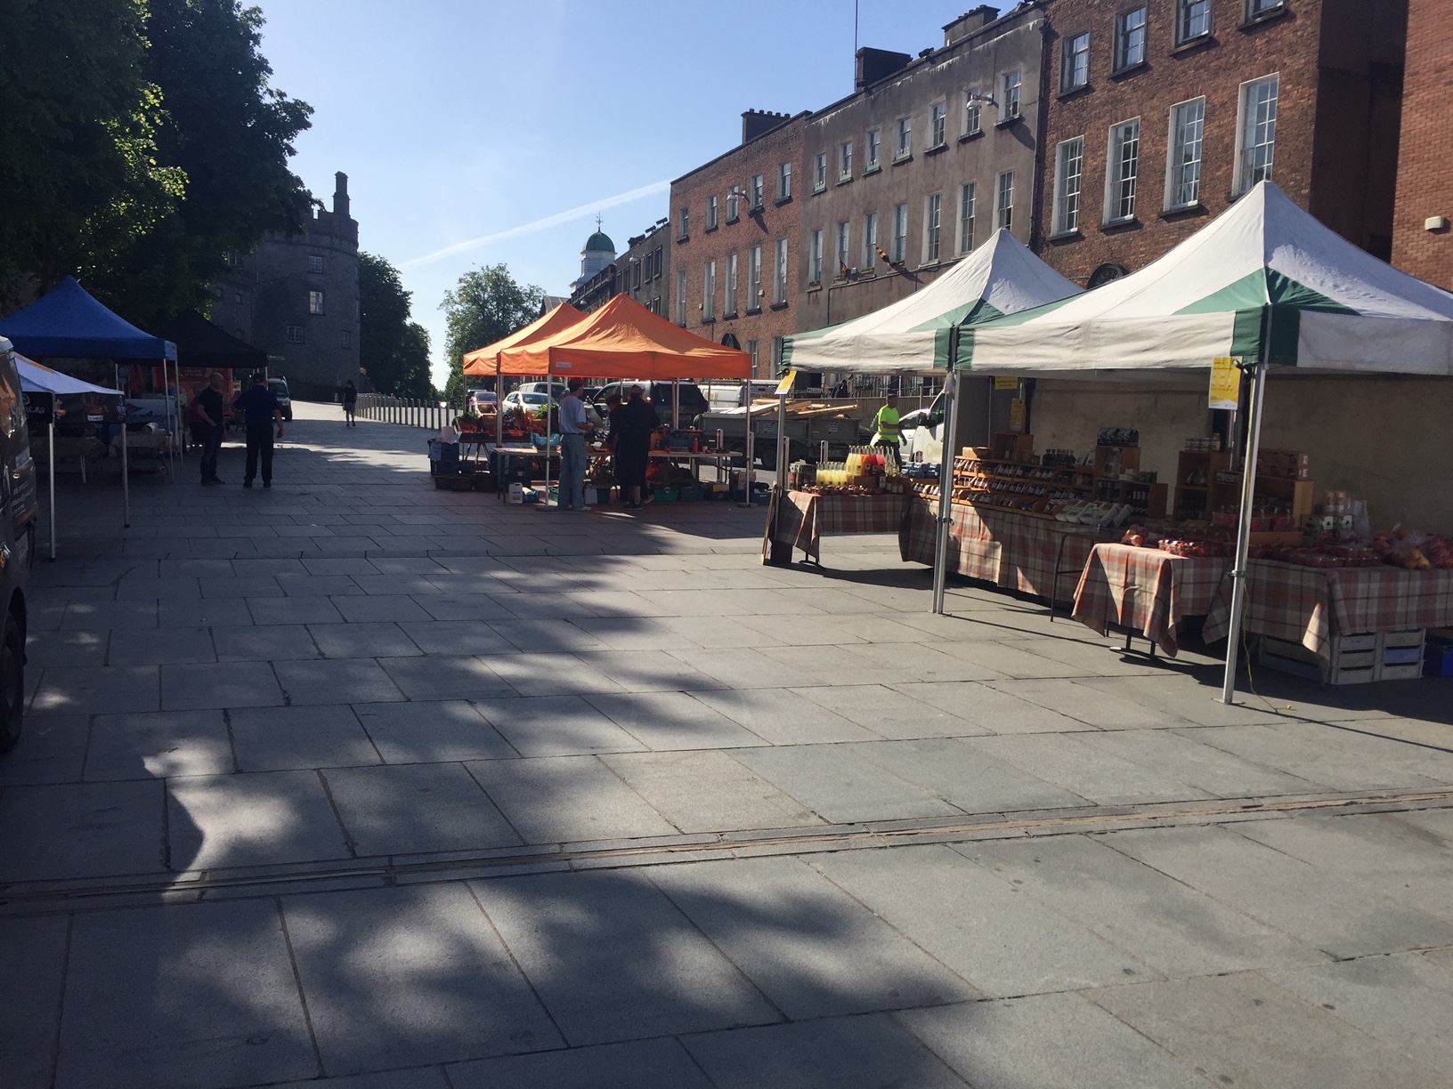
Farmers Market & Seating Areas

Slide 21
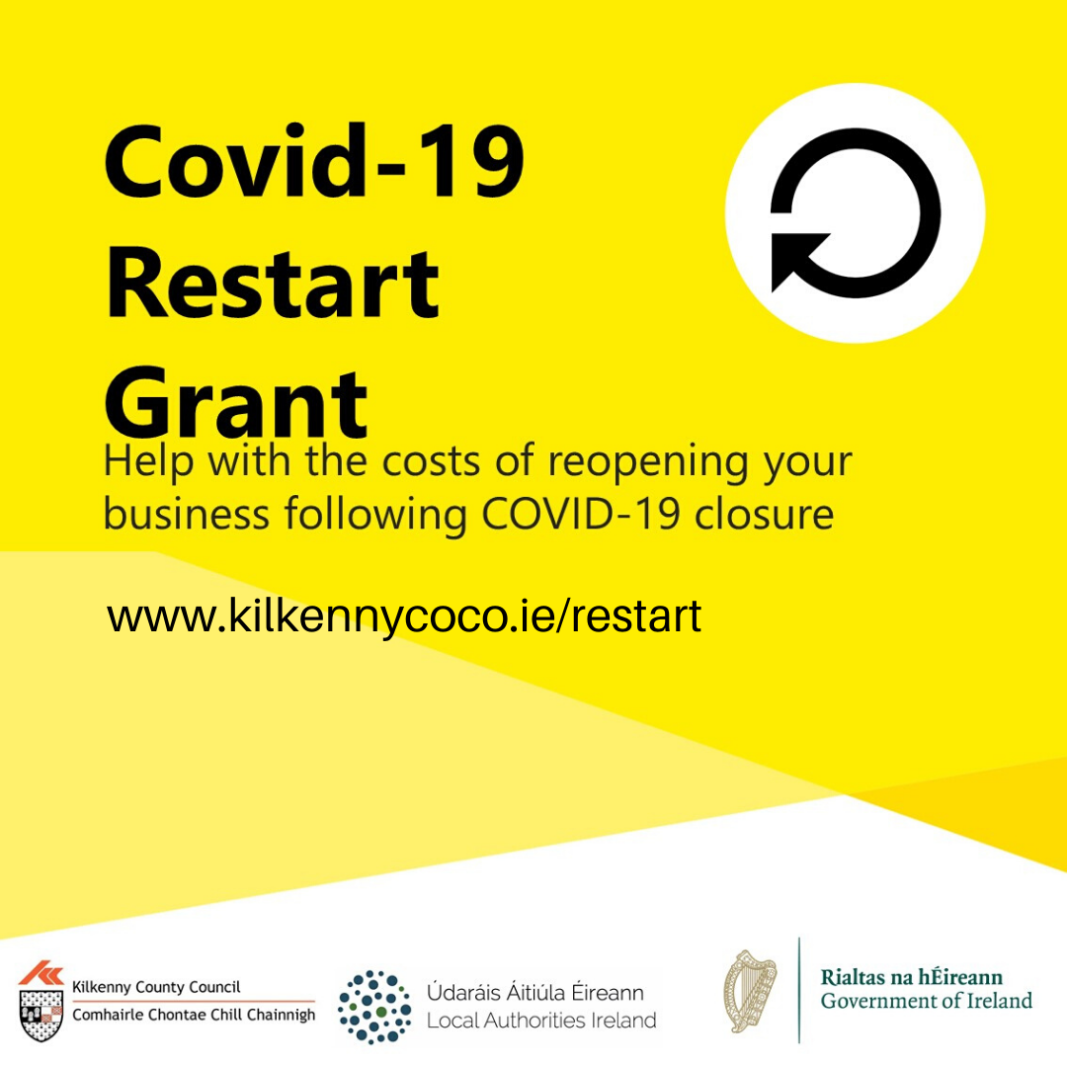


RE-START GRANT
KILKENNY COUNTY COUNCIL
​COMHAIRLE CHONTAE CHILL CHAINNIGH

Slide 22
What is the Re-Start Grant?
€250m direct financial grant aid for micro and small businesses to assist with the cost of re-opening and re-employing workers following closure due to COVID-19.

Slide 23





Administration
The Re-Start Grant is administered by Kilkenny County Council on behalf of the Department of Business, Enterprise & Innovation. The Re-Start Team are responsible for processing applications from receipt to payment and have also dealt with in excess of 1,300 phone queries and e-mails to date.
Enterprise Ireland transferred first tranche funding of €3.75m on commencement of the scheme effective from 22nd May.
The application process is straight forward, facilitated on-line and payments are made quickly by electronic funds transfer.

Slide 24
Subject to qualifying criteria below, any business that operates from a commercially rateable premises or where rates are paid on behalf of the business, can apply.
Had an annual turnover of less than €5m and employs a maximum of 50 wholetime workers.
Has closed or suffered a projected loss of 25%+ in turnover from 1st April to 30th June.
Commits to remain open or re-open if closed.
Declares intention to retain employees that are on the Temporary Wage Subsidy Scheme.
Who Can Apply?

Slide 25
How much is the grant payment?
The grant is based on the amount of rate demand for calendar year 2019 only, subject to a minimum payment of €2,000 and maximum of €10,000. In the event the rate demand is reduced on appeal the appeal amount will apply if the grant is greater than €2,000.
The grant is a financial contribution towards the cost of re-opening or keeping a business operational and re-connecting with employees and customers. The grant can also be used to defray on-going costs e.g. utilities, insurance or for measures to ensure employee and customer safety.
Applications will be accepted on-line until the 31st August.
What can the grant be used for?
Closing date

Slide 26

Statistics to date
920 no. of applications received.
67 no. of applications in process.
€2,634,493 value of applications paid with average grant payment per business €3,600.
KCC anticipates a further 800-900 applications near to the closing date 31/08/2020.

Slide 27

Initial press release announcing grant.
On-going advertisement on social media platforms – Face-book, Twitter & Instagram, LEO pages and Council pages.
Mail shot via e-mail to over 1900 businesses.
Postal flyer to over 1400 Rate Demand payers.
Advert on K.C.L.R. announcing grant and calling for applications.
Promotion on local radio by Head of Finance.
Shop Kilkenny with KCLR – Promotion by Fiona Deegan, S.E.O., Local Enterprise Office.
On-going advertisement in local press.
Next – Further press release advising of uptake to date.
Re-Start team members phoning rate payers who have not applied to date.
Communications

Slide 28



Find Out More
Re-Start Team on 056-7794902
restart@kilkennycoco.ie
www.kilkennycoco.ie/restart

Slide 29
Budget 2020 update
Introduction
Onset of Covid-19.
Impact was being felt by businesses from February.
Widespread closures from Mid march under Government instructions.
Sudden nature of closure – has had serious impact on businesses.
Council services had to be maintained with exceptions.
Significant restructuring on how Council services were delivered was carried out in compliance with HSE guidelines.

Slide 30
Budget 2020 update
All Council Income streams have been impacted since early on in the crisis.
  Commercial Rates
  Housing Rents
  Car parking,
  Planning Receipts
  Fire Charges
  Property rental.
  Development Contributions
  Other Income streams.

Slide 31
Commercial Rates
Government announcements in March/May:
  Collection of commercial rates deferred until the end of May.
  3 month waiver on commercial rates for businesses forced to close due to public health requirements covering the period April, May, June.
  Restart grant for businesses impacted by Crisis.
2 Submissions made by the Local Government sector to the DHPLG on the impact of the crisis on commercial rates income.
Detailed analysis of the commercial rates customer base has been carried out.
DHPLG still has to issue detailed guidance on the 3 months rates waiver.
The position regarding commercial rates post June is to be reviewed by Government as part of a broader package of measures.

Slide 32
Commercial Rates
Total Gross rate demand for 2020 for KCC is €21m.
Total estimated loss in Rates income for KCC is €8.7m.
The estimated value of the compensation for April/May/June arising from the Government announcement is €2.5m.
This leaves a net shortfall in Income from commercial rates of €6.2m.
The extent of the loss will be impacted by :
  How many businesses will reopen.
  How quickly businesses can recover.
  What further compensation will be provided by Government.

Slide 33
Other Income
Car Parking
  Total budgeted Income for the year - €2.34m.
  Actual amount received at date of closedown - €539k
  Estimated loss for the year - €800k.
Housing Rents
  Estimated Income reduction for the year of €400k.
  Rent review carried out in Q1 has been deferred until further notice.
Other Income
  Estimated reduction for the year of €500k.
Development Contributions – Funding for capital programme.
  Budget of €3m for 2020.
  Current projected income for 2020 - €1.75m

Slide 34
Income Reduction
Total estimated reduction in Income
  Commercial Rates (Net of compensation of €2.5m) €6.2m.
  Other Income €1.7m.
  Overall Total Income Reduction €7.9m.
  Dependent on:
    Business recovery
    Additional Government support.

Slide 35
Additional Costs Arising from Crisis.
Crisis has resulted in additional costs for the Council across a number of headings.
  IT investment.
  Protection measures – screens , masks , etc.
  Limited outdoor works for 8 weeks(could impact on road grant).
  City – One way system and other interventions.
  Difficult to provide accurate estimate at this stage.
  Estimated additional costs could exceed €500k.

Slide 36
Organisations supported by Council
Organisations such as the Watergate, Rothe House, Butler Gallery, MMM, CDP, Festivals, Events.
All have had to close/cancel due to the crisis.
All have taken action to minimise their losses.
Request that funding allocation in the adopted budget be maintained.
Some festivals, events had made commitments prior to Covid-19.
Some are also planning scaled down events for later in the year to assist with the recovery and reopening of Kilkenny.
CDP have requested payment of the 2nd half of the loan approved amounting to €75k.
  €40k paid.

Slide 37
Expenditure Review
Review of discretionary expenditure has been carried out.
Limited in the number of budget headings that can be reviewed.
As previously advised expenditure on a number of budget areas has been deferred until better clarity is available on the full year position.
Total Estimate on expenditure that has been deferred - €2.35m.
Full details attached in Appendix 1.

Slide 38
Expenditure Review
 | Budget 2020 | Deferred Expenditure
 | €'000's | €'000's
Division A-Housing and Building | 2,915 | 530
Division B-Road Transport & Safety | 1,854 | 535
Division D-Development Management | 1,189 | 387
Division E-Environmental Services | 2,348 | 236
Division F-Recreation and Amenity | 2,166 | 205
Division H-Miscellaneous Services | 220 | 85
Division J-Central Management Charges | 2,729 | 373
Overall Total | 13,421 | 2,353

Slide 39
Capital Programme
Social Housing – Fully Grant Funded
  Expenditure in 2020 - €27m
  Delivery of 150 units in 2020.
  Working capital requirement of approx. €5m on an ongoing basis.
  Additional €5m tied up in working capital on other housing developments.
Roads Projects – Fully Grant funded
  Total estimated expenditure in 2020 of €11.5m.

Slide 40
Capital programme excl Housing & Roads (100% grant funded)
3 large projects under construction:
  Abbey Quarter - Public Realm/Park/Other €4.7m
  Breagagh Valley infrastructure €15.3m
  Butler Gallery €6.3m
  Total Estimated expenditure €26.3m.
  Additional match funding required in 2020 to complete these 3 projects - €6.1m.
St Francis Bridge:
  Final payment to contractor has yet to be paid
    Estimate of €1.3m.
    Waiting on the contractor to revert.

Slide 41
Capital programme excl Housing & Roads (100% grant funded)
Other projects under construction:
  Total Expenditure - €5.9m.
  Match funding required - €1.4m.
Project | €'000's
Ferrybank Park | 700
Medieval Mile extension to Parliament Street | 873
Refurbishment of Vicar Street & Greensbridge St. | 600
Kilkenny - Off Street Connectivity | 600
Lighting up the Medieval Mile | 730
City Demarcation & Gateways | 430
Callan - Fair Green | 399
Callan - Motte Field | 360
Callan - Bridge Street/Mill Street | 150
Thomastown Public Realm | 900
Thomastown Quayside Car Park | 128
Thomastown Maudlin St Regeneration | 65
Total Expenditure | 5,935

Slide 42
Capital programme – Future projects
Project Name | Grant Status | Project Cost Estimate | Match Funding Required
 |  | €'000's | €'000's
Mayfair Library & Public Realm | Grant approved | 6,842 | 3,835
AQ Urban Street, Park Project and other | Grant applied for | 14,614 | 3,651
Public Lighting | No Grant | 4,929 | 3,940
Tholsel | Grant applied for | 4,965 | 1,683
Tomastown Sessions House | Grant approved | 1,427 | 517
Thomastown Library | Grant approved | 2,911 | 2,425
Oromonde Street Capital works | Grant applied for | 1,000 | 265
Kilkenny Greenway | Grant approved | 15,000 | 3,000
Greensbridge Board walk to AQ | Grant applied for | 1,000 | 250
City Mobility improvements (High St.& Rose Inn St.) | Grant applied for | 4,068 | 1,017
Ormonde St Upgrade | Grant applied for | 1,061 | 265
Carneige Plaza and Barrack Lane | Grant applied for | 1,805 | 451
Upgrade St Mary's precinct | Grant applied for | 955 | 239
Ferrybank/Belview link / N29 |  | 14,000 | 3,500
Northern Ring Road |  | 300 | 300
Overall Total |  | 74,877 | 25,339

Slide 43
Capital programme – Summary
 | Estimated Cost - €’m | Match Funding required - €’m
Large Projects under construction | 26.3 | 6.1
Smaller Projects under construction | 5.9 | 1.4
St Francis Bridge | 1.3 | 1.3
Total Committed | 33.5 | 8.8
Future Projects | 74.9 | 25.0

Slide 44
Capital Programme
Existing Borrowings
  Term Loan at the end of 2019 €11.7m
  New loan drawn down in 2020 € 5.0m
  Capital Commitments on completed projects €10.3m
  Total Loan liability €27.0m
  Additional Loan Finance required in 2020/early 2021 €7.5m
    €5M provided for in the 2020 budget.
  This will bring total borrowings to €35m.
CCMA Submission has been made on behalf of the sector to provide additional grant funding for shovel ready projects.

Slide 45
Cash
Key focus on cash collection from all grant sources.
  Government departments have processed grant claims much quicker.
  €4M of LPT allocation paid early, 2/3rds of annual allocation now paid up.
  Increase in the turnaround time on housing grant applications which has made a significant impact on cashflow.
  Council has been able to pay all bills on time since the beginning of the crisis.
  Available cash balance at the end of last week of approx. €7.5m.
  Overdraft facility has been increased from €13m to €20m in March.
    Overdraft is only for working capital purposes.
    The temporary increase is purely an emergency measure.

Slide 46
Summary
Council facing significant income reduction for 2020.
    Currently estimated at €7.9m.
Still a high degree of uncertainty for businesses.
More Government support is needed for the LG sector.
Need to source additional grant funding to deliver on planned capital projects.
We must proactively manage the situation we find ourselves in.
  Doing nothing is not an option.

