Slide 1

Kilkenny County Council
18th October 2021
Carol McCarthy
Catchments Team Manager
LAWPRO
Draft River Basin Management Plan for Ireland 2022 – 2027

Slide 2
Content of Presentation
About the Plan
Condition of our waters
  Ireland
  Kilkenny
Main themes of the Plan
Selected Plan measures
How to make a submission

Slide 3
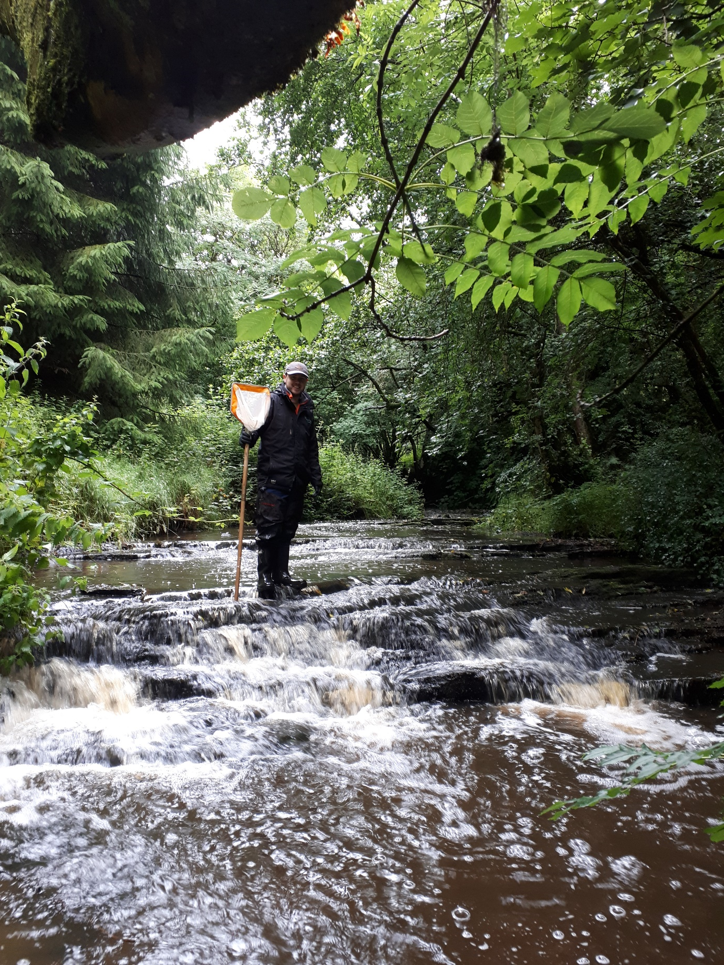
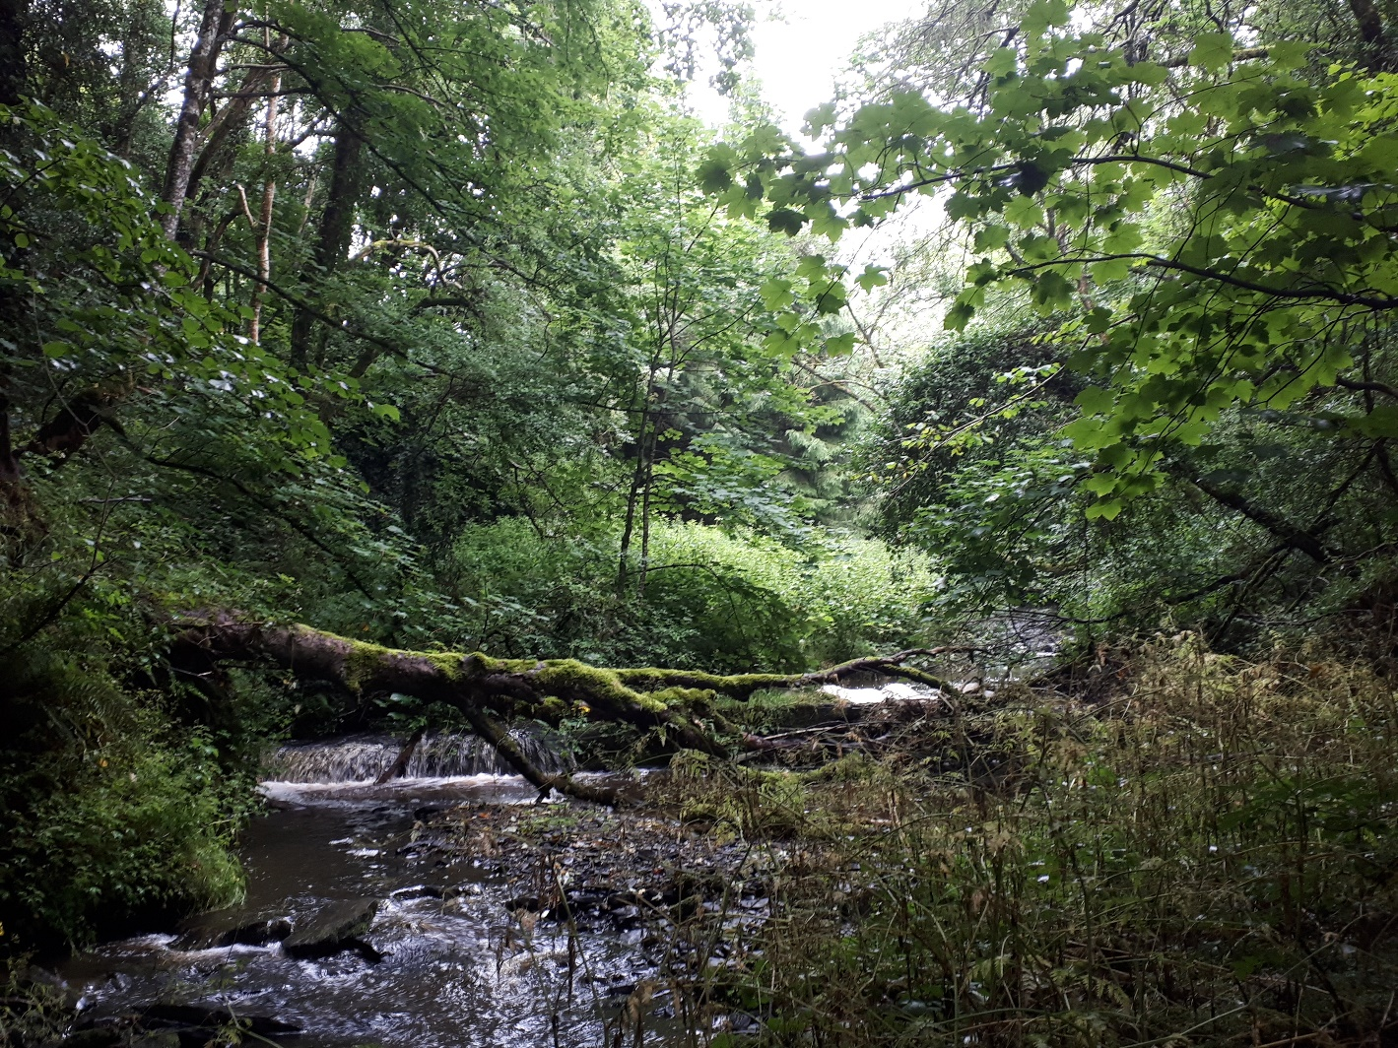
What is the River Basin Management Plan?
A national plan that aims to protect and restore good water quality in all our natural waters.
To benefit health, biodiversity, climate, communities and jobs.
Muckalee River
Muckalee River
Notes:
This is a public consultation on a Plan which details how water quality in Kilkenny and across the country will be managed. It outlines the activities responsible for water quality declines, and the actions that are needed to correct those problems.

Slide 4
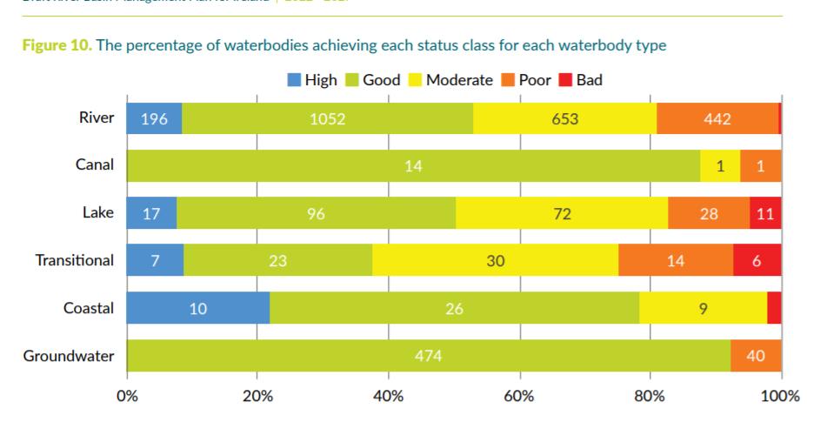
Condition of our waters
National Picture
  Just over half (53%) of surface waters are in good or high ecological status (2018).
  Overall water quality is not improving at a fast enough rate.
Notes:
Key Message: water quality is not improving fast enough.
Groundwater 92% of waterbodies are at good status.
Just over half (53%) of surface waters are in
good or high ecological status.
Summary:
Two thirds did not change in status.
One fifth declined
Just over one in ten improved.
Overall there was a 4.4% net decline in water quality mostly driven by declines in rivers.
However, assessments in 2019 and 2020 shown that the proportion of rivers improving in quality in the Priority Areas for Action at 21% is higher than the proportion improving outside of these areas at 13%, indicating that the targeting of actions is helping to improve water quality.
A large number of river waterbodies are still declining and unless this is addressed, sustained and progressive improvements in water quality will be difficult to achieve.

Slide 5
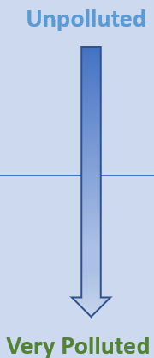
Condition of Waters in Kilkenny
Current status | Number of waterbodies
High | 1
Good | 26 (41.5%)
Moderate | 26
Poor | 12 (58.5%)
Bad | 0
}
}
There are 65 monitored surface water bodies in Kilkenny.
Between 2015 and 2018, 18 water bodies deteriorated and 8 improved.
The status will be reported on again in 2022 (for the period 2019 – 2021).
There is only 1 High Status Objective Water Body (Muckalee/Douglas River) in the County
and this is no longer meeting its high-status objective.
There are 19 ground waterbodies – all are at good status – for now!

Slide 6
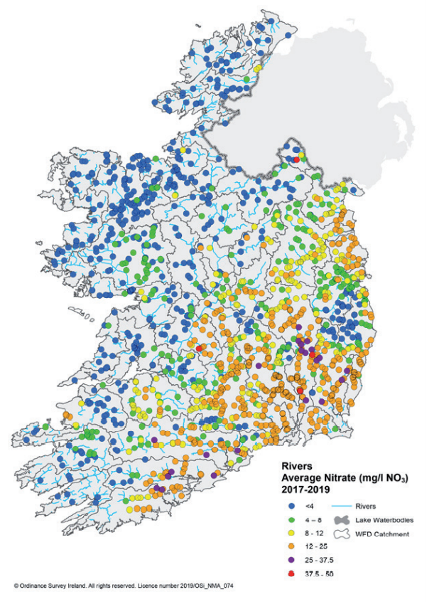
High Nitrate levels in SE
Nutrients (Nitrate and Phosphate)
are too high with trends going in
the wrong direction.
High Nitrate levels in the south
and southeast are damaging our
Estuaries.
Elevated nitrate concentrations
are contributing to eutrophication
in our freshwaters and estuaries
and causing difficulties with drinking
water standards in some areas.
Notes:
Intensive farming, free draining soils, lower rainfall

Slide 7
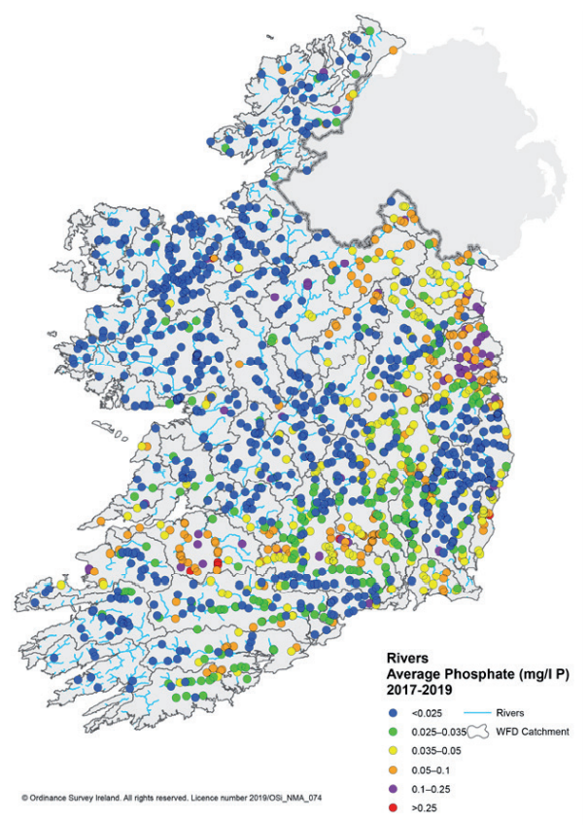
Elevated Phosphate levels

Slide 8
Significant Pressures for water bodies at risk
  The number of waterbodies impacted by agriculture has increased by 223.
  The number of waterbodies impacted by urban wastewater has decreased by 83 (the greatest decrease in any one significant pressure type).
  Increased: changes to hydromorphology, urban surface water run-off and septic tanks.
  Decreased: peat, industry and forestry.
Agriculture
(1000)
Hydromorphology
(442)
Forestry
(233)
Urban Waste Water
(208)

Slide 9
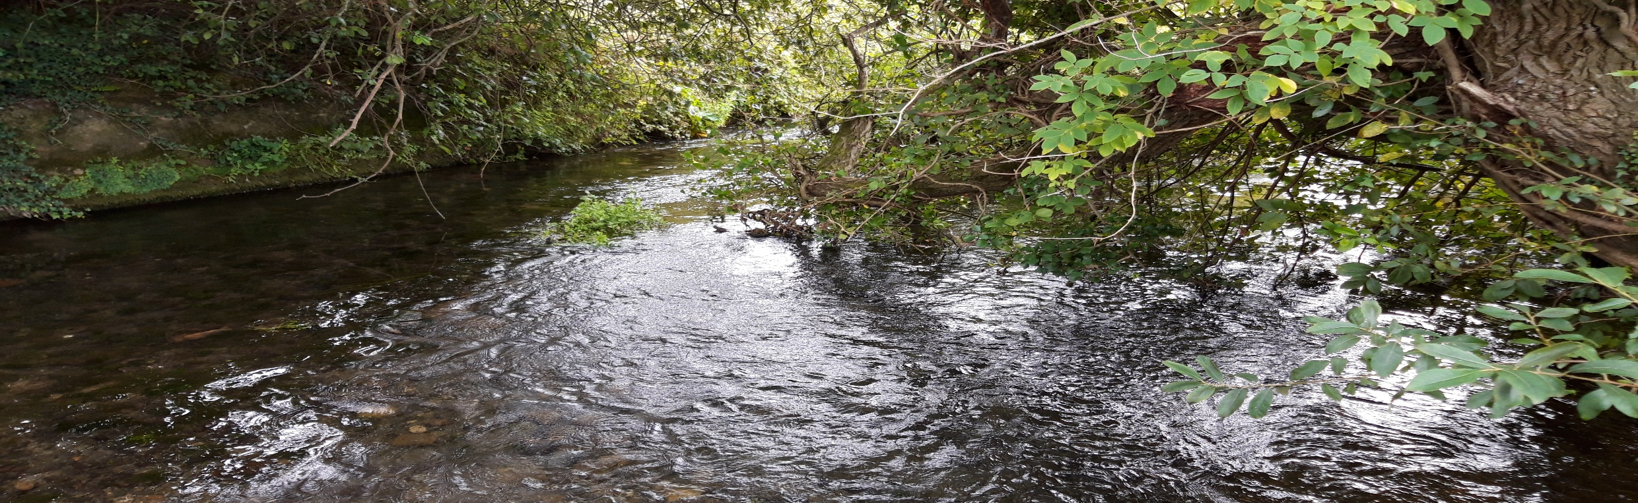
The main themes in the Plan
Increased national ambition to halt the decline in water quality and reverse the damage – focus on protection as well as restoration.
Integrated Catchment Planning – a specific plan put in place for each of the 46 river catchments in the country.
Greater co-ordination and collaboration between State agencies, local authorities and LAWPRO.
Focus on monitoring implementation of measures.
Delivering multiple benefits for biodiversity and climate action.
Nuenna River

Slide 10
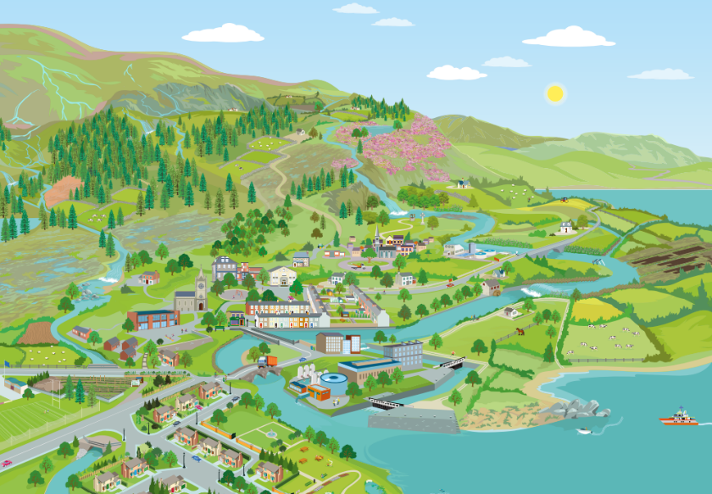

The measures in the plan aim to address the issues affecting water quality that arise from human activities.
Septic Tanks
Forestry
Peat Extraction
Physical Modifications
Urban Wastewater
Agriculture
Surface water
Run-off

Slide 11
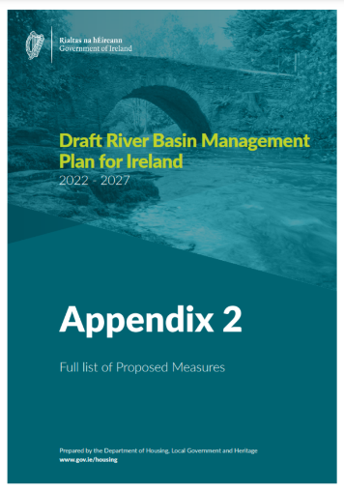
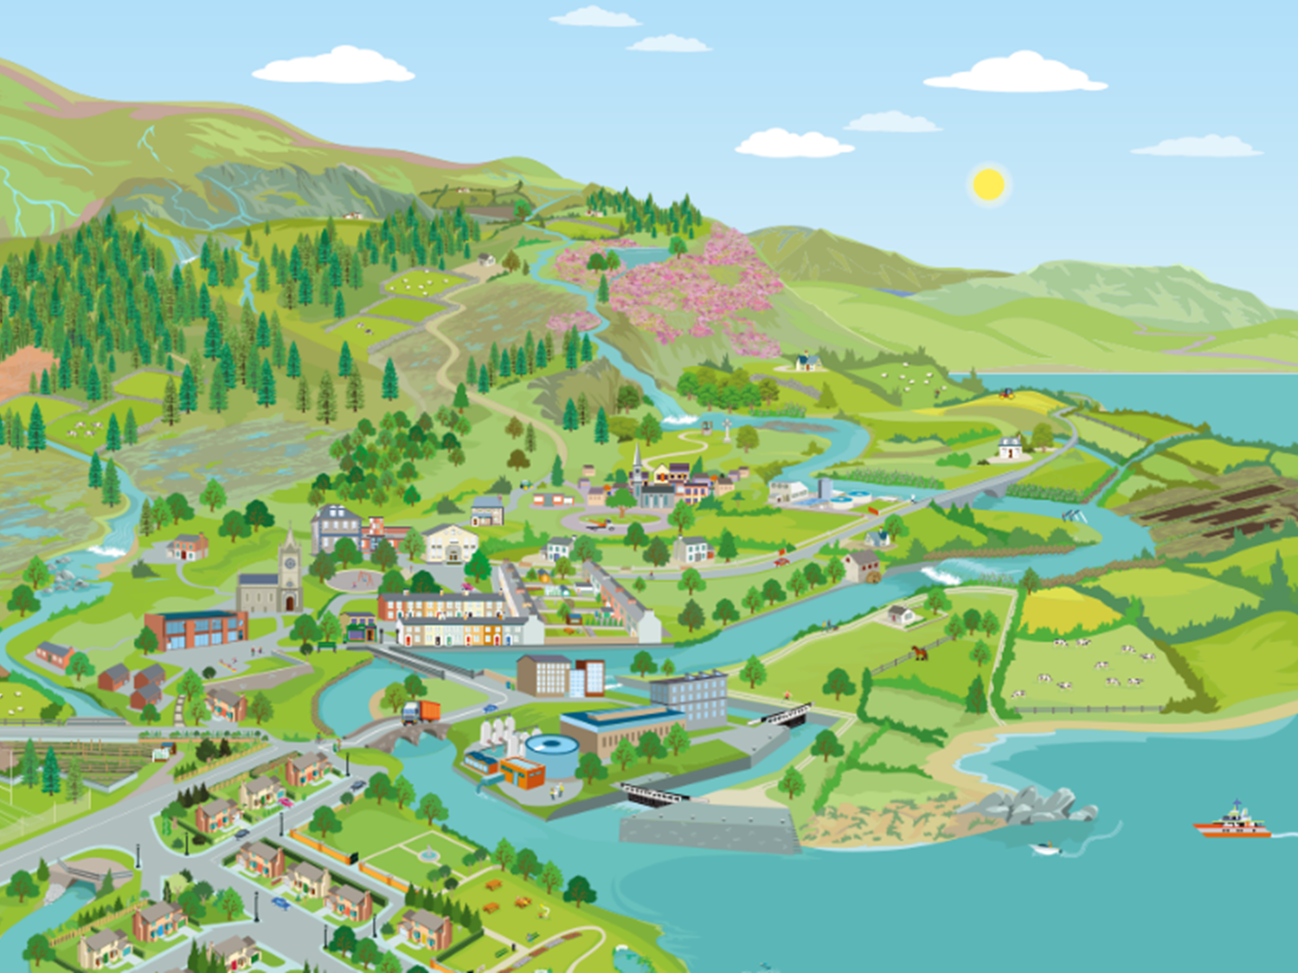

Appendix 2 contains over 100 separate measures. Here are some key themes:
Governance/ Implementation
Public Participation
Agriculture
Hydromorphology/ Physical changes
Forestry
Urban Wastewater
Programme of Measures
(2022 – 2027)
Business
Surface Water run-off
Land Use Planning
Septic Tanks
Peat Extraction
Drinking Water
Invasive Species
Aquaculture

Slide 12
Agriculture Measures
  Proposals for a stronger and more effective Nitrates Action Programme
    Updated Good Agricultural Practice for the Protection of Water Regulations
    Tighter controls on nitrogen inputs
    Establishment of a chemical fertiliser register
    Improved, targeted enforcement of the Regulations by local authorities
  Ireland’s Common Agricultural Policy (CAP) strategic plan to be submitted to EU in Jan 2022, aims to deliver and reward positive environmental outcomes
  Continuation of Agricultural Sustainability Support and Advisory Programme (ASSAP)
    Increased focus on sustainability across all advisory services
    Farm sustainability plans

Slide 13

Selected Plan Measures
LAWPRO, in consultation with all stakeholders, will produce templates for the catchment management plans that will be put in place for each of the 46 hydrometric catchments (Rivers Barrow, Nore and Suir in Kilkenny).
Each local authority will put in place a County level plan.
The Blue Dot Programme will draft a detailed work plan for waters with a High Status Objective, with a view to them forming part of the proposed local catchment management plans.
Carry out a review of Local Authority Resources to put in place appropriate resources to support individual local authorities in fulfilling their role in water quality protection and restoration.
The Department, along with the governance tiers, will continually review progress in implementation of measures and the distance to the 2027 target.

Slide 14
Selected Plan Measures
DHLGH will finalise new water and planning guidance.
  water status impact assessments
Roll out training on the new guideance to practitioners.
Progress amendments to the planning and development legislation to give effect to the new guidance.
The development of a new authorisation system for in-stream engineering works will strengthen controls of land drainage practices and their enforcement.
Provide interim guidance documentation to local and planning authorities on measures to be implemented to support the delivery of a greater focus on nature-based solutions to surface water management in advance of a national implementation strategy.

Slide 15
Selected Plan Measures
Complete a review of the National Inspection Plan (NIP) 2018-2021 to inform the next NIP for the period 2022-2027. Prioritise inspections to areas of greatest environmental and public health risk and secure upgrading works where required.
In line with the programme for government commitment to continue to help fund upgrades to domestic waste water treatment systems, DHLGH will continue to monitor the uptake of the new grant schemes to ensure adequate numbers of people are availing of this measure.
A research project will be initiated on behaviours and attitudes to assess the level of uptake, impediments to uptake and to make recommendations for improving uptake of the grant scheme.
DHLGH will deliver a multi-annual investment programme to provide wastewater infrastructure for unsewered villages.
DHLGH will review the outcomes of the pilot projects under the first multi-annual Developer-Provided Water Services Infrastructure Resolution Programme to inform future policy considerations on resolving sub-standard, developer-provided infrastructure with sustainable solutions.

Slide 16
Selected Plan Measures
The Department, together with the Department of Rural and Community Development, will develop and publish in 2024 a Rural Water Services Strategic Plan for the period 2025 to 2050.
The Department will strengthen water protection provisions where necessary in relevant sectoral policies. These include water services policy, spatial planning policy, agricultural policy and aquaculture policy.
To ensure that the actions selected are effective, sustainable and cost efficient under changing conditions, a “climate check” will be required for all measures carried out under this plan.
The Climate Adaptation Plan for the Water Quality and Water Infrastructure Sectors will be updated.

Slide 17
Selected Plan Highlights
NPWS will finalise legislation for the implementation of the EU Invasive Alien Species Regulation.
NPWS will prepare draft management plans and action plans for priority invasive species.
NPWS will advance negotiations on the recruitment of additional Biodiversity Officers.
An additional €500,000 will be provided for projects tackling Invasive Alien Species under the Local Authority Biodiversity Grant Scheme.
DHLGH will provide increased funding to LAWPRO’s Community Water Development Fund to allow for additional projects, including invasive species control projects, to be undertaken at community level.

Slide 18
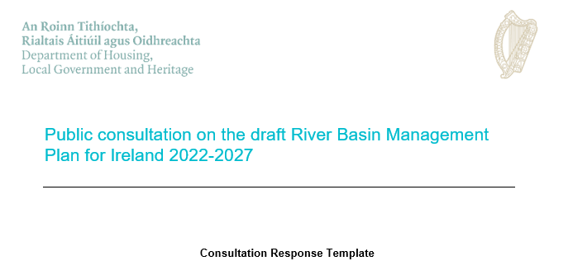
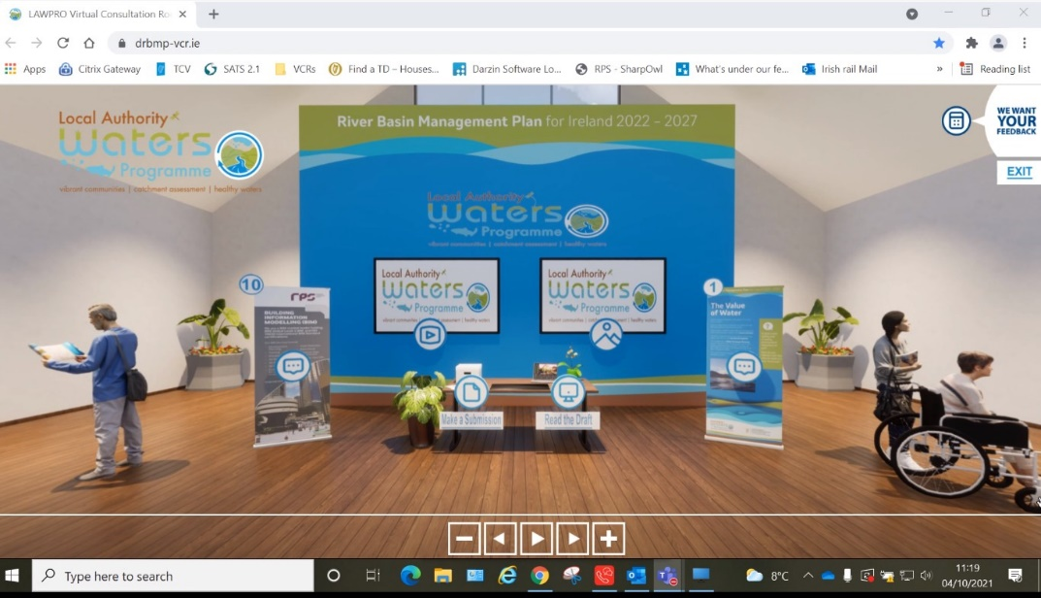
How to make a submission
Direct to Department of Housing, Local Government, and Heritage
https://www.gov.ie/en/consultation/2bda0-public-consultation-on-the-draft-river-basin-management-plan-for-ireland-2022-2027/
Visit the LAWPRO Virtual Consultation Room at www.lawaters.ie
Attend a LAWPRO Municipal District level meeting – find out more at www.lawaters.ie
Notes:
LAWPRO will compile all submissions and a report will be sent to the Department of Housing, Local Government, and Heritage to ensure local communities have a say in decision making for the final plan.
The issues raised will then be sent to the relevant State agency and local authority.

