Slide 1

















Public Lighting Energy Efficiency Project – Eastern Region
Kilkenny County Council Meeting
19st September 2022
Ken Boland: Lead Authority Project Manager Eastern Region

Slide 2
Public Lighting Energy Efficiency Project
This Project is about Climate Change Mitigation
It is the largest single action that Local Authorities can take to reduce their emissions- the change to LED lanterns can reduce LA electricity usage by 20%.
It is an example of how climate change mitigation action can actually improve the living experience of the public while making very significant reductions in energy usage and emissions.

Slide 3
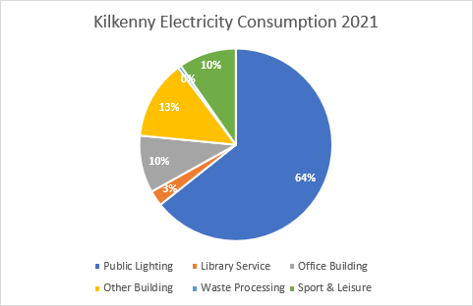
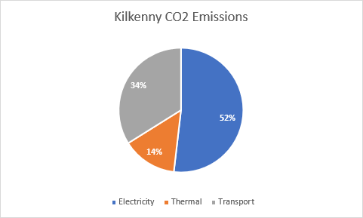
Public Lighting Energy Efficiency Project

Slide 4
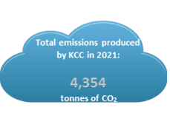
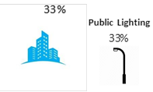

Public Lighting Energy Efficiency Project
Kilkenny County Council’s Emissions Overview 2021 | Kilkenny County Council’s Emissions by Category 2021
 | Buildings & Facilities | Municipal Fleet 34%

Slide 5
Public Lighting Energy Efficiency Project
What is the Project
To upgrade approximately 75,000 existing lanterns with new LED Lanterns. The lighting will be designed to the latest standards ( KK= 5,500 lanterns)
Install 25,00 new brackets 1,500new poles, and 2,000 micro pillars. Replace missing column doors.
Isolate the Local Authority Lighting Assets from the ESB network including the upgrading of safety equipment in the poles
Survey of all Public Lighting infrastructure and record on the new Maproad Public Lighting Data base.
Up dating of the Un Metered Register (UMR) used for billing by the electricity suppliers

Slide 6
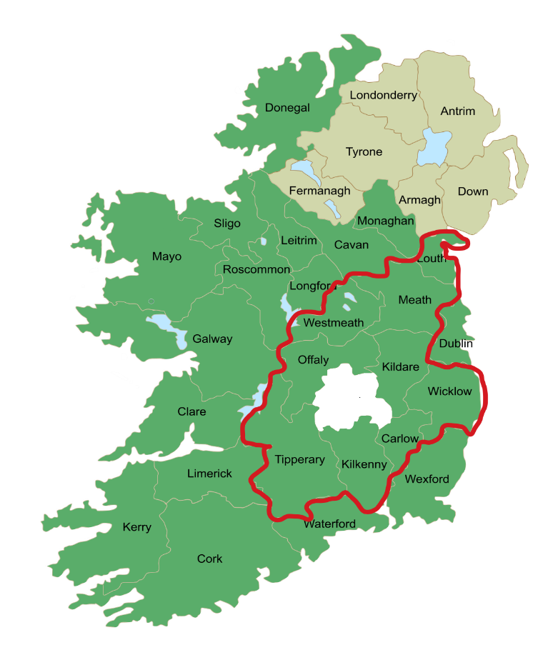
Public Lighting Energy Efficiency Project

Slide 7
Public Lighting Energy Efficiency Project
Why do the Project
Energy Saving of approximately 60-70% for each LED lantern changed.
Reduction in Carbon Dioxide emissions by 50%
Improved quality lighting for the public and the environment
Improved public safety and convenience for the Public
Helping Local Authorities achieve Climate action targets
Reduced faults and higher reliability and lower maintenance cost

Slide 8
Public Lighting Energy Efficiency Project
Example of the savings derived from changing to LED lanterns
Kilkenny County Council
Public Lighting energy consumption for 2020 4,000,440 kWh
Saving in energy when all lanterns changed to LED 2,400,000kWh
Reduction in overall Kilkenny Co Co energy consumption approx. 18%

Slide 9
Eastern Region: principal dates
Works Contract for construction and handover stages
2 tenders received 3rd November 2021
Killaree Lighting Services(KLS) -ASD JV & Le Cheile
Letter of Intent issued to KLS ASD JV 18th February 2022
Letter of Acceptance issued to KLS ASD 15th July 2022
Contract Signed 17th August 2022
Consultant Contract for construction and handover stages
1 tender received from Arup 29th October 2021
Letter of Acceptance issued to Arup 21st July 2022

Slide 10
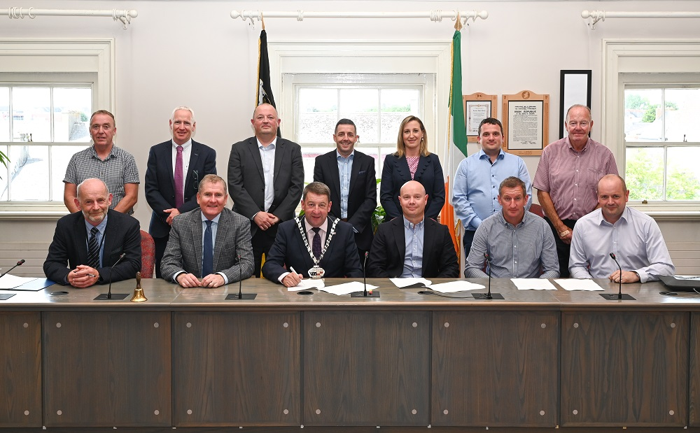
Eastern Region: Contract Signing

Slide 11
Eastern Region: up coming works Work’s Contract stage (iv)- (v)
Site Mobilisation, Health & Safety, Environmental, Quality, Design documentation to be prepared including the preparation of an Accepted Programme – duration approximately 3 months.
Commencement of initial site surveys in Kilkenny early -mid October 2022, Carlow early November 2022
Design of lighting commence Kilkenny October / November, Carlow December 2022.
Lighting install commence Kilkenny Jan 2023,

Slide 12
Public Lighting Energy Efficiency Project
Scope of the Project
Survey of approximately 125,000 lanterns
Upgrading of 75,000 lanterns, 25,000 brackets,1,500 poles, 2,000 micro pillars in 9 Local Authorities
Duration: 30 Months- survey, design, manufacture, install and test between 800-1000 lanterns per week and associated works.
Resources: 3 survey crews, 10 installation crews, 2 ESBN crews, logistics and support team, design team, Supervision team.

Slide 13
Public Lighting Energy Efficiency Project
Finance
Overall budget in the order of €56m- values commercially sensitive.
Price Inflation is a significant risk and currently being examined in the Eastern Region.
The energy costs are fixed until 2024 and the OGP will carry out a competition for the next period.
Once the lighting has been upgraded in a Local Authority and records agreed with the Un metered register (UMR) (managed by the ESB) the savings will be applied to the new scheme.

Slide 14
Public Lighting Energy Efficiency Project
Questions and Comments
Thank you for your time
Ken Boland, Project Manager, PLEEP ER.
Kilkenny County Council

Slide 15
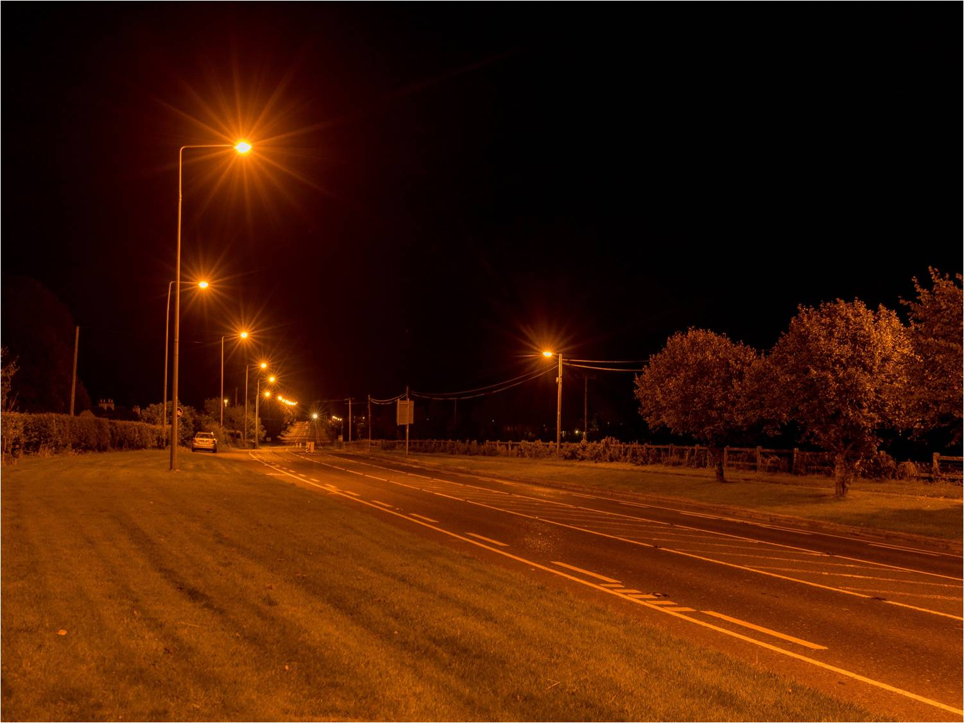
Public Lighting Energy Efficiency Project

Slide 16
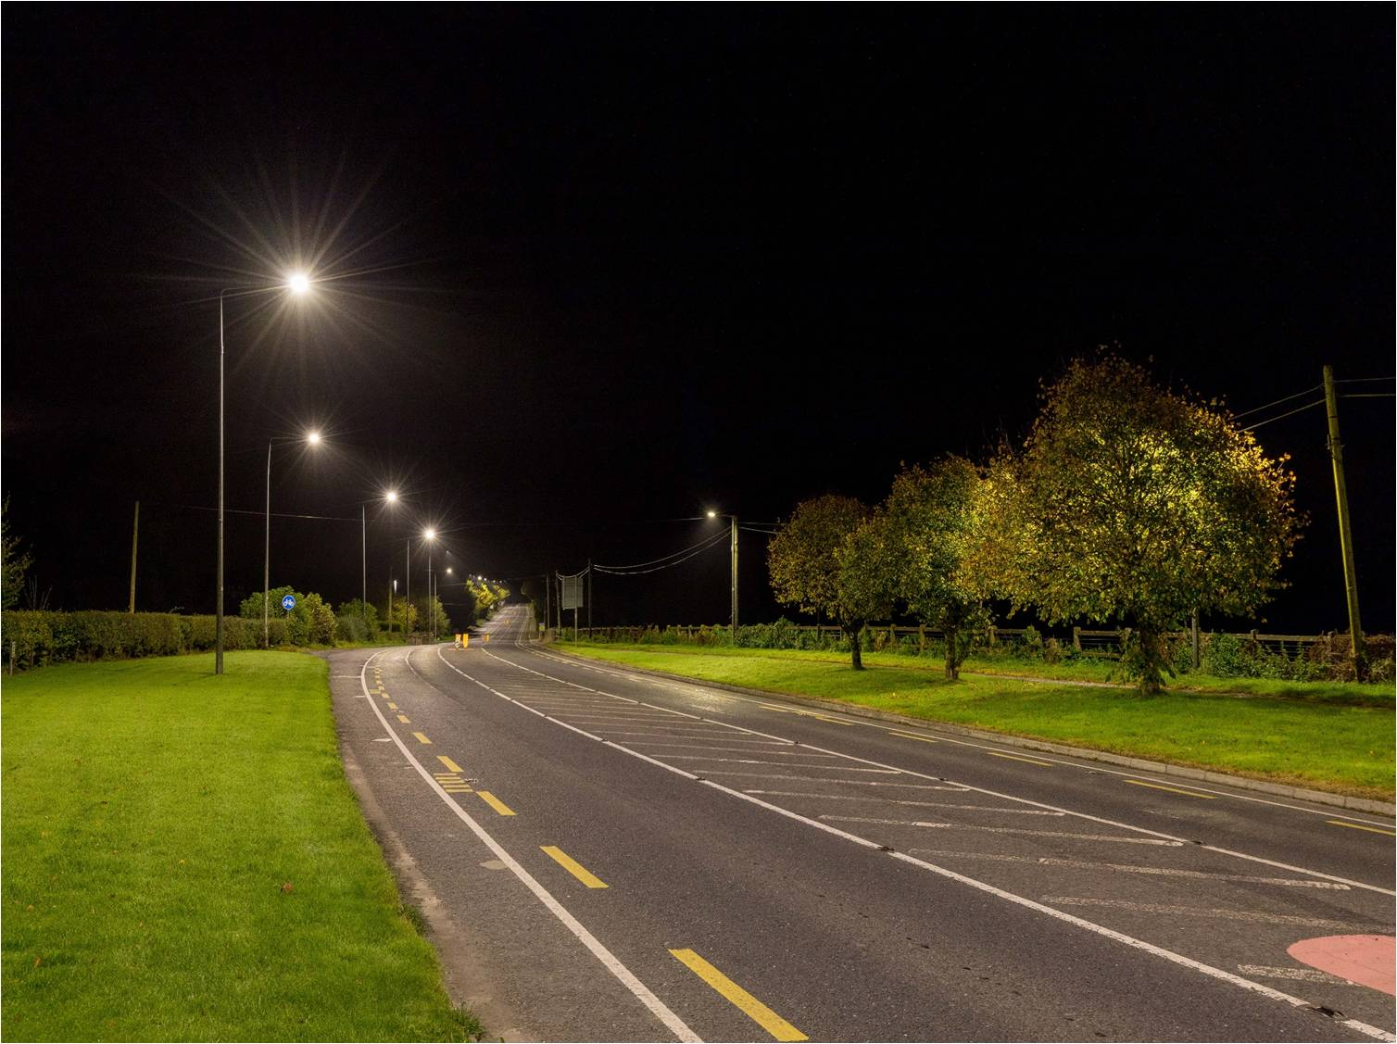
Public Lighting Energy Efficiency Project

Slide 17
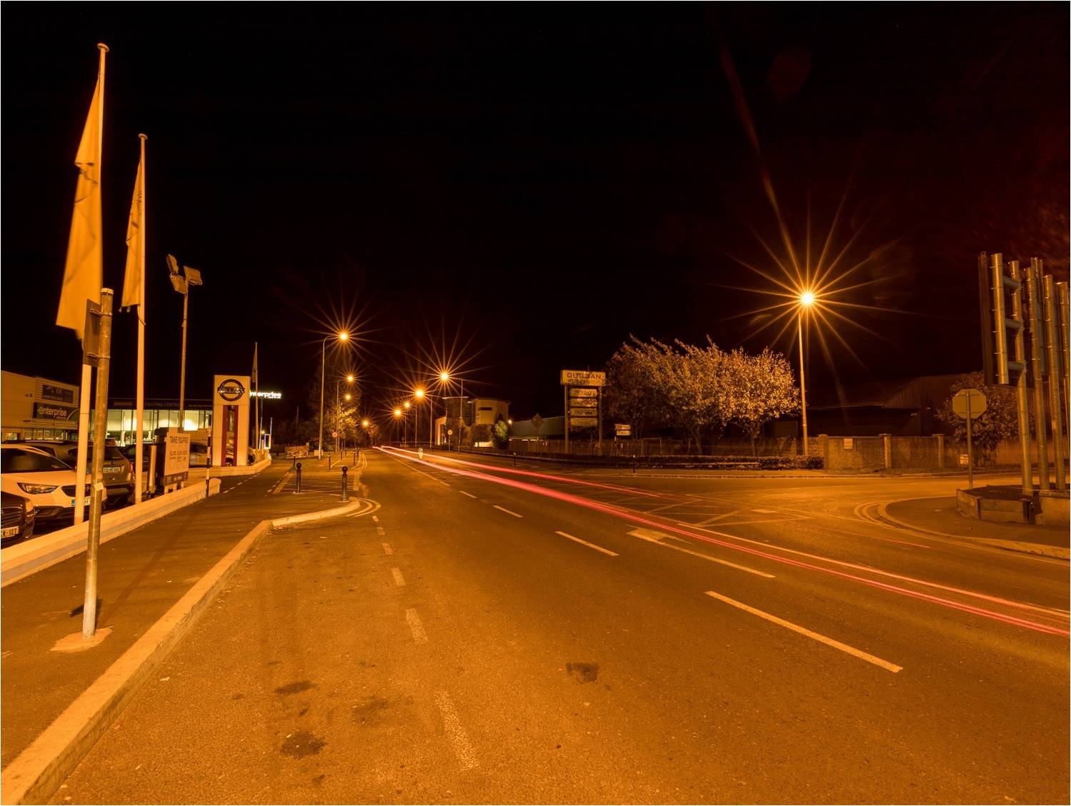
Public Lighting Energy Efficiency Project

Slide 18
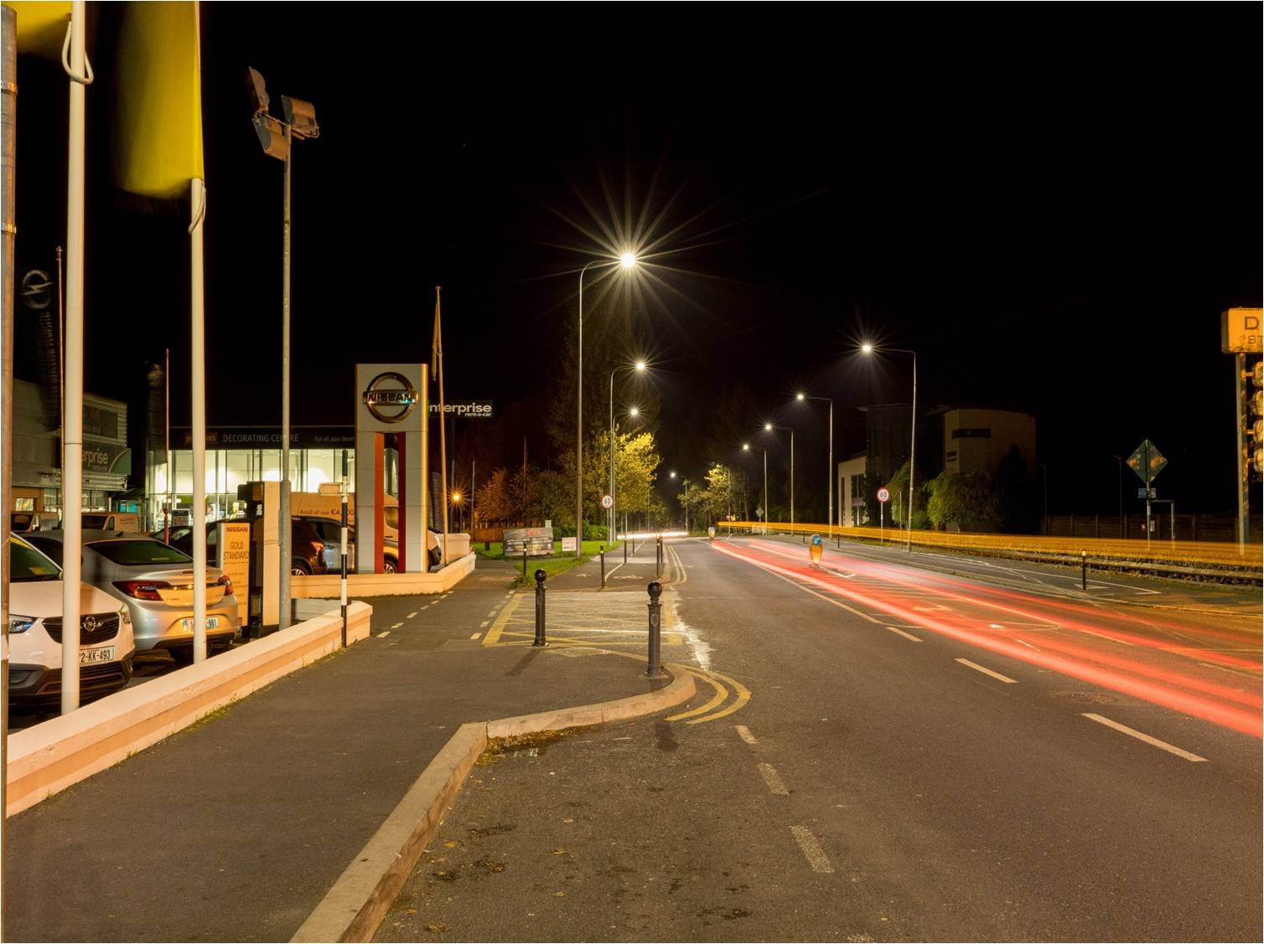
Public Lighting Energy Efficiency Project

