Slide 1
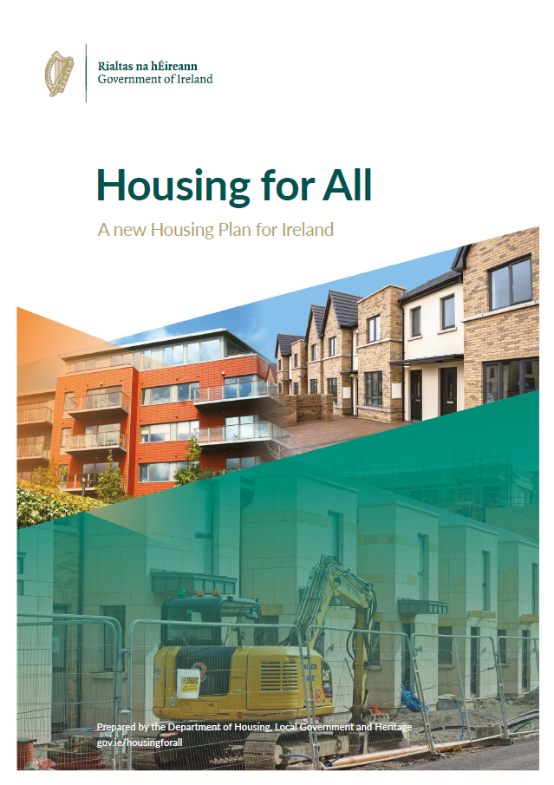

Council Meeting
21st March 2022
Housing Capital Update

Slide 2
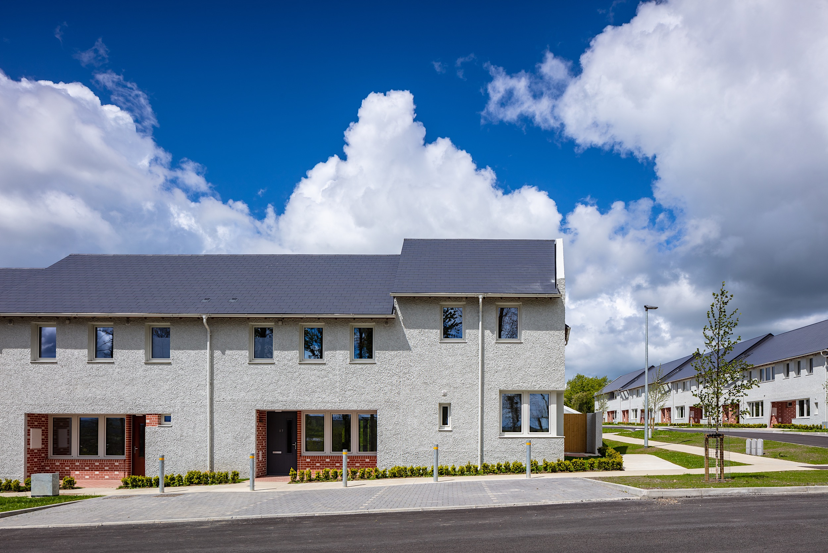
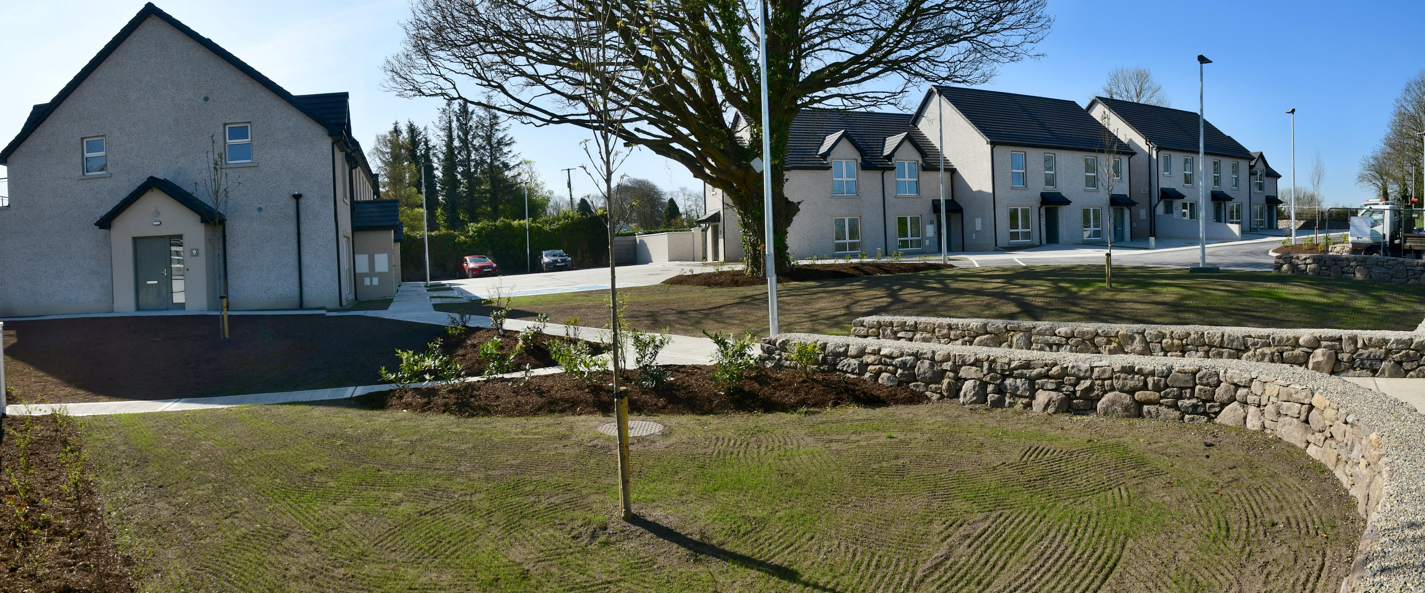
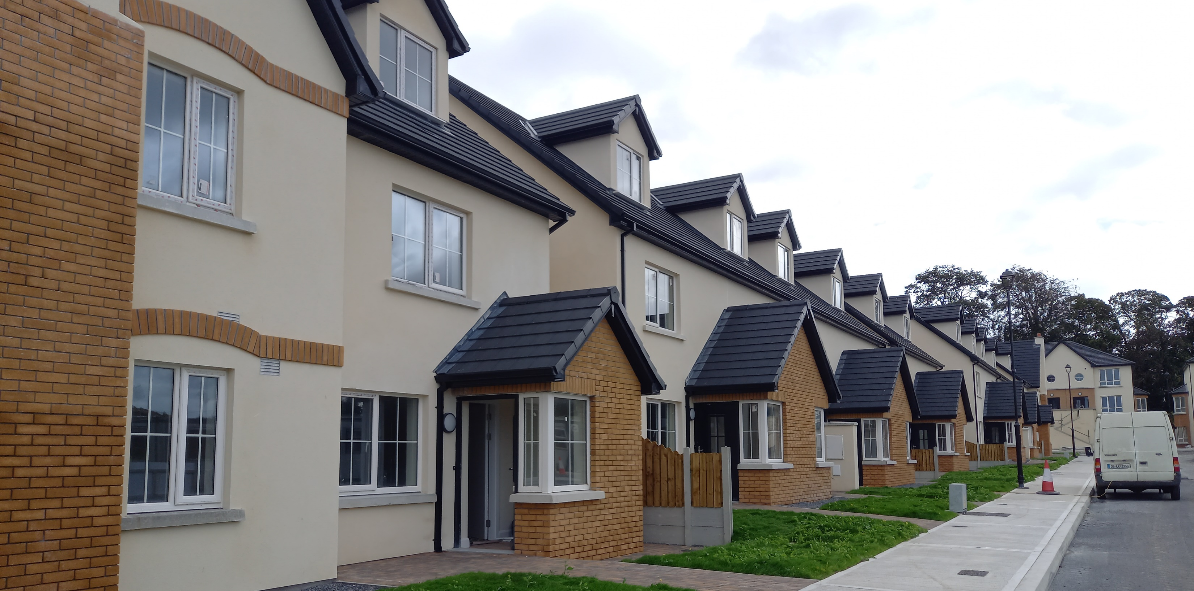
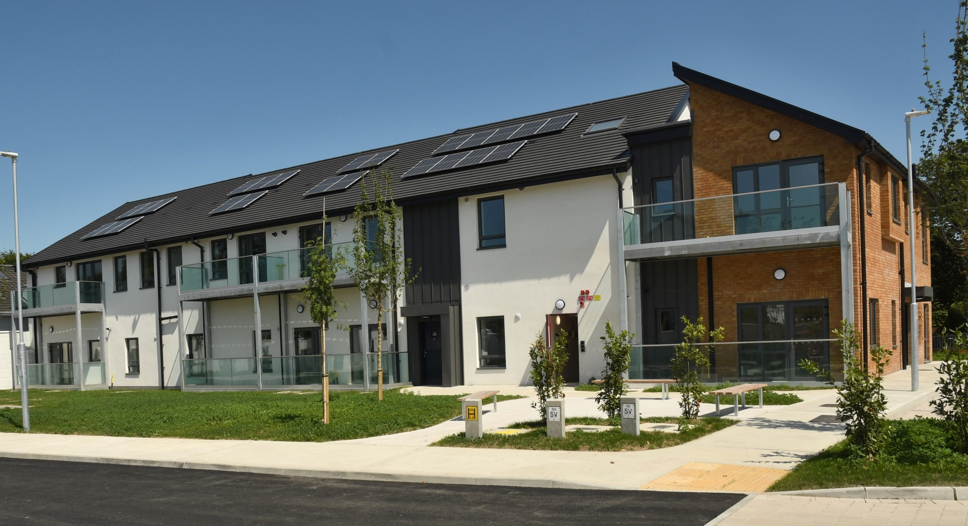
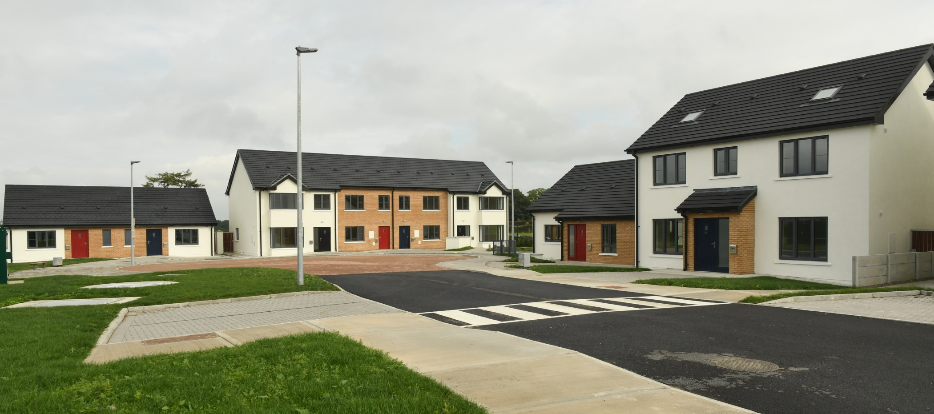
16 units Blackwater Grove, Kilmacow
2021
33 units Glebeside, Castlecomer
18 units Pairc Nua, Kilkenny
40 units Margaretsfield, Kilkenny
22 units Station Ave, Ballyragget
Notes:
Rebuilding Ireland – Shapshot of delivery by KCC under previous programme, completing this year.
269 units over target (build, acquisition, leasing)
Most of the “low hanging fruit” has been dealt with – unfinished estates, ‘easily developable’ sites
Delivery under next phase has different challenges and a changed construction industry environment

Slide 3
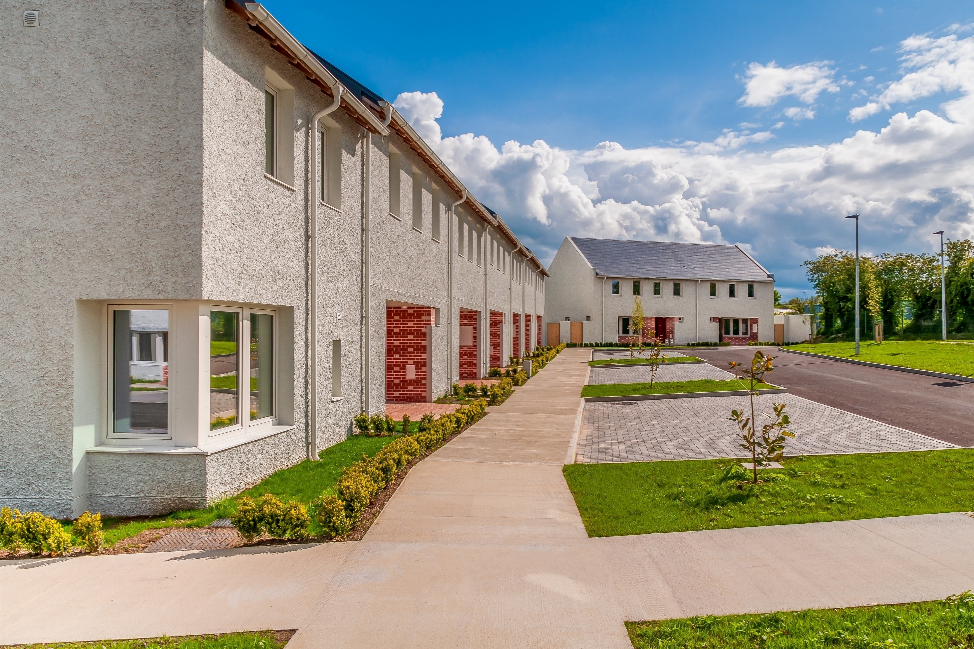
Housing Delivery – 2021
Scheme | Project Name | Units Delivered
SHIP CONSTRUCTION | Glebeside, Donaguile, Castlecomer, Co Kilkenny | 33
SHIP CONSTRUCTION | Station Avenue Phase 2, Ballyragget, Co Kilkenny | 22
SHIP CONSTRUCTION | Pairc Nua [The Broguemaker], Castlecomer Road, Kilkenny City | 18
SHIP CONSTRUCTION | Ayrfield, Kilkenny City | 6
SHIP CONSTRUCTION TURNKEY | Blackwater Grove, Lower Kilmacow, Co. Kilkenny | 16
SHIP CONSTRUCTION TURNKEY | Limegrove, Ferrybank | 7
 |  | 102

Slide 4
Housing Delivery – 2022 Projected
Scheme | Project Name | Total Number of Social Units Expected | Approved Housing Body | Project Status | Projected Completion
SHIP CONSTRUCTION TURNKEY | Limegrove, Ferrybank | 10 |  | Completed | January 2022
SHIP CONSTRUCTION SINGLE STAGE | Ayrfield, Kilkenny City | 2 |  | Completed | January 2022
SHIP CONSTRUCTION TURNKEY | Pennefeather Court, Hebron Road, Kilkenny City | 8 |  | Completed | February 2022
SHIP CONSTRUCTION SINGLE STAGE | Shanganny, Jenkinstown | 2 |  | On-site | March 2022
SHIP CONSTRUCTION TURNKEY | Pennefeather Green, Hebron Road, Kilkenny City | 58 |  | On-site | April 2022
AHB CALF Construction | Orchard Close, New Orchard, Kilkenny | 23 |  | Cluid Housing | May 2022
AHB CALF Turnkey | Nuncio Road, Kilkenny Phase 3 | 22 |  | Respond | Q2 2022
CAS CONSTRUCTION TURNKEY | Tinnypark, Callan Road, Kilkenny | 6 | SOS Kilkenny | Funding Approved Turnkey | Q3 2022
CAS CONSTRUCTION | Grennan Villa, Thomastown | 5 | Camphill Communities of Ireland | On-site | Q3 2022
CAS CONSTRUCTION | Kingsriver, Ennisnag | 2 | Kingsriver Housing Association Limited | On-site | Q3 2022
CAS CONSTRUCTION | Fiennes Court, William Street | 7 | Good Shepherd Services | On-site | Q3 2022
CAS CONSTRUCTION | Brother Thomas Place, Church Lane, kilkenny | 12 | Good Shepherd Services Ltd | On-site | Q4 2022
 |  | 157

Slide 5
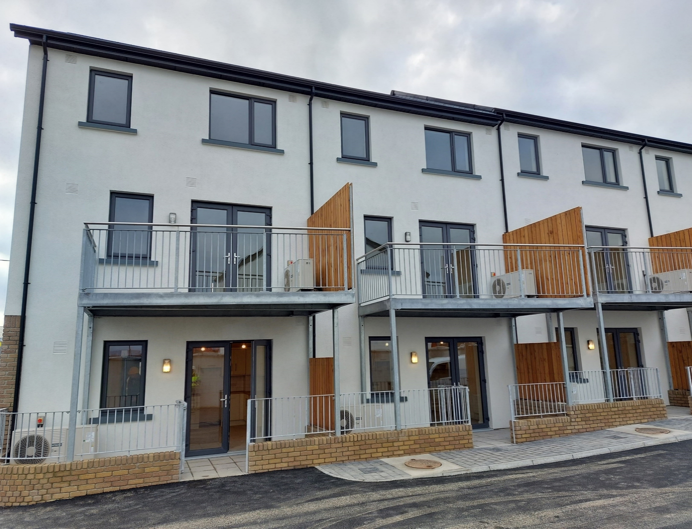
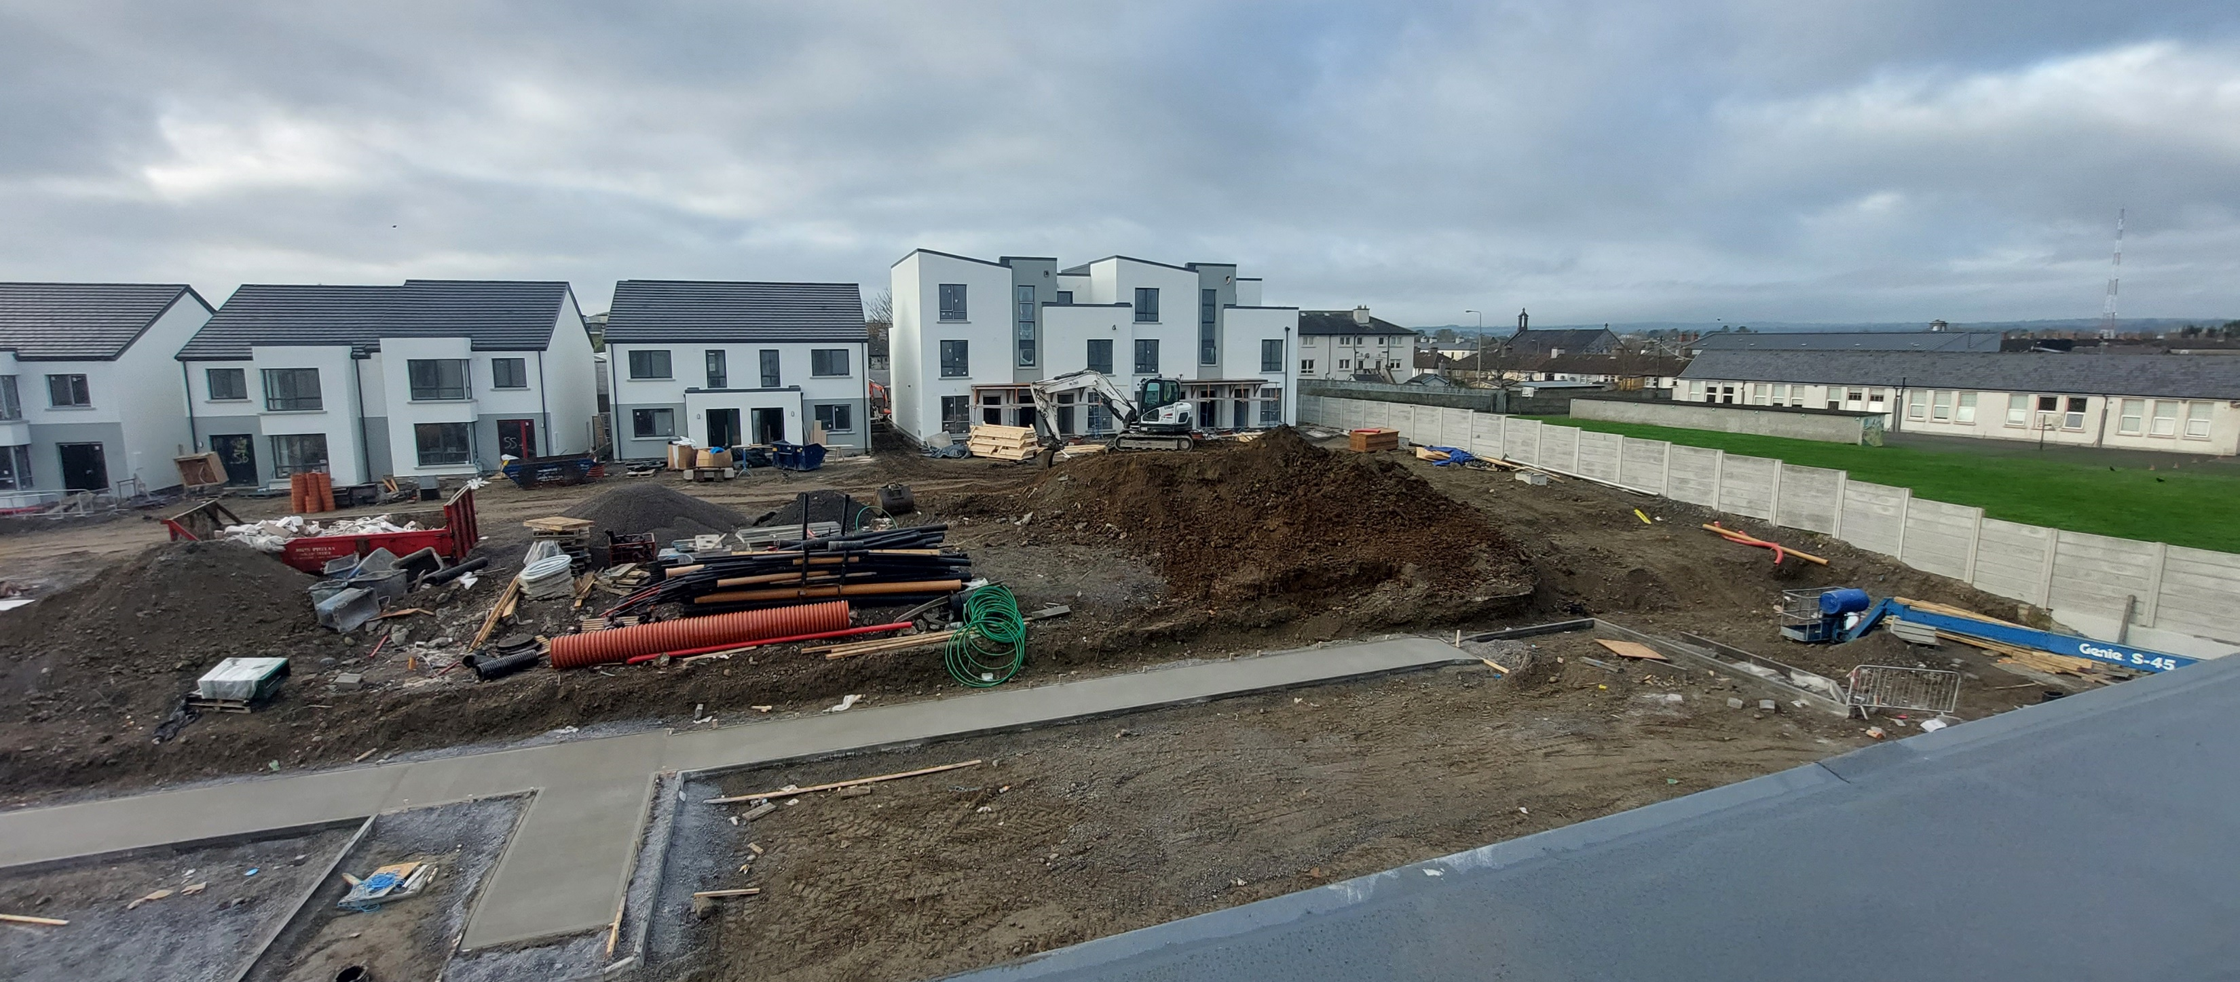
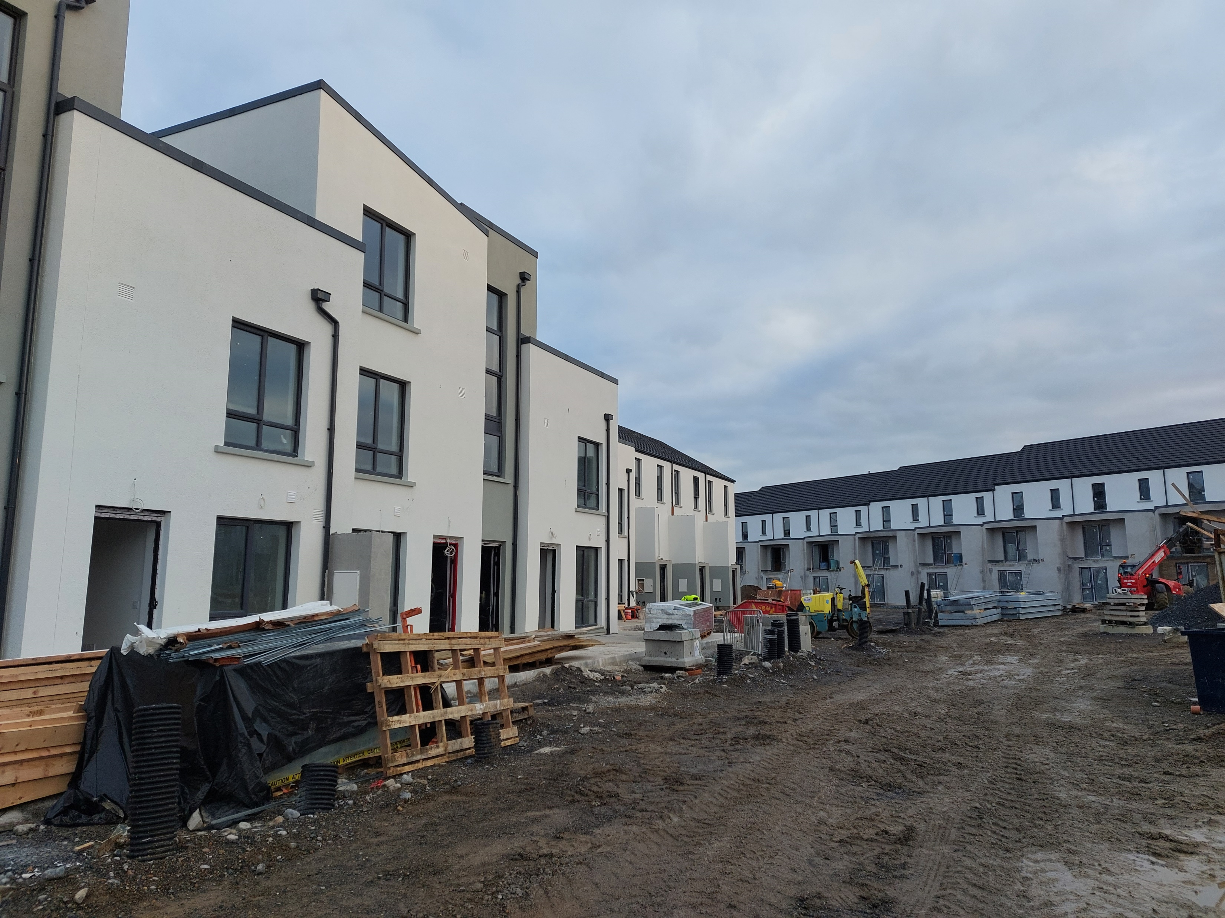
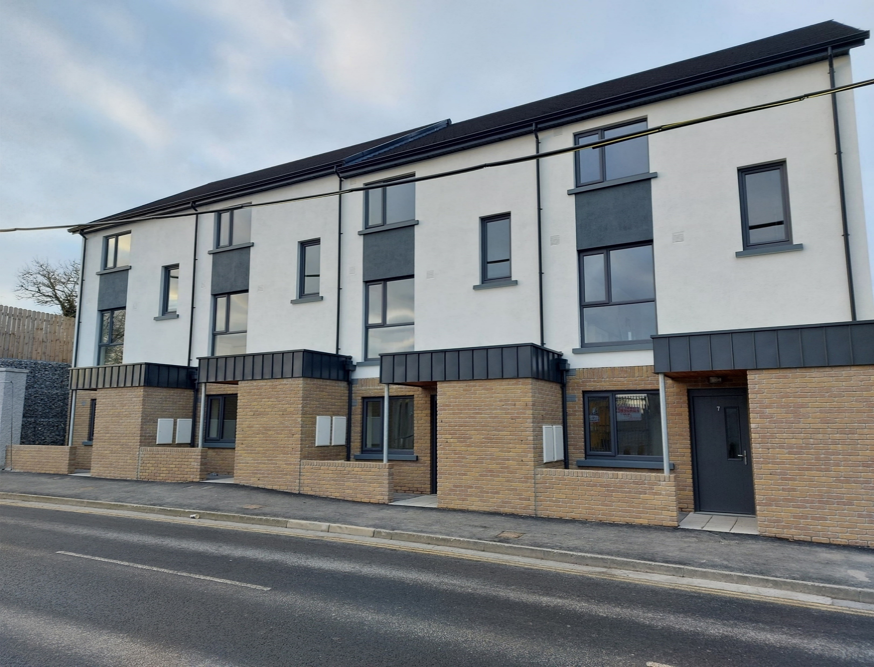
Pennefeather Green, Hebron Road, Kilkenny City

Slide 6
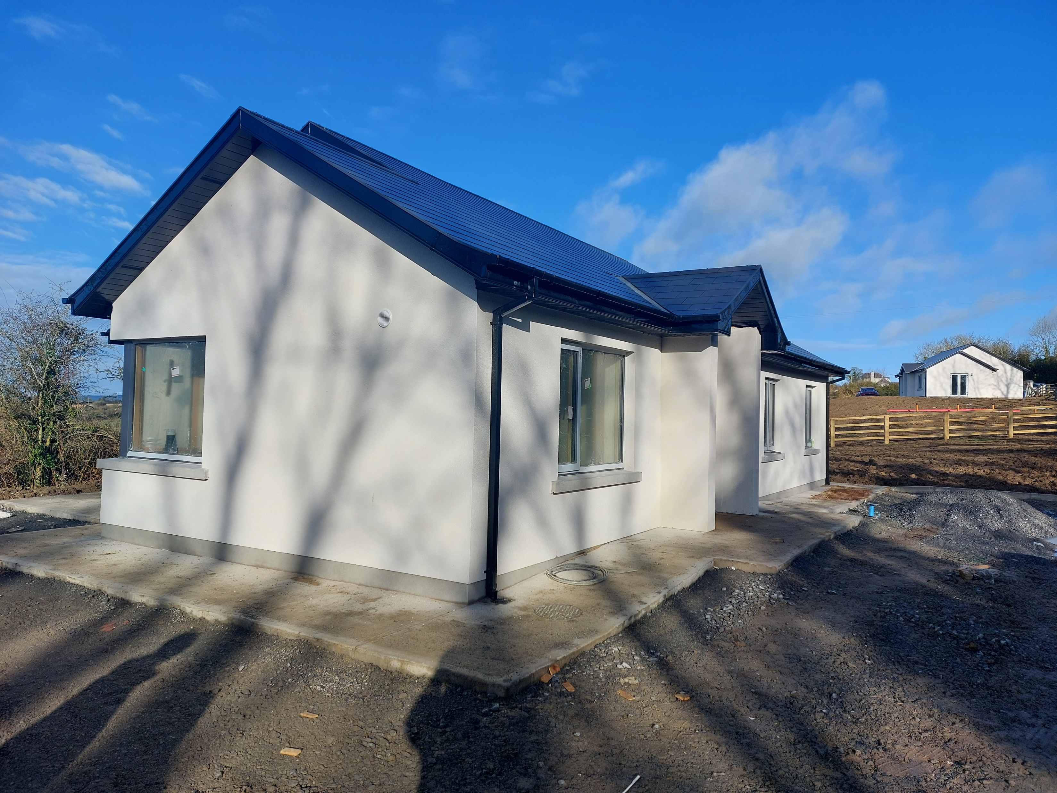

Slide 7
Challenges to Capital Delivery
Complexity of site appraisals for potential purchases
Construction costs continually increasing
Availability of contractors / trades
Significant number of projects ongoing, challenging to get new projects into pipeline
Affordable Housing Regulations Imminent
Expressions of Interest for Affordable Housing to be sought – to gauge interest

Slide 8
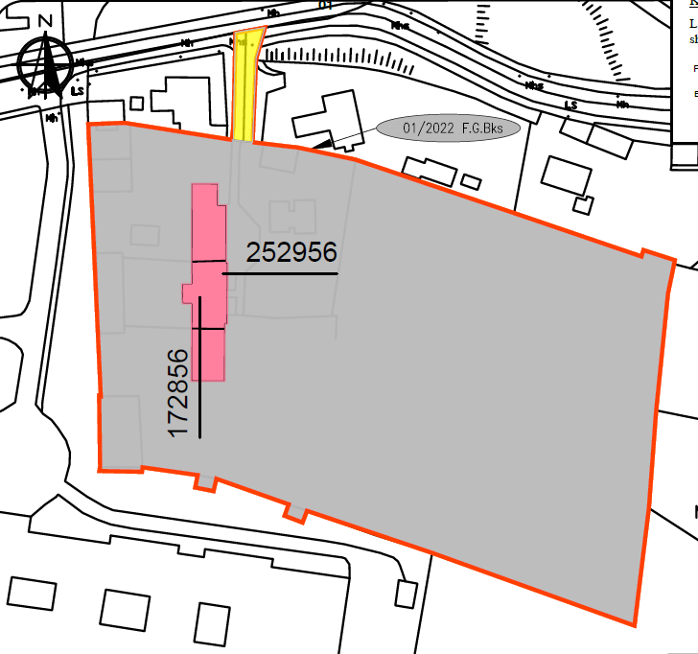
Vacant Homes- CPOs
2020 CPOs
10 advertised-5 annulled for various reasons
  1 sold & since refurbished, 2 under refurb. following intervention, 2 with legal issues
5 Confirmed, ready for vesting, survey & refurbishment proposal
1 ABP Oral Hearing found against KCC
2022 CPOs
4 advertised January:
  Castlecomer Barracks Lands & Lands at The Butts
  Dwellings at Wolfe Tone St., Kilkenny & Main St., Gowran
Required to clear title issues & no objections

Slide 9
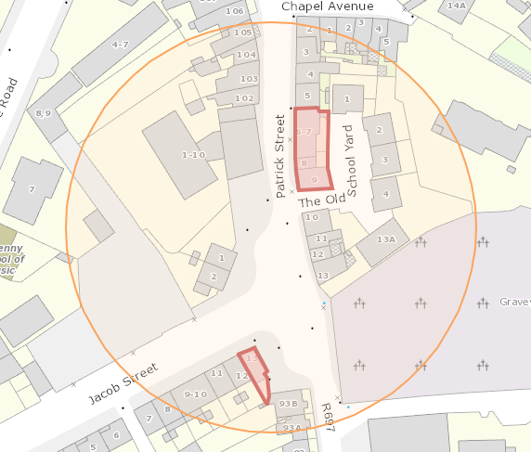
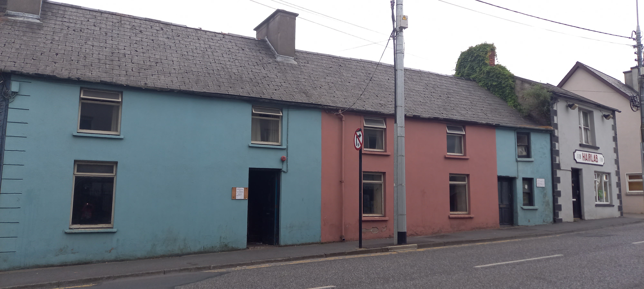
Vacant Homes
Notes:
Vacant houses at 6/7 Upper Patrick St. acquired under 2020 CPO
Vacant house at No. 8 & premises at No. 9 (Hairlab) now acquired by agreement to carry out urban regeneration project of entire block
Plan to be combined with extension/refurbishment of No.13 Jacob St.

Slide 10
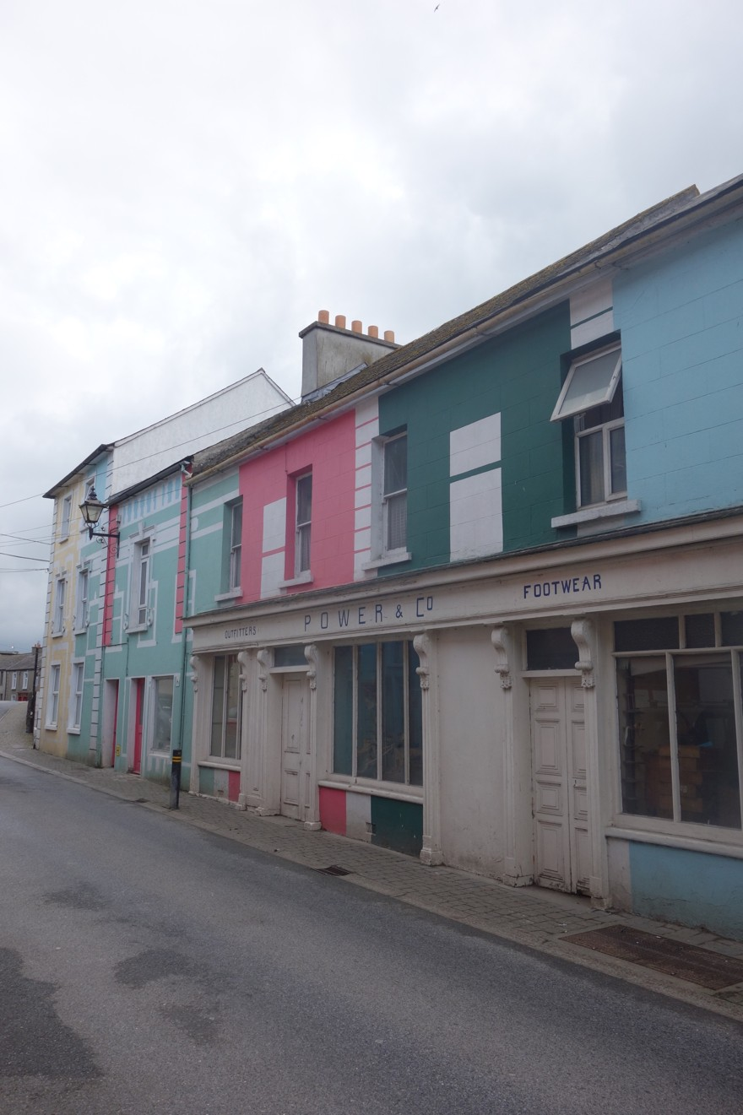
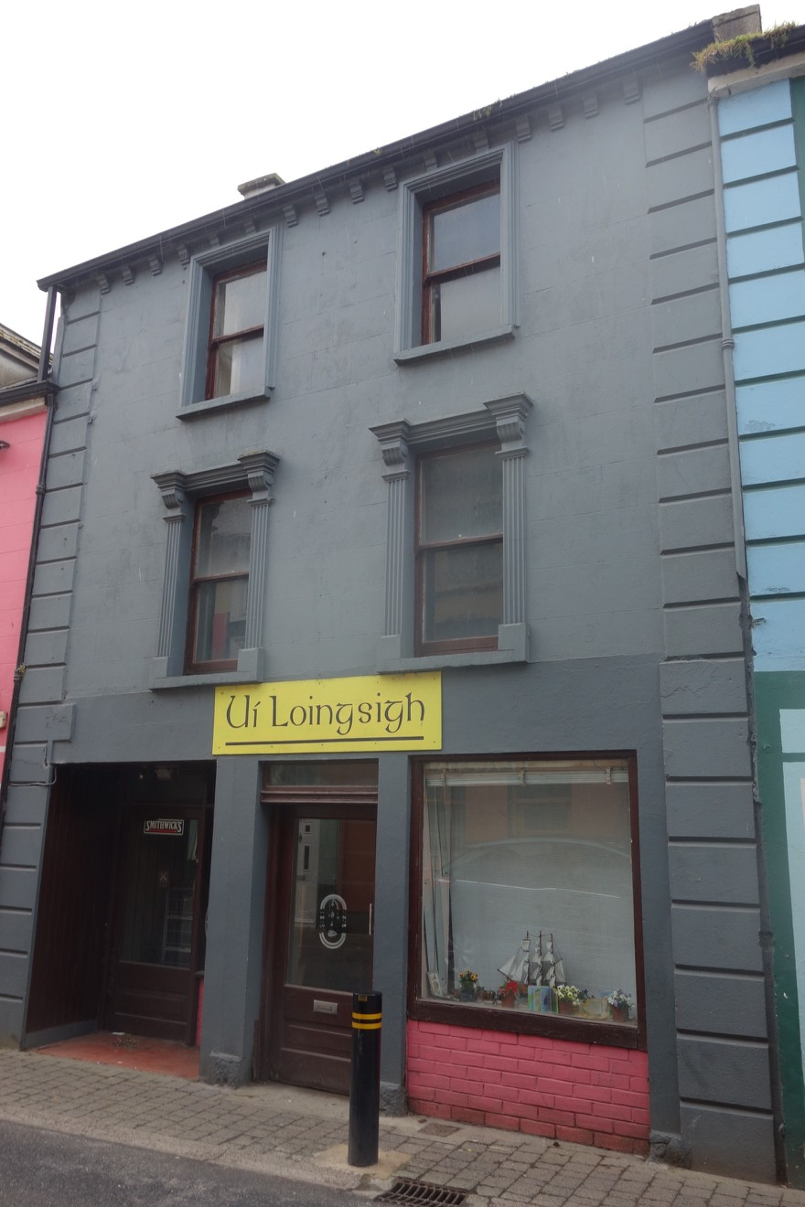
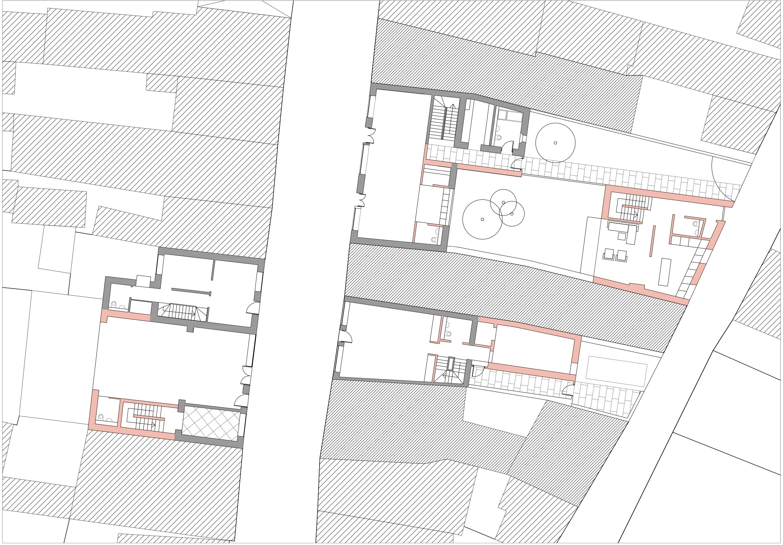
Residential Regeneration-Bridge St., Callan
Notes:
Following on from the Residential Regeneration Pilot 2 vacant premises now acquired for regeneration;
Power’s & Co. & Ui Loinsigh’s both protected structures and both with plots backing onto Clodeen Lane to the rear (See sketch proposal)

Slide 11
Current Housing Demand
Gross Housing Need 1,633 ( Including Transfer Requests, HAP/RAS tenants)
Nett Housing Need 712 (Applicants with no current housing solution)
HAP Tenancies 770 (Down from 880)
Housing Applications 113 (40% increase in applications)
Notices to Quit 60 (60% families)
Homeless Presentations 68 (47% increase 2020 – 2021)

Slide 12
Allocations 2022
Priority - Time on List
Transfer Applications - disability, overcrowding and downsizing only
Current Refusal Rates are high - 22.5% in 2021.
Urge applicants to accept offers of accommodation when made, preference for specific locations and developments can not be facilitated
Prevention of Homelessness - NTQs and Temporary Emergency Accommodation

