Slide 1


Kilkenny County Council
Affordable Housing
Council Meeting 20th June 2022

Slide 2

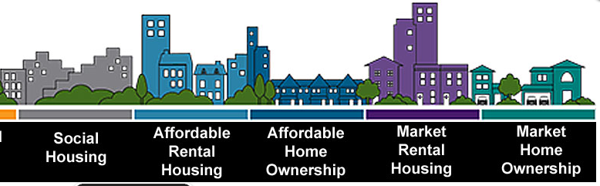
Tenure Types
Social
Market Rental
Cost Rental
Affordable Purchase
Market Purchase
No subsidy
25% below market rent
LA or AHB tenants
Subsidised Purchase
Private Purchase at Market Rents
Equity Stake
Different Schemes
Affordable Rental
Secure Tenancy
Market Rents
Secure Tenure
Income limits
Notes:
Explanation of different tenure types

Slide 3
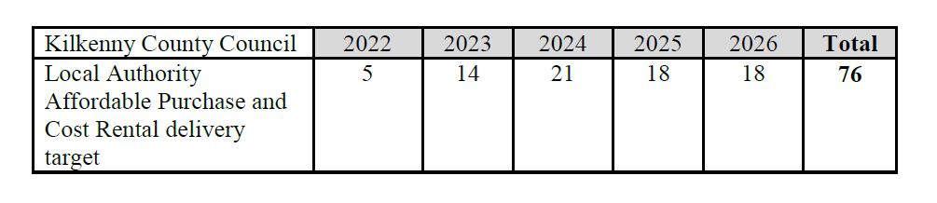
Affordable Housing
Kilkenny County targets for affordable housing

Slide 4


Affordable Housing Survey
Kilkenny County Council are conducting an online survey to determine the level of interest in Affordable Housing in County Kilkenny.
This will help us to establish the need in Kilkenny and plan the delivery of affordable housing in the County.
Notes:
First KCC scheme for many years in Piltown. 1 beds at front providing street elevation,

Slide 5
Affordable Housing Survey
Survey will assist Kilkenny County Council in formulating plans for successful Affordable Housing Options.
Relevance of Survey
Information Sought | Why is this information needed?
Peoples incomes / capacity to buy | So we know what sale price we need to aim for in an affordable scheme
Unit type sought | The right unit types can be planed for
Preferred location | We will know where the demand is
Contact details | We can contact people when a scheme becomes available
Notes:
First KCC scheme for many years in Piltown. 1 beds at front providing street elevation,

Slide 6
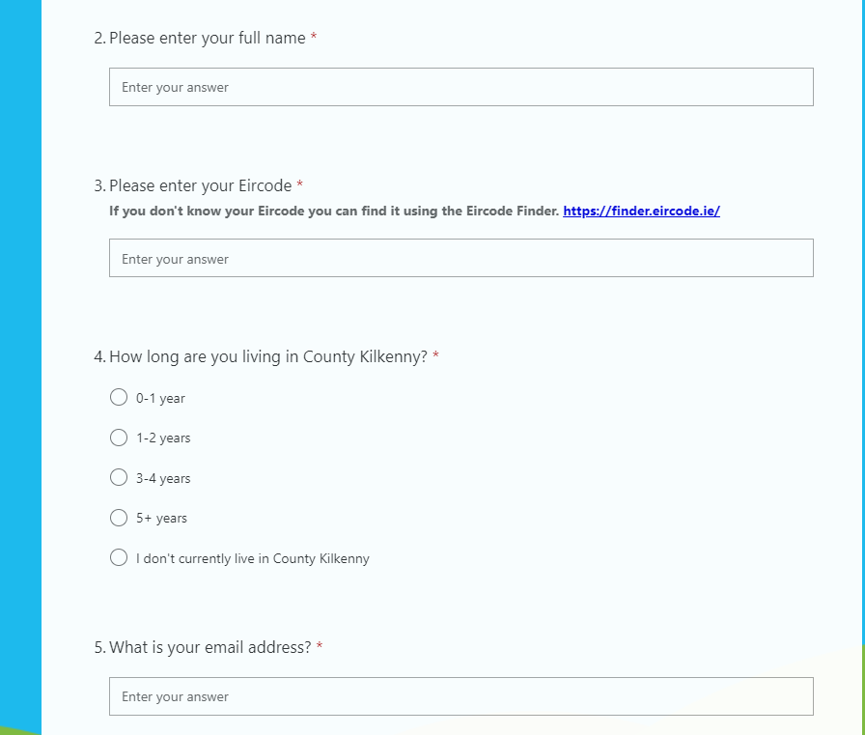

Slide 7
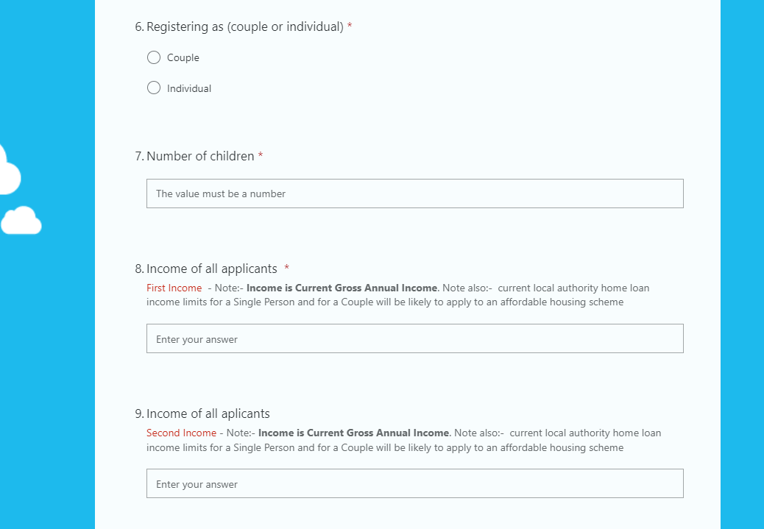

Slide 8
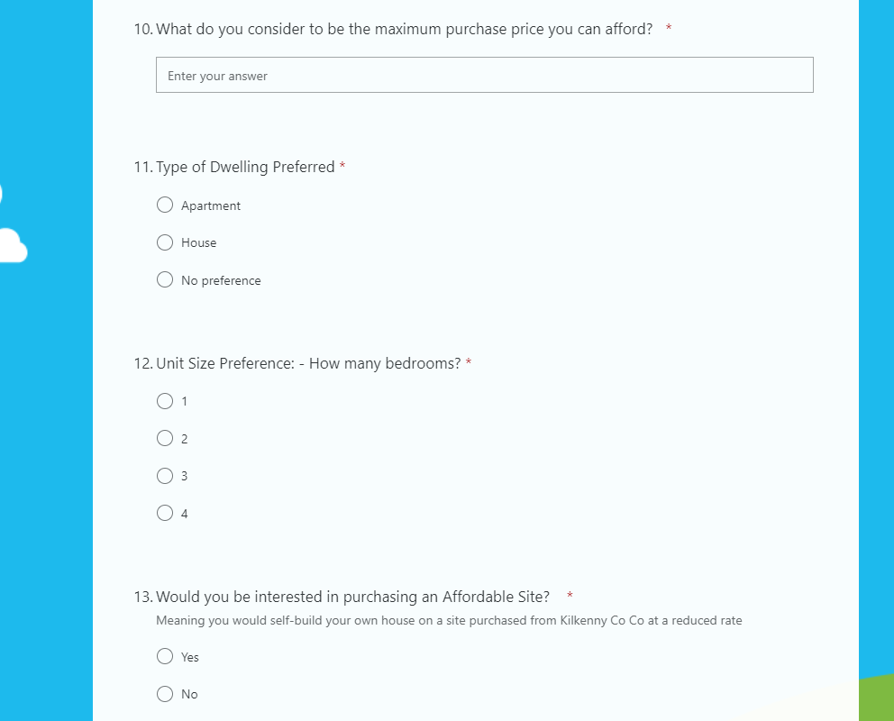

Slide 9
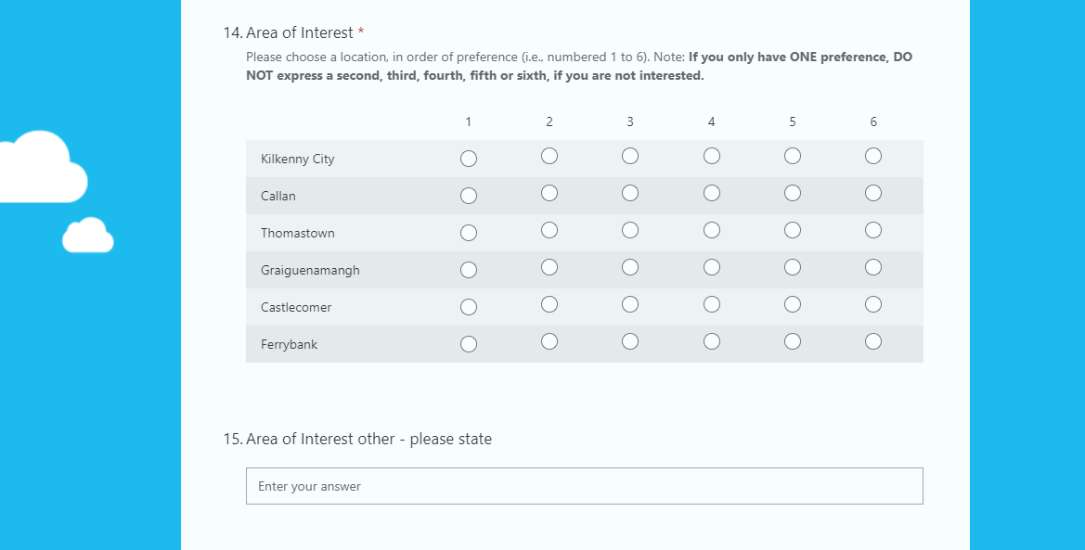

Slide 10



CALL TO HOME BUILDERS AND HOUSING DEVELOPERS
Kilkenny County Council is seeking expressions of interest for advance purchase arrangements for uncommenced residential developments for affordable and social housing.
Details on our website www.kilkennycoco.ie

Slide 13
thank you.

