Slide 1
KILKENNY
Part 8 Proposal
South-North Link Road, Ferrybank, Co Kilkenny
Council Meeting
21st February, 2022

Slide 2
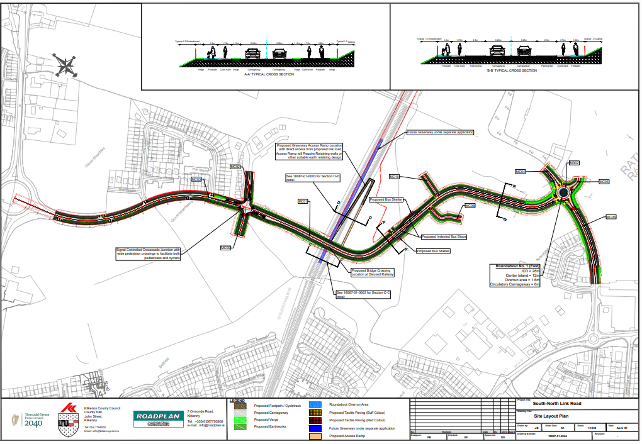

Slide 3
The Ferrybank-Belview Local Area Plan identified the need for improvement of the existing road network in order to allow for the proper planning and sustainable development of the Plan Area.
The scheme will:
Create a continuous road and active travel link between the existing Belmont Road Roundabout to the existing Abbeygate Roundabout
Facilitate mobility in the Ferrybank area and in particular active travel and public transport
Provide necessary Infrastructure for the future development of zoned housing lands
Funding by way of URDF funding and own resources
Scheme Purpose

Slide 4
The link is approximately 1km in length,
Provision of a new road overbridge over the existing Greenway.
Provide a new footpath link to the Greenway by way of a new shared surface on the top of the existing Greenway embankment with access via a ramped shared surface to the Greenway
Provision of cyclist and pedestrian facilities
Provision for future bus-stops each side of the new road.
Principal Features

Slide 5
THANK YOU

