Slide 1


Slide 2
Presentation to Elected Representatives Oct 16th, 2023

Slide 3

Agenda
Background
The Organisation
Progress To Date
Looking Ahead

Slide 4
Kilkenny Civic Trust
Private Company Limited By Guarantee
Charitable Status – Not for Profit
Set up in 1989 – Paddy Donnelly KCC
Acquired premises of Kilkenny Design Workshops (Castle Yard) and Butler House
Own Butler House and Garden & Castle Yard
Operate Medieval Mile Museum on behalf of KCC since 2017
Supporting KCC & Fáilte Ireland in the design of the new unified attraction
Do not receive any state financial support
Any surplus generated is put back into the ongoing maintenance & upkeep of our heritage properties

Slide 5
Our Vision
To create living heritage for visitors to enjoy

Slide 6
Our Mission
To protect, enhance & promote our heritage properties

Slide 7
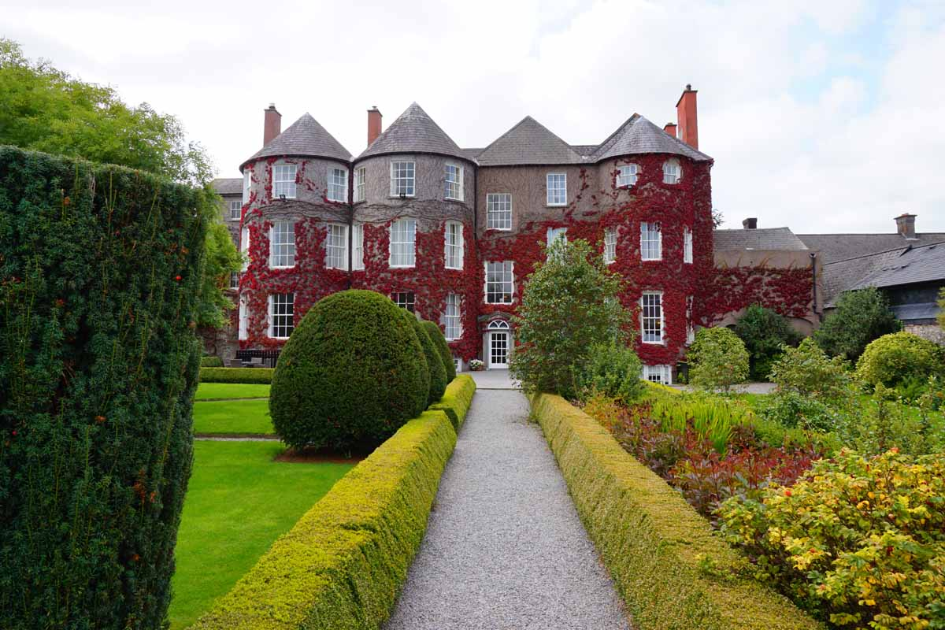
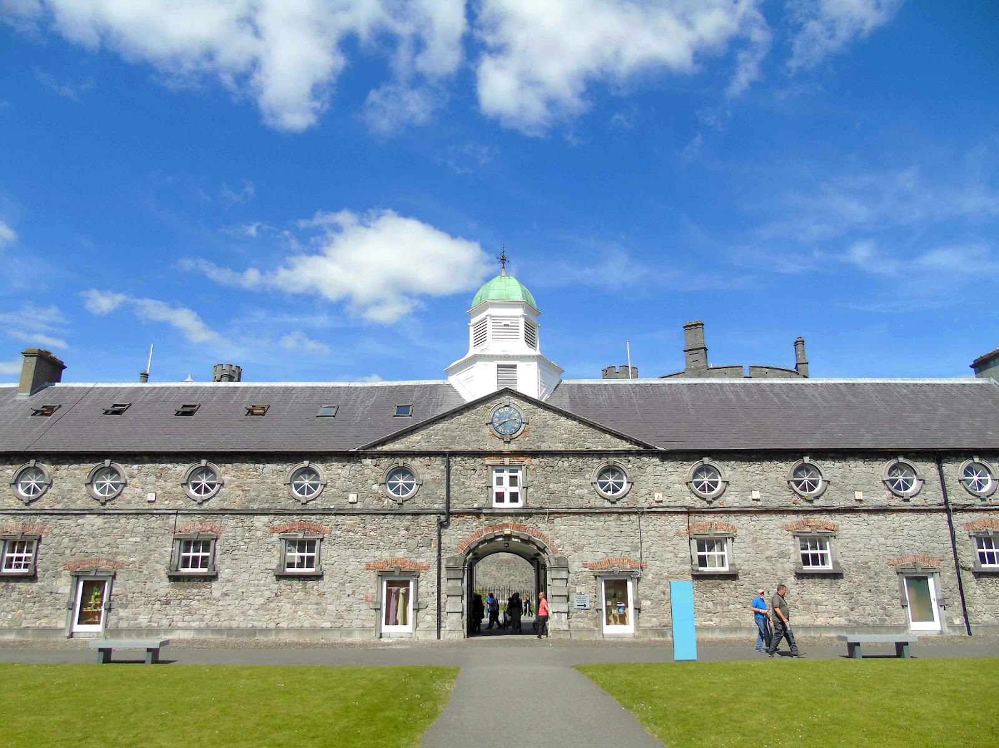
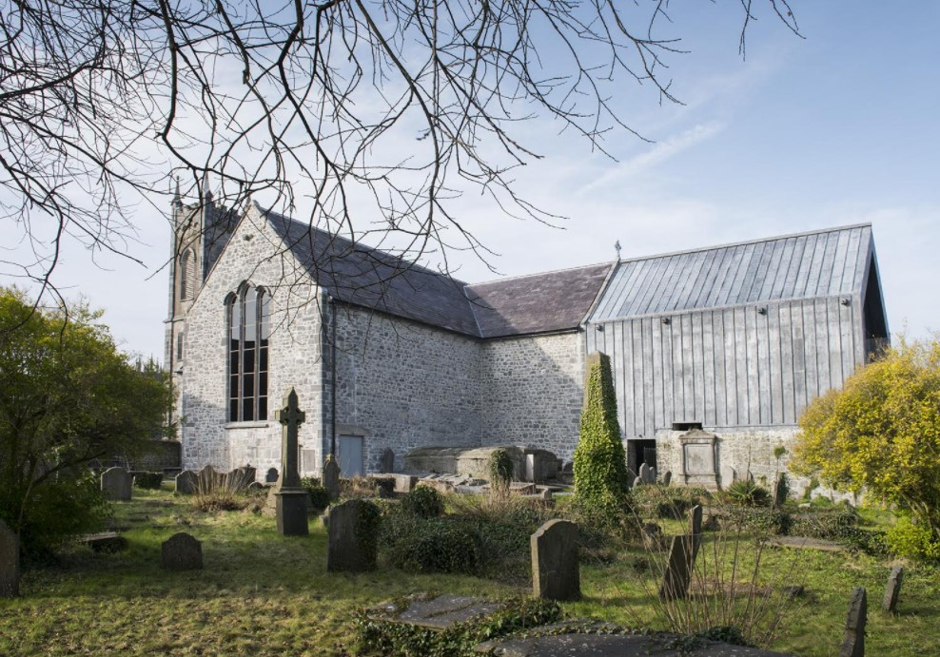
Three Properties

Slide 8
The markets we operate in
Tourism
Visitor Attraction
Hotel / Hospitality

Slide 9
Our Voluntary Board
Sean McKeown – Chairperson
Cllr. Martin Brett
Cllr. Andrew McGuinness
Brian Keyes – Editorial Operations Director, Iconic Media Group
Brian McColgan – Founder of Abbey Group of Travel Companies
Terry Clune – Group CEO CluneTech, Chairman Taxback & Transfermate
Martin Coughlan – Owner Coughlan Carroll & Co Chartered Accountants
Siobhán O Dwyer – Global Head of Marketing & Public Affairs Kingspan Group

Slide 10
Our Contribution To Kilkenny
Since 1989 – Managed and maintained Butler House & Castle Yard
Donated over €1 Million to various Kilkenny City & County projects
Contributed to St Marys Church renovation - €400,000 and donated a further €250,000 since it opened
Operated Medieval Mile Museum since 2017 to National Museum of Ireland standards
Upgraded & and refurbished Butler House to high conservation standards
Provide three unique spaces for festivals, launches, and civic events
Actively participate in the development of tourism in Kilkenny
Employ over 40 people in high season

Slide 11
Our Operating Model
Product / Services
Generate
Surplus
Reinvest
Properties
Customer

Slide 12
Medieval Mile Museum
Owned by KCC
Started as the restoration of St Mary’s Church
Capital Costs Funded by Failte Ireland & KCC
Opened in 2017
Launched as a commercial visitor attraction
Contractual Agreement with the National Museum of Ireland
KCC provides subvention to the Civic Trust to operate/manage/promote the museum

Slide 13
Kilkenny Civic Trust - Our Museum Role
To market and operate the Medieval Mile Museum on behalf of Kilkenny County Council
To manage the collection of invaluable Kilkenny artifacts – Liber Primus, Sword, Mace & Historical Documents
To manage the St Marys Church building
To contribute to the development of Kilkenny’s Medieval Mile
To delight visitors with 800 years of Kilkenny’s History
To assist Kilkenny County Council in the design and development of the new unified attraction

Slide 14
Medieval Mile Museum
Hosted Ministerial Visits & Civic Events
Hosted the World Travel Writers Gala Dinner
Hosted the Launch of the Association of Visitor Attractions
Provided complimentary open days & ambassador pass for Kilkenny people
Created and delivered several educational events for the local community

Slide 15
Festivals / Events Hosted
Yulefest
Kilkenny Arts Festival
Tradfest
Savour
Kilkenny Animated
St Patrick’s Day Festivities
Kilkenny Day
Culture Night
Science Week
Heritage Week

Slide 16
Local Groups Hosted
Kilkenny Ambassadors
Music Generation
Kilkenny GAA
KCETB
Lions Club
Samaritans
Amber Women’s Refuge
Cois Nore
Lingaun Valley
Mount Carmel
Many Local Schools

Slide 17
Experience Development Since Opening
Various Tours ( Medieval Mile Trail, Graveyard Tour)
Audio Guides
Human Remains Exhibition
Lego Hunt
Bryan Vault in the Graveyard
Currently working with the designers of the new unified attraction

Slide 18
Visitor Numbers for Medieval Mile Museum
2017 - 22840
2018 – 23260
2019 – 22310
2020 & 2021 – Covid Years
2022 – 15600 Post Covid
2023 – 18500 Estimate
2024 – 20000 Forecast

Slide 19


5 Star Customer Feedback - Trip Advisor
What a tour! It was an hour long but didn't feel like it. Our tour guide was entertaining, and funny and really made the tour interesting. He made it easy to follow and didn't stop for one minute with all the information he had. You can tell he has such a passion for Kilkenny history that it was hard not to have it after the tour! It was a fantastic tour from start to finish. One of the highlights of my weekend !!
Spent 12 days in Ireland, and this 1 hour tour of this amazing museum, with our fantastic guide was truly a highlight of our trip! Pat has extensive knowledge of Kilkenny, and it’s fascinating history. Pat’s ability to share & and tell the story will have you hanging on his every word as he shares interesting historical facts. Definitely make this your 1st tour/stop in Kilkenny, you will leave with much appreciation, knowledge of the rich history of this vibrate town!

Slide 20


Trip Advisor Feedback
This was one of the most spectacular museums and guided tours I have ever been on. Our guide was incredibly well-informed, funny, and insightful. The story about the struggle between the merchant/rulers of the city and the bishop of the cathedral that was outside the city walls, and the way it culminated in the story of Dame Alice Kyteler (the so-called "Witch of Kilkenny") was not only highly entertaining but was educational, as well. This is a great museum, with a rich history, and some artifacts you won't see anywhere else!
If museums are not usually your thing, go anyway. There is something of interest for most people. You can just look around part of it or take the guided tour. I thought I could see enough without the tour but I was very wrong and I was glad I took it. The building itself is beautiful and the whole place is so well designed.

Slide 21
New Unified Tourism Attraction
- Combining Medieval Mile Museum and Tholsel into a new Tourism Attraction
- Genesis:
  Placemarque Report - Destination Towns
  Kilkenny needs an attraction that will shift the centre of gravity of tourism from the Castle to the City Centre
  Feasibility Study and Business Case Prepared and funded by Failte Ireland
  Outcome – new unified Attraction - Museum of Medieval Kilkenny
  New Attraction to tell the stories of Ireland’s Medieval Capital
  Stories of real people - powerful Mayors, wealthy Merchants, less fortunate victims, etc.
  Family friendly focus
  Attract additional international visitors
  Provide a new and unique experience, not available elsewhere
- New Attraction will also enable KCC to retain use of the Tholsel as Town Hall and for Civic Use

Slide 22
New Unified Tourism Attraction
- KCC approached and Civic Trust agreed to partner in application to Failte Ireland in 2019:
  KCC responsible for construction and fit out costs of new Attraction
  Civic Trust will manage/operate new Attraction on behalf of KCC
- Successful Application made to Failte Ireland for Grant Funding towards Capital Costs in 2019
- Programme for delivering new Attraction:
  detailed design almost complete. Civic Trust proactively involved
  construction contract to be awarded before year end – expected 12-month for completion
  3-months for fit out of new experience, including virtual reality technology
- New Attraction – Museum of Medieval Kilkenny - expected to be open by end of Q2 2025
- KCC will engage with Failte Ireland on revised Capital Costs since project application submitted in 2019

Slide 23
New Unified Tourism Attraction
- Current Partnership Model between KCC and Civic Trust needs to be reviewed
- Museum of Medieval Kilkenny will offer a much bigger / better tourism experience
- Mentor appointed to assist in agreeing on a suitable Model to operate the new Attraction from 2025 onwards
- Civic Trust will require additional funding in 2024 to market and promote the new Museum of Medieval Kilkenny
- Kilkenny Civic Trust is engaged with KCC as part of the budget process
- Existing Medieval Mile Museum will operate as normal for 2024 in advance of opening of new Attraction in 2025

Slide 24
Thank you for your support
Any Questions ?

