Slide 1
Draft Kilkenny County Council Climate Action Plan 2024-2029
Notification re publication of Draft Plan
Not required to adopt plan
Follow on from the workshop with Elected Representatives (11th Sept)
Scope
Contents
Timeline (Feb ‘23 – Feb ‘24)
Communication & launch of Draft Plan
Council Meeting
16th Oct 2023
Dearbhala Ledwidge
Climate Action Coordinator

Slide 2

5 year statutory plan (2024-2029)
“Local Authority Climate Action Plan Guidelines” (DECC, 2023)
Actions:
  1. Adapt to climate impacts
  2. Statutory targets (2030)
    51% ↓ emissions
    50% ↑ energy efficiency
  3. Demonstrate Leadership
Vision
“Kilkenny County Council will be a climate resilient organisation that inspires and supports the county’s transition to a biodiversity rich, sustainable and climate neutral economy by 2050”

Slide 3
Robust engagement programme
  Staff
  Elected Representatives
  SPC
  Public (PPN, Tidy Towns, SEC’s)
  Stakeholders (local & national)
Review climate submissions made to other plans & programmes
- e.g. CDP, LECP, National Dialogue on Climate, SUMP
Mission
“To deliver the Council’s statutory emissions and energy targets, embed climate action in all Council governance, operations and services, and thereby inspire and facilitate climate action in the county”

Slide 4
Contents
Climate Change (Definition & Policy)
Scope & Methodology
Kilkenny County Council
  Profile
  Climate action to date
Targets
Baseline Data
  Climate Risks
  Emissions
Kilkenny City Decarbonisation Zone (DZ)
Vision, Mission, Goals & Actions
Implementation & Reporting
Strategic Environmental Assessment & Appropriate Assessment

Slide 5
Commenced
Feb 2023
Feb 24th CAP process officially commenced
Build evidence base.
April-May
Climate Change Risk Assessment & Baseline Emissions Report
Pre Draft
Public Engagement
April-June
Events/Public Engagement (PPN, Tidy Towns, Bike Fest etc)
Local Authority Climate Action Training programme
Presentation to Council Plenary Meeting (20th March)
Climate Action Steering Committee (9th May)
Climate Action Steering Committee (4th April)
Review submissions
Consultkilkenny.ie
Climate Action Steering Committee (31st Jan & 28th Feb)
Sectoral workshops with national stakeholders
Presentation to SPC4 (6th April)
Presentation to Council Plenary Meeting (15th May)

Slide 6
Drafting Plan
June - Sept.
Workshops with Council Service Areas (x 25)
Publication of Draft
Plan
Publish Draft (week 23rd Oct)
Public consultation 6 weeks
Submissions
Prepare submissions report
Make Amendments to Plan
Presentation to Council Plenary (27th July)
Workshop with Elected Representatives (11th Sept)
Presentation to SPC4 (18th July)
DZ Consultation (Chamber of Commerce, Kilkenny Tourism, CKLP, SEC’s)
Case studies, webpage, video, logo
SEA/AA
Climate Action Steering Committee (13th Sept)
Maximise participation & opportunity for engagement

Slide 7
Members consideration
Circulate report to members
Adopt & Publish Plan
19th Feb Council approve/approve subject to modifications, by resolution
Publish Plan (March) (Irish & English)
SEA /AA
6 Weeks to consider
Statutory deadline 23rd Feb

Slide 8
Communication & Leadership

Slide 9


Slide 10


Slide 11
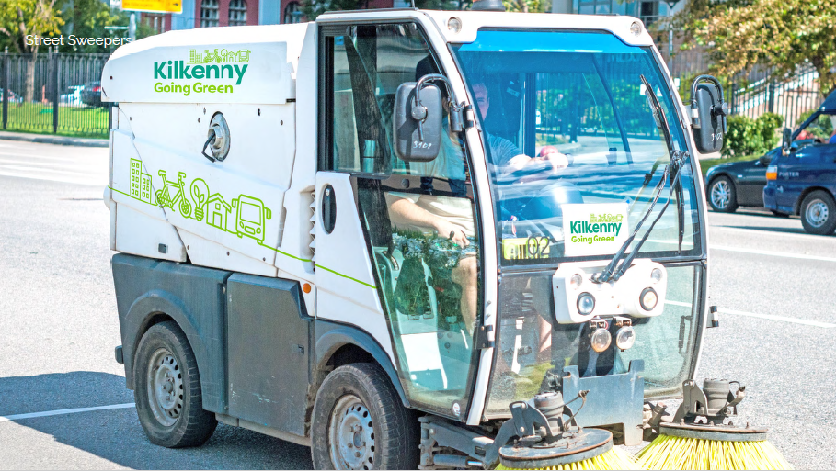


Slide 12
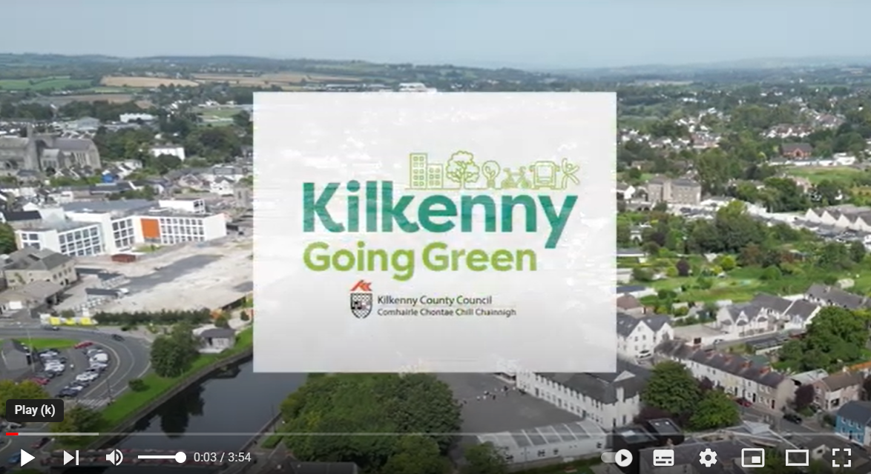
https://www.youtube.com/watch?v=Afy-OeSRicA

