Slide 1
Proposed access to CBS Link Road

Slide 2
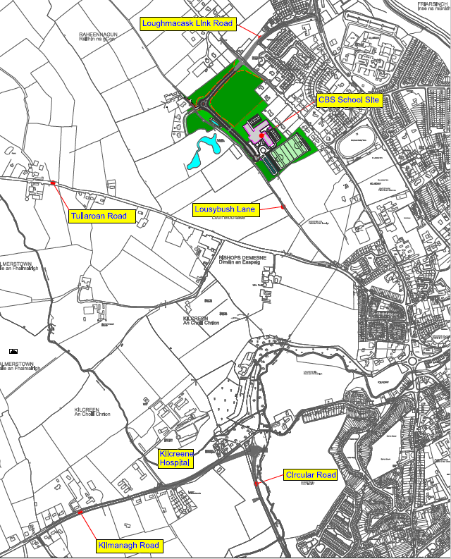

Slide 3
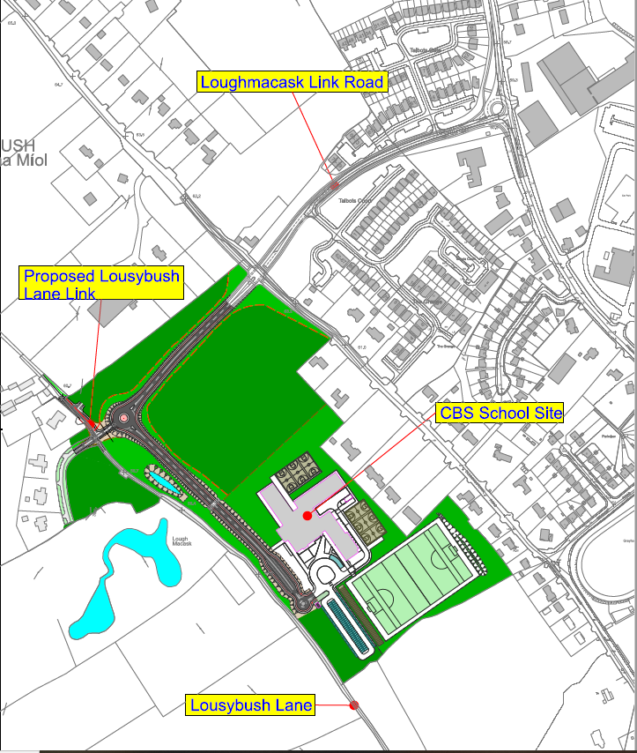

Slide 4
